Slide 1
AA01-SG05 On appraisal and Disposition in Latin America
Alicia Barnard
InterPARES Trust AI Seminar
October 28, 2023
Vancouver, Canada

Slide 2
The team
Norma Fenoglio, Argentine
Raquel Umaña, Costa Rica
Alicia Barnard, Mexico (Lead)
Aida Luz Mendoza, Peru
Undergraduate students
Diana Cortés Ortiz, Costa Rica
Sara Fuentes Cerdas, Costa Rica
María Jesús Gamboa Muñoz, Costa Rica
Gennessy Hernández Jiménez, Costa Rica
Estif Oviedo Eguizabal, Peru
Tathiana Jesús Lopez Maravi, Peru

Slide 3
About the case study
Goal
To understand appraisal processes applied for both physical and digital records in speaking Spanish selected Latin American countries to identify challenges that affect appraisal and possible uses of AI models to solve them. (Argentine, Columbia, Chile, Costa Rica, Mexico, and Peru)
Activities
To implement a survey to learn about the processes of appraisal of physical and digital records to identify weak points and difficulties related to the above-mentioned processes and the possibility of using artificial intelligence (AI) applications in selected countries in Latin America
To carry out a study on regulation provisions regarding records/archival classification and disposition schedules, and policies related with the use of data, regualtions and ethics on selected countries
Lit commented in Spanish for dissemination (in progress)

Slide 4
Survey methodology
Criteria
Six selected countries. Responses from other countries were received: seven more from the Region plus one form Spain, other from Portugal and fourteen of unknown provenance.
To be applied to public servants of
National or general archives that authorize disposition in their institution or in federal agencies
National autonomous organizations
Congresses at national level
Judiciary or national court
To get organizations for follow up and possible interviews.
About the Survey
Overview of disposition processes (physical, digital or hybrid records)
Information about physical or digital records and problems about disposition and possible use of AI
Information of the use o AI application in digital records
16 questions plus three breakdowns (one breakdown question was eliminated because of inconsistency in responses). Questions related with respondents data are kept confidential.
73 respondents, two duplications were eliminated, 71 analysed.

Slide 5
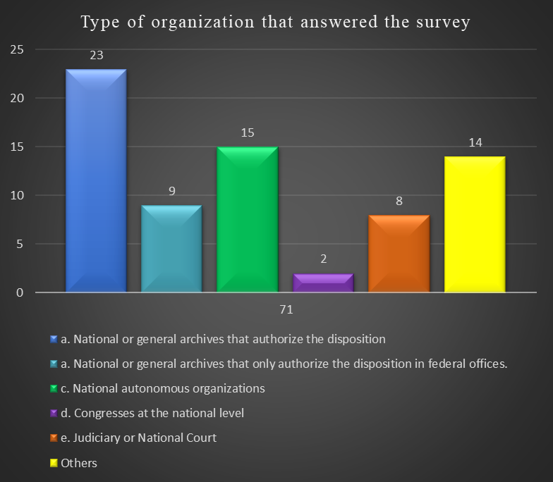
Country | Participants
Argentine | 1
Bolivia | 1
Chile | 2
Columbia | 4
Costa Rica | 1
Ecuador | 4
Spain | 2
Honduras | 1
México | 28
Panama | 1
Peru | 2
Portugal | 1
Dominican Republic | 1
Unknown | 22
Total | 71
All the respondents, including the 30.98% that did not accept follow up (unknown), were considered for analysis.
20 % did not meet the organizations criteria
Notwithstanding there respondents that accepted follow up, only five are willing for a recorded interview.

Slide 6
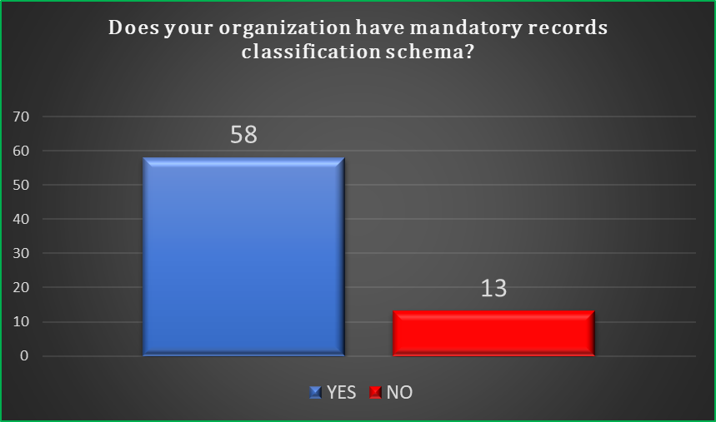
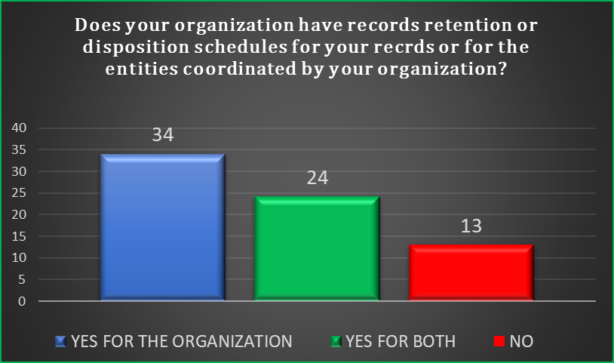
Both classification schemas and retention schedules have regulations (81.69%). Besides, the retention graphic allows to identify that there are around 33.80% organizations coordinating other agencies.

Slide 7
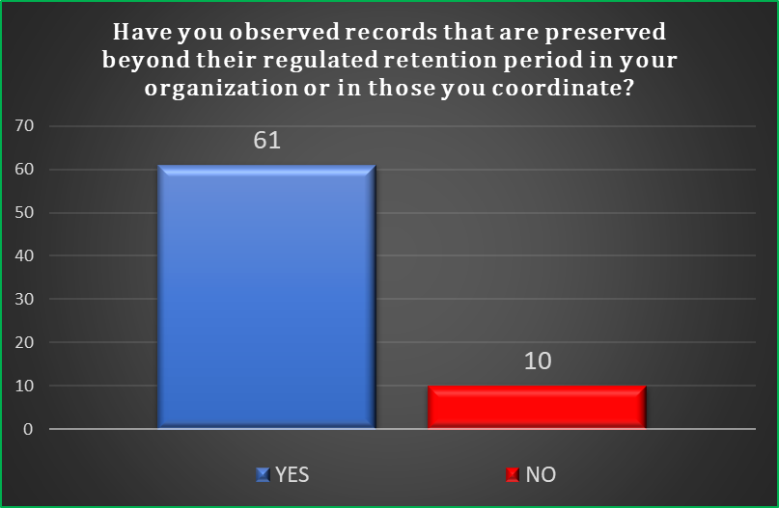
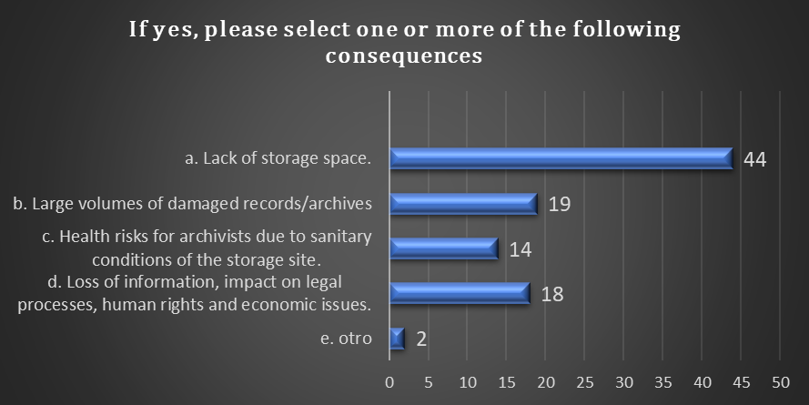
Although there are regulations for classification schemas and disposition schedules, it is perceived that either the issuance is recent or agencies do not implement said instruments.

Slide 8
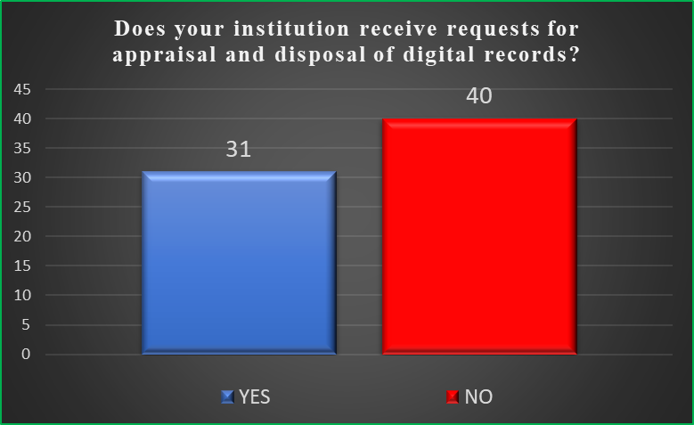
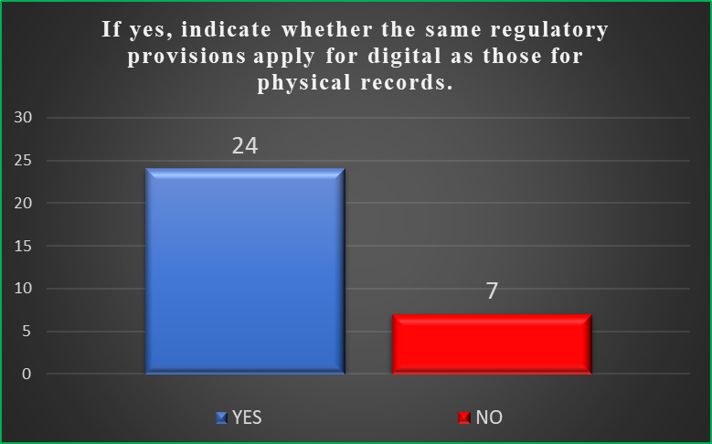
Both graphics reflect that although they receive digital records, appraisal and dispositions 43.66% those organizations do not have specific criteria for digital records appraisal 77.41%

Slide 9
Report on regulations on appraisal and possible dispositions on Artificial Intelligence in selected countries. By Aída Luz Mendoza
Archival regulations on records retention and disposition, including classification schemas already established in countries studied.
Any regulation for records/archives treatment through AI applications a risk-based approach is required for personal information, human rights, individuals’ obligations, and the public sector.
Public policies, as government commitments on AI, turn to be a good start and foundation because they may contain information useful for taking appropriate measures on data, ethics and the use of AI. It is assumed that each policy or strategy can lead to a specific regulation or law on AI for records and archives.

Slide 10
Insights
SG05 will maintain the purpose of looking for the possibility of a test bed partner to explore AI applications for appraisal.
In the light of the survey results, we will make some cross reference studies to get deeper information.
By collaborating with AA02, the survey in Spanish proposed is also being disseminated, we feel that some of our results might be useful for said project.
Dissemination will continue, looking for an in person/virtual international seminar related to AI and appraisal in one of the countries that are participating in SG5
Also, will maintain with assistance of undergraduate students Spanish commented literature review for dissemination related with for appraisal and disposition, as well as for ethical and regulations topics.
We wellcome to our team Ivina Flores Melo, researcher from the Brazilian Institute of Information in Science and Technology

