Slide 1
There is no substitute for careful analytical work AI and appraisal
Dr Jenny Bunn
[event]
28 October 2023

Slide 2
Framing appraisal
“In the reduction of modern public records great care must be exercised to retain those that have value. In the long run the effectiveness of a record reduction program must be judged according to the correctness of its determinations. In such a program there is no substitute for careful analytical work. Techniques cannot be devised that will reduce the work of deciding upon values to a mechanical operation. Nor is there a cheap and easy way to dispose of records unless it is one of destroying everything that has been created, of literally wiping everything off the board.”
T. R. Schellenberg, The Appraisal of Modern Records, Bulletins of the National Archives, Number 8 (October 1956): 46 pages. Archives and Records Management Resources | National Archives

Slide 3
Shifting levels of analysis
“While appraising the evidential values of records the archivist must take into account the entire documentation of the agency that produced them. […] Similarly, while appraising the informational values of records, the archivist must take into account the entire documentation of society on the matter to which the information relates.”
T. R. Schellenberg, The Appraisal of Modern Records, Bulletins of the National Archives, Number 8 (October 1956): 46 pages. Archives and Records Management Resources | National Archives
Macro
Meso
Micro

Slide 4
Shifting foci of analysis
“The appraisal of machine-readable records involves the evaluation of the information contained in the records (content analysis), as well as an evaluation of the technical aspects of the records (technical analysis). The content analysis involves the traditional activities of archival appraisal combined with some new considerations particular to machine-readable records. The technical analysis is a relatively new activity in the appraisal of records, but one which is of the utmost importance in the evaluation of machine-readable records.”
The Archival appraisal of machine-readable records: a RAMP study with guidelines prepared by Harold Naugler for the General Information Programme and UNISIST. Paris: Unesco, 1984.

Slide 5
Data acquistion
Paradigm project (2005-2007), Useful appraisal tools, paradigm | workbook on digital private papers | appraisal and disposal | useful appraisal tools (archive-it.org)
Directory tools, Directory management tools, Synchronisation (to find duplicates), File comparison tools, Digital forensic tools.
DROID – The National Archives (UK) - Download DROID: file format identification tool - The National Archives
Bitcurator, https://bitcurator.net/
ePADD, https://library.stanford.edu/projects/epadd
Archifiltre, https://archifiltre.fabrique.social.gouv.fr/

Slide 6
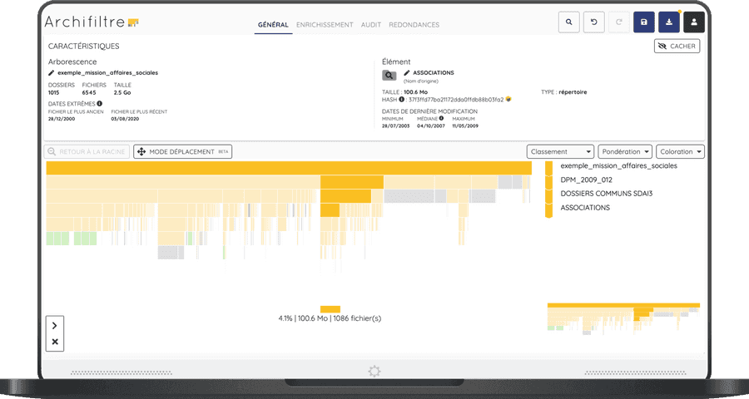
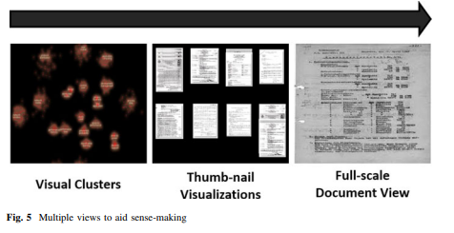
Data visualisation
“Visualization and VA hold much promise as tools to support a sustainable future for archives, particularly as cognitive aid to archivists in undertaking complex analytic tasks, like arrangement and description, which cannot yet fully be achieved using computational methods.”
“To leverage archivists’ use of form to infer context, we propose to develop a computer algorithm to cluster archival records by their form.”
Lemieux, V.L. Visual analytics, cognition and archival arrangement and description: studying archivists’ cognitive tasks to leverage visual thinking for a sustainable archival future. Arch Sci 15, 25–49 (2015). https://doi.org/10.1007/s10502-013-9212-y

Slide 7
Rules and patterns
Anne Gilliland-Swetland, "Development of an Expert Assistant for Archival Appraisal of Electronic Communications: An Exploratory Study," PhD Dissertation, University of Michigan, 1995. (Described in Chapter 23 in Research in the Archival Multiverse, https://library.oapen.org/handle/20.500.12657/31429)
“At its core, AI is a research field spanning philosophy, logic, statistics, computer science, mathematics, neuroscience, linguistics, cognitive psychology and economics. AI can be defined as the use of digital technology to create systems capable of performing tasks commonly thought to require intelligence. AI is constantly evolving, but generally it: a) involves machines using statistics to find patterns in large amounts of data, b) is the ability to perform repetitive tasks with data without the need for constant human guidance”
A guide to using artificial intelligence in the public sector - GOV.UK (www.gov.uk)
Notes:
Rules on presence of certain words in conjunction with others – not seeing words but seeing vectors.

Slide 8
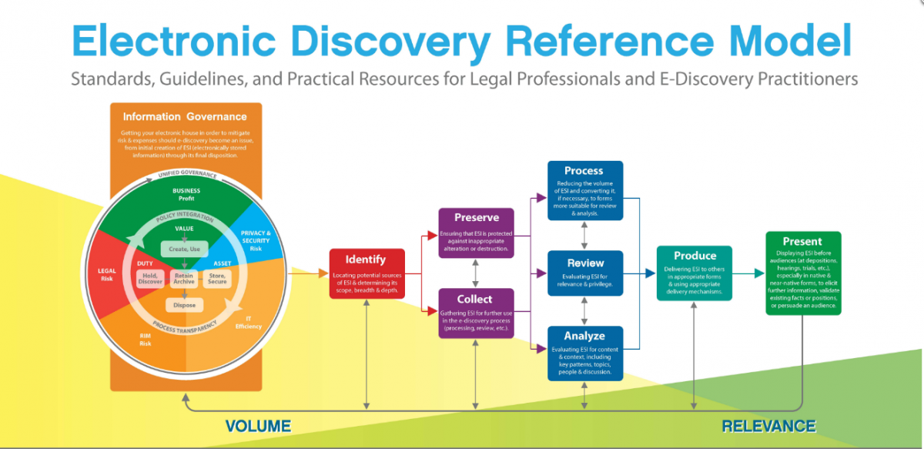
A question of balance
“The eDiscovery software tools are able to facilitate a ‘funnel’ approach to analysing born-digital records collections. The amount of information to review can be systematically reduced by using the tools”
The National Archives (2016), The application of technology-assisted review to born-digital records transfer, Inquiries and beyond: Research report. technology-assisted-review-to-born-digital-records-transfer.pdf (nationalarchives.gov.uk)
“the key … is to find a balance between two extremes: making sweeping statements about large batches of records and undertaking very granular assessment”
Victoria Sloyan (2016) Born-digital archives at the Wellcome Library: appraisal and sensitivity review of two hard drives, Archives and Records, 37:1, 20-36, DOI: 10.1080/23257962.2016.1144504

Slide 9
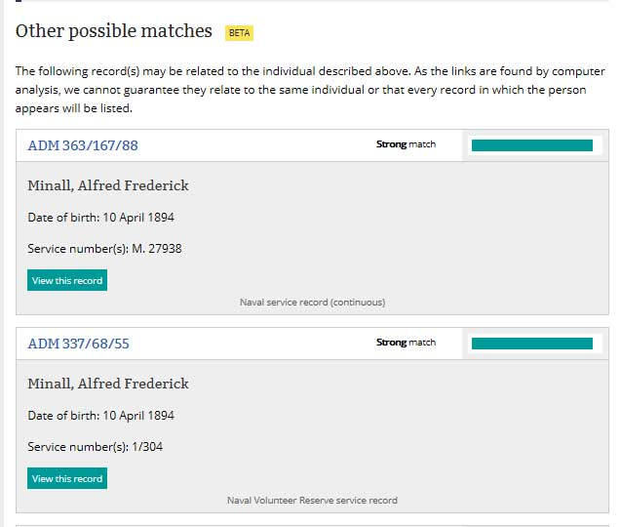
Better data?
The Cybernetics Thought Collective
Traces through time - Making connections: tracing people through our collection - The National Archives blog

Slide 10
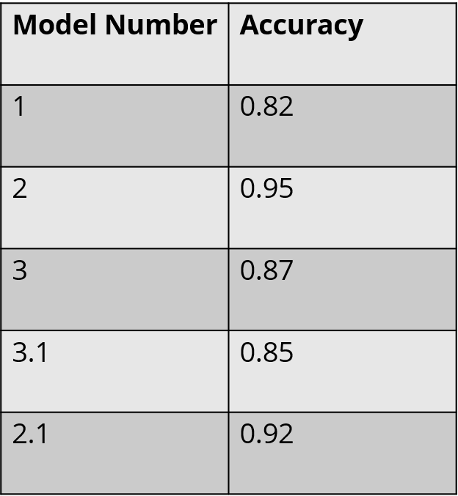
Better balance?
2-F1-0.95
3-F1-0.47
1755 (TN) | 44 (FN)
94 (FP) | 833 (TP)
3325 | 118
372 | 0
Throw
Predicted
Keep
kainos-aws-national-archives.pdf (nationalarchives.gov.uk) https://www.nationalarchives.gov.uk/information-management/manage-information/preserving-digital-records/research-collaboration/using-ai-for-digital-selection-in-government/
Actual
Throw
Keep
Keeping stuff we don’t need
Throwing stuff we do need
10

Slide 11
In summary
Framing appraisal as ‘careful analytical work’ which takes place at multiple levels of analysis
New forms of data leads to new means to acquire and to visualise data
New means to acquire and visualise data leads to better data analysis?
Questions of AI/ML in relation to appraisal
What sort of analysis can it carry out on what basis? What information can I gain from this analysis?
How can statistical analysis (in terms of probabilities) to help me achieve a better balance?

