Slide 1
Architecting Accountability in AI: Paradata and AI in Commodity Markets at the Bank of Canada
October 28, 2023
ITrustAI Public Symposium, UBC
Mario Beauchamp & Alex Richmond
Bank of canada

Slide 2
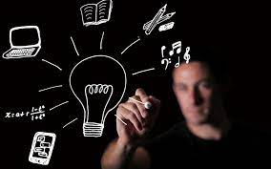
Agenda
The Challenge: Deepening our real-time understanding of commodity markets
The Proof of Concept: Applying Explainable AI to Our Models
Breaking Down the AI
Paradata and its Importance
PoC Paradata → Actual examples!
Questions

Slide 3
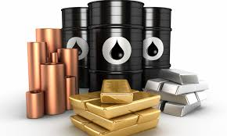
The Challenge
In today’s volatile markets, how can the Bank better understand impacts on commodities markets?
Can we better identify trends and understand the factors of change over time?
Can we truly understand the intensity of communication surrounding commodities issues, and does the “talk” match the actual market?

Slide 4
Combine Bank-developed algorithms and new AI applications to show that the technology can strengthen the Bank’s ability to understand changes in commodities markets, and apply our capabilities to policy recommendations
As part of this work, develop a framework for the application of paradata – a key component in ensuring the “explainability” and ethical application of the AI used in formulating market analysis

Slide 5
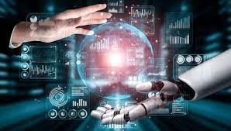
What Does the AI Technology Do?
With the high volume of available content, point us to the most relevant material – cut out the noise
With the relevant content, automatically apply tags that identify specific developments within the markets – think supply & demand
Aggregate the data to allow identification of events over time – recent events or expectations of the future?

Slide 6
The right to an explanation – New legislation (GDPR etc.) – direct link to understanding AI, the algorithms in use and their outcomes
Explainable AI means making the tools understandable and interpretable
This leads us to paradata – which documents relationships between AI implementations and their results, “making those results understandable in terms of the systems and individuals responsible for them.”
Accountability and Explainable AI

Slide 7
Primary Objective:
We want to develop an AI for the Bank of Canada that allows us to create a Natural Language Processing Engine (NLP) that specializes in the field of economics
Fine tuning → equip our engine with the ability to analyze a given sentence and accurately categorize its sentiment, making it an expert in economic language
And the paradata?
We are working with a limited dataset
Paradata becomes a crucial component
Paradata enables us to uncover the thinking patterns that underlie the dataset
Makes it easier to expand
We gain valuable insight into the origins of our data, including how previous attempts were made
Getting to the Bottom of the Answers behind the answers
Breaking down the AI

Slide 8
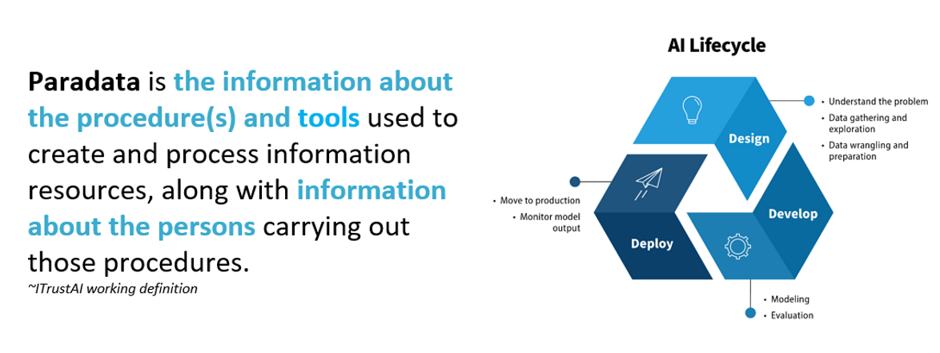
What is Paradata???
Paradata and the Proposed
Framework
Paradata is key in supporting transparency and accountability when using AI.

Slide 9
The term was first used back in 1998…
Work to date…
Acknowledgement that it’s needed – in many fields, from archeology to information science and data engineering
Definitions – including the ITrustAI working definition as provided by our colleagues
Challenges including how to:
Define it across disciplines
Collect it
Maintain it
Make it accessible
Paradata – Advances in the work

Slide 10
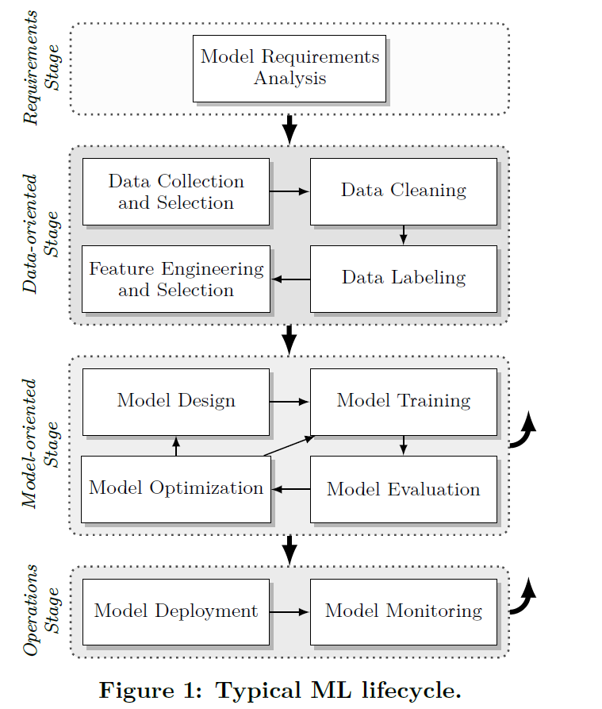
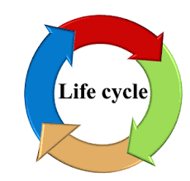
We Start From the ML Lifecycle
What we end up with is paradata that provides:
Information about the model and/or tool
Information about the data used
Information about the QA process
Procedural information
Paradata: A Framework
Source: Marius Schlegel, Kai-Uwe Sattler, “Management of Machine Learning Lifecycle Artifacts: A Survey,” SIGMOD Record, December 2022 (Vol. 51 No. 4)

Slide 11
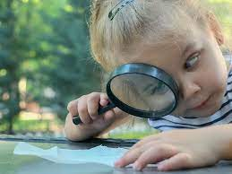
Our Framework Should Capture…
Value(s) | Details it provides
Identification Metadata | Name of the data sets, types, associations, pipelines
Data-set Metadata | Ablation method, training/validation/test split ratios, size, date, source
Model-Related Metadata | Learning rate, parameters such as weights & biases, hyperparameters, quality & performance metrics
Experiment or Project Metadata | What has been used to capture data processing or model training runs, number of epochs, optimization algorithm
Pipeline Metadata | Details on how to execute the ML workflows
Operationalization Metadata | Audit logs details, result statistics
Paradata: The Details

Slide 12
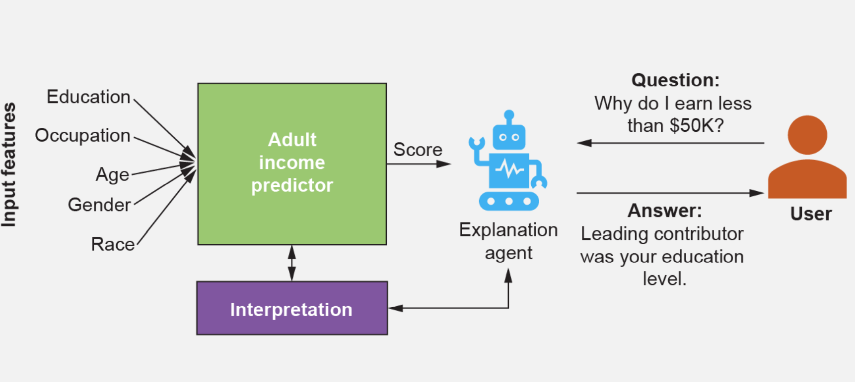
Remember our duty to explain…
Paradata: Visualizations
How does the algorithm create the model?
How does the trained model make predictions?
How do parts of the model affect predictions?
What did a model make a certain prediction?

Slide 13
How we document the paradata…
Building off existing work
As a starting point, use a version of the W3C PROV model → PROV ML
PROV = Provenance – “Information about entities, activities, and people involved in producing a piece of data or thing, which can be used to from assessments about its quality, reliability or trustworthiness.” ^{W3C}
Why a model like PROV? It allows for the all-important contextual details of an AI implementation and the provenance to be expressed consistently and it supports interoperability?
The interoperability is key when we look at how to address the practicality in the capturing of paradata
Paradata: A Preservation Template

Slide 14
Architecting accountability…
The first big question is accountable to whom?
Paradata supports an explainable AI – explainable to whom?
Who is the intended audience? In the Bank’s case, it’s more than one
Ultimately accountable to Canadians
To the Managing Director of the Bank’s International Economics Department
To the Governor of the Bank
Each of these is a totally different audience
What about accountability?
Ultimately, accountability rests on principles of authenticity, trustworthiness, reliability
In the AI/ML world of algorithms, our paradata framework needs to capture both software & data architectures, but also the cultural mores

Slide 15
Value(s) | Details it provides
Identification Metadata | Name: Daily Oil Bulletin
Data-set Metadata | Training/validation/test split ratios: training 90 % Validation Size 90 %
Model-Related Metadata | Hyperparameters: Learning Rate 3e-1 Epoch 2 Batch Size: 16 weight decay of 0.001 Performance Metrics; Accuracy 88%
Experiment or Project Metadata | Optimization Algorithm: Adam W
Pipeline Metadata | Validates models: Oil Bulletin from current day Separate by sentence Score each sentence Aggregation of relevancy Send results to economists
Paradata from our PoC…

Slide 16
Questions ?
Contacts:
arichmond@bankofcanada.ca
mariobeauchamp@bankofcanada.ca

Slide 17
Further Details

Slide 18
Details of the PoC
Challenge: Could we accelerate INT’s capabilities to review externally generated content concerning the international oil market?
We could try to automatically apply tags to content coming from the Oil Market Bulletin
First step → use the tags to highlight, for the economists, the most relevant content
What did we do?
Corpus of training material provided to allow for refinement of AI algorithms
We used Doccano – but had to suspend due to technical issues

Slide 19
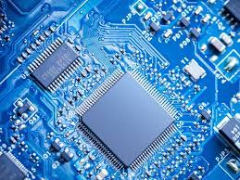
Components of the PoC
AI/ML Model:
EconBERT, developed by Mario Beauchamp
Training Sources:
RePEc ^{(Research Papers in Economics)} – Abstracts
Reports from the Federal Reserve
Bank of Canada MPR(s)
The Daily Oil Bulletin
Tags/Labels:
Not Relevant
Price
Positive
Negative
Neutral
Supply (as above)
Demand (as above)
Time
Future
Current
Intermediate

Slide 20
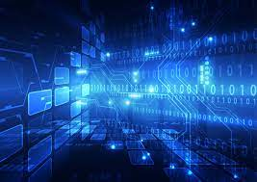
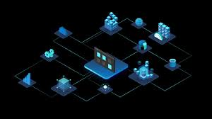
Technology Stack
- RoBERTa MLM architecture
- Python Transformer Code from HuggingFace
- Using Azure Machine Learning to keep track of all jobs
- Pre-Training:
CC-NEW, BookCorpus, REPEC Abstracts
- Fine-Tunning, using sentiment Analysis
- A100GPU (Pre-Training), TeslaV4 GPU (Fine-Tunning)

Slide 21
Current Work
Enter Modeca and CAM → Content Auto Tagging Manager
Mario continues to refine EconBERT
We start to develop the paradata framework
We also started to work with the Bank’s Ethical AI team
Challenges:
Economists were initially applying the training labels based on single sentences, without broader context
Do we have enough training content?
Are their biases in an article headline?

Slide 22
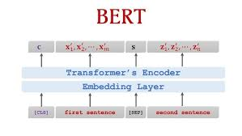
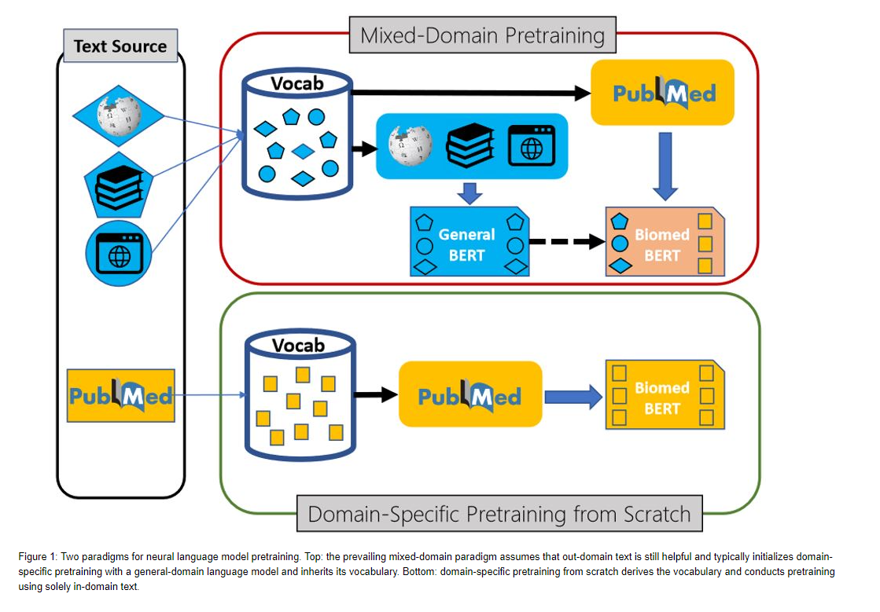
EconBERT
Mario – some explanation please ☺
Mixed domain vs. econ only? Might be interesting…. Just a thought ☺

Slide 23
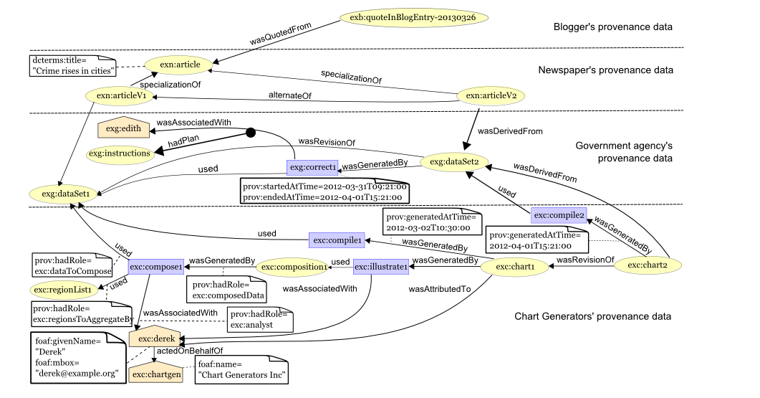
PROV- ML Model

Slide 24
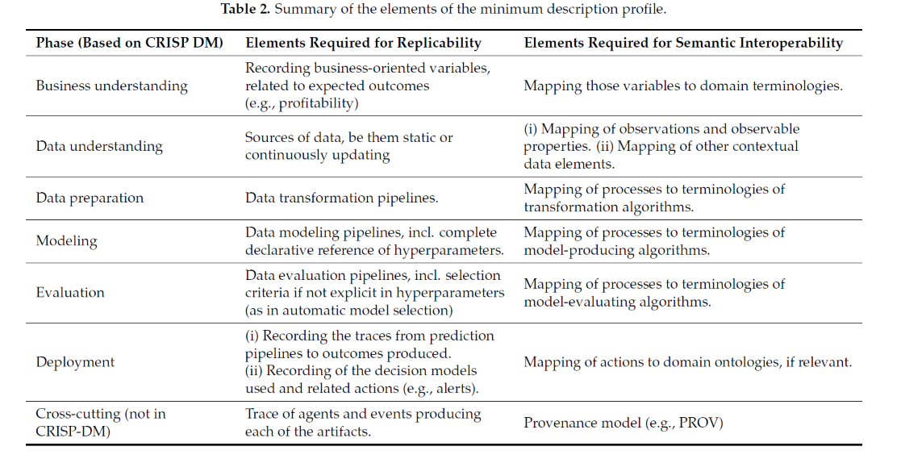
Elements of a Description Profile
Source: Mora-Cantallops, Sanchez-Alonso, Garcia-Barriocanal, Sicilia, “Traceability for Trustworthy AI: A Review of Models and Tools,” Big Data Cong. Comput. 2021, 5, 20. https://
doi.org/10.3390/bdcc5020020

Slide 25
Concepts of the PROV Model
The PROV model focuses on three key concepts in an AI implementation:
Entity
Activity
Agent
And the relations between them

Slide 26
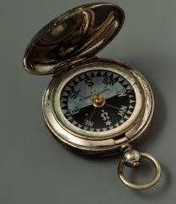
Next Steps
What is our strategic direction???
Continue to refine our AI/ML model
Explore the use of CAM when augmented by EconBERT
Validate our paradata framework and a preservation template
Explore methods of automating the template
Look to encode the paradata and then use in a tool such as Wholetail

