Slide 1
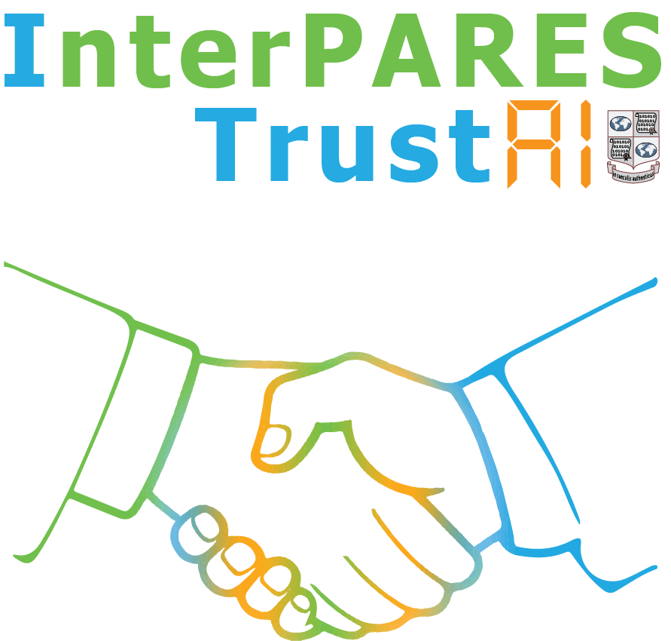
Putting PI into ML Pipeline: Archival Duties
Presentation
by Paige Hohmann and Jim Suderman
to the
ITrustAI Public Symposium
Forest Sciences Centre, UBC
Vancouver, 28 October 2023

Slide 2
Pipeline: a provocative metaphor
“[The pipeline is] a multi-billion dollar natural gas project — touted as the largest private sector investment in Canadian history — and an assertion by Wet'suwet'en hereditary chiefs that no pipelines can be built through their traditional territory without their consent.”
Chantelle Bellrichard, Jorge Barrera (CBC News), “What you need to know about the Coastal GasLink pipeline conflict”, 11 February 2020
“Elected councils for the Wet’suwet’en and other Indigenous bands have signed lucrative ‘impact benefit agreements’ with TransCanada (now called TC Energy), builder of the Coastal GasLink pipeline that would bring fracked gas 670 kilometres from Dawson Creek, B.C., to an LNG Canada liquefaction plant at Kitimat.”
David Suzuki, Ian Hanington (David Suzuki Foundation), “Pipeline blockade is a sign of deeper troubles”, 17 January 2019
“...the Government of Canada and of the Province of British Columbia have escalated their use of force, surveillance, and criminalization of land defenders and peaceful protesters to intimidate, remove and forcibly evict Secwepemc and Wet’suwet’en Nations from their traditional lands...”
Letter, dated 29 April 2022 (CERD/EWUAP/106th session/2022/MJ/CS/ks), from Verene Shepherd, Chair of the Committee on the Elimination of Racial Discrimination (on Office of the High Commissioner for Human Rights) to Leslie Norton, Ambassador and Permanent Representative of Canada to the United Nations.

Slide 3
Pipelines and the AI Data Mills
Skip the Pipelines: use existing AI tools to support archivists and other record custodians in making decisions regarding access and protecting the privacy of creators, subjects, and other stakeholders
Dataset pipeline: preparing an archival corpus for “datafication” in the course of developing an AI tool to support decisions on access and privacy protection.
Administrative pipeline: Reifying the data procurement
Technical pipeline: Researcher interface with the data set

Slide 4
Existing AI tools for protecting privacy
PI Category | gretel | Presidio (Microsoft) | Amazon Web Services | PII Tools
Unique [individual] identifier | generic key (token), GitHub token, google data, hostname(?), IMSI (subscriber ID), JSON web token, SendGrid credentials, Slack secrets, US SSN | MEDICAL_LICENSE, US_DRIVER-LICENSE, US_PASSPORT, US_SSN, UK_NHS, NIF (Spain: personal tax ID), FIN/NRIC (Singapore: national registration ID) | SSN, PASSPORT_NUMBER, DRIVER_ID, AWS_ACCESS_KEY, AWS_SECRET_KEY, MAC_ADDRESS, USER_NAME | username, id_scan, driver_licence, passport, tax_id, ssn
Sex [gender] |  |  |  | gender
race |  |  |  | race
“A key question that must be asked for the development and deployment of an AI system is: do datasets exist that are fit or suitable for the purpose of the various applications, domains and tasks for which the AI system is being developed and deployed?”
NIST, “Towards a Standard for Identifying and Managing Bias in Artificial Intelligence” Special Publication 1270, 86 pages (March 2022) p. 17. DOI: https://doi.org/10.6028/NIST.SP.1270
IP address |  |  | IP_ADDRESS | ip [unclear, probably IP address]
Unique [individual] identifier | generic key (token), GitHub token, google data, hostname(?), IMSI (subscriber ID), JSON web token, SendGrid credentials, Slack secrets, US SSN |  | SSN, PASSPORT_NUMBER, DRIVER_ID, AWS_ACCESS_KEY, AWS_SECRET_KEY, MAC_ADDRESS, USER_NAME | username, id_scan, driver_licence, passport, tax_id, ssn
sex [gender] |  |  |  | gender
race |  |  |  | race

Slide 5
Using archival concepts in datafication
Steps
Identify documents (beginning/end)
Document type, e.g., email, letter, etc.
Indicate diplomatic elements
Protocol, eschatocol, annotations
Link to info external to documents
Organization, functional classification
Associate redacted text with
Document, Element, Context
email - end
letter - start
Protocol
Body
Organization_{n}
Organization_{n+1}
Organization_{n+2}
redaction
Eschatocol
Function_{n}
Function_{n+1}
Function_{n+2}
letter - end
application - start

Slide 6
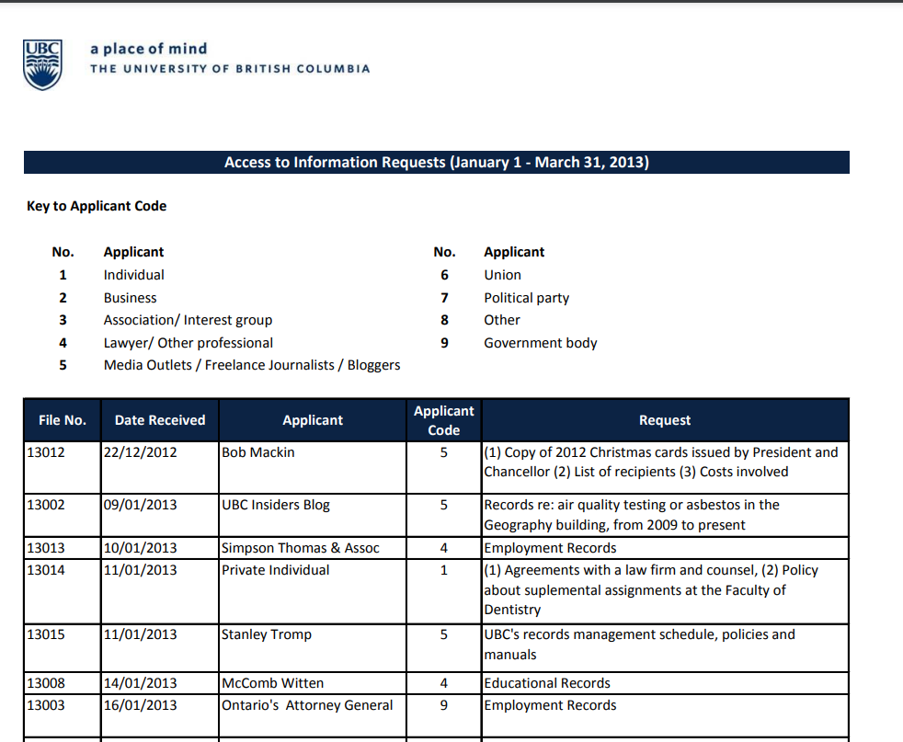
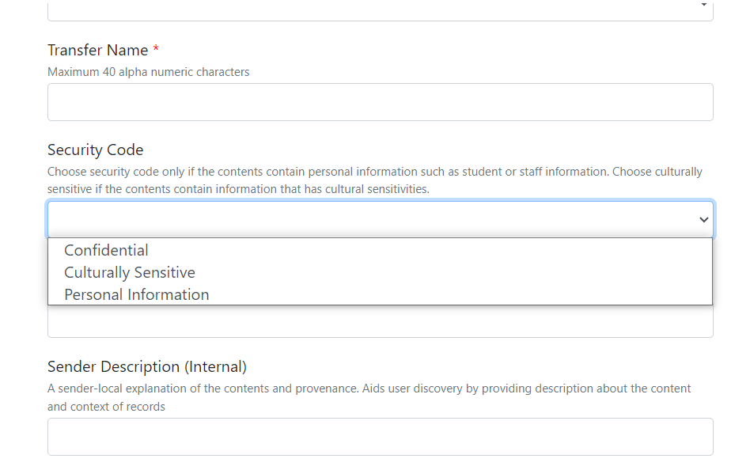
Focus: Administrative Pipelines
Identifying the data set
A practitioner’s solipsism leads to UBC records
UBC MoveIT: sensitivity classification:
Prior proposal: Teamshare records
Office of University Counsel: an alternative proposal →
“Twinned” corpus
UBC Office of University Counsel (2023). “Summaries of Prior Requests
Previous Access to Information Requests” https://universitycounsel.ubc.ca/subject-areas/access-and-privacy-general/access-to-information/public-information/summaries-of-prior-requests/
Towell, B. (2022). “Building Digital Preservation Capacity For UBC’s Institutional Records” UBC Records Management. https://recordsmanagement.ubc.ca/2022/09/27/building-digital-preservation-capacity-for-ubcs-institutional-records/

Slide 7
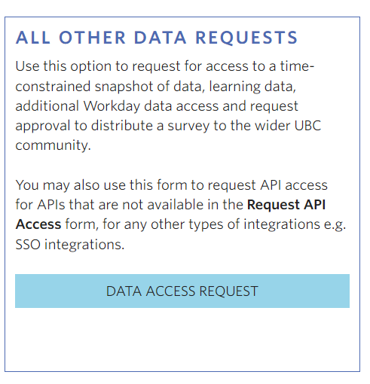
Focus: Administrative Pipelines
Getting the data set
Reifying the data procurement path
Behavioural Research Ethics Board
Ethics certificate: Dependent on DAR
Data Governance Committee - Office of the CIO
DAR: Dependent on Ethics Certificate
Supplements: NDA; Research Data Management Plan, Processes for data security maintenance
UBC Office of the CIO: Data Governance Services. (2023). Access UBC Data. https://cio.ubc.ca/data-governance/data-governance-services/access-ubc-data
Notes:
Address dual risk domains: Research risk (harm to human subjects) / Institutional risk (legal harm, reputational harm)

Slide 8
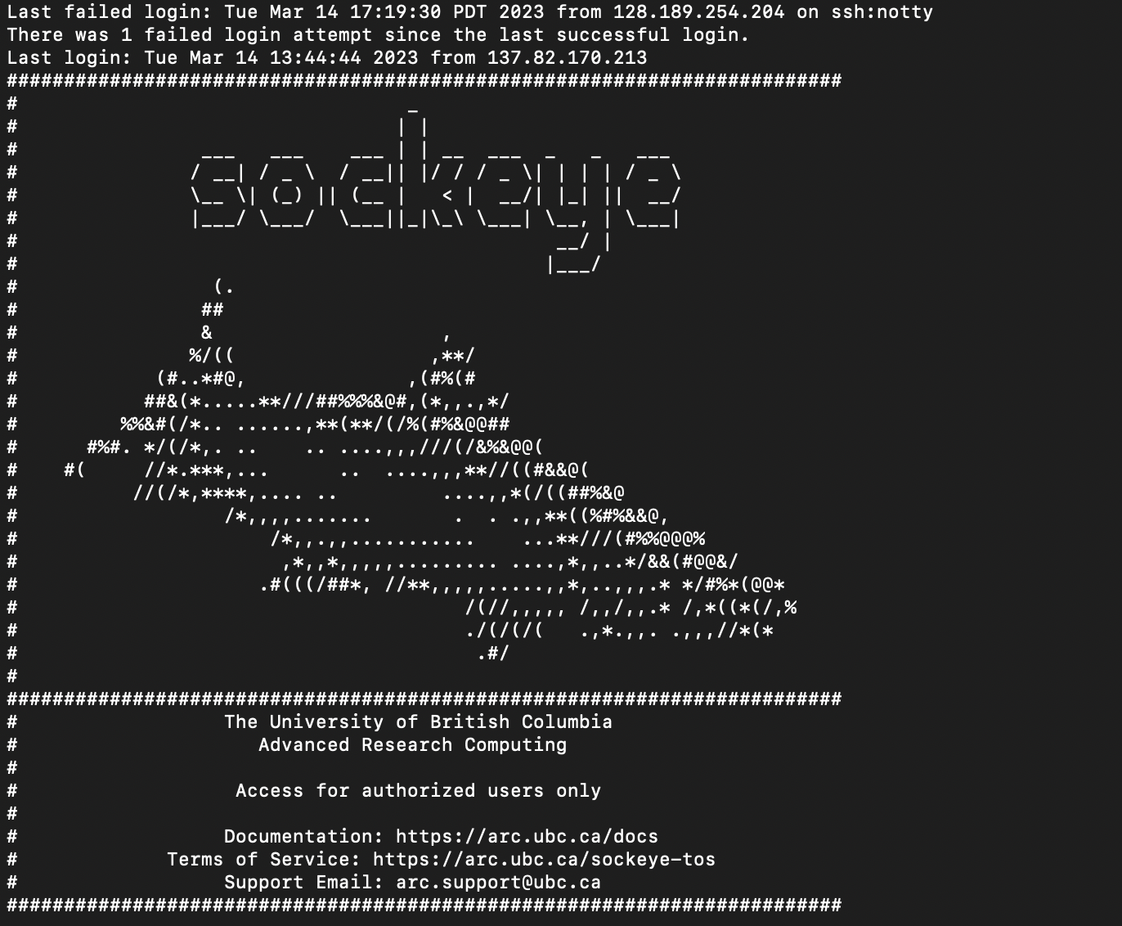
Focus: Technical Pipelines
Moving and securing the data set
UBC ARC Sockeye
- high-performance computing platform available to UBC researchers across all disciplines.
- designed to significantly increase UBC’s computing capacity and supplement the national platform for digital research infrastructure (DRI)
Sockeye specs and TOS were supplement supporting approval for the release of this sensitive data with the support of the ARC Sensitive Research Team.
UBC Advanced Research Computing. (2023) UBC ARC Sockeye. https://arc.ubc.ca/ubc-arc-sockeye

Slide 9
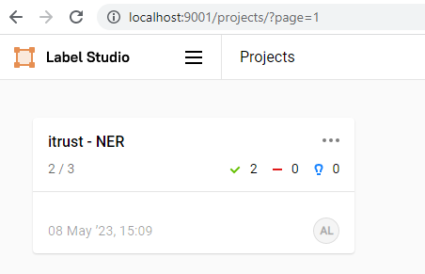
Focus: Technical Pipelines
Researcher interface with the data set
Working on pairing functional requirements with available workflows and tools
Labellers (archivists): LabelStudio
Identify documents
Indicate diplomatic elements
Associate with external info
Characterize context of redacted data

Slide 10
Status and next steps
Apply, flex, develop established "administrative pipelines"
Purpose: secure a fit-for-purpose dataset
Outcome: Build substrate; manage policy and risk
Status: complete (payload is in Sockeye)
Characterize the activities of conventional records "analytical pipeline”
Purpose: encode the “catch and release” process in machine-readable terms (diplomatics?)
Outcome: document labelling; “datafication;” AI modelling
Status: in progress (functional requirements have been defined)
Push datafied records through the “data set pipeline”
Purpose: replicate characterized activities in an AI
Outcome: parsable data set
Status: upcoming

Slide 11
Thank you
Paige Hohmann, Archivist Okanagan Special Collections & Archives |  | Jim Suderman, Study Lead PI Content Assessment study

