Slide 1
UNESCO Radio Archives AI for AUDIO Discovery
Peter Sullivan
InterPARES Plenary 9 – October 28 2023
Vancouver

Slide 2
Outline
Overview of UNESCO Radio Archives
Spoken Language Identification (LID)
Building an audio Dataset for LID
2

Slide 3
I Trust AI Objectives
Identify specific AI technologies
Determine the benefits and risks
Integrate archival concepts and principles in AI
Validate outcomes case studies and demonstrations.
3

Slide 4
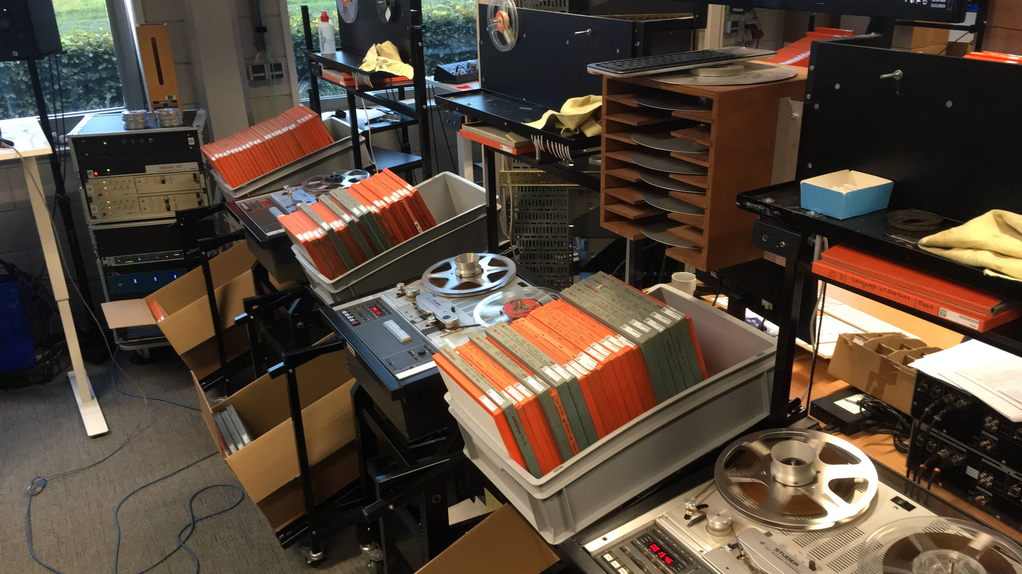
UNESCO RADIO ARCHIVE Driving Question:
In collaboration with Eng Sengsavang
How can AI enable better description of archival audio?
4

Slide 5
Metadata Scheme
Coverage_placename
Creator
Personality
Publisher
Contributor_organization
Contributor_person
Rights
Title
Other_lang_title
Third_lang_title
Description
Other_lang_description
Third_lang_description
57 elements total
Vital for discoverability
Format_length
Program number
Associated Document
File location
Source (script)
Language
Access_category
Rightsholder
5

Slide 6
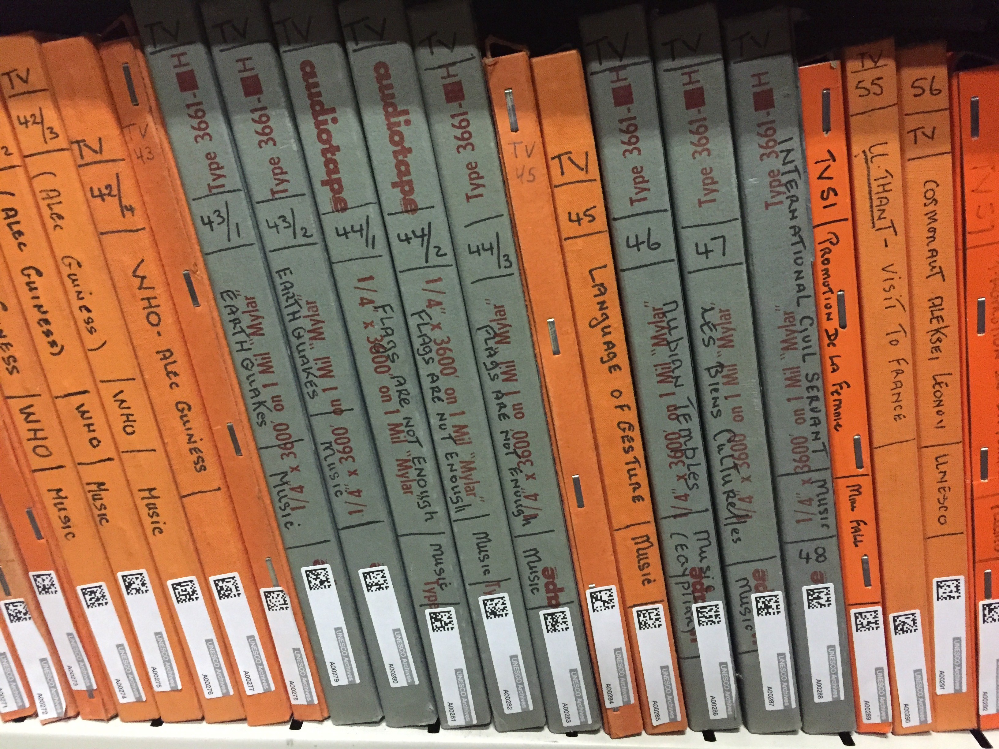
UNESCO Archives Quantity
~6,500 available on digital platform (16,000 total)
But only ~800 described so far
6

Slide 7
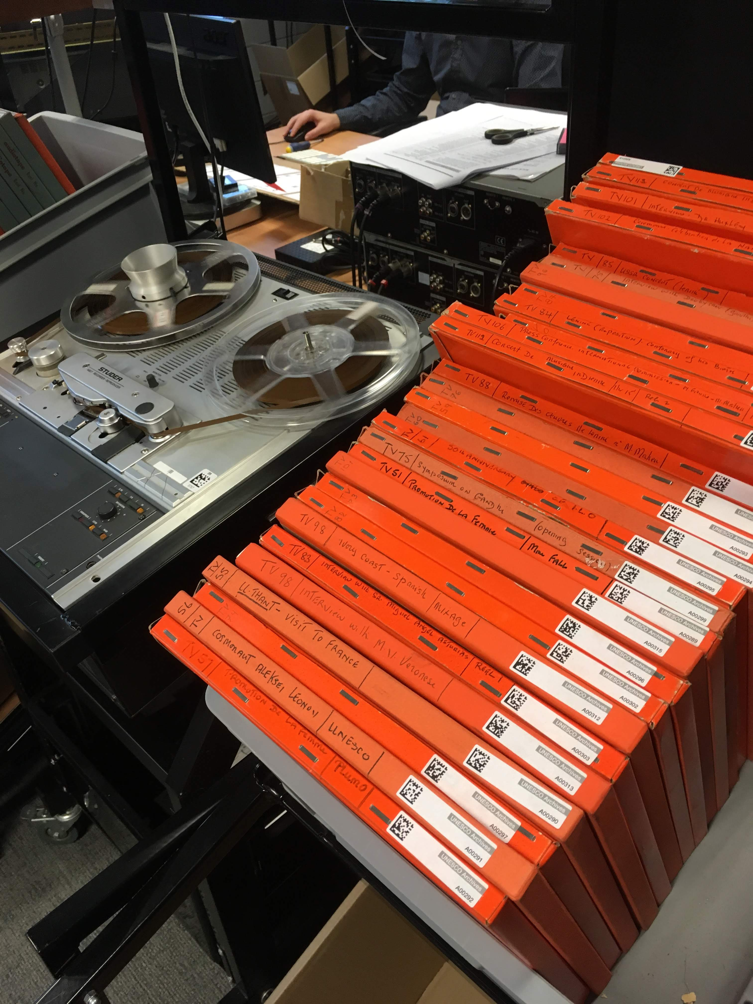
UNESCO Archives Coverage
5 Core UNESCO areas:
Education
Culture
Natural Sciences
Communication and Information
Social and Human Sciences
Plus:
UNESCO History
7

Slide 8
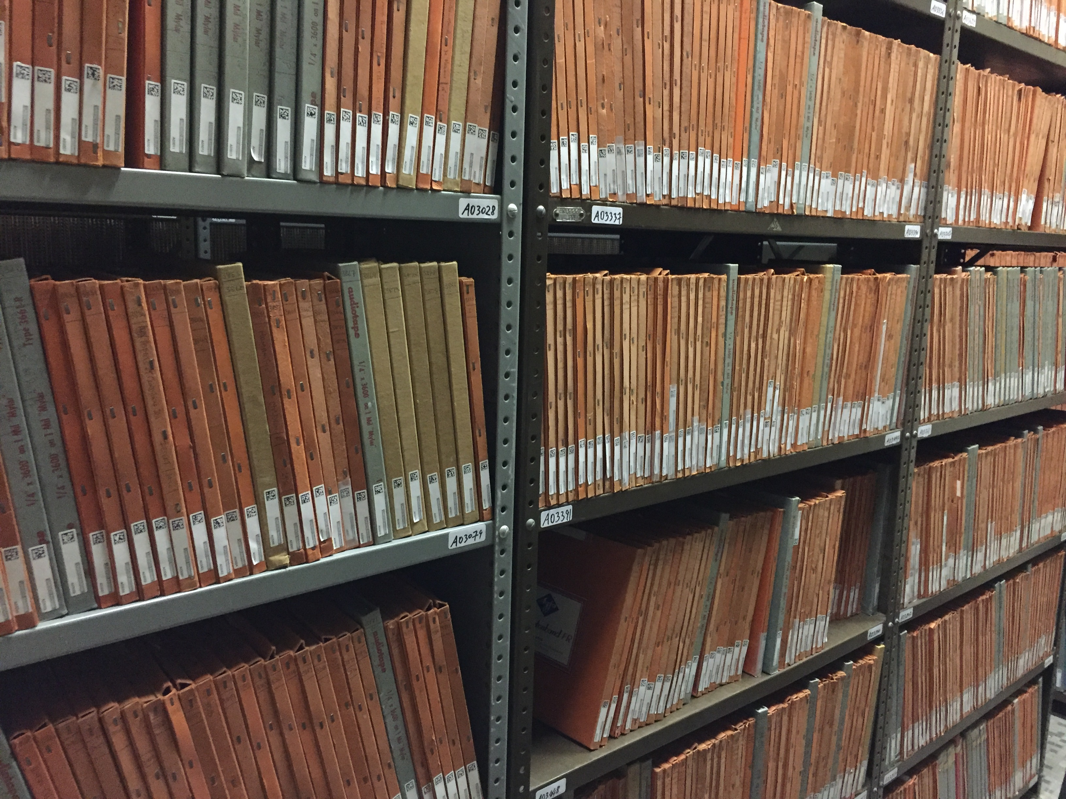
UNESCO Archives Languages
70+ recognized languages
French
English
Spanish
Multilingual (4%)
8

Slide 9
UNESCO Archives Metadata Enrichment Plan
Title
Other_lang_title
Third_lang_title
Description
Other_lang_description
Third_lang_description
Coverage_placename
Creator
Personality
Publisher
Contributor_organization
Contributor_person
Rights
File location
Source (script)
Transcript
Format_length
Program number
Associated Document
Language
9

Slide 10
Text vs. Speech Language ID
Text Based
Orthographic clues
Full sentence used as input
Models:
Transformer Model (BERT etc…)
Speech Based
Potential Confounders:
Speaker
Recording setup
Short audio clip
Models:
Convolutional Neural Network
(x-vector)
Fine-tuned Audio Transformer

Slide 11
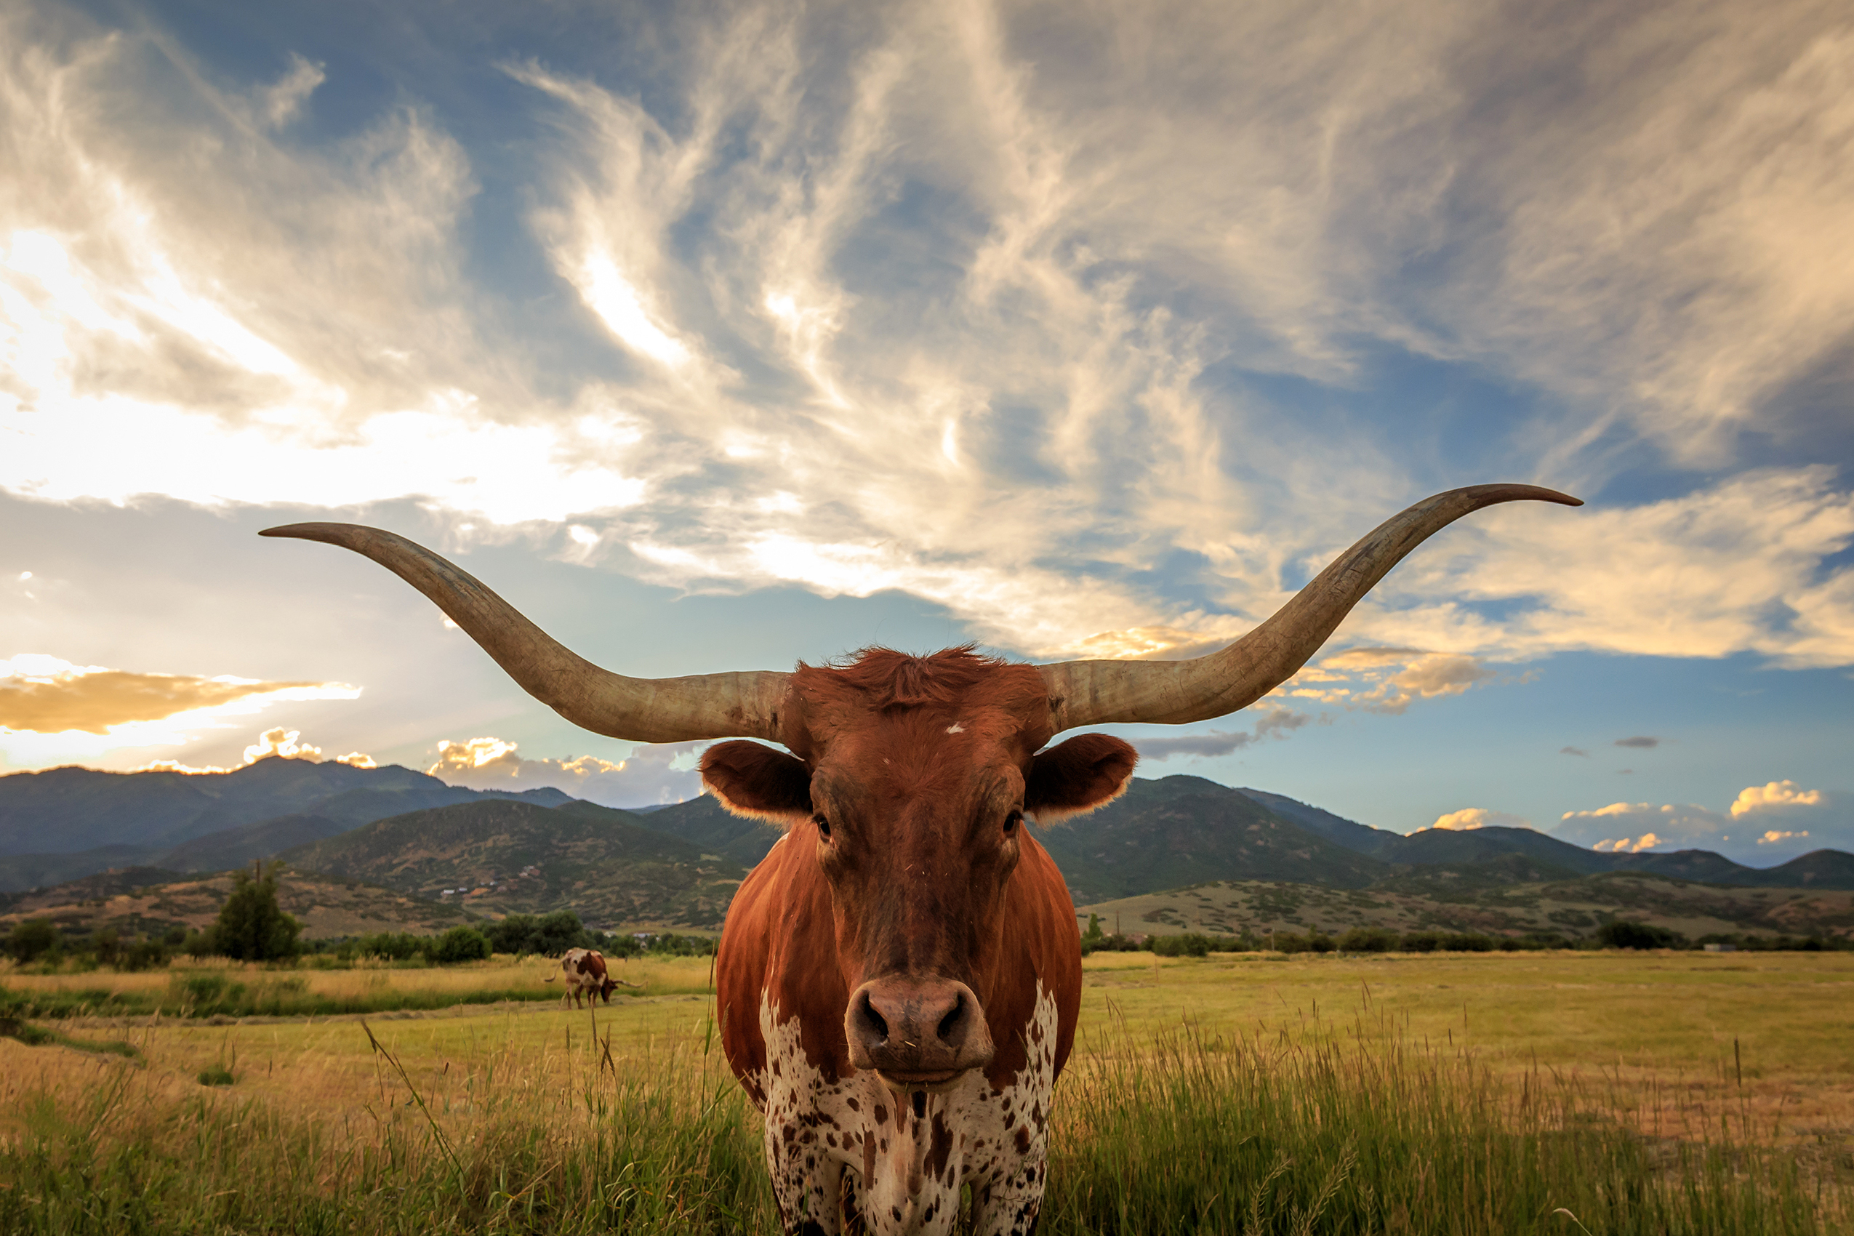
Recent Work: Lang ID
How robust are LID models to changes in recording domain?
or
Sullivan, P., Elmadany, A., Abdul-Mageed, M. (2023) On the Robustness of Arabic Speech Dialect Identification. Proc. INTERSPEECH 2023, 5326-5330, doi: 10.21437/Interspeech.2023-1005

Slide 12
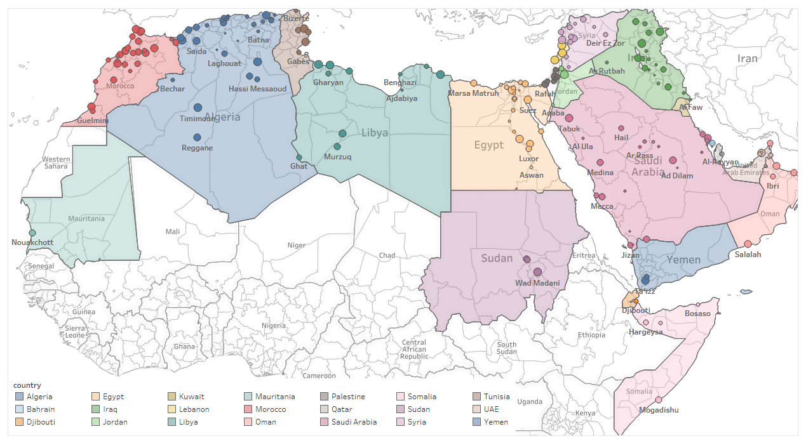
Recent Work: Lang ID
Arabic Dialect ID
Evaluate Fine-tuned Audio Transformers
ADI17 fine-grain classification (Train)
ADI5 coarse-grain classification (Test)
Major drop in performance
F1 92% (ADI17 Test)
→ 80% (ADI5 Test)!
Sullivan, P., Elmadany, A., Abdul-Mageed, M. (2023) On the Robustness of Arabic Speech Dialect Identification. Proc. INTERSPEECH 2023, 5326-5330, doi: 10.21437/Interspeech.2023-1005

Slide 13
Recent Work: Lang ID
Can noisy self-training prevent domain overfit?
Self-train on “silver”-label audio data
Evaluate on difficult television drama audio
Baseline 5% vs. Self-training 45%
Sullivan, P., Elmadany, A., Abdul-Mageed, M. (2023) On the Robustness of Arabic Speech Dialect Identification. Proc. INTERSPEECH 2023, 5326-5330, doi: 10.21437/Interspeech.2023-1005

Slide 14
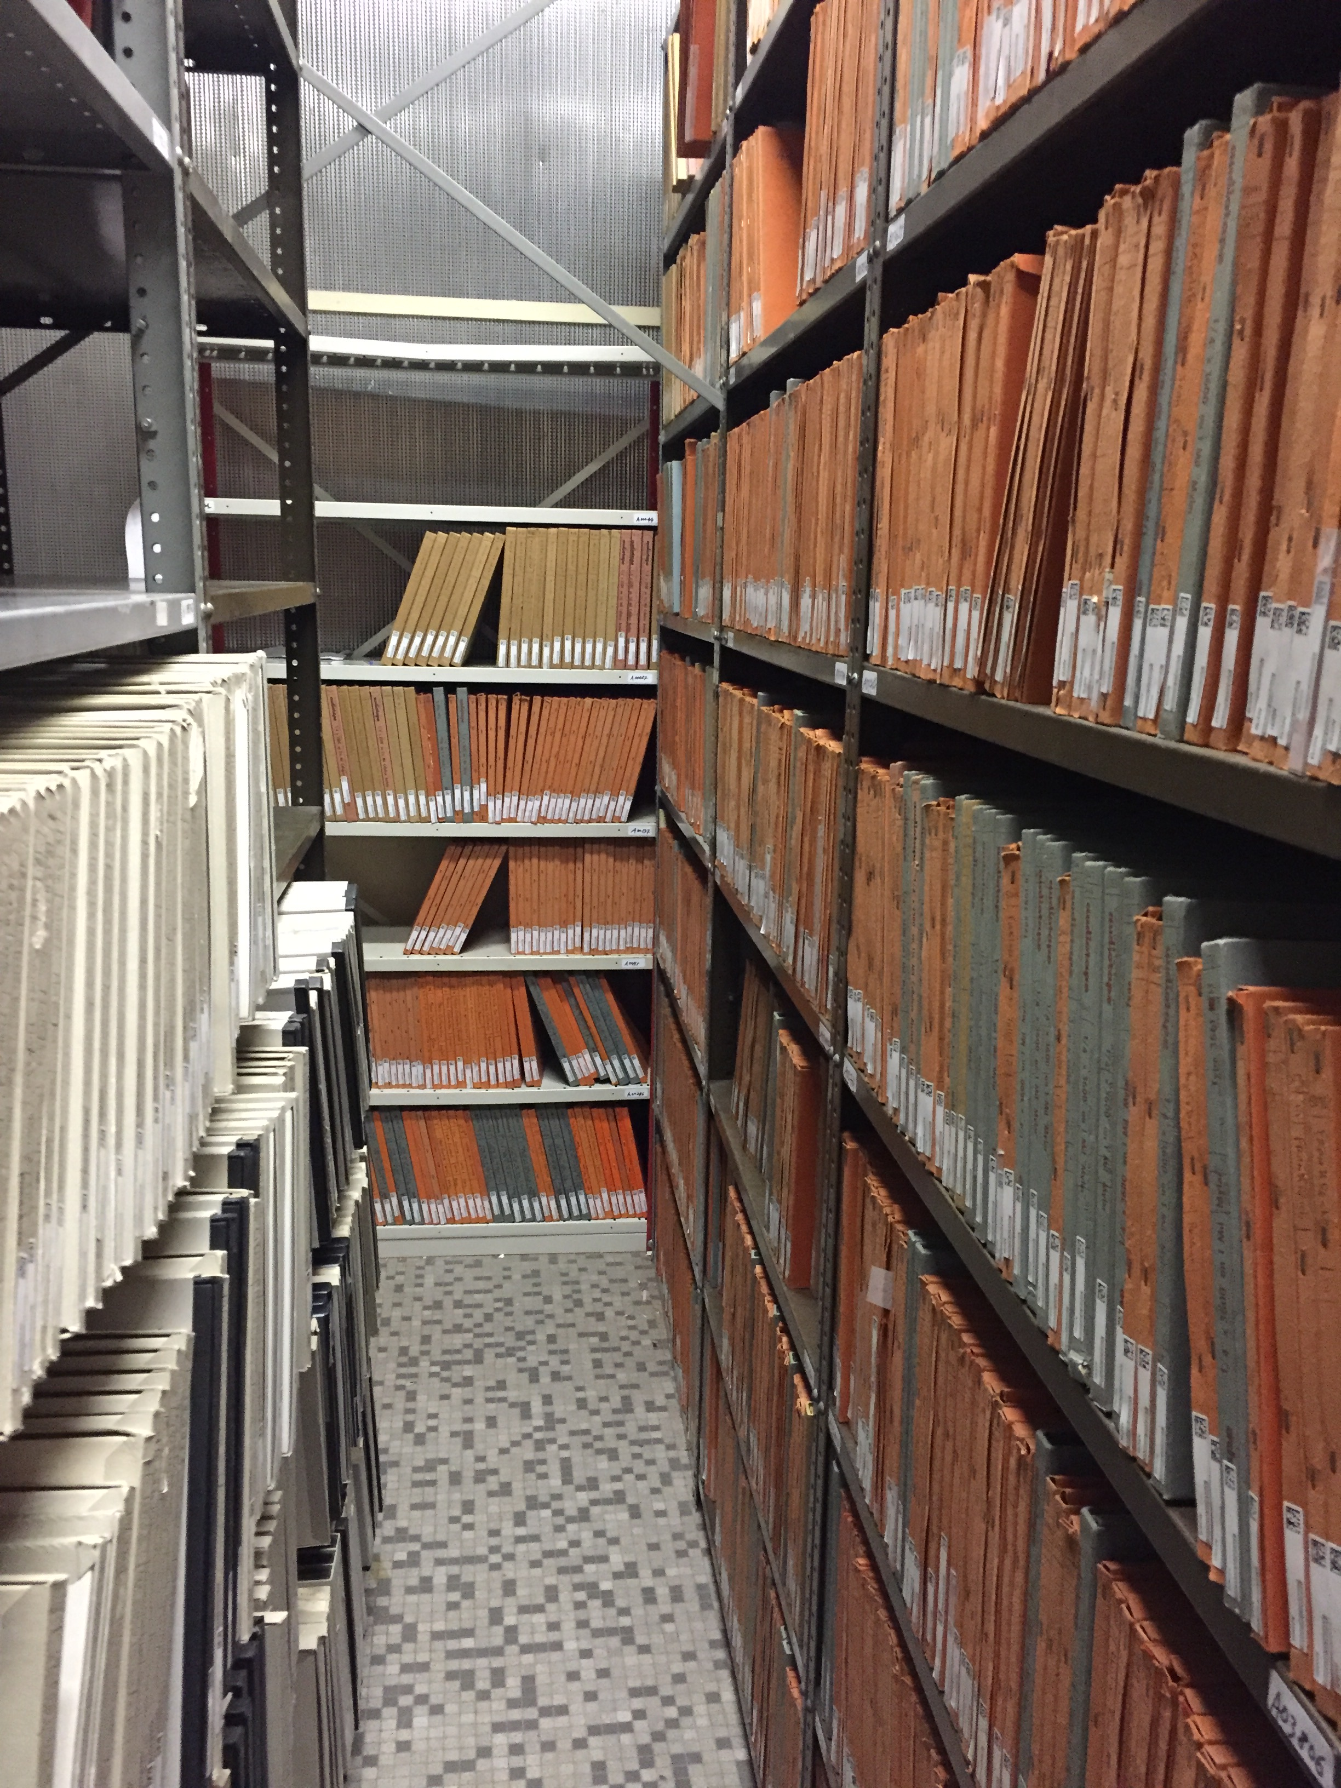
Takeaways
Take care!
Speakers! → Isolate in one split
Time period → 70 year old film vs. 40 year old
Languages → Need to select target languages with enough content
Gender bias in UNESCO production?
Can we self-train on adjacent domains?

Slide 15
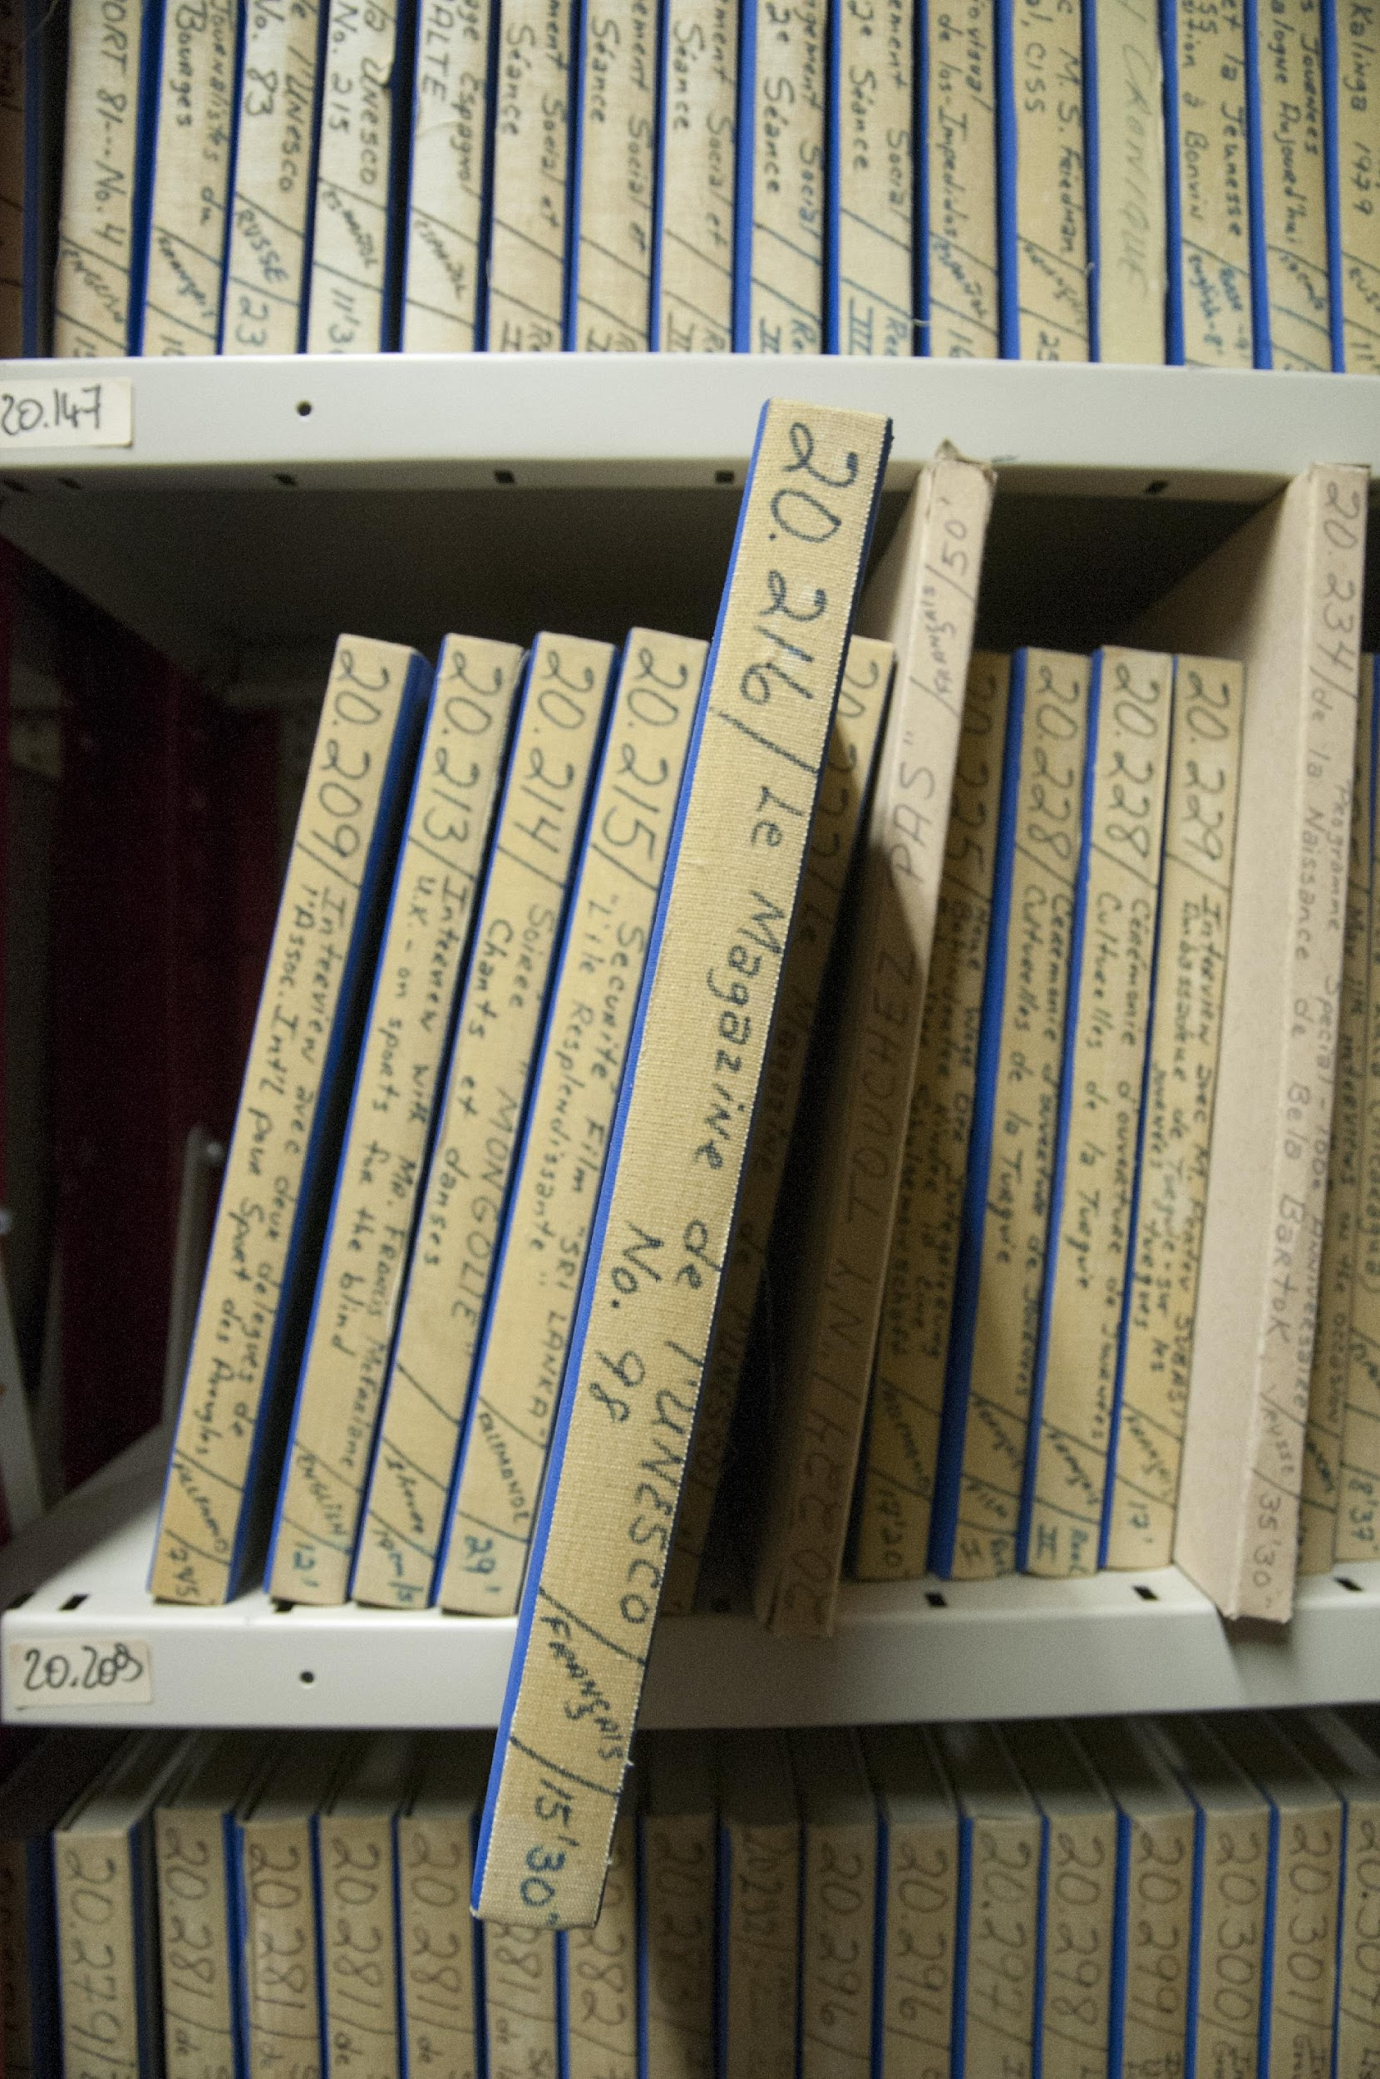
Building a Dataset Train – Dev - Test
Music? → Filter out
Multilingual? → Put in challenge set
Languages → Split into challenge or main sets
Speakers? → Put in only one split
Linked Recordings? → Put in only one split
Balance → Time? Language?
READY FOR EXPERIMENTS!

Slide 16
Next Steps
Evaluate Language ID methods for archival audio
Analyze if age of audio impacts accuracy
Identify languages that need special care
Proceed to Speech Transcription and Summarization

Slide 17
Thank You!
17

Slide 18
Archival Diplomatics
18

Slide 19
Motivation
Expert knowledge can enhance AI
Feature Selection
Need for ensuring AI conforms to archival concepts
Do AI tools respect the archival bond?
19

Slide 20
Components of a record
medium
form
Assuming that AI method is being applied to records…
content
What parts of a record are impacted?
How might this inform the design of AI tools that respect diplomatic theory?
act
persons
archival bond
context
20

Slide 21
Diplomatics Lens
What elements of a record are or aren’t relevant to a task?
What are the ‘gaps’ in these AI approaches?
How do we bridge them?
21

Slide 22
Archival Challenges
Reference & Access
medium
Enriching Descriptive Metadata
form
Example:
Generating descriptive metadata for non-textual records
AI Link:
Audio summarization, Speaker ID, Language ID, Automatic Speech Recognition
content
act
persons
archival bond
context
22

Slide 23
Diplomatics
0.0-8.0: I have with me in the studio today Dr. George Stoddard, Dean of the School of Education of New York University.
8.0-21.0: He's one of the experts who've been convened to a UNESCO meeting to study the effect of mass media, that's films, press and radio, on juvenile delinquency. Dr. Stoddard.
22.0-36.0: Well, really the purpose of the meeting is somewhat broader than that. It's to study all the influences of the mass media, particularly the cinema and television, on the behavior of children.
Consistent form across similar types of recordings.
Example: First 30 seconds of interviews almost always include who is being interviewed, and about what. (Protocol)
0.0-7.0: Now here in the studio is Mr. Frederick Bellinger from the United States of America and for
8.18-15.18: the past year he's been in Egypt working for UNESCO Technical Assistance. Now I believe
15.22-22.06: Mr. Bellinger, you are a chemical engineer. What exactly were you doing in Egypt?
22.06-28.64: Under the UNESCO Technical Assistance Program I was asked to go to Egypt to assist the National
28.64-35.64: Research Council in definitely planning and starting a basic and applied research effort
36.24-39.76: in the industrial chemistry field.
23

Slide 24
Archival Challenges
Creation & Use
medium
Digital records classification
form
Example:
Email Classification (Assign class code for indexing)
AI Link:
Named Entity Recognition (NER), Topic Modeling, Weakly Supervised Learning
content
act
persons
archival bond
context
24

Slide 25
Diplomatics
901.0-905.0: Sound of radio
910.0-916.0: Those noises from beyond the Earth mark the end of this, the fourth program in the series,
916.0-919.0: Signposts for the Atomic Age.
919.0-922.0: They are edited and introduced by Richie Calder.
922.0-927.0: The program was produced by Rex Keating in the studios of UNESCO, Paris.
Consistent form across similar types of recordings.
Example: Last ~10 seconds “sign off” for reports and programs, or thanking guests for interviews. (Escatacol)
210.26-217.3: This is Professor C. N. Vakil speaking from UNESCO headquarters in Paris and returning
217.3-220.18: you to UN Radio in New York.
285.84-289.04: That sounds very encouraging. Well thank you very much indeed Mr. Ballinger.
830.0-832.0: Thank you very much, Dr. Stallone.
25

Slide 26
Diplomatics
0.0-2.0: Thank you.
2.0-12.0: <Applause>
12.0-21.0: Madam President, and fellow librarians, and fellow Texans, and fellow Californians,
21.0-26.0: it's a great pleasure for me to be here again.
26.0-35.0: I think one way we're going to solve this problem of Alaska is to combine Texas and California.
35.0-42.0: <Laughter>
42.0-47.0: Miss Moore said that I would always remain a Texan, but I'm part Californian too,
47.0-57.0: because this is the place where I did my graduate work, and this is the place where I first cast a ballot in an election.
….
Programs, Interviews, and Reports generally carry the necessary information within this brief introductory protocol.
But speeches are problematic!
An anchor would have contextualized who is speaking before broadcast!
26

Slide 27
Diplomatics Takeaways
Genre of recording potentially important (speeches & meetings vs. programs, reports and interviews)
Detection of topic is less relevant for AI tools (explicitly discussed)
Protocol contains much of relevant information w.r.t. descriptive metadata
Aspects of speech (e.g. tone of voice, “tenor of conversation”) something not fully captured in diplomatics schema designed for text.
27

Slide 28
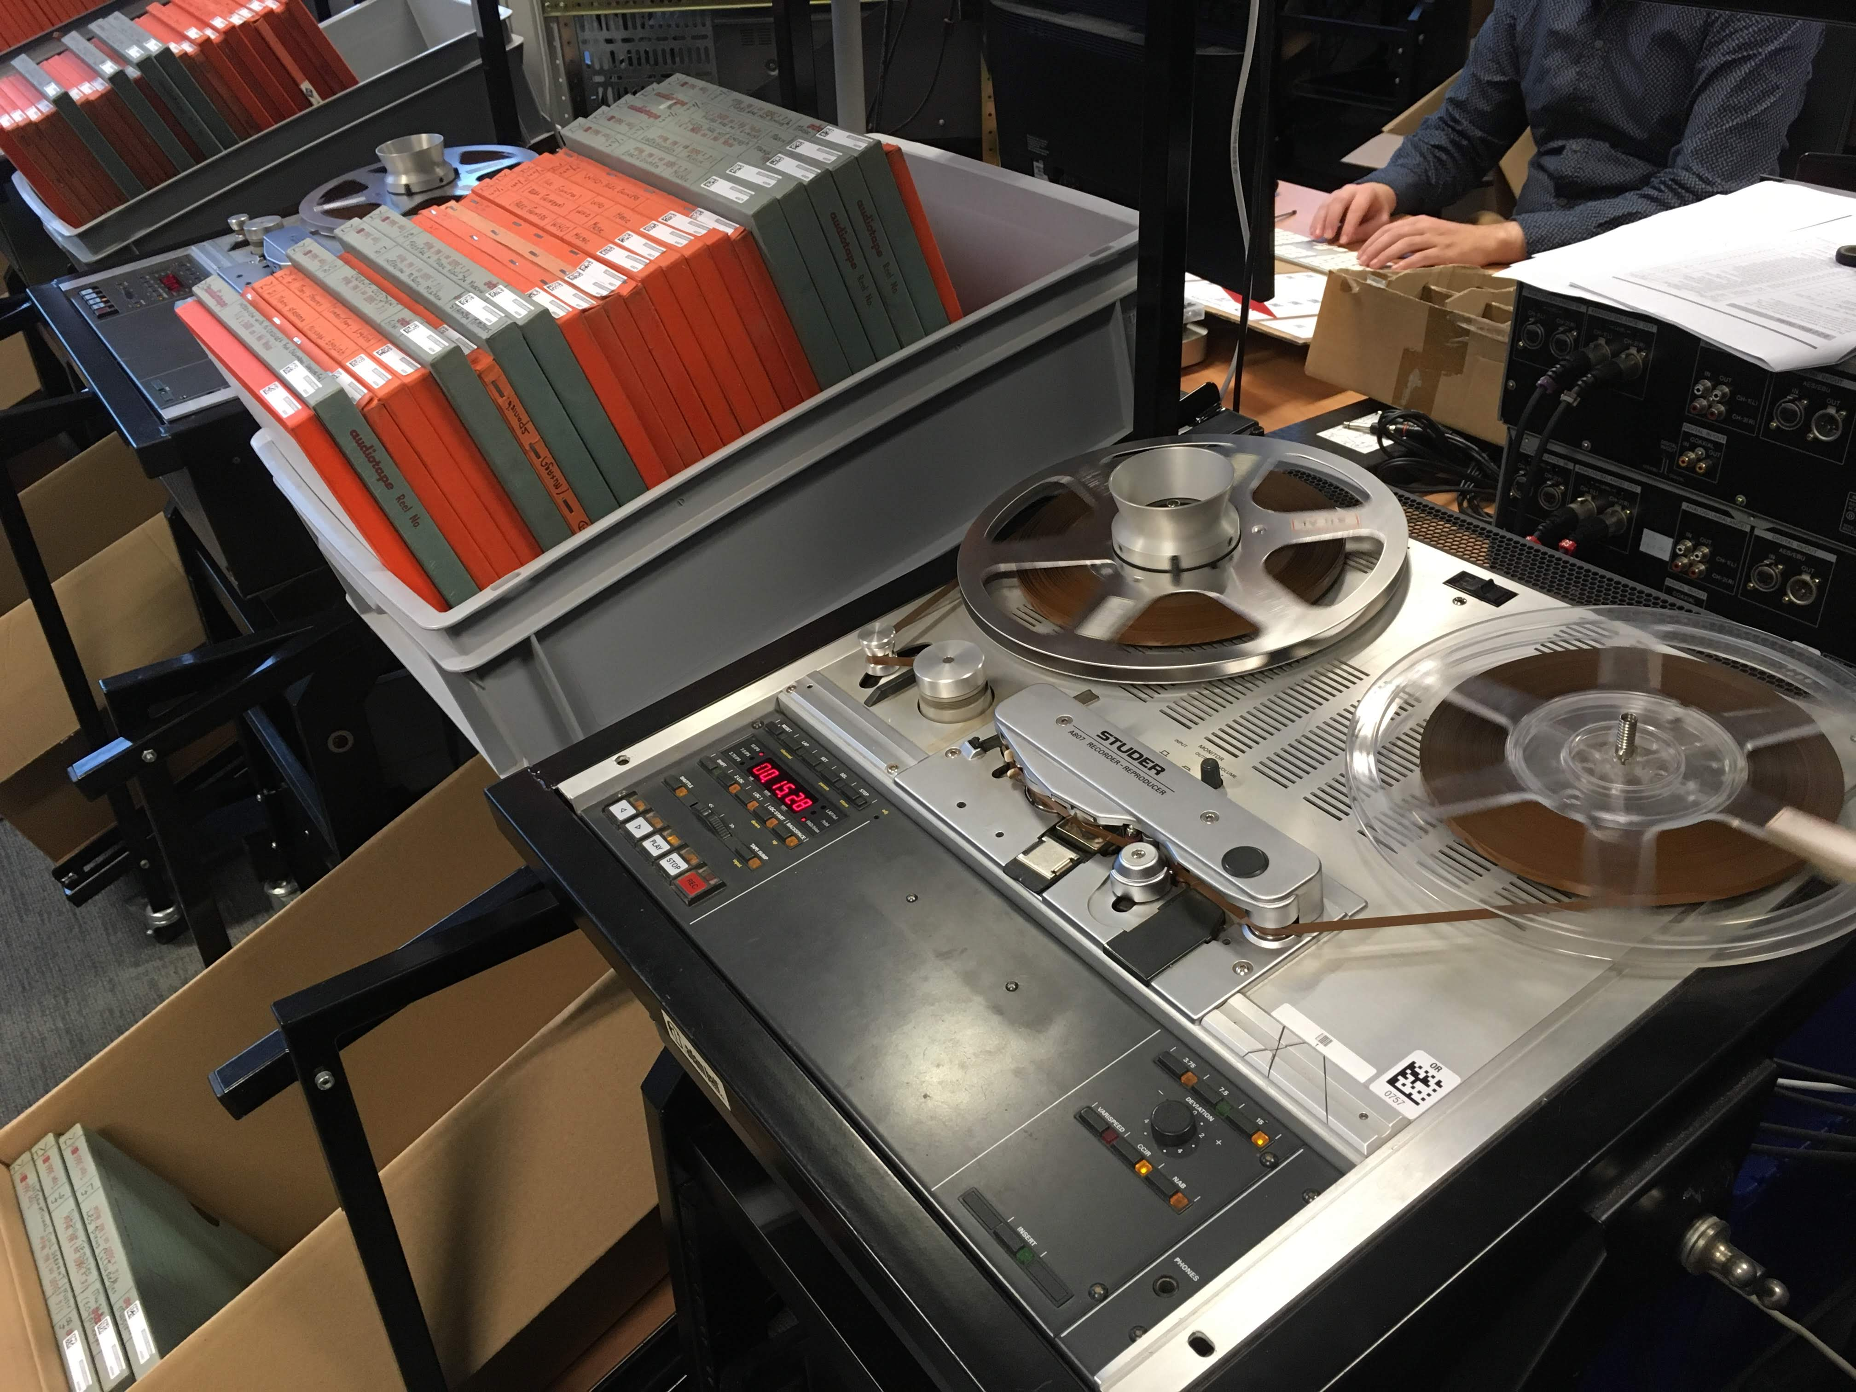
So far…
Sample 10% (n=589):
Apply baseline model to
ID Language
Transcribe
Translate into English
Analyze subset of English recordings for diplomatic analysis
28

Slide 29
Archival Challenges
Retention &
Preservation
medium
Preserving AI experiments
form
Example:
What are the essential elements of a file recording the act of an AI hyperparameter search?
content
29
act
persons
archival bond
context

Slide 30
Language ID
A11406.gl.txt
0.0-4.0: MÉXICO, PRÓXIMA
12.0-15.0: Aquí, la UNESCO en Paris.
15.0-20.0: Tenemos el gusto e el inmenso placer de recibir en nuestros estudios
Some samples may be mis-identified?
Case in point Welsh and Galician?
4/8 Welsh recordings actually English
27 Galician recordings detected, but they are generally Spanish.
A11903.gl.txt
0.0-3.0: Aquí, na Unesco, en París.
3.0-6.0: Temos o gozo de receber nos estudios
6.0-8.0: o professor Alain Jox

Slide 31
Diplomatic Analysis Challenges
Diplomatic analysis of audio fairly novel
Many recordings not records in a narrow (juridical) sense.

Slide 32
AI Models
Spoken language identification.
70 different languages!
Transcription.
Save time
Identify anomalies
Find overlapping programs

Slide 33
AI Models
Automatic translation
Enable description of non-English recordings
Automatic summarization
Need short description for access

Slide 34
Archival Challenges
Creation & Use
medium
Sensitivity review
form
Example:
Reviewing documents for Personally Identifiable Information
AI Link:
NER, Graph Convolutional Networks (GCN), Supervised Learning
content
act
persons
archival bond
context
34

Slide 35
Archival Challenges
Reference
& Access
medium
Access to textual materials
form
Example:
Visualizing digital records in aggregate (fond, series, file)
AI Link:
Topic Modeling, GCN, Clustering
content
act
persons
archival bond
context
35

