Slide 1

Trusted Data Forever:
Is AI the Answer?
Emanuele Frontoni¹, Marina Paolanti¹, Tracey P. Lauriault², Michael Stiber³,
Luciana Duranti⁴ and Muhammad Abdul-Mageed⁵
1 VRAI Vision Robotics and Artificial Intelligence Lab, University of Macerata, Italy
2 Critical Media and Big Data Lab, Carleton University, Ottawa, ON K1S 5B6, Canada
3 Intelligent Networks Lab, University of Washington Bothell, WA, USA
4 InterPARES Lab, University of British Columbia, Vancouver, BC V6T 1Z4, Canada
5 NLP and ML Lab, University of British Columbia, Vancouver, BC V6T 1Z4, Canada
6th International workshop on Data Analytics solutions for Real-LIfe APplications
29th March-1st April, 2022 Edinburgh, UK

Slide 2
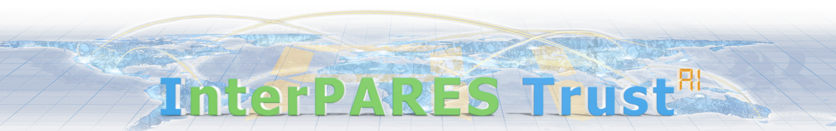
A long story … with more than 80 partners worldwide
Archival science + Data Science & AI
InterPARES Trust AI (“I Trust AI") international research partnership, aims to
(1) identify and develop specific AI technologies to address critical records and archives challenges; (2) determine the benefits and risks of employing AI technologies on records and archives; (3) ensure that archival concepts and principles inform the development of responsible AI; and (4) validate outcomes through a conglomerate of case studies and demonstrations.
https://interparestrustai.org

Slide 3
Trusted Data Forever:
Is AI the Answer?
VISION
Archival institutions and programs worldwide work to ensure that the records of governments, organizations, communities, and individuals are preserved for future generations as cultural heritage, as sources of rights, and as vehicles for holding the past accountable and to inform the future.
This commitment is guaranteed through the adoption of strategic and technical measures for the long-term preservation of digital assets in any medium and form — textual, visual, or aural. Public and private archives are the largest providers of data big and small in the world and collectively host yottabytes of trusted data, to be preserved forever. Several aspects of retention and preservation, arrangement and description, management and administrations, and access and use are still open to improvement.
In particular, recent advances in Artificial Intelligence (AI) open the discussion as to whether AI can support the ongoing availability and accessibility of trustworthy public records.

Slide 4
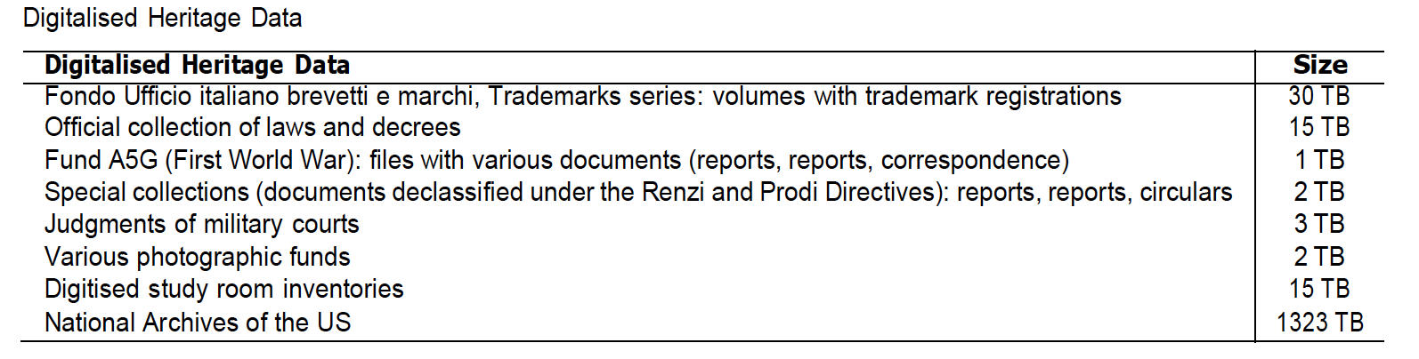
A VARIETY OF STUDIES … AND DATA
EXAMPLES (from more than 50 studies)
Building and Creating a Digital Twin for Preservation
Data from Emergency Services Communications Systems
AI in the Middle Age Learning from Parchments

Slide 5
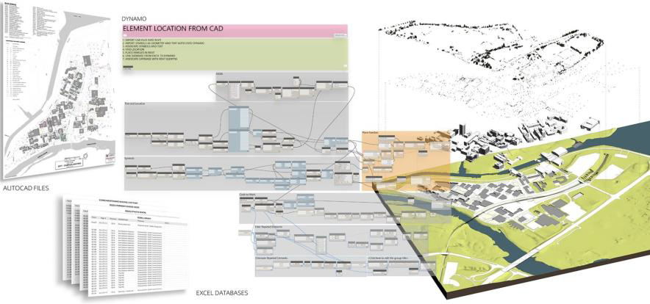
BUILDING AND CREATING A DIGITAL TWIN FOR PRESERVATION
IDEA: Archives and digital twin

Slide 6
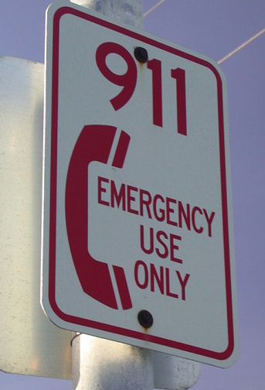
DATA FROM EMERGENCY SERVICES COMMUNICATIONS SYSTEMS
IDEA: US “Next Generation 911” (NG911) project
This study will explore fundamental challenges associated with a particular use case for AI in records and archives: data from critical systems surrounding incidents such as natural disasters or actions by bad actors. This study leverages work ongoing at the University of Washington Bothell (UWB) and at the University of British Columbia (UBC).
At UWB the work has been focused on developing AI based simulations of emergency public communications systems, such as "next generation 911" (NG911) in North America, and to manage such work via a system that collects, visualizes, and manages provenance information from simulation artifacts. These systems, Graphitti and Workbench, are described at https://depts.washington.edu/biocomp/index.html.
At UBC the focus is on building and preserving digital disaster archives in Japan from the point of view of archival studies, such as the 2011 Great East Japan Earthquake archives.

Slide 7
TEAM
Archivio di stato di Milano:
Benedetto Luigi Compagnoni - Director;
Carmela Santoro - Archivist, Deputy director;
Antonella Cesarini - Archivist;
Davide Bruno De Franco - Archivist, Director Archivio di Stato di Novara.
University of Macerata & Marche Polytechnic University:
Emanuele Frontoni, Professor - Computer Science and Computer Vision
Marina Paolanti - PhD, Assistant professor
Andrea Felicetti - PhD, Postdoc
Pierluigi Feliciati - Professor, Records and Information Science
University of Pavia:
Luca Fois - PhD, Postdoc, Dipartimento di studi umanistici
Washington University:
Joseph T. Tennis - Professor, Associate Dean for Faculty Affairs, Executive Director of Administrative Services

Slide 8
CONTEXT: AN OUTSTANDING HERITAGE
The Archivio di Stato of Milan (ASMi) preserves more than 130.000 documents on parchment, covering nearly a thousand years of history.
The main collections of parchment documents are the Museo diplomatico and the Pergamene per fondi.
The Museo diplomatico holds the most ancient Italian original private deed, dating back to the year 721 and a large number of documents preceding the year 1000.
The Pergamene per fondi holds imperial and royal charters, papal bulls, chancery documents, and private deeds coming from a huge variety of ecclesiastical and secular institutions of northern Italy (12th-18th centuries).

Slide 9
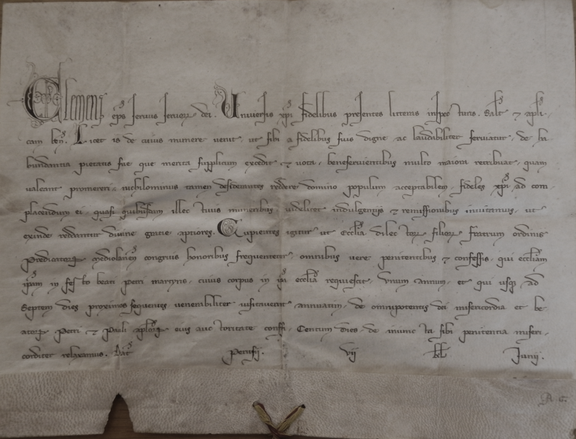
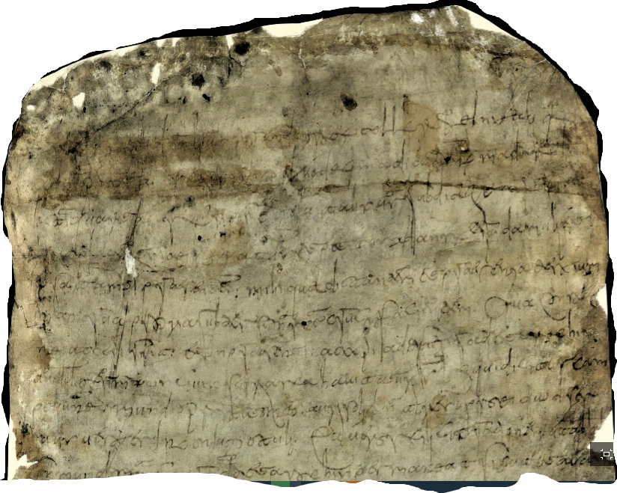
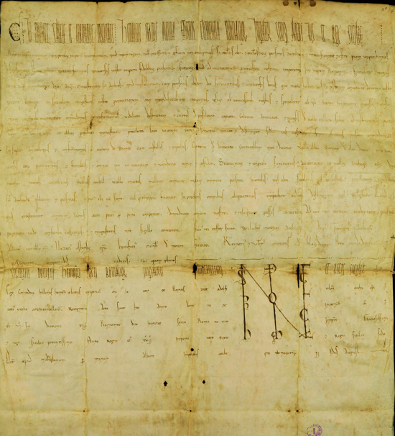

DATA FROM EMERGENCY SERVICES COMMUNICATIONS SYSTEMS
The beginning of the most ancient original document preserved in Italian State Archives: the mundium of a Longobard woman called Anstruda dated 13 may 721
(ASMi, Museo diplomatico, b. 1, n.. 3.
Two examples of papal bull and imperial charter

Slide 10
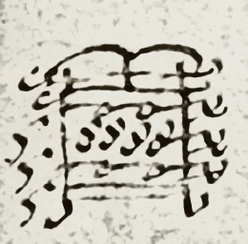
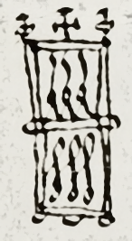
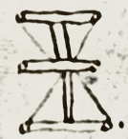
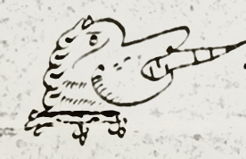
THE SIGNUM: A USEFUL MARKER
The signum or Notarial sign is a specific and personal drawn mark used by a single notary before his signature.
Identifying the signum means that every notary could be recognised and tracked in a virtually infinite series of documents.
The AI will contribute either in create a library of signa and investigate their less visible features.

Slide 11
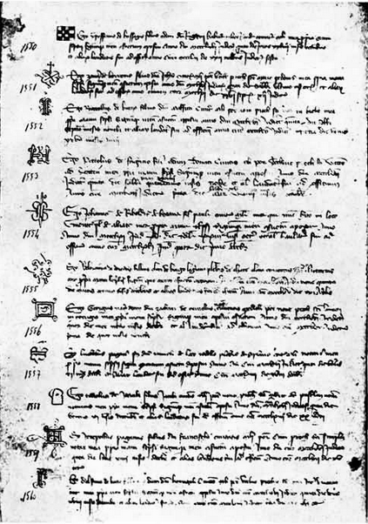
MAIN OBJECTIVE:
BUILDING UP A NOTARIAL MATRICULA BEFORE AD 1350
The aim of the project is to use the AI to build up a Matricula of Milanese notaries of the twelfth and thirteenth centuries (in separate steps).
The progressive investigation of all the parchment documents of the ASMi will lead to a complete list of notaries and their identification.
The process will also generate a list of all the surviving documents related to every single notary.

Slide 12
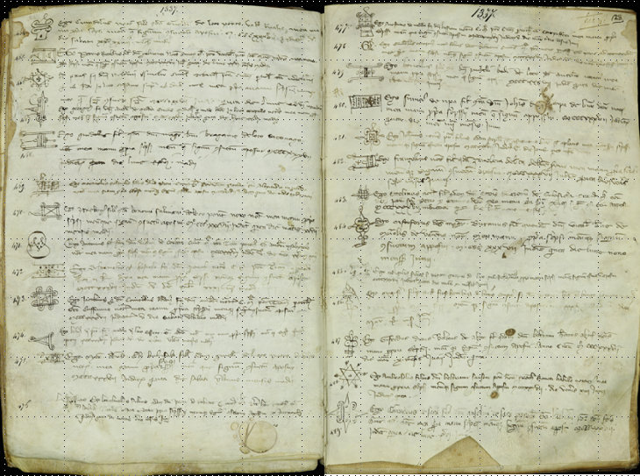
MAIN OBJECTIVE:
BUILDING UP A NOTARIAL MATRICULA BEFORE AD 1350
The oldest notarial Matricula preserved in ASMi (Archivio Notarile, Matricola dei notai 1337-1510).
It is possible to guess the huge number of notaries created in a year (for instance in 1337 at least 489).
Each Matricula registers the notarial sign and the subscription of every new notary who worked in Milan.

Slide 13
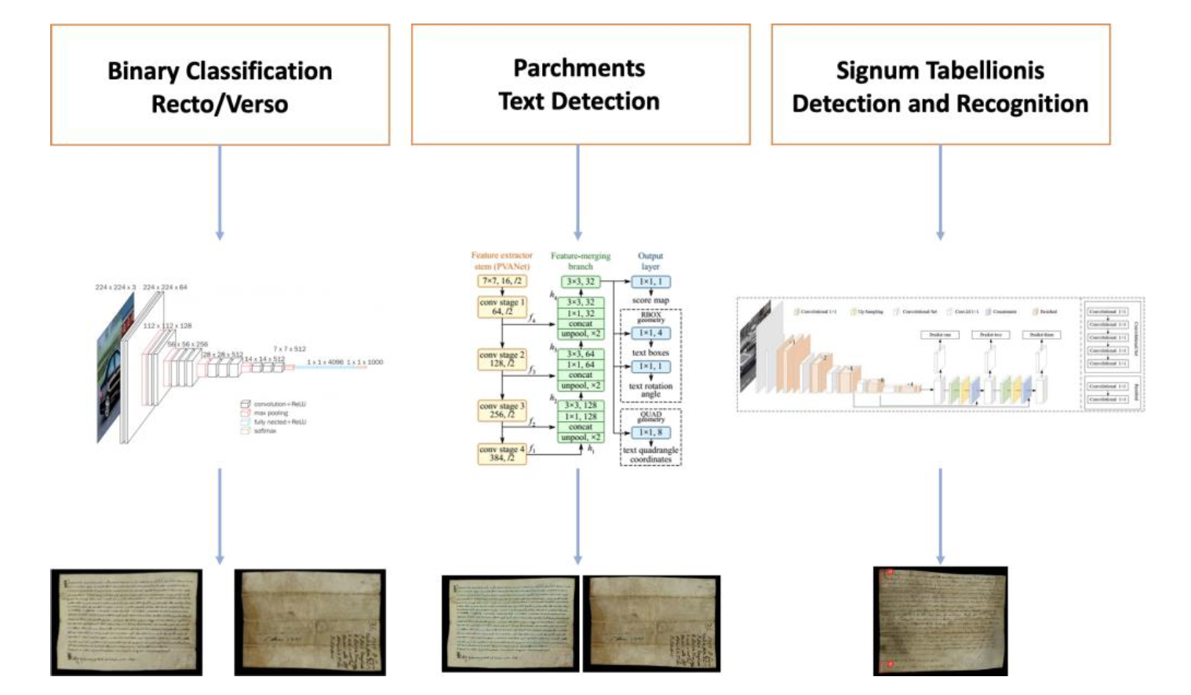
PERGANET

Slide 14
BINARY CLASSIFICATION RECTO/VERSO

Slide 15
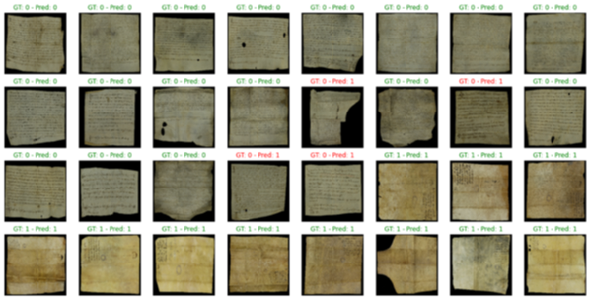
BINARY CLASSIFICATION RECTO/VERSO: RESULTS

Slide 16
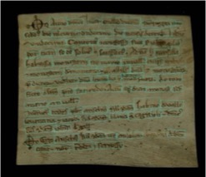
PARCHMENTS TEXT DETECTION

Slide 17
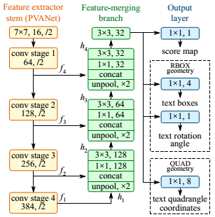
PARCHMENTS TEXT DETECTION: EXPERIMENTS
Word detection
DNN Model: EAST
Use of trained model (tested over datasets: ICDAR 2015, MSRA-TD500, COCO-Text)

Slide 18
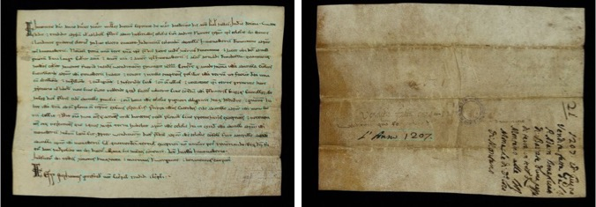
PARCHMENTS TEXT DETECTION: RESULTS

Slide 19
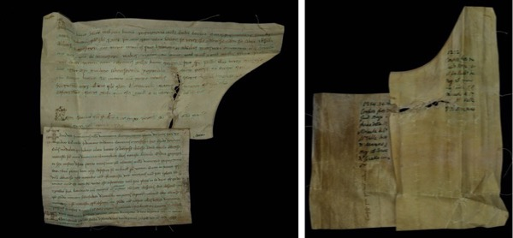
PARCHMENTS TEXT DETECTION: RESULTS

Slide 20
SIGNA TABELLIONIS DETECTION AND RECOGNITION

Slide 21
NOTARIAL MATRICULA ANNOTATION
- 2768 signa

Slide 22
SIGNA TABELLIONIS DETECTION AND RECOGNITION: RESULTS

Slide 23
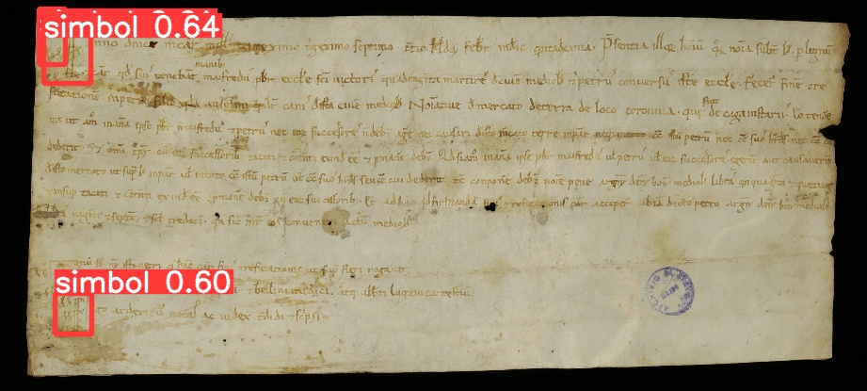
SIGNA TABELLIONIS DETECTION AND RECOGNITION: RESULTS
For each prediction is showed class (signum) and confidence
signum 0.64
signum 0.60

Slide 24
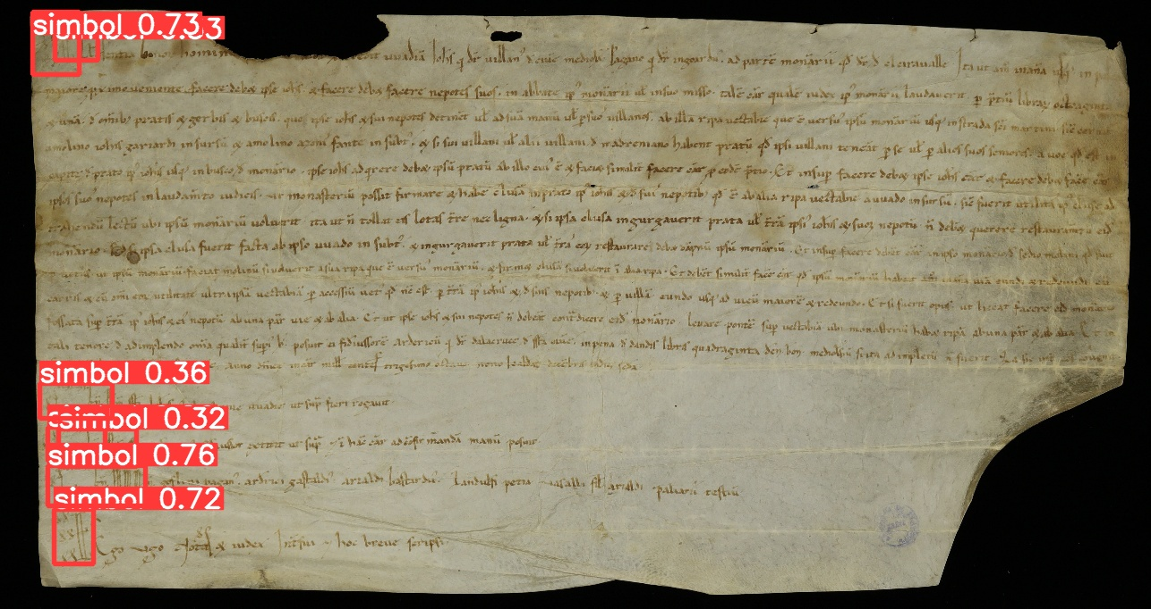
SIGNA TABELLIONIS DETECTION AND RECOGNITION: RESULTS
signum 0.73
signum 0.36
signum 0.32
signum 0.76
signum 0.72

