Slide 1
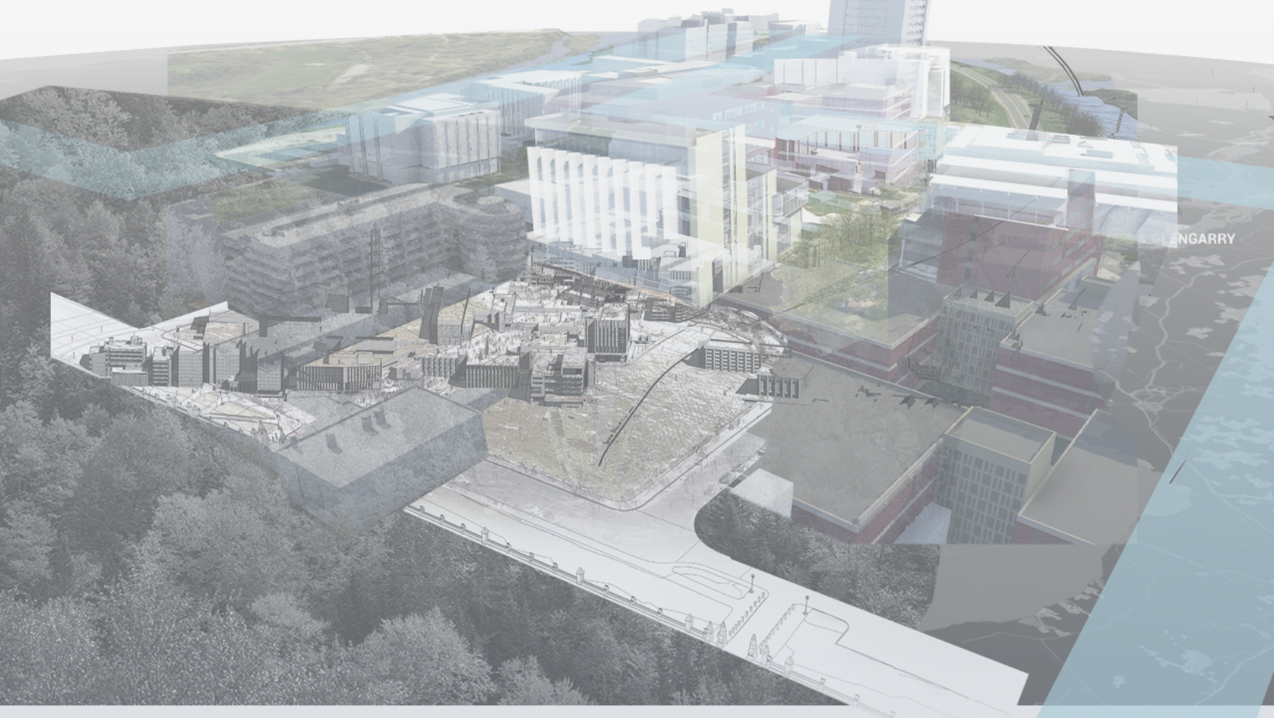
Trusted Data for Ever: Is AI the Answer?
AI4DH2021
May 24, 2022
International Workshop on Artificial Intelligence for Digital Humanities
Organized in conjunction with ICIAP 2021, the 21st International Conference on Image Analysis and Processing
Lecce, Italy
Tracey P. Lauriault (remote)
Associate Professor, Critical Media & Big Data
School of Journalism & Communication
orcid.org/0000-0003-1847-2738
Tracey.Lauriault@Carleton.ca
@TraceyLauriault

Slide 2
Table of Contents
Funding
I Trust AI
Imagining Canada’s Digital Twin
CS04 – I Trust AI Digital Twin Case Study
Framing the research w/Critical Data Studies
Is AI the answer to the preservation of trusted data for ever?

Slide 3
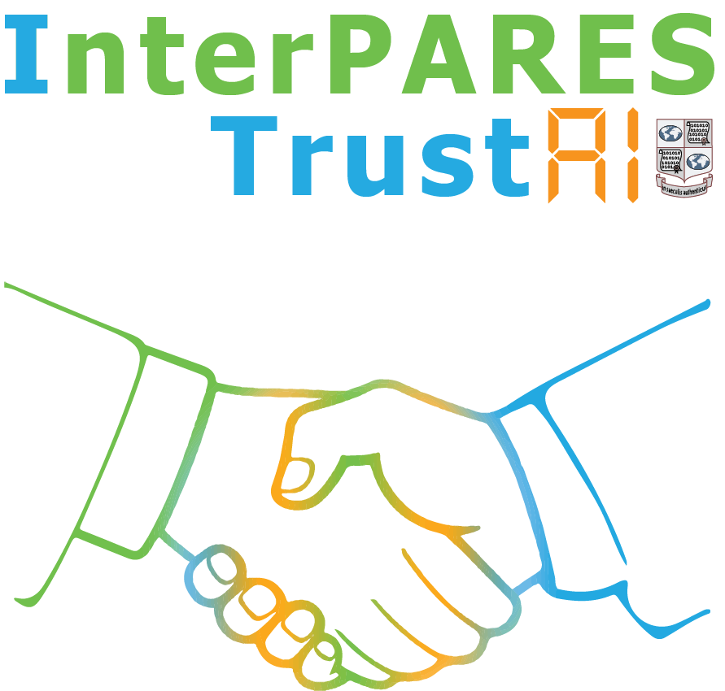
This talk draws
on research conducted as part of:
InterPARES Trust AI
based at the University of British Columbia, Vancouver, Canada
supported by the Social Sciences and Humanities Research Council of Canada,
https://interparestrustai.org/trust, @itrustai
Imagining Canada’s Digital Twin
based at Carleton Immersive Media Studio (CIMS), Carleton University, Ottawa, Canada
funded by the New Frontiers in Research Fund (NFRF)
https://canadasdigitaltwin.ca

Slide 4
I Trust AI
https://interparestrustai.org/trust, @itrustai

Slide 5
The InterPARES mission (1998-2027)
Luciana Duranti aimed build an international team of archival researchers where none existed before, and whose members, in turn, would build new research teams approaching new issues from multiple perspectives.
To clearly convey this message to all participants, Duranti called the project “inter pares” (Latin for “among peers”) and made this name into an acronym “International Research on Permanent Authentic Records in Electronic Systems.”
The name InterPARES has provided a
continuing identity to the project through its phases, an overarching ongoing idea, by conveying the spirit and ultimate goal of the research, and
a research identity to the people involved in the project, conveying their own purpose.

Slide 6
InterPARES Goal
To ensure that digital records are created accurate and reliable and preserved authentic regardless of place, technology, or length of time.
Each project built on the findings and products of the previous one. The difference among the projects is only the technology in which the records are created and/or maintained over time:
databases and office systems
interactive, dynamic and experiential systems
technologies requiring few resources
the cloud environment
The fundamental concepts and terminology were established at the outset and added to but not changed.

Slide 7
InterPARES Goals
InterPARES began with researchers from 12 countries, and, by the end of its 4th phase, it comprised almost 500 researchers from 42 countries. Its success is due to a few old principles that have guided us as a team:
“If you want to go fast, go alone. If you want to go far, go
together”
You will never have to convince your stakeholders to buy into your findings and products if they have contributed to developing them
An amazing amount of work can be accomplished if no one cares who gets the credit
The outcomes of the research belong to every researcher

Slide 8
InterPARES Principles
Students are the greatest resource of any research project and will contribute to its continuity over the years
Graduate research assistants, once graduated and become either academics or professionals themselves, will continue with the project as co-investigators and bring with them their organizations
As archival science is both a pure science and an applied science, researchers must be both academics and professionals
multiple voices from multiple contexts for different purposes support each participant’s agenda
InterPARES does not address an audience; it incorporates the audience as researchers into the research project
Nothing helps creativity more than heated arguments

Slide 9
I(terPARES) Trust AI
I Trust AI is the 5th phase of the InterPARES project, directed by Luciana Duranti and Muhammad Abdul-Mageed
Like the previous phases, I Trust AI focuses on
maintaining the trustworthiness of digital records over time, and on
digital means of trustworthy access to and preservation of records in all media and form.
I Trust AI, as the name says, focuses on the use of Artificial Intelligence for reaching those purposes.

Slide 10
I Trust AI Research Objectives
Identify specific AI technologies that can address critical records and archives challenges
Determine the risks and benefits of using AI technologies on records and archives
Establish how archival concepts and principles can inform the development of responsible AI
Validate outcomes from Objective 3 through case studies and demonstrations

Slide 11
I Trust AI will
Generate new knowledge on the uses of AI, such as Machine Learning (ML), on public records
Improve upon existing tools and create new ML tools that will address:
archival needs, such as machine translation, image recognition and description, optical character recognition (OCR) and handwritten text recognition, text summarization and classification, and text style transfer for language civilization (e.g., removal of bias, hate, and sexism).
The tools developed will be tailored to, tested for, and deployable by the records and archives community
Produce best practices, standards, and guidelines for applying ML tools across an entire problem space, bringing archival knowledge and practice to bear on problems such as bias in ML, explainable artificial intelligence (XAI), and image description
Enrich research and lead to knowledge co-creation in several disciplines, including archival science, records management, AI, cybersecurity, information science, law, and ethics, through knowledge exchange and uptake between scholars and practitioners within and among those discipline
Train a substantial cohort of students -- future scholars and professionals -- who will bring their enhanced knowledge to the institutions, organizations, communities, and governments they will serve, and to the archives and records community as a whole

Slide 12
Imagining Canada’s Digital Twin (ICDT)
https://canadasdigitaltwin.ca
Images Source: Carleton Immersive Media Studio (CIMS) and the presentation at the WG1 Meeting on October 25, 2021 by PhD student Nicolas Arellano

Slide 13
A digital twin is
An ecosystem of multi-dimensional and interoperable subsystems of
things in the real world, natural & human made,
a digital replica of those things,
a system that communicates between the digital and the real-world things,
and the people and institutions that govern, contribute to, use and share it.

Slide 14
IMAGINING CANADA’S DIGITAL TWIN (ICDT)
1st initiative that aims to address the opportunities, challenges, and responsibilities involved in developing a DT for all of Canada
Our goal is not to resolve the question of a DT, but to:
determine the plausibility of the concept & the level of effort required to see it realized,
and to establish a national group to move forward in that realization.
ICDT proposes an inclusive, and multidisciplinary research consortium for the creation of a technical, cultural, and ethical framework for building Canada’s digital twin.

Slide 15
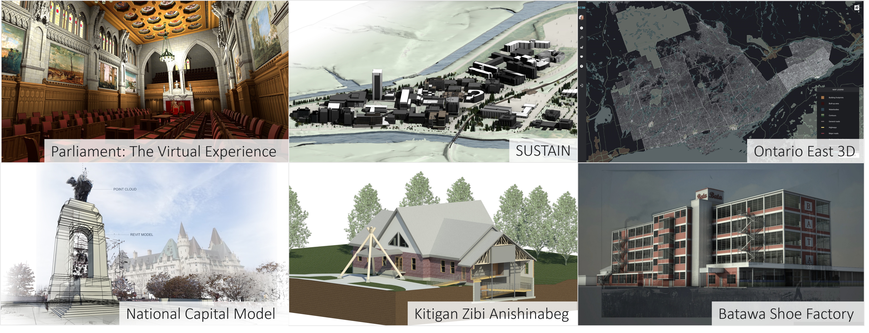
Carleton Immersive Media Studio (CIMS)
http://cims.carleton.ca/#/home

Slide 16
ICDT Objectives
Build a research consortium comprised of academic, Indigenous, not-for-profit, public, and private partners that represent local and regional networks.
Develop a DT prototype of the Montréal-Ottawa-Toronto corridor using a distributed network for the Architecture, Engineering, Construction, & Operations (AECO) sector
Our research, the consortium and the prototyping will inform the application for a second phase of funding to the NFRF Transformation program.

Slide 17
Longterm Objectives
To develop a proof-of concept DT that will enable data producers and users—regardless of their size, capacity, or geographic context—to manage authoritative and trusted datasets, automated processes and technical systems for the benefit of their own communities, and according to their own jurisdictional responsibilities and culture.
We are also concerned with how these data and technological assets and their organizations might be interoperable across communities to create a Canada entity.
To create a collaborative environment to enable the co-governance of shared common assets for multiple users, for multiple purposes affording checks and balances for economic development, social progress and environmental responsibility.

Slide 18
Data Governance
Data Governance:
“is the exercise of authority, control, and shared decision making (planning, monitoring and enforcement) over the management of data assets”
Governance:
“the exercise of authority and control over a process, organization or geopolitical area. The process of setting, controlling, and administering and monitoring conformance with policy”
Data Governance – making sure that information and data are managed properly (rules, policies - executives)
Data Management – managing data to achieve goals (doing it – managers, stewards, curators)
Data
lifecycle
Notes:
See John Ladley (2019) Data Governance How to Design, Deploy and Sustain an Effective Data Governance Program, 2nd Edition, Elsevier.
See DAMA International (2017) DAMA-DMBOK Data Management Body of Knowledge, 2nd Edition, Technics.

Slide 19
meets

Slide 20
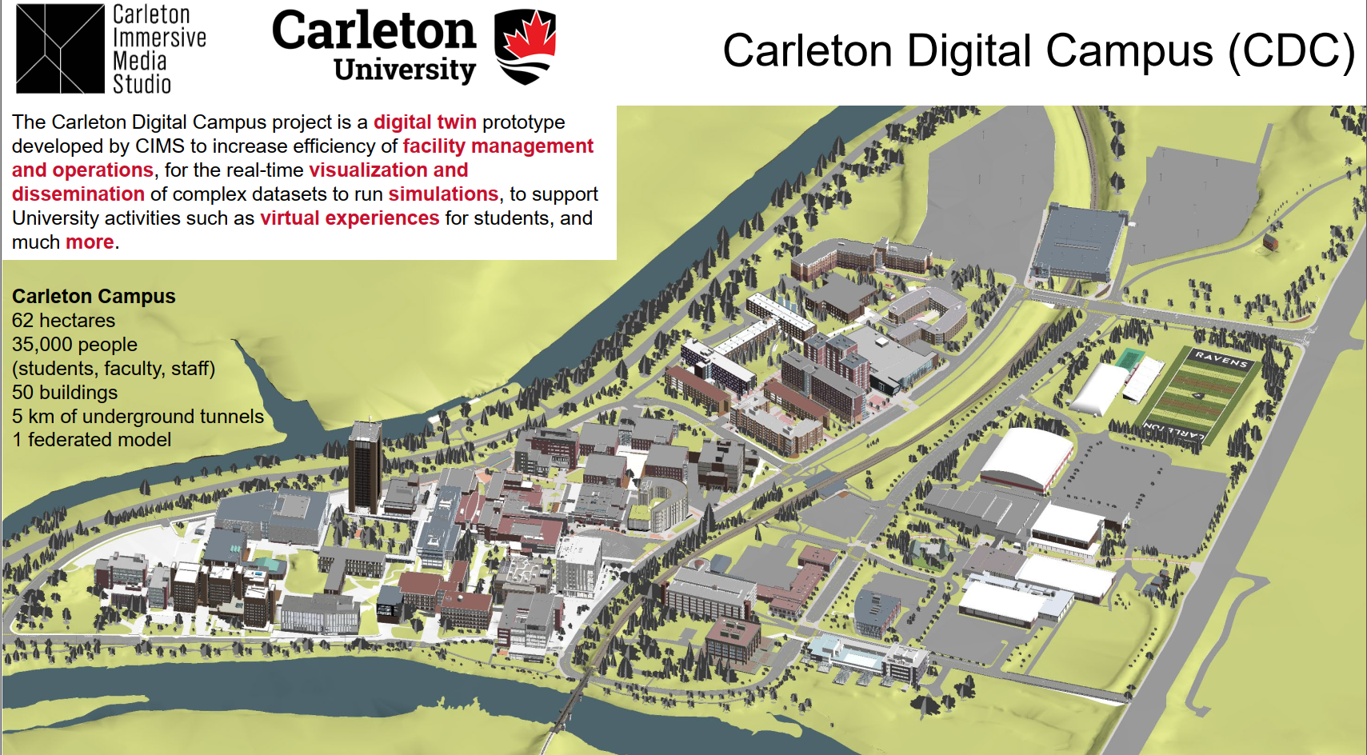
Case study of the Carleton University Campus
CIMS opens its Sustain Digital Campus project that involves a digital twin of the Carleton University Campus as a case study to I Trust AI.
The model is being used to analyze building and campus performance.
The project demonstrates that technology can be used to improve the quality of indoor environments, reduce energy costs, and application for asset management.
See Video presented to WG1 October 25, 2021 https://play.miun.se/media/WG+1+meeting+monday+25th+October/0_b3w6ikr5

Slide 21
CS04 – Digital Twin
Provides critical records and archival challenges in terms of the use and creation of complex records – BIM, ASM, Digital Twins, VR and AI
This would include a literature review of the preservation of related data & technologies
Involves and ecosystem of data, real-time systems, AI/ML, IoT, building information systems (BIM), asset management systems (AMS), LIDAR, VR, simulations and techniques, technologies, and data of importance to fields in architecture, urbanism, planning, construction and engineering.
Archival concepts of authenticity, reliability, and accuracy, and others will be identified as research progresses.

Slide 22
Sample of ICDT Data & Technology
Hardware
Software/Management
Data Types
Lidar
Laser
BIM
.ifc
Point cloud
.dwg
ASM
Photogrammetry
Engines
Software/Platforms
.rvt
Geospatial
Static
Real-time
Notes:
Hardware
- Oculus Rift (VR headset): https://www.oculus.com/rift/
- HTC Vive (VR headset ): https://www.vive.com/us/
Software (Data Modelling)
- Revit (Autodesk): https://www.autodesk.com/products/revit/overview
- Dynamo studio (Autodesk): https://www.autodesk.com/products/dynamo-studio/overview
- Dasher (Autodesk): https://dasher360.com/ / https://www.autodesk.com/research/projects/project-dasher
- Autodesk 3Ds Max: https://www.autodesk.ca/en/products/3ds-max/overview?term=1-YEAR&tab=subscription
- Rhinoceros 3D (design application software): https://www.rhino3d.com/
- BlenderBIM: https://blenderbim.org/
- Blender OS: https://www.blender.org/
- OSArch OS: https://osarch.org/
- OS: Maputnik style editor: https://maputnik.github.io/
- Esri’s ArcGIS: https://www.esri.com/en-us/arcgis/about-arcgis/overview
- Esri’s CityEngine: https://www.esri.com/en-us/arcgis/products/arcgis-cityengine/overview
- Adobe XD: https://www.adobe.com/ca/products/xd.html
- Adobe ProtoPie: https://www.protopie.io/adobexd
Software (Data Management)
- SPECKLE (Interoperability platform): https://speckle.systems/
- infoworks: https://www.infoworks.io/
- OS: PostgreSQL: https://www.postgresql.org/
- Solace: https://solace.com/
- Zoho (PM software): https://www.zoho.com/projects/
- Slack (team communication): https://slack.com/intl/en-ca/
- Github: https://github.com/
- Microsoft excel: https://www.microsoft.com/en-us/microsoft-365/excel
- Amazon webservices: https://aws.amazon.com/
Game engine
- Unreal engine: https://www.unrealengine.com/en-US/
- Unity engine: https://unity.com/
Data types
- Laser
- point cloud
- Photogrammetry
- Geospatial
- Lidar
- BIM (building information model)
- ASM (asset management system)
- static
- real-time
- .DWG (for solid-body geometry)
- .RVT file format : https://docs.fileformat.com/cad/rvt/#:~:text=A%20file%20with%20.,floor%20plans%2C%20elevations%20and%20sections.&text=Revit%20files%20can%20be%20opened%20using%20Autodesk%20Revit%20or%20Autocad%20Architecture%20software.
- .IFC file format: https://fileinfo.com/extension/ifc#:~:text=An%20IFC%20file%20is%20a,elements%2C%20materials%2C%20and%20shapes

Slide 23
CS04 - Digital Twin
The Sustain Digital Campus project has conducted real experimentation in the four test buildings at Carleton University.
8 BIM buildings at Carleton
This ecosystem of technologies allows Architecture, Engineering, Construction, and Operations (AECO) professionals to analyze real-time data and visualize the modeling results and the analysis results into their actual designs, improving the overall process and to manage these assets.
Virtual recreation of buildings by CIMS https://cims.carleton.ca/#/home
ASAU Tour Fall 2021 https://youtu.be/ydlV6hDpuGs
CDC Browser application https://youtu.be/Al1OtyUAAu4
Imagining Canada’s Digital Twin https://canadasdigitaltwin.ca/about-2-2/

Slide 24
CS04 - Objectives
A case study to understand how a digital twin is used and created so that it can be preserved
Test the preservation of the Carleton University Digital Twin created as part of the digital campus work at the Carleton Immersive Media Studio (CIMS) and the Sustain Project
By doing so, assess if it is possible to use AI to automate the preservation of digital twins and related technologies
Explore how AI/ML + IoT which are part of digital twins can be preserved

Slide 25
CS04 – Research Team
­Tracey P. Lauriault, I Trust AI Lead, Associate Professor, Critical Media and Big Data, School of Journalism and Communication, Carleton University (Tracey.Lauriault@Carleton.ca)
Stephen Fai, Professor cross appointment in the Department of Civil and Environmental Engineering, the Institute for Comparative Studies in Literature, Art, and Culture, and the Azrieli School of Architecture and Urbanism; Director of the Carleton Interactive Media Studio (CIMS) (sfai@cims.carleton.ca)
Nicolas Arellano, Ph.D. Candidate at Carleton University | Research Team Lead at CIMS (narellano@cims.carleton.ca_
Travis Kinnear (he/him/his), MLIS, Digital Archivist, Corporate Records and Archives, University Secretariat, Carleton University (Travis.Kinnear@carleton.ca)
Tero Päivärinta, Professor, Luleå University of Technology, Research subject: Information systems, Digital Services and Systems, Department of Computer Science, Electrical and Space Engineering, (tero.paivarinta@ltu.se)
Göran Samuelsson, Senior lecturer, Department: Department of Information Systems and Technology (IST) and Information Specialists for The Swedish Transport Administration (Goran.Samuelsson@miun.se goran.samuelsson@trafikverket.se)
Liam O’Brien, Professor in Architectural Conservation and Sustainability Engineering, PI the SUSTAIN Project (Sensor-based Unified Simulation Techniques for Advanced In-Building Networks) project at Carleton University (liam.obrien@carleton.ca)
H. Burak Gunay, Assistant Professor in Building Science, Department of Civil and Environmental Engineering (burak.gunay@carleton.ca)
Annantonia Martorano, Dipartimento di Storia, Archeologia, Geografia, Arte e Spettacolo - SAGAS, University of Florence (UNIFI) (annantonia.martorano@unifi.it)
Elena Gonnelli, PhD student at the University of Florence., (gonnellielena@gmail.com elena.gonnelli@unifi.it)
UNIFI research Assistants
Raquel Jennyfer De Souza raquel.desouzasantos@stud.unifi.it;
Luca Tondini, Irene Nocentini, Erica Cavina, Valentina Vazzano

Slide 26
A Critical Data Studies view of the Case Study

Slide 27
Conceptualizing Data
“data are commonly understood to be the raw material produced by abstracting the world into categories, measures and other representational forms – numbers, characters, symbols, images, sounds, electromagnetic waves, bits – that constitute the building blocks from which information and knowledge are created” (Kitchin, 2014:1)
“data do not exist independently of the ideas, instruments, practices, contexts and knowledges used to generate, process and analyze them” (Kitchin, 2014:2)

Slide 28
Framing Data
Technically
Ethically
Politically & economically
Spatial/Temporal
Philosophically
Technological Citizenship
Data activism
As cultural artifacts
@GlacialMeg

Slide 29
Technically
Data quality
Validity
Reliability
Integrity
Authenticity
Useability
Certainty
Bias
Calibration
Error
Sample size
Sampling techniques
Uncertainty
Models
Methods
Volume
Variety
Veracity
Interoperability
Format
Techniques
Metadata
Instruments
Analytics
Storage
Linked
Structure
Science
Samples

Slide 30
Ethically
Codified & enshrined in rules, principles, policies, licences and laws
How are data shared, used, generated, protected?
Data collection can harm – psychologically
Dataveillance – data analytics – social sorting
Cultural bias
Data protection Laws
The Signal Code: A Human Rights Approach to Information During Crisis
Justice
Equality
Fairness
Sovereignty
Honesty
Respect
Rights
Entitlement
Care
Access
Sharing
Laws
Notes:
https://hhi.harvard.edu/publications/signal-code-human-rights-approach-information-during-crisis

Slide 31
Political Economy
How people think about them and how used by the state
Notions of how they should be regulated
Discursive regimes
Funding decisions
How do data leverage profit
Traded in the marketplace
Data as agents of capital interests
Data & surveillance capitalism
Open data view
Business view
Civil society view
Citizen view
Economic resource
Copyright
Patents
Data Governance

Slide 32
Spatial / Temporal
Place, Space, Time, Scale, Relationality
History
Changes:
Organizational
Improvements in techniques & tools
Laws
Technologies
Boundaries
Jurisdictions
Worldviews
July 4 2020 March 14 2022
Satellite image Maxar Technologies v/AP
Mariupol Drama Theater, Mariupol Ukraine
Notes:
https://www.ctvnews.ca/world/russian-invasion-before-and%20-after-satellite-images-show-destruction-across-ukraine-1.5819898

Slide 33
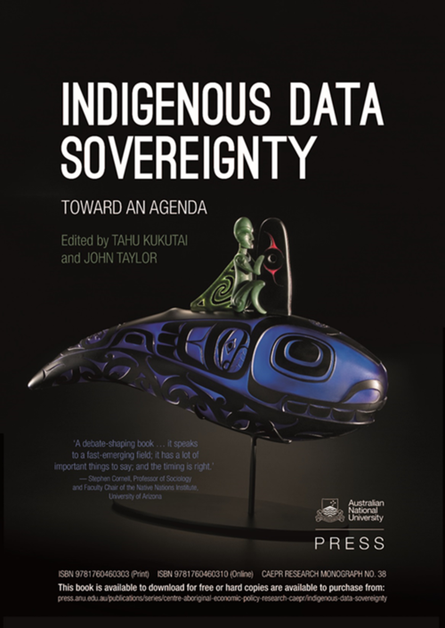
Philosophically
Epistemological units (how we know)
Data produce the world
Data are more than representations
Not independent of thought systems
Data are social and material
We make the world to enable data to flourish
Component of the real and producer of the real
Ontologically benign (what is)
Neutral technical things
Pre-analytical
Pre-factual
Objective realist view
Mechanical objectivity
Science has no politics

Slide 34
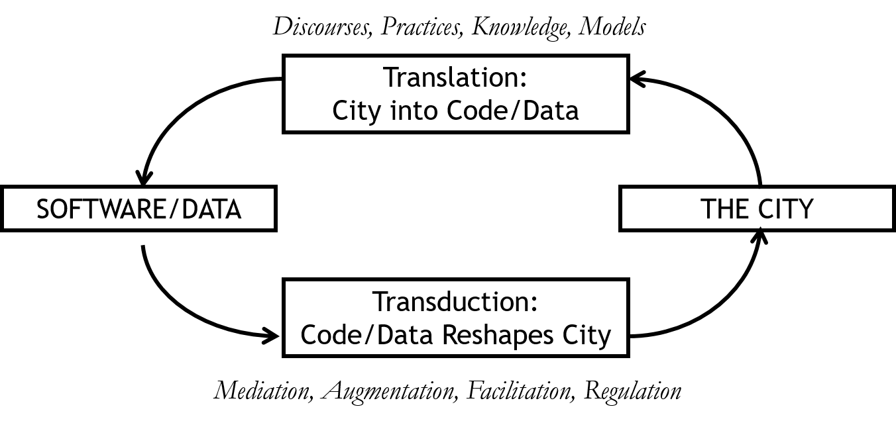
Social Shaping Thesis
Kitchin, 2012

Slide 35
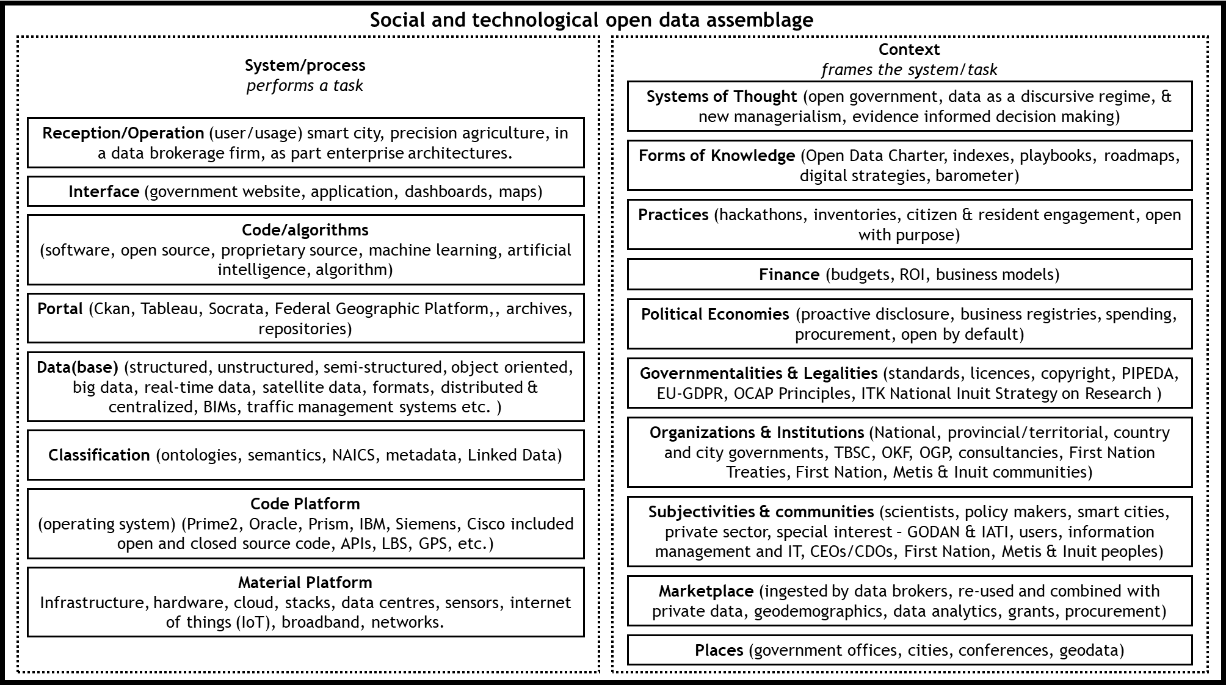
Social & Technological Data Assemblage
Lauriault, T. P. Looking Back Toward A “Smarter” Open Data Future
Notes:
https://utpdistribution.com/9780776629735/the-future-of-open-data/

Slide 36
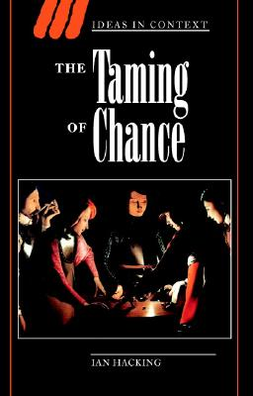
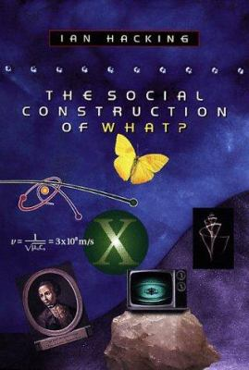
Philosophy of Science

Slide 37
Dynamic Nominalism
Notes:
Counting:
#of people who speak French at home, the volumes of different phenomena, or (i.e., surfaces covered in pavement);
Quantifying:
turning counts into measures, rates, classifications (i.e., % of people who speak French at home ih Canadian cities, ratio of pavement to greenspace);
Creating norms:
establishing what might or should be expected (i.e., a bilingual city, the ratio of pavement to greenspace for rural areas would be x while urban areas would be y);
Correlation:
determining relationships between measures (i.e., this % would suggest more funding, remote rural areas have this particular ratio and are considered underdeveloped);
Taking action:
employing knowledge to tackle and treat issues (i.e., Increase grade school support, the ratio suggest further development and funding);
Scientification:
establishing and adopting scientific knowledge (i.e., middle French immersion, the right ratio for specific places is considered the objective formula for that kind of place);
Normalization,
seeking to fashion the world to fit norms (e.g., all children learn French in School, Phoenix Park is prestigious and therefore only prestigious institutions are associated with it, while the ratio of greenspace to pavement is optimal and other like places with that ratio should be created);
Bureaucratization,
putting in place institutions and procedures to administer the production of expectations and undertake action (i.e., School funding ensures French immersion, ensure that the factors associated with the success of Phoenix park are encoded in by-laws and adhered to);
Resistance,
to forms of knowledge, norms, bureaucracy by those that are affected in negative or positive ways and who suggest altering the form that makes up that (i.e., In Vancouver Chinese should be the priority, those who live on the outskirts of the Phoenix Park wall want to slow traffic speeds and increase traffic in the empty space of the park and want to increase the number of gates to make the park more accessible).
Classification:
or objects in this case are the grouping of things regarded as having shared characteristics;
Objects of focus:
in this case, are the ‘real’ material things such as buildings, trees, or roads understood by people who then act toward these through the classification; or ideas such as skin colour or where one comes from
Institutions:
that institutionalize classifications (ontologies, models) and manage the data infrastructures that operationalize these; census, national mapping organizations, data brokers
Knowledge:
that is used to formulate, reproduce and tweak classifications (ontology, model); and
Experts:
those within institutions who produce and exercise knowledge, implementing the classification (data base managers, modelers).

Slide 38
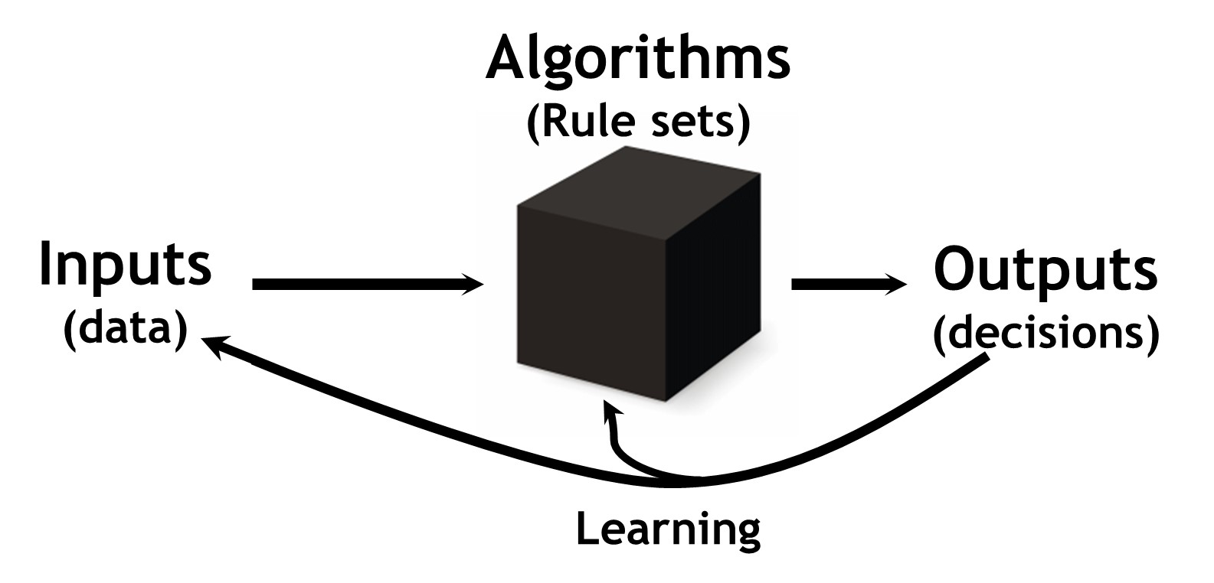
Bias & Black Box
Social Bias
Judgement based on prejudice / pre-conceived notions, lack of context in interpreting the facts
Technical bias
Over sampling of a population
Spatial & temporal & scale
Structural Bias
Social 1st & technical is 2nd
Socio-technical form of bias

Slide 39
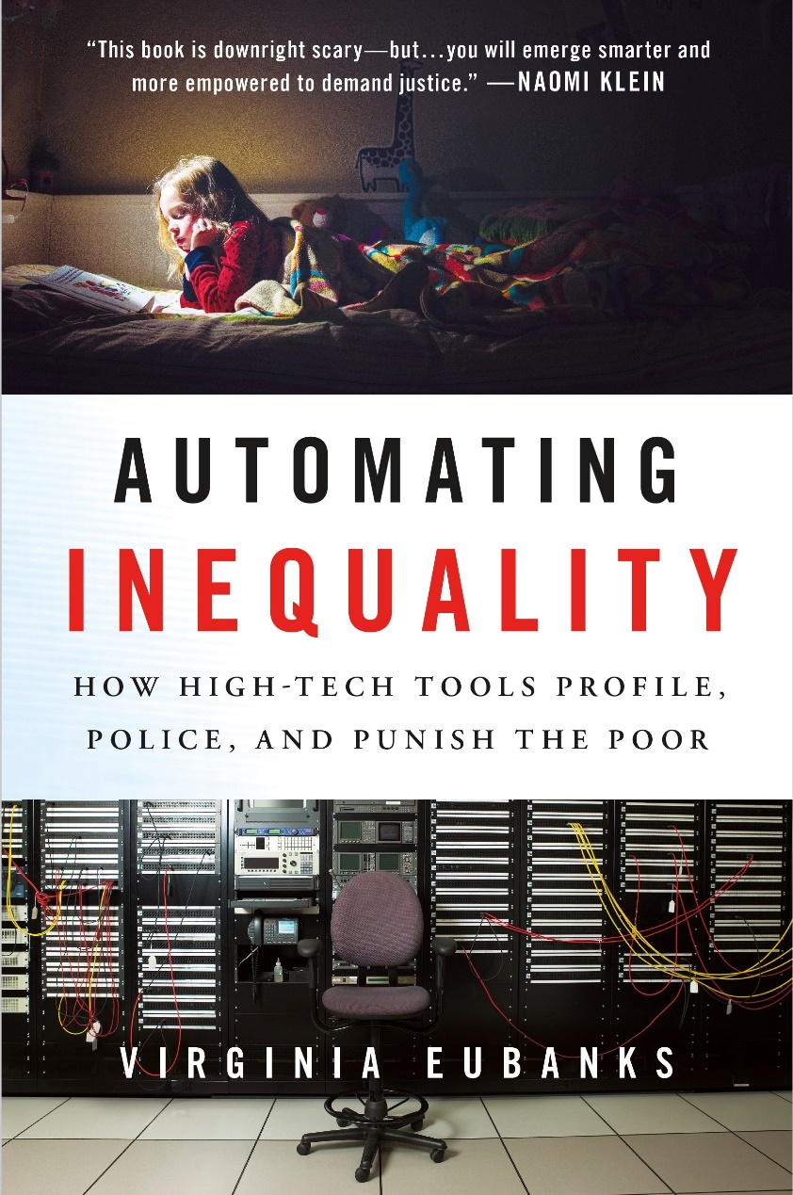
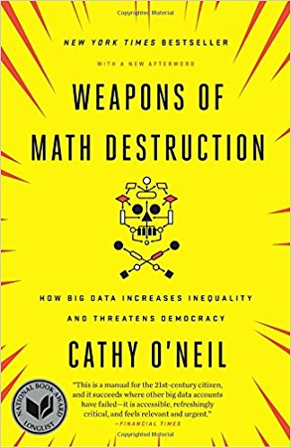
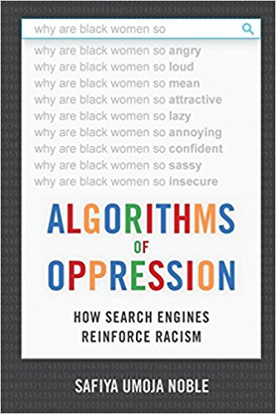
AI & Classification

Slide 40
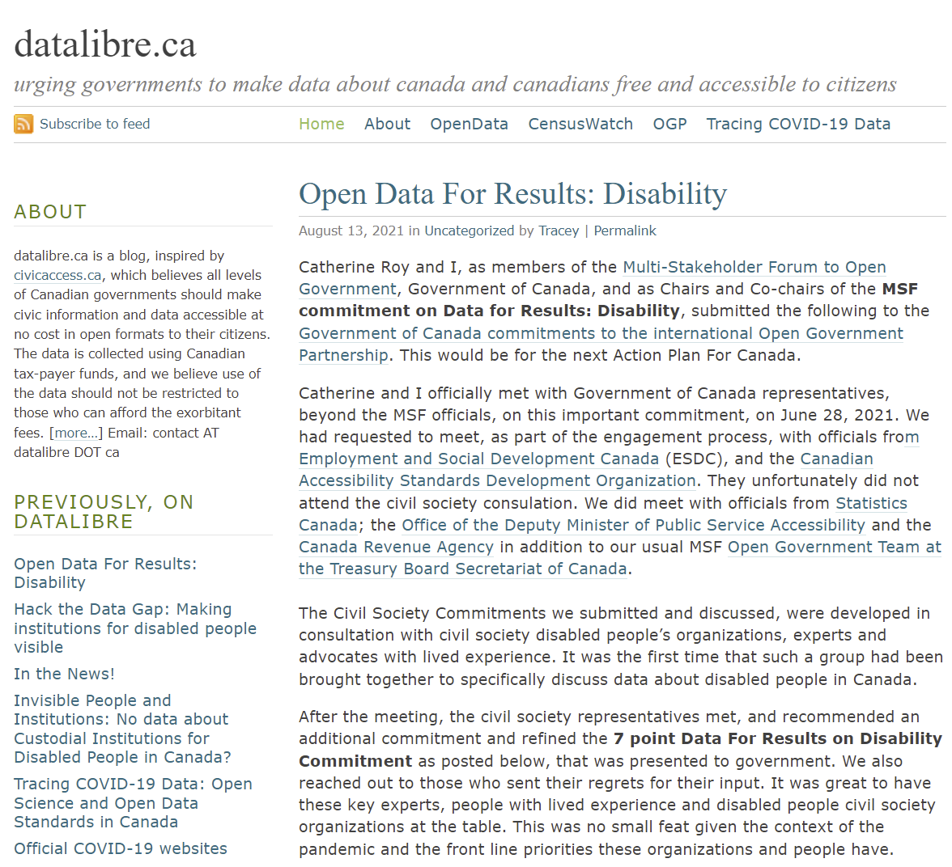
Technological Citizenship
We live in a technological society
Decisions about technology are political
We should not leave all technological decisions to the technocrats
3 preconditions for technological citizenship
Agency
Capacity to act – power
Knowledge
Those who possess those preconditions have the responsibility to act and intervene in the technological society
Andrew Feenberg, 2011
Notes:
https://www.sfu.ca/~andrewf/copen5-1.pdf
https://datalibre.ca/

Slide 41
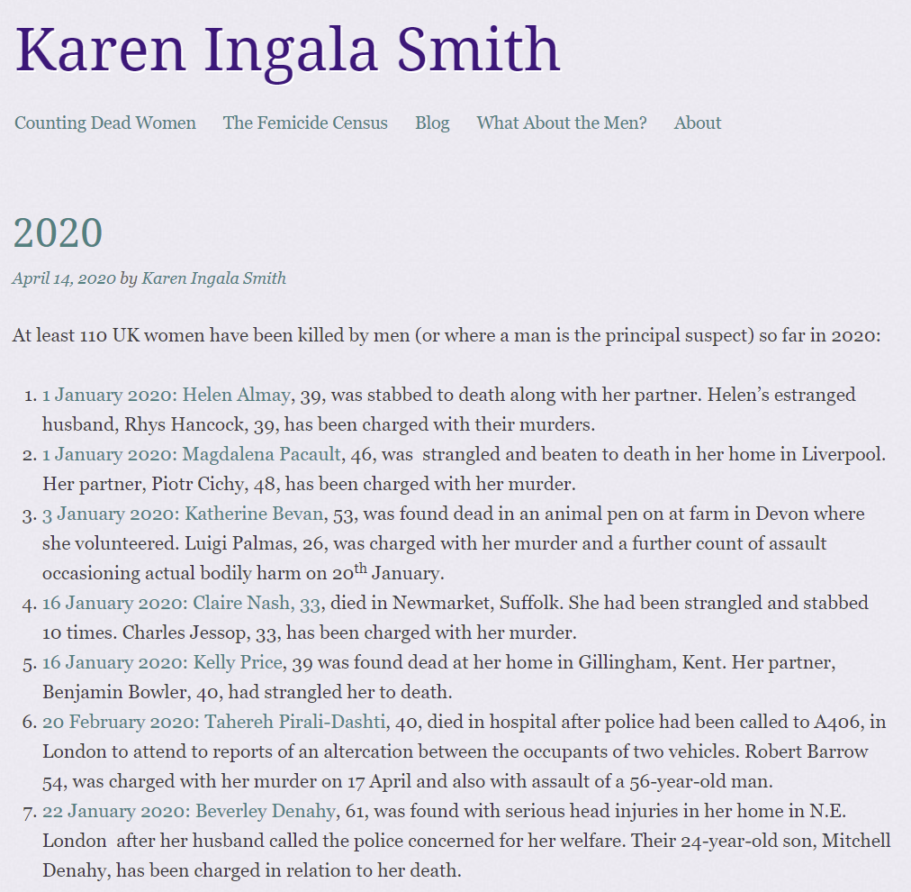
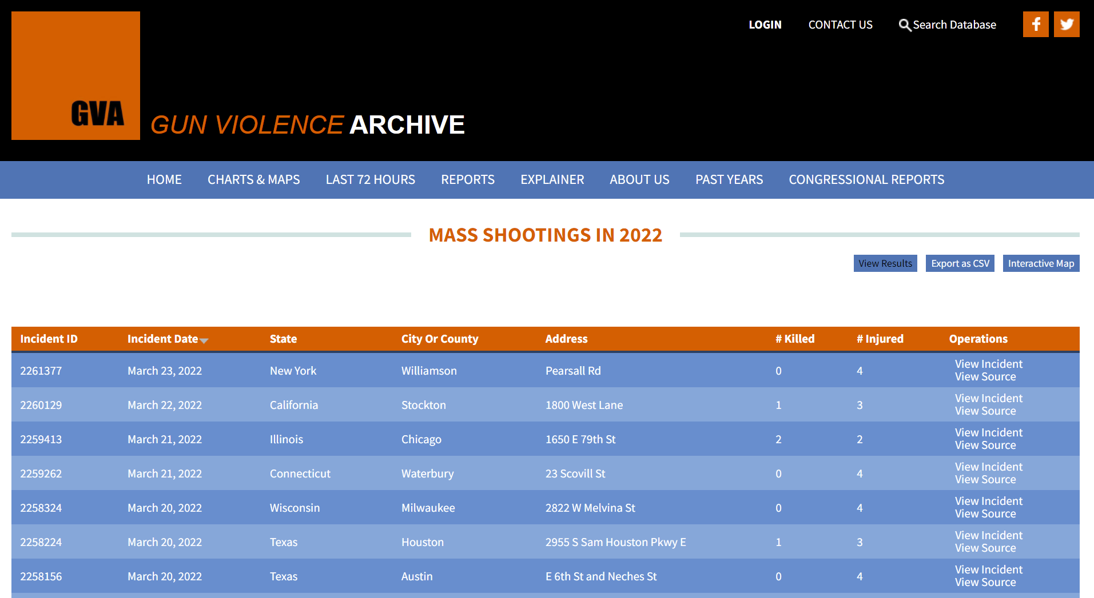
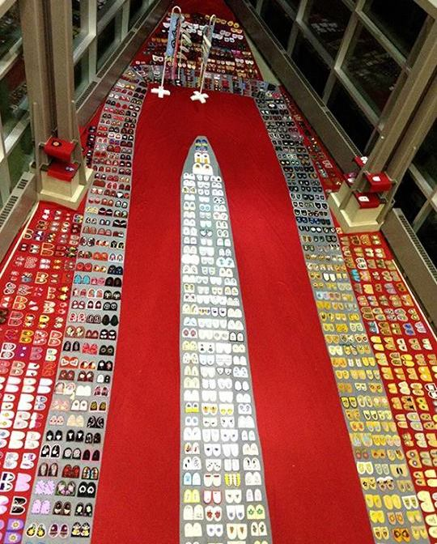
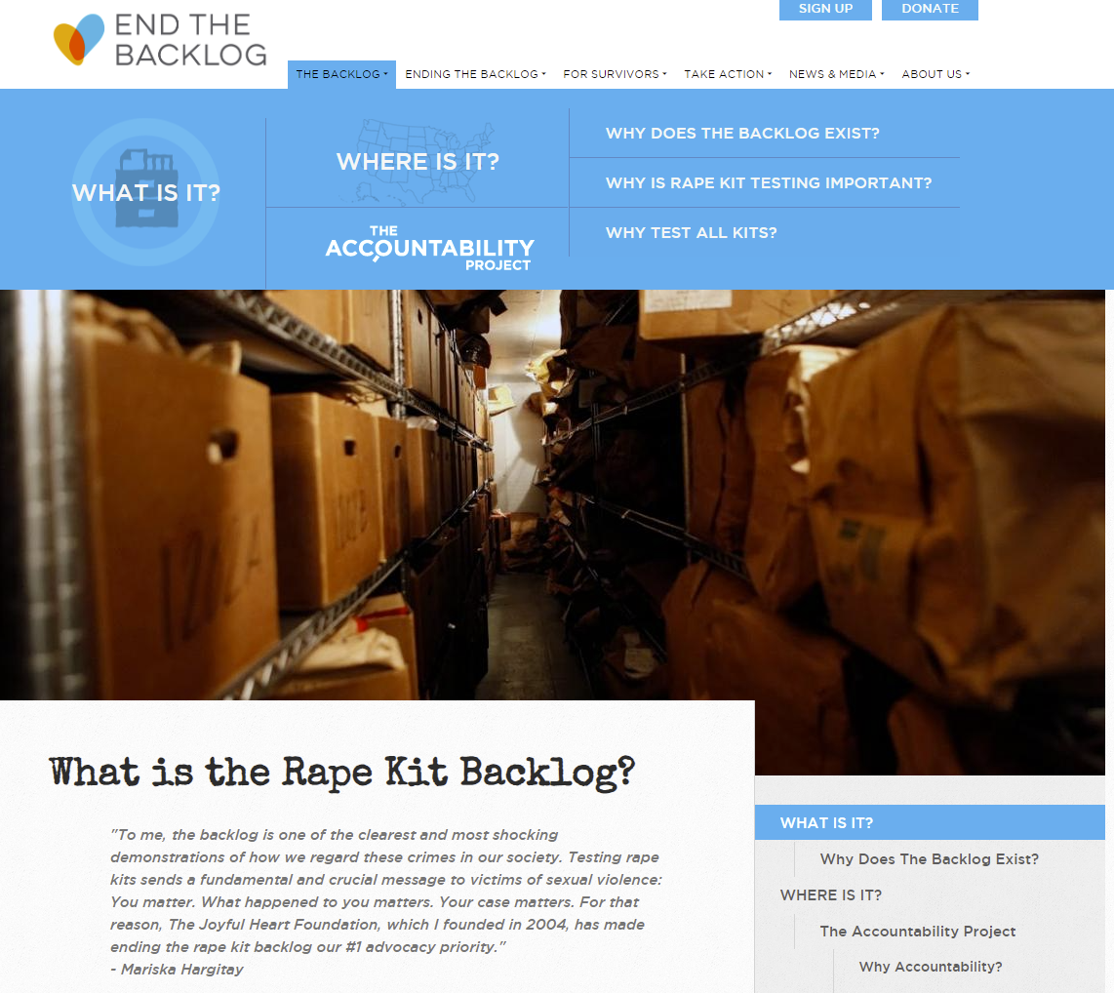
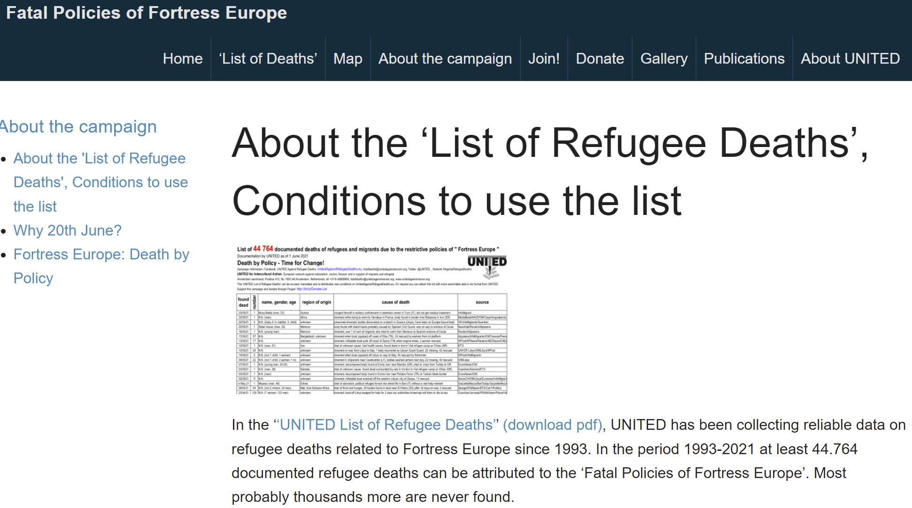
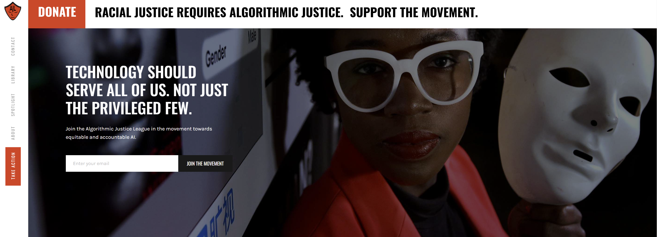
Data Activism
Walking With Our Sisters
Notes:
http://walkingwithoursisters.ca/
https://www.endthebacklog.org/backlog/what-rape-kit-backlog
https://kareningalasmith.com/2020/04/14/2020/
https://www.gunviolencearchive.org/reports/mass-shooting
https://unitedagainstrefugeedeaths.eu/about-the-campaign/about-the-united-list-of-deaths/

Slide 42
Is AI the answer to the preservation of trusted data for ever?

Slide 43
Possibly!!
Technologically solutionist view
I Trust AI case studies and general studies will help us better understand
How AI/ML can be used in the archives
How AI/ML may automate preservation practices & possibly create archival packages
How AI/ML and other automated processes can be preserved
If this means creating the twin of a twin in the CS04 example

Slide 44
Q & A
Tracey.lauriault@carleton.ca
@TraceyLauriault

