Slide 1
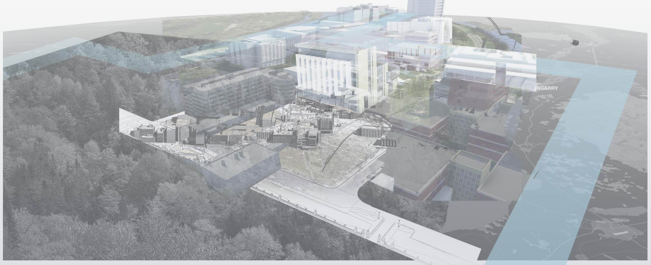
I Trust AI - Digital Twin
Meeting w/ PRtd Digital Projekthantering
Trafikverket - Swedish Transport Administration
Stockholm, Sweden
28/07/2022 (In-Person)

Slide 2
I(terPARES) Trust AI
https://interparestrustai.org/trust, @itrustai
I Trust AI is the 5th phase of the InterPARES project, directed by Luciana Duranti and Muhammad Abdul-Mageed, University of British Columbia
Like the previous phases, I Trust AI focuses on
maintaining the trustworthiness of digital records over time, and on
digital means of trustworthy access to and preservation of records in all media and form.
I Trust AI, as the name says, focuses on the use of Artificial Intelligence for reaching those purposes.

Slide 3
I Trust AI Research Objectives
Identify specific AI technologies that can address critical records and archives challenges
Determine the risks and benefits of using AI technologies on records and archives
Establish how archival concepts and principles can inform the development of responsible AI
Validate outcomes from Objective 3 through case studies and demonstrations

Slide 4
InterPARES Principles
As archival science is both a pure science and an applied science, researchers must be both academics and professionals
multiple voices from multiple contexts for different purposes support each participant’s agenda
InterPARES does not address an audience; it incorporates the audience as researchers into the research project
Students are the greatest resource of any research project and will contribute to its continuity over the years
Graduate research assistants, once graduated and become either academics or professionals themselves, will continue with the project as co-investigators and bring with them their organizations

Slide 5
I Trust AI will
Generate new knowledge on the uses of AI, such as Machine Learning (ML), on public records
Improve upon existing tools and create new ML tools that will address:
archival needs, such as machine translation, image recognition and description, optical character recognition (OCR) and handwritten text recognition, text summarization and classification, and text style transfer for language civilization (e.g., removal of bias, hate, and sexism).
The tools developed will be tailored to, tested for, and deployable by the records and archives community
Produce best practices, standards, and guidelines for applying ML tools across an entire problem space, bringing archival knowledge and practice to bear on problems such as bias in ML, explainable artificial intelligence (XAI), and image description
Enrich research and lead to knowledge co-creation in several disciplines, including archival science, records management, AI, cybersecurity, information science, law, and ethics, through knowledge exchange and uptake between scholars and practitioners within and among those discipline
Train a substantial cohort of students -- future scholars and professionals -- who will bring their enhanced knowledge to the institutions, organizations, communities, and governments they will serve, and to the archives and records community as a whole

Slide 6
I Trust AI – Digital Twin Case Study Objectives
Carleton University is an I Trust AI Partner, with Tracey P. Lauriault as the Lead
Case study to understand how a digital twin is used and created so that it can be preserved
Test case of the Carleton University Digital Twin created as part of the Digital Campus work at the Carleton Immersive Media Studio (CIMS) and the Sustain Project
By doing so, assess if it is possible to use AI to automate the preservation of digital twins and related technologies & also explore how AI/ML + IoT as part of the digital twin can be preserved

Slide 7
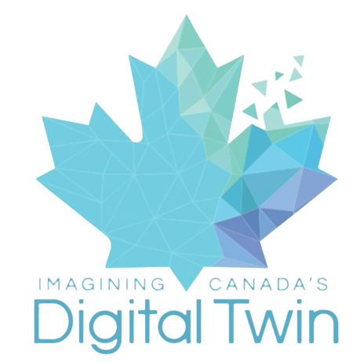
ICDT DATA GOVERNANCE WORKSHOP
Carleton Immersive Media Studios & On Zoom October 22, 2021
Convened by: Dr. Tracey P. Lauriault, Associate Professor, Critical Media and Big Data, School of Journalism and Communication Anna-Lena Theus, PhD Candidate & Research Assistant School of Journalism and Communication Carleton University
https://canadasdigitaltwin.ca
7

Slide 8
IMAGINING CANADA’S DIGITAL TWIN (ICDT)
2-year project is funded by the New Frontiers in Research Fund (NFRF) Exploration program
Objective 1: Build a research consortium comprised of academic, Indigenous, not-for-profit, public, and private partners that represent local and regional networks.
Objective 2: Develop a DT prototype of the Montréal-Ottawa-Toronto corridor using a distributed network for the Architecture, Engineering, Construction, & Operations (AECO) sector
Our research, the consortium and the prototyping will inform the application for a second phase of funding to the NFRF Transformation program.

Slide 9
IMAGINING CANADA’S DIGITAL TWIN (ICDT)
Is the 1st initiative that aims to address the opportunities, challenges, and responsibilities involved in developing a DT for all of Canada
The goal is not to resolve the question of a DT, but to:
determine the plausibility of the concept & the level of effort required to see it realized,
and to establish a national group to move forward in that realization.
ICDT proposes an inclusive, and multidisciplinary research consortium for the creation of a technical, cultural, and ethical framework for building Canada’s digital twin.

Slide 10
LONGTERM OBJECTIVES
To develop a proof-of concept DT that will enable data producers and users—regardless of their size, capacity, or geographic context—to manage authoritative and trusted datasets, automated processes and technical systems for the benefit of their own communities, and according to their own jurisdictional responsibilities and culture.
We are also concerned with how these data and technological assets and their organizations might be interoperable across communities to create a Canada entity.
To create a collaborative environment to enable the co-governance of shared common assets for multiple users, for multiple purposes affording checks and balances for economic development, social progress and environmental responsibility.

Slide 11
CHALLENGES
Geography
Data Sharing
Data governance
Institutional framework
Sustainability

Slide 12
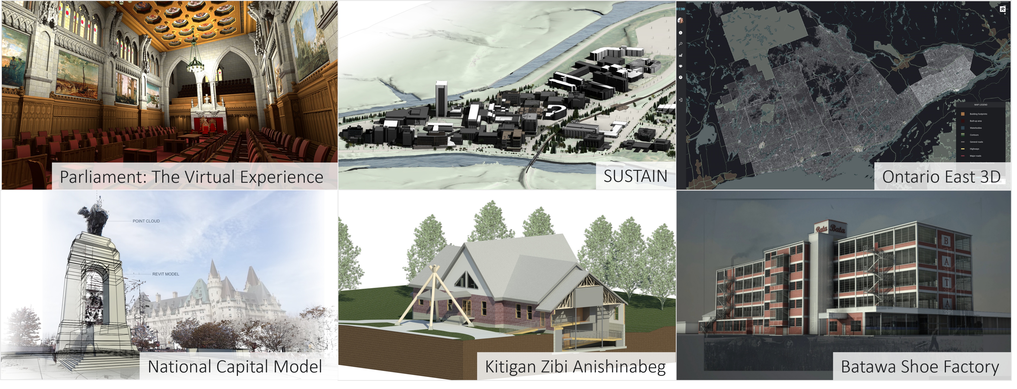
CARLETON IMMERSIVE MEDIA STUDIO (CIMS)

Slide 13
WHAT WE LEARNED
Hardware
Software/Management
Data Types
Laser
Lidar
BIM
.ifc
Point cloud
.dwg
Photogrammetry
Engines
Static
ASM
Geospatial
Software/Platforms
.rvt
Real-time
Notes:
Hardware
- Oculus Rift (VR headset): https://www.oculus.com/rift/
- HTC Vive (VR headset ): https://www.vive.com/us/
Software (Data Modelling)
- Revit (Autodesk): https://www.autodesk.com/products/revit/overview
- Dynamo studio (Autodesk): https://www.autodesk.com/products/dynamo-studio/overview
- Dasher (Autodesk): https://dasher360.com/ / https://www.autodesk.com/research/projects/project-dasher
- Autodesk 3Ds Max: https://www.autodesk.ca/en/products/3ds-max/overview?term=1-YEAR&tab=subscription
- Rhinoceros 3D (design application software): https://www.rhino3d.com/
- BlenderBIM: https://blenderbim.org/
- Blender OS: https://www.blender.org/
- OSArch OS: https://osarch.org/
- OS: Maputnik style editor: https://maputnik.github.io/
- Esri’s ArcGIS: https://www.esri.com/en-us/arcgis/about-arcgis/overview
- Esri’s CityEngine: https://www.esri.com/en-us/arcgis/products/arcgis-cityengine/overview
- Adobe XD: https://www.adobe.com/ca/products/xd.html
- Adobe ProtoPie: https://www.protopie.io/adobexd
Software (Data Management)
- SPECKLE (Interoperability platform): https://speckle.systems/
- infoworks: https://www.infoworks.io/
- OS: PostgreSQL: https://www.postgresql.org/
- Solace: https://solace.com/
- Zoho (PM software): https://www.zoho.com/projects/
- Slack (team communication): https://slack.com/intl/en-ca/
- Github: https://github.com/
- Microsoft excel: https://www.microsoft.com/en-us/microsoft-365/excel
- Amazon webservices: https://aws.amazon.com/
Game engine
- Unreal engine: https://www.unrealengine.com/en-US/
- Unity engine: https://unity.com/
Data types
- Laser
- point cloud
- Photogrammetry
- Geospatial
- Lidar
- BIM (building information model)
- ASM (asset management system)
- static
- real-time
- .DWG (for solid-body geometry)
- .RVT file format : https://docs.fileformat.com/cad/rvt/#:~:text=A%20file%20with%20.,floor%20plans%2C%20elevations%20and%20sections.&text=Revit%20files%20can%20be%20opened%20using%20Autodesk%20Revit%20or%20Autocad%20Architecture%20software.
- .IFC file format: https://fileinfo.com/extension/ifc#:~:text=An%20IFC%20file%20is%20a,elements%2C%20materials%2C%20and%20shapes

Slide 14
DATA GOVERNANCE
Data Governance:
“is the exercise of authority, control, and shared decision making (planning, monitoring and enforcement) over the management of data assets”
Governance:
“the exercise of authority and control over a process, organization or geopolitical area. The process of setting, controlling, and administering and monitoring conformance with policy”
Data Governance – making sure that information and data are managed properly (rules, policies - executives)
Data Management – managing data to achieve goals (doing it – managers, stewards, curators)
Data
lifecycle
Notes:
See John Ladley (2019) Data Governance How to Design, Deploy and Sustain an Effective Data Governance Program, 2nd Edition, Elsevier.
See DAMA International (2017) DAMA-DMBOK Data Management Body of Knowledge, 2nd Edition, Technics.

Slide 15
DG Workshop OBJECTIVES
The aim is to have an informative and engaging interaction between a select group of experts.
The objectives of the workshop are to:
share visions of what an ideal data (& technology) governance model for Canada’s Digital Twin might look like;
enable the free and open exchange of knowledge and ideas about data governance; and
identify synergies and develop new relationships.

Slide 16
PARTICIPANTS
GOVERNMENT
Bret Donnelly, INFC
Ata-Ul Munim, INFC
Ryan Ahola, NRCan
Shannon Denny, NRCan
Simon Riopel, NRCan
Graham Wilkes, NRCan
Cameron Wilson, NRCan
Tom Dufour, StatCan
André Loranger, StatCan
INDUSTRY & ASSOCIATIONS
Mark Anderson, AECO Innovation Lab
Arash Shahi, AECO Innovation Lab
Mark Whitell, AECO Innovation Lab
John Hale, buildingSMART
Greg Schleusner, Building Smart Int.
Derek Cheung, canBIM
Mark Cichy, canBIM
Melissa Dane, FNIGC
Peigi Wilson, FNIGC
UNIVERSITY
David Fewer, U Ottawa
Peter Pulsifer, Carleton U
Stéphane Roche, U Laval
ICDT & CIMS
Stephen Fai, ICDT, CIMS
Tessa Hebb, ICDT
Alex Ramirez, ICDT
Tracey P. Lauriault, ICDT
Julie Ivanoff, ICDT, CIMS
Serdar Tuncer, ICDT
Anna-Lena Theus, ICDT
Leslie Rao, Observer

Slide 17
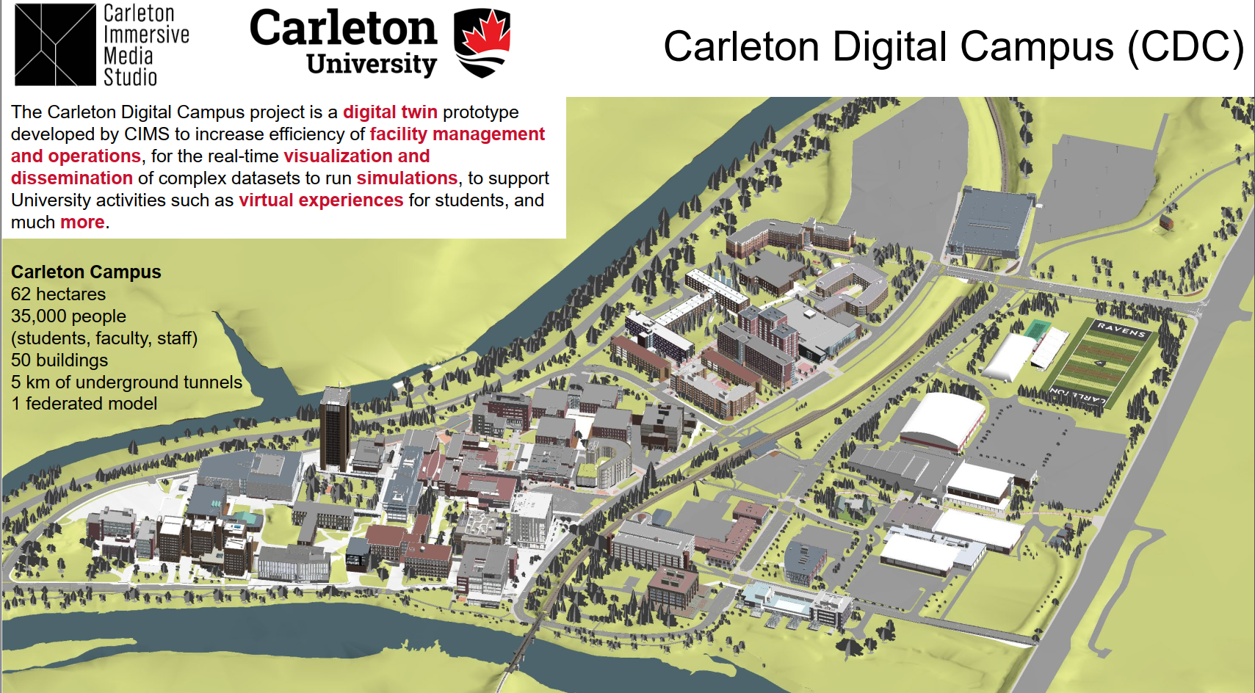
I Trust AI - Digital Twin Case Study
The CIMS Sustain Digital Campus project involves a digital twin of the Carleton University Campus
The model is being used to analyze building and campus performance. The project demonstrates that technology that can be used to improve the quality of indoor environments, reduce energy costs, and application for asset management.
Video presented to WG1 October 25, 2021 https://play.miun.se/media/WG+1+meeting+monday+25th+October/0_b3w6ikr5
A digital twin is an ecosystem of multi-dimensional and interoperable subsystems made up of
physical things in the real-world,
digital versions of those real things,
synchronized data connections between them
and the people, organizations and institutions involved in creating, managing, and using these.
see https://canadasdigitaltwin.ca/
17

Slide 18
I Trust AI - Digital Twin Case Study
The project has conducted real experimentation in four test buildings at Carleton University.
This ecosystem of technologies allows Architecture, Engineering, Construction, and Operations (AECO) professionals to analyze real-time data and visualize modeling and analysis into their actual designs, improving the overall process and to manage these assets.
Virtual recreation of buildings by CIMS https://cims.carleton.ca/#/home
ASAU Tour Fall 2021 https://youtu.be/ydlV6hDpuGs
CDC Browser application https://youtu.be/Al1OtyUAAu4
Imagining Canada’s Digital Twin https://canadasdigitaltwin.ca/about-2-2/

Slide 19
I Trust AI - Digital Twin Case Study
Provides critical records and archival challenges in terms of the use and creation of complex records – BIM, ASM, Digital Twins, VR and AI
This would include a literature review of the preservation of related data & technologies
Involves and ecosystem of data, real-time systems, AI/ML, IoT, building information systems (BIM), asset management systems (AMS), LIDAR, VR, simulations and techniques, technologies, and data of importance to fields in architecture, urbanism, planning, and engineering.
Archival concepts of Authenticity, reliability, and accuracy, and others will be identified as research progresses.

Slide 20
I Trust AI – DT CS Research Question
Can a digital twin be preserved and what is required at the point of creation to ensure that it can be?
What are the challenges in terms of the creation and use of a digital twin in an archives?
For ingest, a question might be - can an archival package be AI generated for such a system?
Also, AI is used to create objects in a digital twin and how can these be preserved?
Would this be a twin of a twin?

Slide 21
I Trust AI – Digital Twin Case Study Team
­Tracey P. Lauriault, I Trust AI Lead, Associate Professor, Critical Media and Big Data, School of Journalism and Communication, Carleton University (Tracey.Lauriault@Carleton.ca)
Stephen Fai, Professor cross appointment in the Department of Civil and Environmental Engineering, the Institute for Comparative Studies in Literature, Art, and Culture, and the Azrieli School of Architecture and Urbanism; Director of the Carleton Interactive Media Studio (CIMS) (sfai@cims.carleton.ca)
Nicolas Arellano, Ph.D. Candidate at Carleton University | Research Team Lead at CIMS (narellano@cims.carleton.ca_
Travis Kinnear (he/him/his), MLIS, Digital Archivist, Corporate Records and Archives, University Secretariat, Carleton University (Travis.Kinnear@carleton.ca)
Sherry Xie, Renmin University of China - School of Information Resource Management (sherrylx@outlook.com)
Tero Päivärinta, Professor, Luleå University of Technology, Research subject: Information systems, Digital Services and Systems, Department of Computer Science, Electrical and Space Engineering, tero.paivarinta@ltu.se
Göran Samuelsson, Senior lecturer, Department: Department of Information Systems and Technology (IST) and Information Specialists for The Swedish Transport Administration (Goran.Samuelsson@miun.se goran.samuelsson@trafikverket.se)
Liam O’Brien, Professor in Architectural Conservation and Sustainability Engineering, PI the SUSTAIN Project (Sensor-based Unified Simulation Techniques for Advanced In-Building Networks) project at Carleton University (liam.obrien@carleton.ca)
H. Burak Gunay, Assistant Professor in Building Science, Department of Civil and Environmental Engineering (burak.gunay@carleton.ca)
Annantonia Martorano, Dipartimento di Storia, Archeologia, Geografia, Arte e Spettacolo - SAGAS, University of Florence (UNIFI) (annantonia.martorano@unifi.it)
Elena Gonnelli, PhD student at the University of Florence., (gonnellielena@gmail.com; elena.gonnelli@unifi.it)
UNIFI research Assistants
Raquel Jennyfer De Souza raquel.desouzasantos@stud.unifi.it; Luca Tondini luca.tondini@stud.unifi.it;
Irene Nocentini irene.nocentini@stud.unifi.it; Erica Cavina erica.cavina@stud.unifi.it;
Valentina Vazzano valentina.vazzano@stud.unifi.it;

Slide 22
Next Steps – w/ Trafikverket
Trafikverket DT as part of the I Trust AI DT case study?
Trafikverket interest in becoming an I Trust AI Government Partner?
the organization (or department) interested in becoming a partner writes a letter stating that they agree with the aims of the research (https://interparestrustai.org/trust/about_research/summary)
that they want to participate and what they expect to gain from participating, what they will commit (non-binding) in terms of researchers and their time,
and possibly also travel budget for their designated researcher(s) to attend meetings in person, and if they would be interested in hosting a meeting.
This is given a dollar amount as an in-kind contribution to the research. Convene a meeting with Transport Canada – Information Exchange?
Convene an information exchange meeting with Transportation Canada, Infrastructure Canada, Natural Resources Canada?
Other Ideas?

