Slide 1
AI and Images Collections: Two Perspectives
Jessica Bushey, M.A.S., Ph.D
San José State University, California, US
October 28, 2023
Jessica.Bushey@sjsu.edu

Slide 2
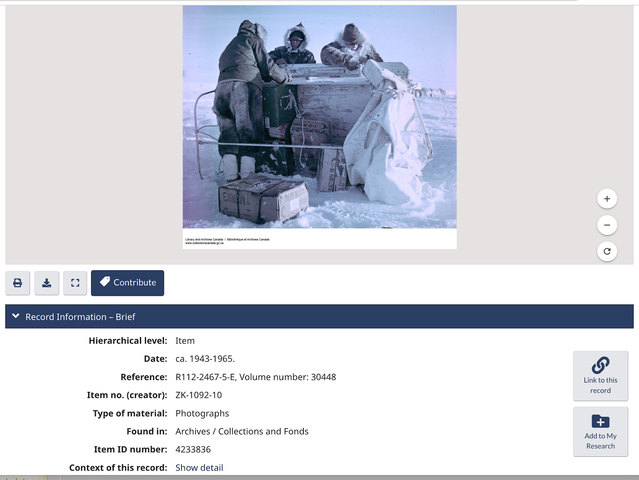
Library Archives Canada. Department of Defense. Arctic Exploration Muskox: http://central.bac-lac.gc.ca/.redirect?app=fonandcol&id=4233836&lang=eng
Hawaii State Archives. Queen Liliuokalani Collection 1890s: https://ags.hawaii.gov/archives/about-us/photograph-collection/queen-liliuokalani-photograph-exhibition/queen-liliuokalani-photograph-exhibition-liliuokalani-1890s/
Notes:
I’m going to talk about two research studies today, both of which are part of I Trust AI Project.
The first is RA 01: Increasing Access to Images & AV records through AI-generated metadata. Case studies at the Hawaii State Archives and the International Federation of Red Cross & Red Crescent Societies are exploring how Artificial Intelligence can assist archivists by automating the capture and creation of metadata for digitized images, social media images, digitized film and digital video in several languages to improve the management of images & av collections and increase their discoverability & access, leading to increased use.

Slide 3
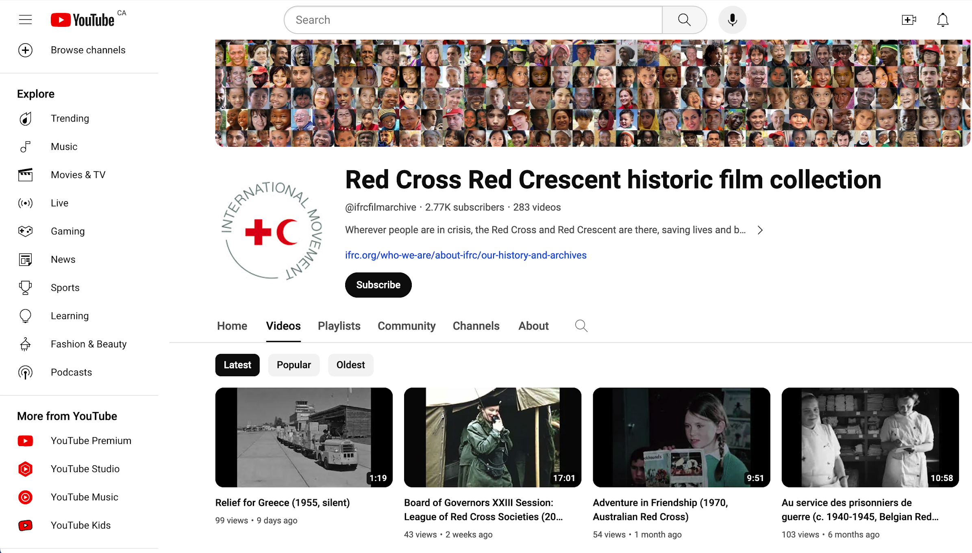
IFRC Film Archives YouTube Channel: https://www.youtube.com/@ifrcfilmarchive/about
Notes:
I’m going to talk about two research studies today, both of which are part of I Trust AI Project.
The first is RA 01: Increasing Access to Images & AV records through AI-generated metadata. Case studies at the Hawaii State Archives and the International Federation of Red Cross & Red Crescent Societies are exploring how Artificial Intelligence can assist archivists by automating the capture and creation of metadata for digitized images, social media images, digitized film and digital video in several languages to improve the management of images & av collections and increase their discoverability & access, leading to increased use.

Slide 4
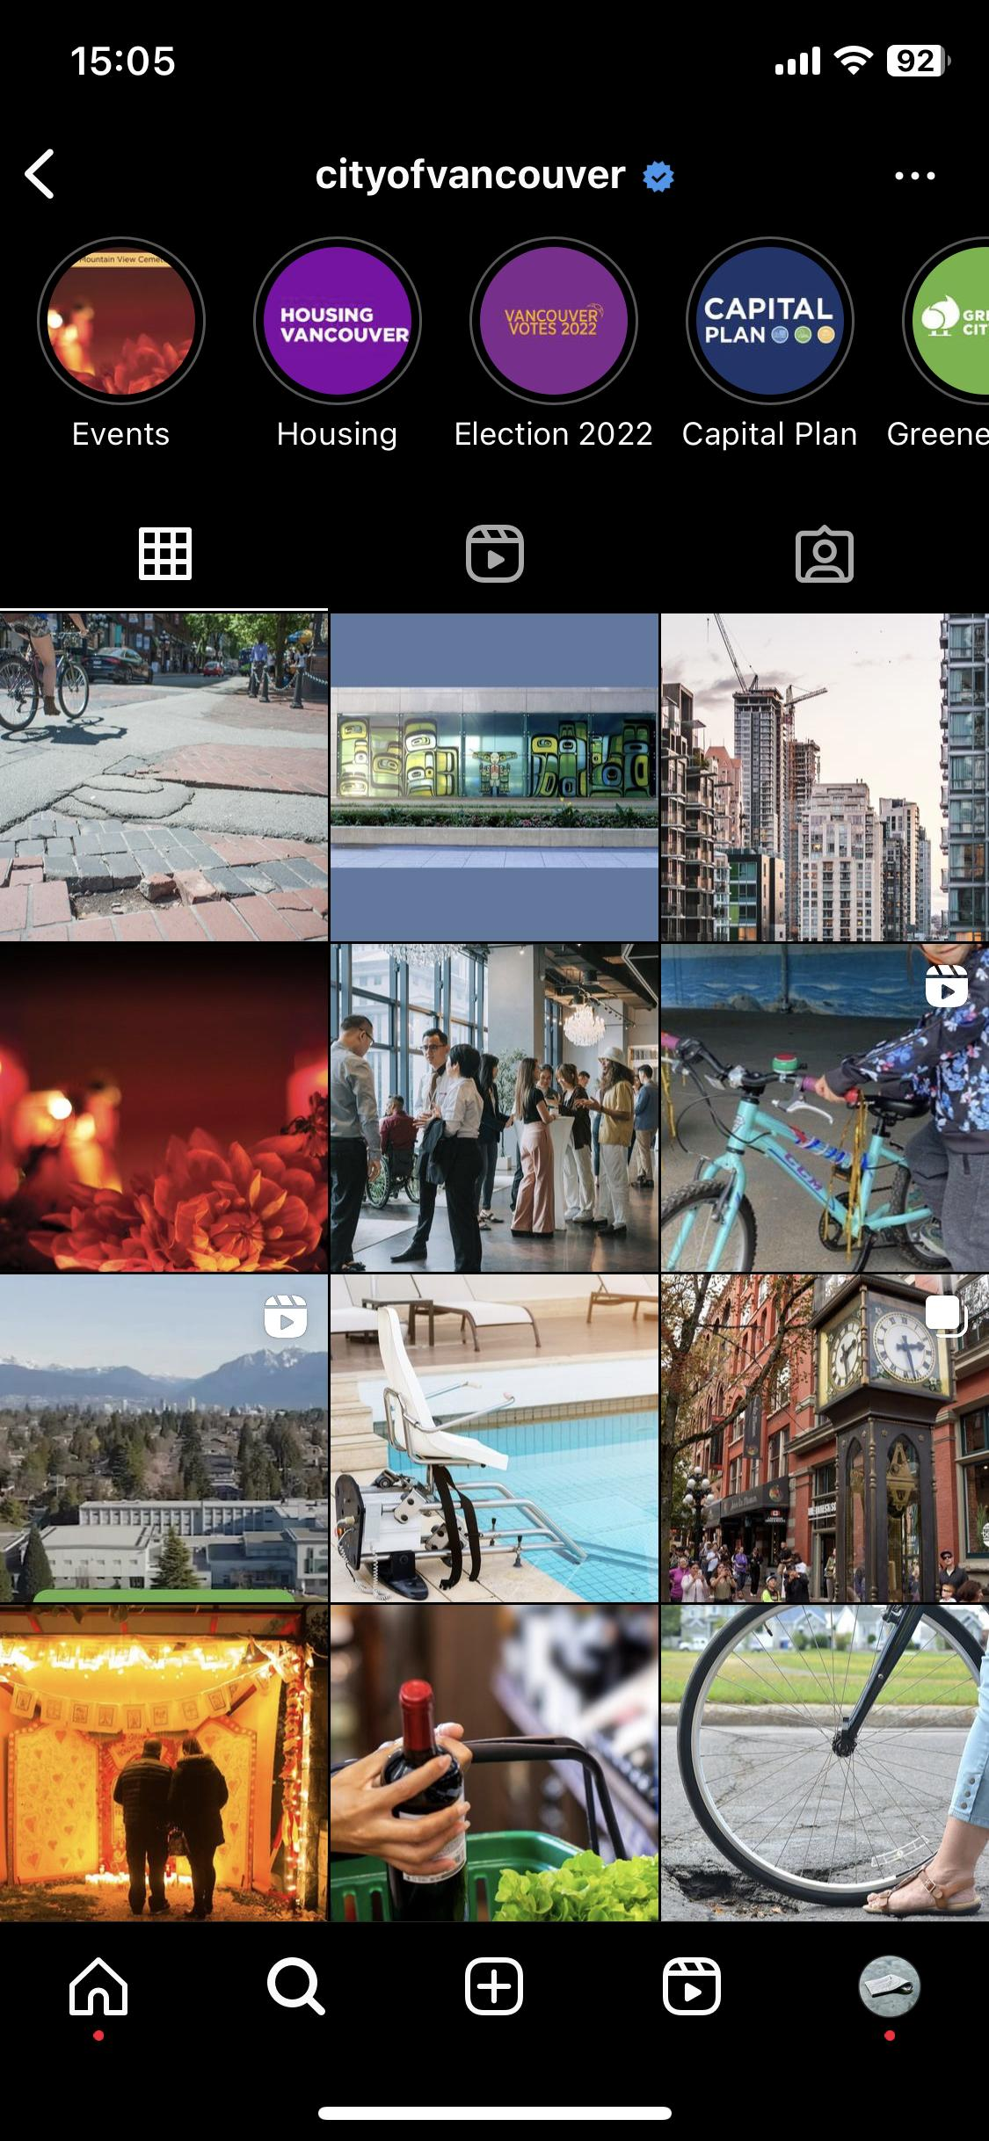
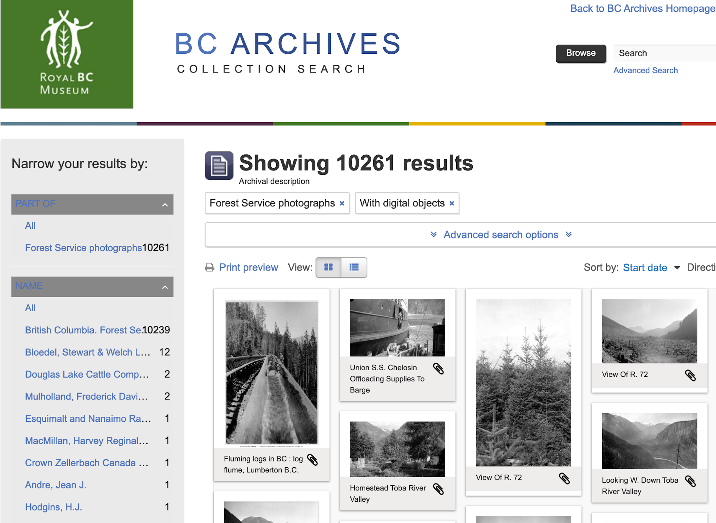
City of Vancouver Instagram homepage, Oct 27, 2023. https://www.instagram.com/cityofvancouver/?hl=en
BC Archives. Forest Service photographs. https://search-bcarchives.royalbcmuseum.bc.ca/informationobject/browse?view=card&sort=startDate&collection=2308886&onlyMedia=1&topLod=0&sortDir=asc
Notes:
I’m currently sharing screencaptures of public search interfaces with different municipal, provincial, state, national and international archives – focusing on their digitized photographs, born digital images collections and digitized film archives. A challenge for archivists and users of archives is to capture and create metadata for images and audiovisual records that identifies the who, what, where and how at the item-level and to create transcripts for multilingual media. It is very time consuming to do this type of archival description, yet images and AV are formats that attract high numbers of researchers and users of archives.

Slide 5
RA 01 – Increase Access to Images & AV records through AI-generated Metadata
Jan 2022 – Dec 2025
Case studies:
Hawaii State Archives [Dr. Adam Jansen]
International Federation of Red Cross & Red Crescent, Film Archives, Geneva. [Grant Mitchell & Sarah-Joy Maddeaux]
Activities:
Annotated Bibliographies for AI & Film and AI & Photo Collections
Literature Review of AI & Photo Collections
Testing COTS AI Video Indexer for Digital Video & Digitized Film
Notes:
The activities to date have been annotated bibliographies for AI & film and AI & images collections. A literature review for AI & images collections. And testing of COTS AI Video indexer Microsoft Azure.
The study explores how AI can be used to analyze a digital photograph and add searchable descriptive element that may be missing from the record creator. The study will determine to what extent AI can improve user access to the content of films and videos - and may also help determine how AI can improve archival description of films and videos - through: automatic speech recognition; machine translation of film dialogue; automated time-coding of scenes; multimodal video summarization. The study explores how AI and Machine Learning can be used to increase discoverability of Social Media posts through content and semantic analysis of text, images, and videos.

Slide 6
RA 01
Early Findings from the Literature Review:
Early adoption of AI applications to assist archivists and curators working in cultural heritage GLAMs for:
Image captioning
Image classification
Image similarity
Backend archival activities require expert oversight.
Training data used for COTS AI raises issues of bias
Access relies on AI interpretation and lacks transparency (Frontend)
GRAs: Kaelan Doyle; Dharani Persaud; Jordan Kerr; Seiji Bessho
Notes:
Drawing on articles published on AI and archives, studies in computational archival science, as well as webinars on current research initiatives in Europe we created a literature review.
AI is given an image and asked to write a description for the image.
AI is given an image and asked to classify it according to pre-defined categories.
AI is asked to find “like” images and then perform a task, either adding metadata or updating it.
These activities are aimed at assisting archivists and curators in the backend of a collections database or asset management system.
But they are also aimed at assisting researchers at the frontend, potentially enabling interpretation and analysis of massive volumes of images and AV within the access platform.
The literature is cautionary, focusing on the prevalence of bias in Training Data, the need for expert oversight, and the importance of alerting users that search results are being provided by artificial intelligence.

Slide 7
RA 01
Next Steps:
Focus on role of bias and risks of AI with PUBLIC RECORDS
Better understand capabilities of COTS AI applications
Explore Image & Text AI application with UBC ML Lab
Training AI based on an index of Photographs
Questions:
How do these actions challenge existing archival theory & standards of arrangement & description?
What is the impact on access & use?

Slide 8
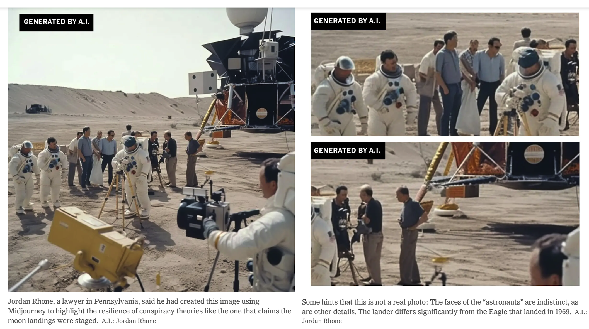
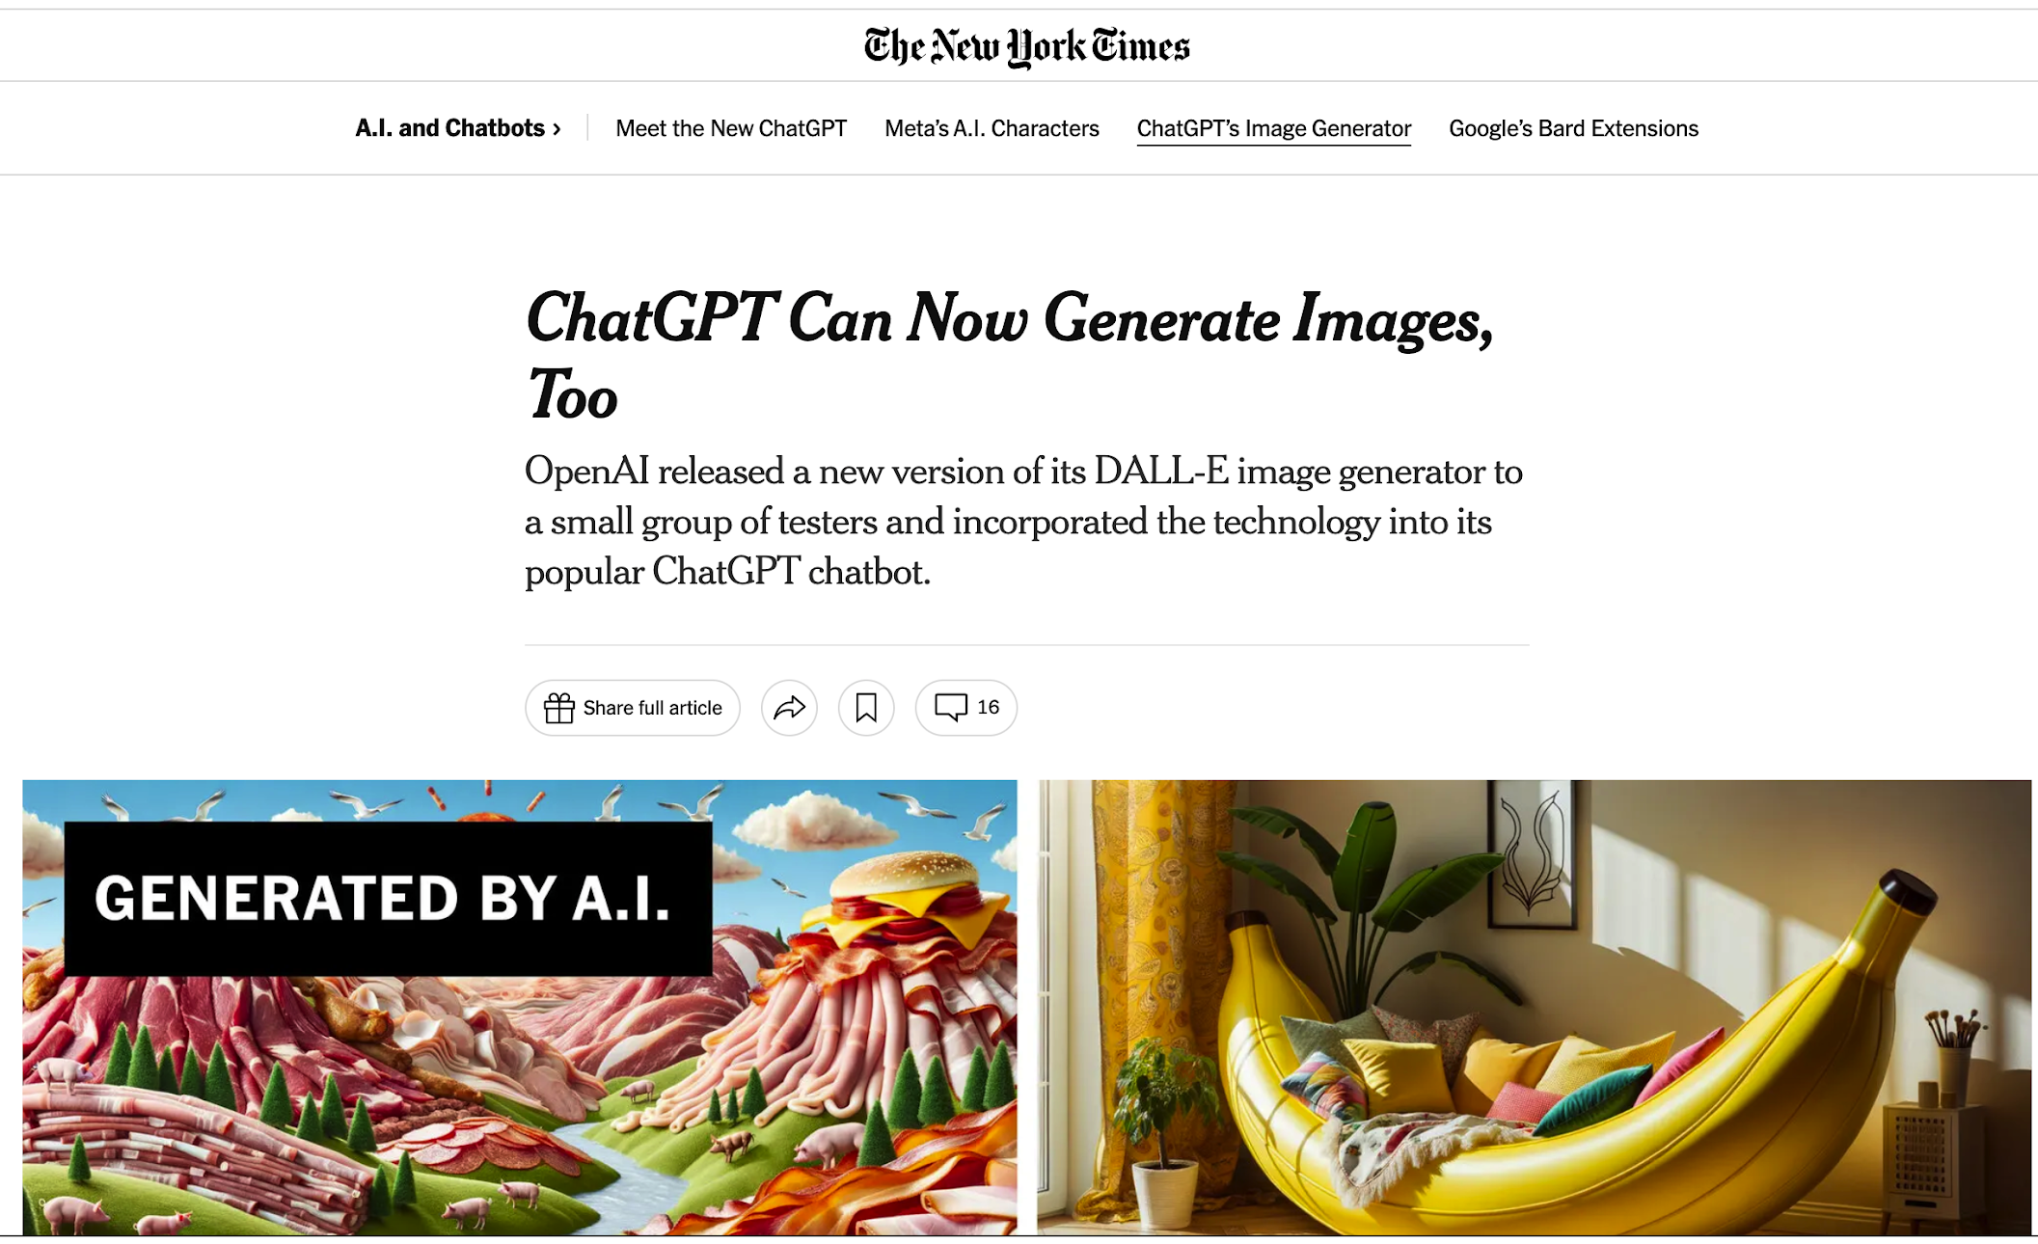
Notes:
The next research study that I will talk about is CU 08: Recordkeeping Practices of Creators using AI to generate images. It became apparent during the research for RA01 that a nascent research area is an exploration of generative AI images as a novel record format. The technology to generate realistic images and videos from textual prompts is improving exponentially and many of the early tell-tale signs have all but disappeared, making it impossible for the public to determine if what they are viewing online is real or fake.

Slide 9
CU 08 - Recordkeeping Practices of Creators using AI to generate Images
April 2023 - Dec 2025
Activities:
Literature Review of Gen-AI Image creation and management
Journalism and Communications
Medical Diagnostics
Law Enforcement
GRAs: Rachel Paprocki; Seiji Beesho
Notes:
At this point, a literature was conducted in the following areas, to identify topic areas. Looking for key issues, recent guidelines or industry standards for AI-gen images emerging from these 3 domains.
‹#›

Slide 10
CU 08
Early Findings:
Intellectual Property & Copyright of AI-generated images
Training images used without permission
Ownership of AI-gen images as creative works
Industry-led metadata specification for AI-gen content (C2PA) and the role of Provenance
Trusting images online
Verification of Authenticity
Explainable AI processes
Lack of Archival input in industry-led initiatives
Notes:
‹#›

Slide 11
CU 08
Next Steps
Interviews
Use Cases
Diplomatic Analysis of C2PA Metadata
Notes:
‹#›

Slide 12
Thank you! Questions?
Jessica.Bushey@sjsu.edu

