Slide 1
Towards a Privacy-Preserving Compute Infrastructure for Archives
Victoria Lemieux
InterPARES Trust AI 9th Symposium
Vancouver, October 28, 2023

Slide 2
Motivation
Archives are faced with large volumes of digitized or digital materials that contain personal information.
The quantity of information in archival holdings that are restricted by various legal provisions (e.g., data protection, privacy laws, etc) is suprisingly high.
There are many approaches to identifying such restricted material (e.g., Personally Identifiable Information), but this remains an open challenge

Slide 3
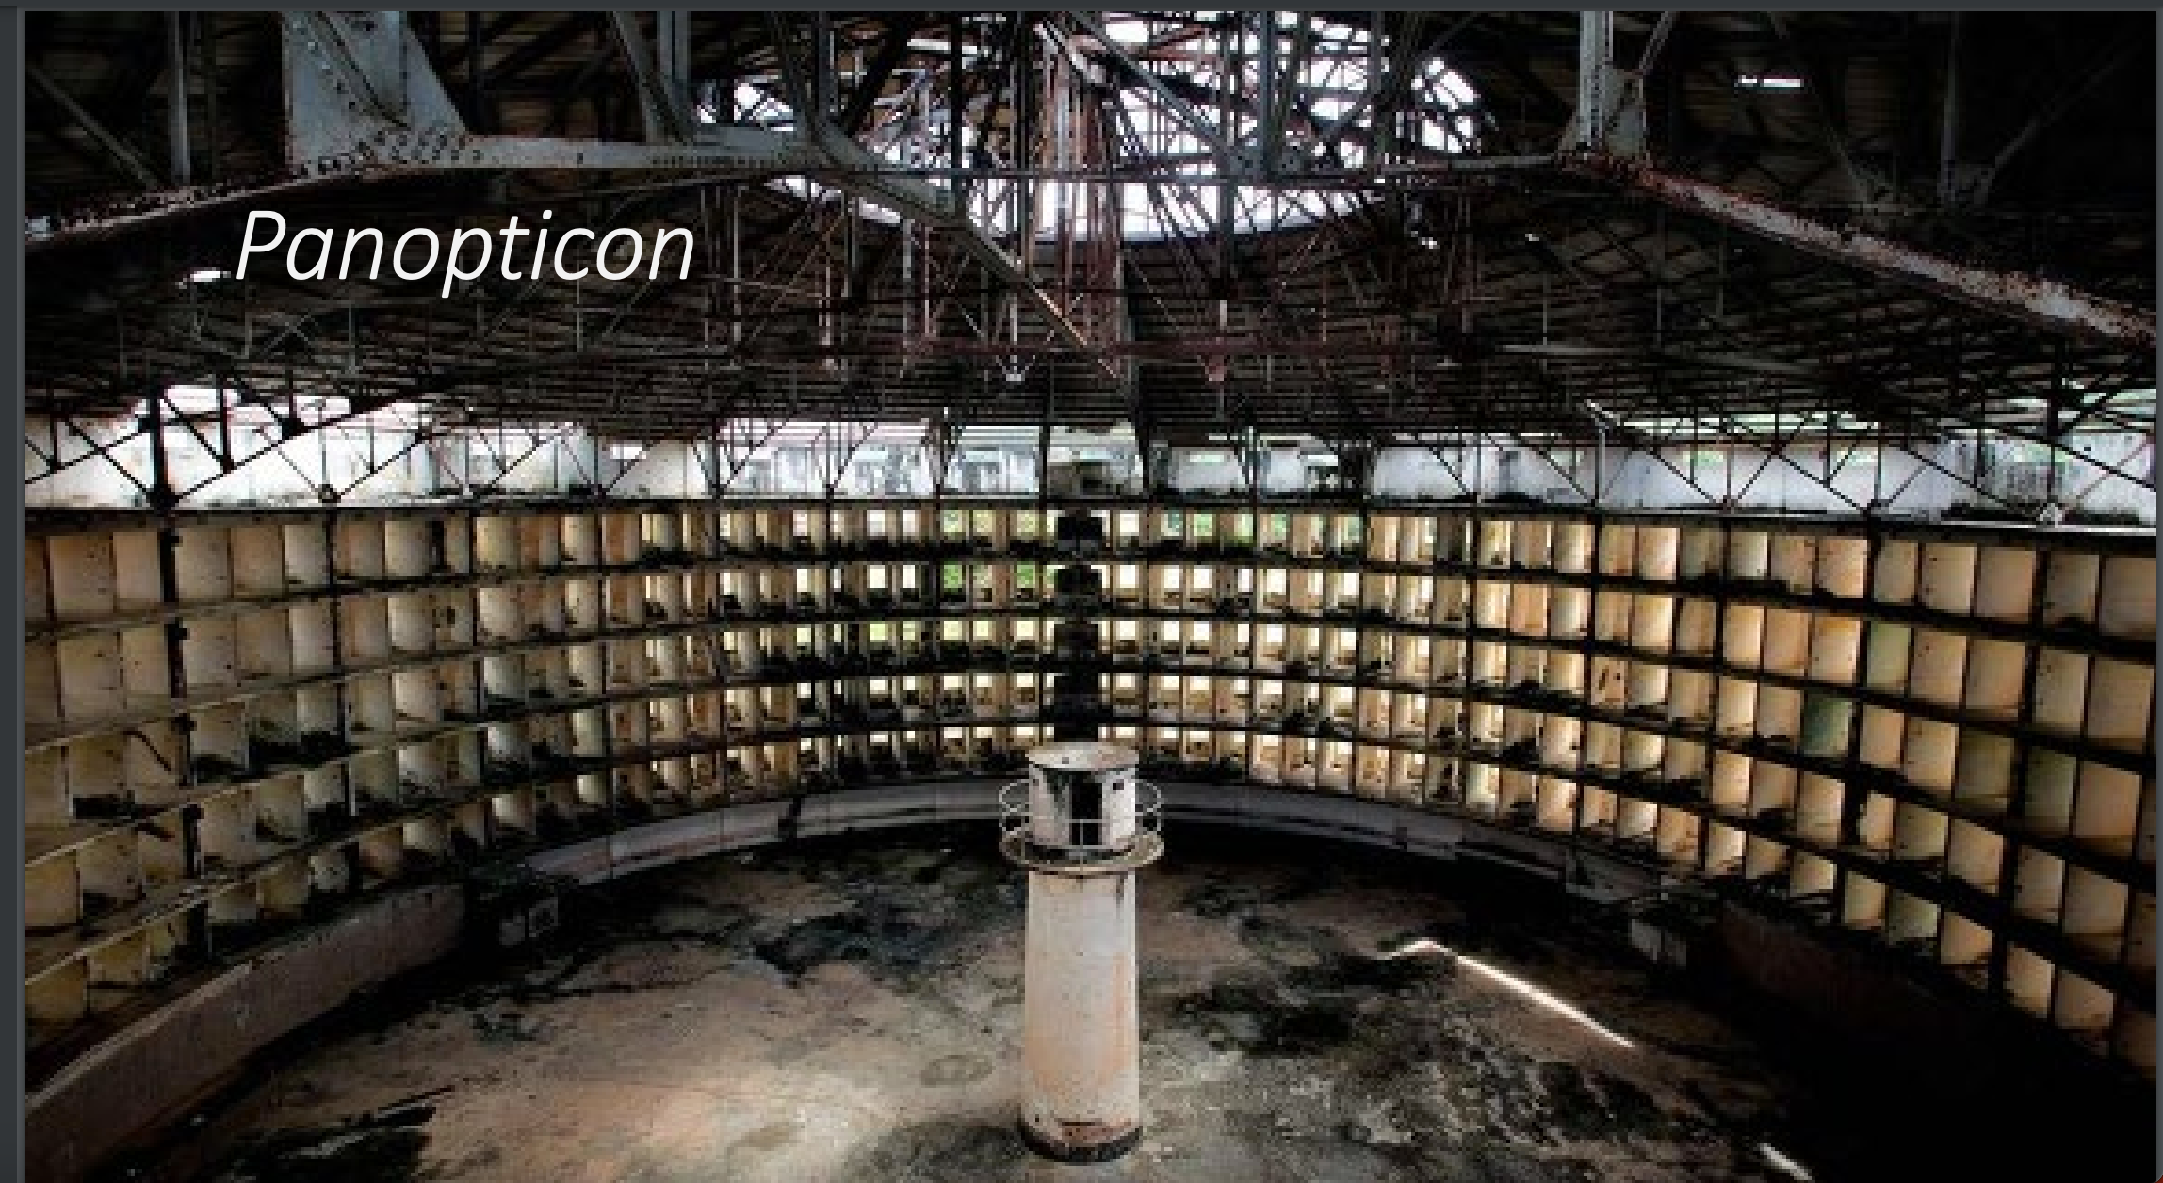
Motivation, cont’d
At the same time, even public records can be very sensitive.
There is a moral imperative that goes beyond the compliance imperative.

Slide 4
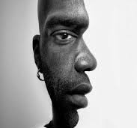
Key Insight
Instead of assuming that PII and other restricted records are the exception in archives, should we flip our perspective and assume that all records are restricted?

Slide 5
Opportunity #1
PETS
PETS = Privacy Enhancing Technologies

Slide 6
Opportunity #1, cont’d
PETS
PETS = Privacy Enhancing Technologies

Slide 7
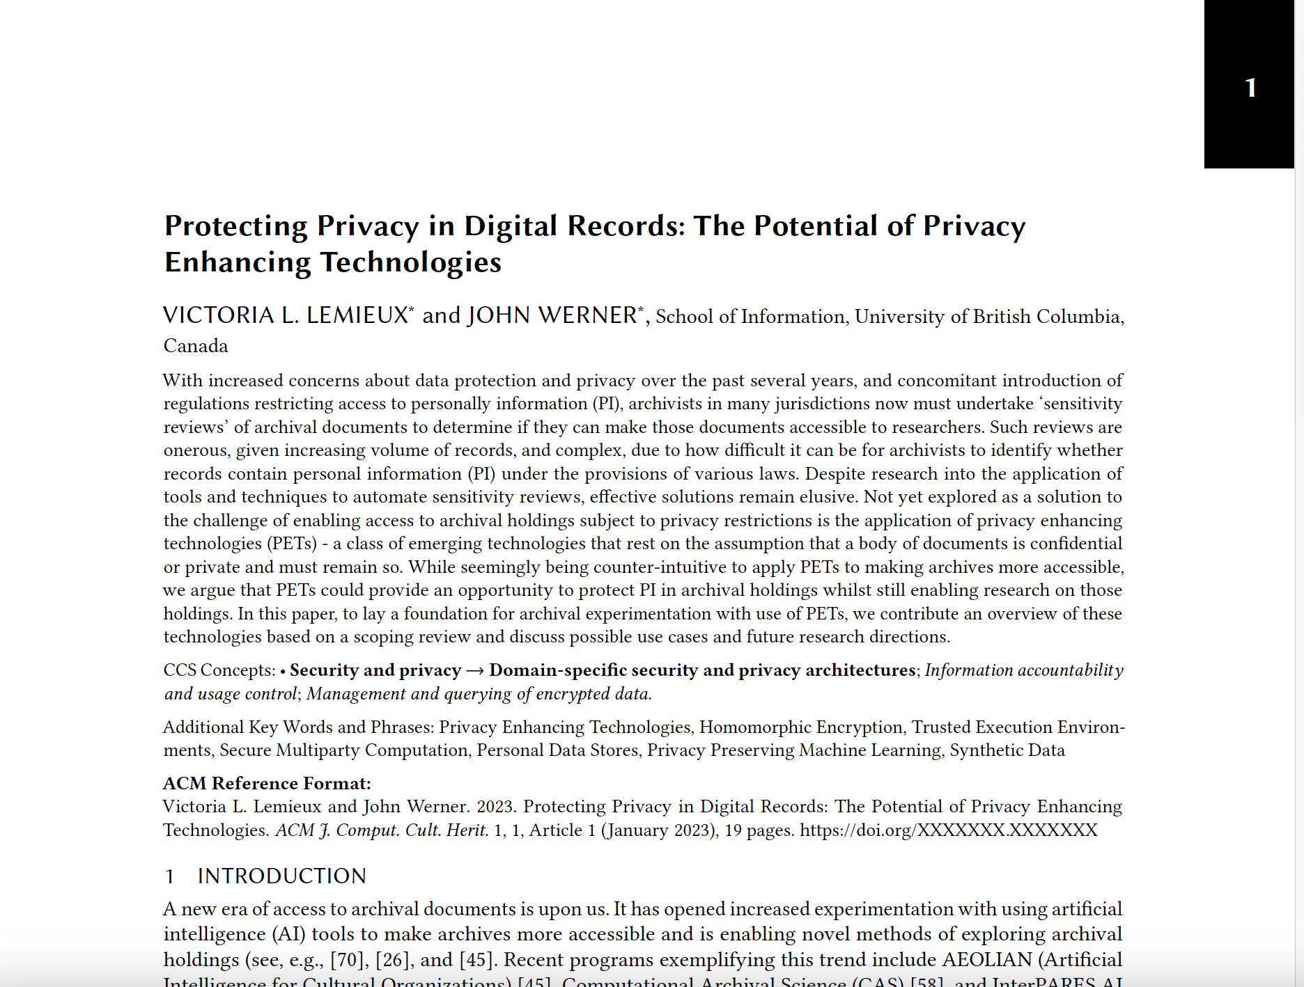
Opportunity #1, cont’d
Privacy enhancing technologies:
An emerging class of
technologies and methods meant to “harness the power of data in a manner that protects privacy and intellectual
property, enabling cross-border and cross-sector collaboration to solve shared challenges”
The White House. 2021. US and UK to Partner on Prize Challenges to Advance Privacy-Enhancing Technologies.

Slide 8
Homomorphic Encryption (HE)
Encryption method that allows for computable functions over encrypted data without altering data’s form or characteristics
Partially, Somewhat and Fully HE
First Fully Homomorphic Scheme introduced in 2009
Can be used to encrypt something like sensitive medical data and then used to train a ML model
Importantly, because it uses Lattice mathematics it is considered quantum-safe
Notes:
HE is an encryption method that allows for computable functions over encrypted data without altering the data's form or characteristics.
There are three different types of HE schemes that have been developed, partially, somewhat and Fully HE. Fully HE encryption allows for an unlimited number and types of mathematical operations on the data with a 'refresher" type of step that can reset the noise in the cipher text. Partially or somewhat schemes only allow for a limited number of operations or a specific type of operation
The first breakthrough in a fully HE scheme was introduced in 2009 and has since been adopted in a variety of settings.
HE can be used to encrypt something like sensitive medical data that then can be used to train a ML model – this would limit harm in that leaked information from the model would be encrypted and difficult to decipher. Some of HE limitations though come in the vain of increased computational times and complexity.

Slide 9
Trusted Execution Environment (TEE)
Function by creating a trusted processing enclave within a computer–protects data in use within the TEE
Most Common model: Intel’s SGX, some by other hardware manufacturers like AMD
Vulnerable to side channel attacks, difficult to predict and prevention focused on known attacks
Typically paired with other PETS
Notes:
The next PET frequently identified included a TEE which functions [read slide] which protects any data from attack or manipulation once its inside the TEE
TEEs are often proprietary in nature with one of the most common models being Intel's SGX , however other manufactureres like AMD have developed their own models.
TEEs while offering protection have documented vulnerabilities against side channel attacks where adversaries exploit information such as the memory patterns of a TEE to leak sensitive information. While there are many prevention measures for such attacks they can be difficult to predict meaning greater vulnerabilities for new attacks or variations on old ones.
Frequently the use of a TEE is paired with some other PET to ensure the privacy of data being used within the system.

Slide 10
Secure Multiparty Computation (SMPC)
Simply defined: a distributed computing task executed in a secure manner
Private inputs → concealed computation → correct output
Variety of tools and protocols: Secret Sharing, Oblivious Transfer Protocol, Yao’s Garbled Circuits, Private Set Intersections; all designed to obfuscate inputs and offer accurate output
Applications in Law Enforcement, Medical Image Sharing, distributed ML
Notes:
Secure Multiparty Computation simply defines is [slide]
Of the pets were going to present this can be one of the most varied and represents a relatively broad range of methods for parties to complete joint computations while protecting the privacy of their own data. In essence it allows for participating parties to upload private inputs into some sort of concealed computation with everyone's data and then each party receives a correct output that consulted the shared data. Every gets the desired result without revealing their private inputs
There are a number of tools and protocols that be used to create an MPC architecture some of these include [slide], respectively these can obfuscate inputs without leading to an accurate outcome
MPC is being used in a variety of contexts such as in law enforcement, medical image sharing and as a way to execute a distributed ML problem that respects the privacy of all parties' data.

Slide 11
Differential Privacy (DP)
Adds a controlled amount of randomness (i.e. “noise”) to a dataset
Prevents reconstruction of data by external parties, hides whether an individual is in or out of a dataset
Created as a response to k-anonymous datasets that leaked information about individuals; proposed in 2006
Highly varied in its adoption and techniques – over 200 identified in Desfontaines and Pejó’s survey (2020)
Used in medical fields, unstructured data (video and audio), Internet of Vehicles, and any other large, public datasets
Notes:
Differential privacy functions be injecting a CONTROLLED amount of randomness i.e noise into a dataset. In this way DP almost functions like a definition where the higher amount of randomness added adds more privacy to the dataset, but this comes subsequently at the cost accuracy when using the data.
DP prevents the reconstruction [slide] and hides whether and individual is in or out of a dataset,
It was created in a response to k-anonymous datasets that were proven to leak sensitive information about individuals
Again similarly to MPCs, DP can be highly variable in their application based on the context, type of data used etc. Over 200 different varieties of DP were identified in one study
Applications for DP again range widely from applying DP to unstructured types of records such as video and audio materials in addition to IoV data, and other large publicly available datasets keen on protecting privacy of individuals contained therein

Slide 12
Personal Control of Data
“systems that provide individuals with access and control over data about them, so that they can decide what information they want to share and with whom . . .” (Royal Society, 2019)
Closely linked to self-sovereign identity (SSI) solutions executed through a consumer facing application
Individuals then use verifiable credentials as “proof” to any sort of identity inquiries like date-of-birth, asset ownership, etc.
Derived from Zero Knowledge Proofs
Notes:
On to the next PET, personal data stores are [slide]
They are closely linked to self-sovereign identity solutions execut4ed through a consumer facing application where individuals grant an external party access to a piece of their personal information without revealing all their data.
Each individuals posseses a set of verified credentials as a proof to any identity inquiries like DoB, assest ownership and other type of information requests
PDS were derived conceptually from zero knowledge proofs or the notion of establishing proof of knowledge of some piece of information without

Slide 13
Privacy Preserving Machine Learning (PPML)
Leverages PETS to protect privacy in ML models
HE, MPC, DP
ML models contain essential information about the training set which is often sensitive
Federated Learning – frequently PPML adjacent but needs PETS to protect information
Significant use in medical field given sensitive and siloed data
Notes:
PPML broadly speaking leveares one or more PETS to protect privacy in the data needed to train ML model, frequently used PETs for this purpose include HE, MPC, or DP, yet are not exclusively limited to those examples.
Broadly speaking, and as touched on before Trained ML models contain essneital information about a training set. This information can be sensitive in nature depending on the data used and is thus prone to 'leak' from the model.
Federated learning or other distributed learning techniques represent a method to train a ML model without centralizing data in a single location. Frequently this is done for privacy reasons yet FL is not inherently privacy preserving if no additional steps are taken to protect the data in the training of an aggregated model from distributed datasets.
PPML is frequently noted in the literature as researchers acknowledge the need to protect the data that is needed for training ML models. This is particularlly true in the medical field as researchers need to train models that contain data with PHI

Slide 14
Synthetic Data
Artificially generated data made for public access
Generated algorithmically (by a model) to simulate real-world events or transactions
Include techniques like: Generative Adversarial Networks (GANs), Recurrent Neural Networks (RNNs), Variational Auto-encoders (VAEs)
Notes:
[slide]
One way to think about synthetic data, therefore, is as the “stunt double” for archival documents containing private information
Synthetic data is [second bullet point]
Some different techniques that create synthetic data include, but are not limited too [ slide]

Slide 15
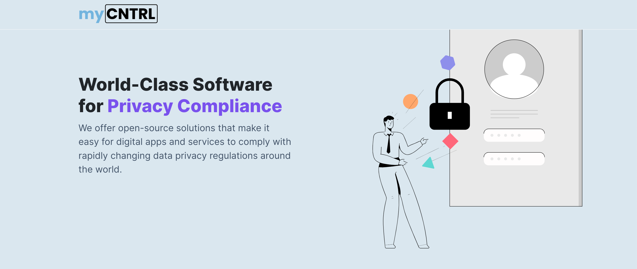
MyCNTRL
https://mycntrl.ca/

Slide 16
Hybrid Use of PETS
PETS are frequently used together to provide a broad range of protection
Application of each depends on the context of the data, participants, expected outcome and so forth
Notes:
With consideration for this long list of PETS its important to point out that
For instance a MPC scheme can be further benefitted from the application of DP so if any dis-honest participant in the MPC attempts to view data from another party it wouldn't be easily available to them.
The application of each PET depends on the context of the data and so forth

Slide 17
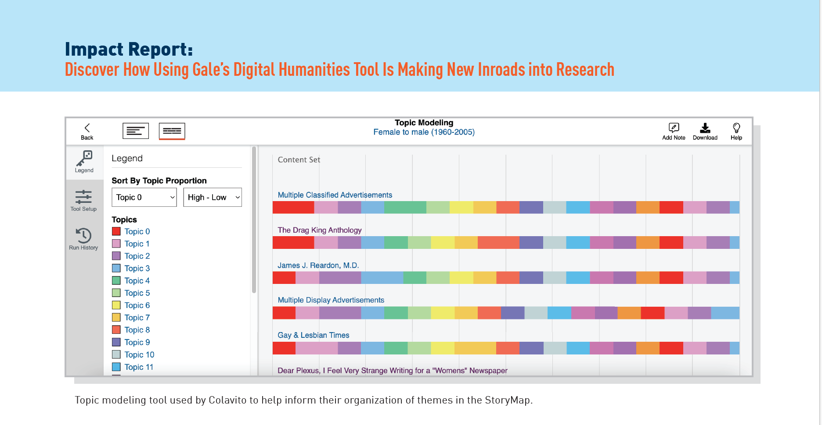
Opportunity #2
The ‘distant reading’ methodology is becoming more prevalent and useful in the digital humanities.

Slide 18
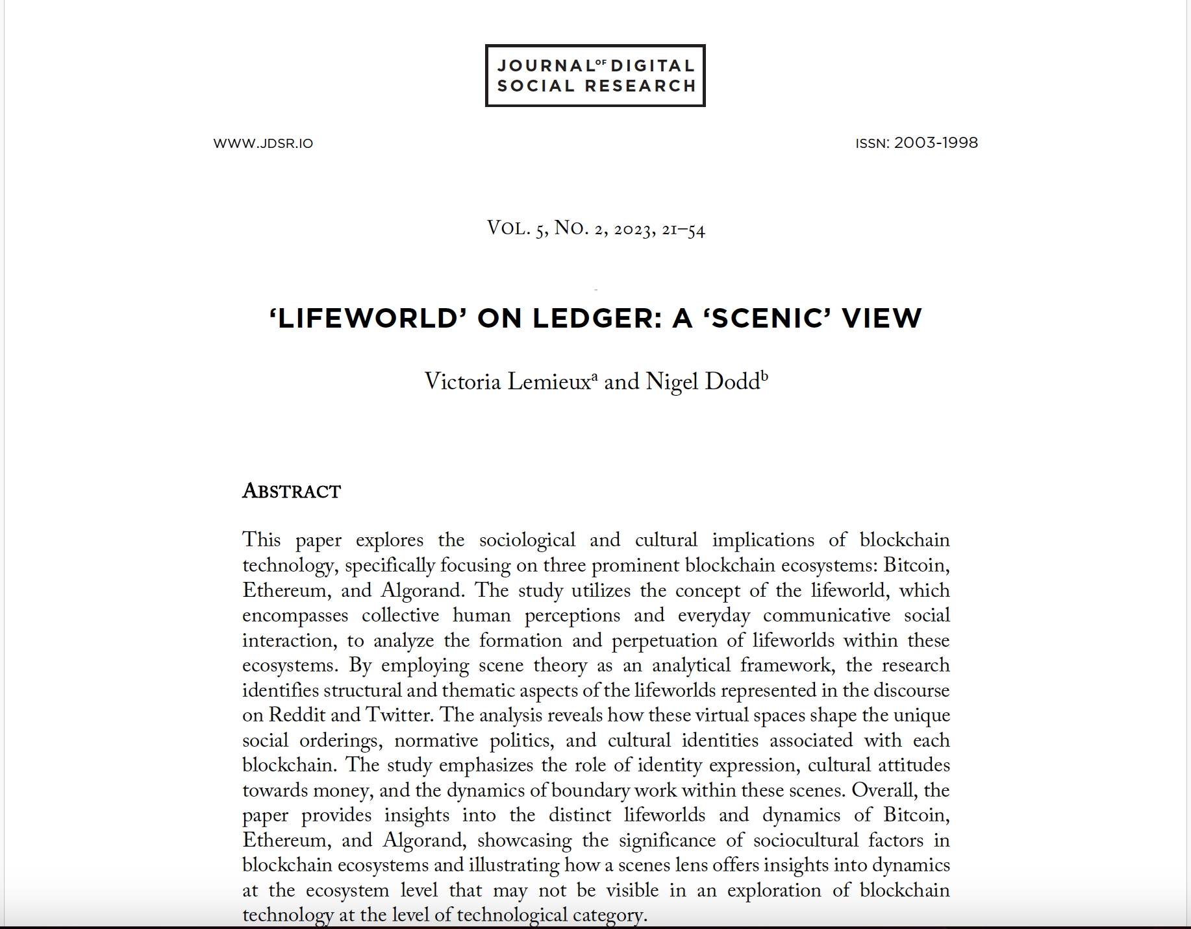
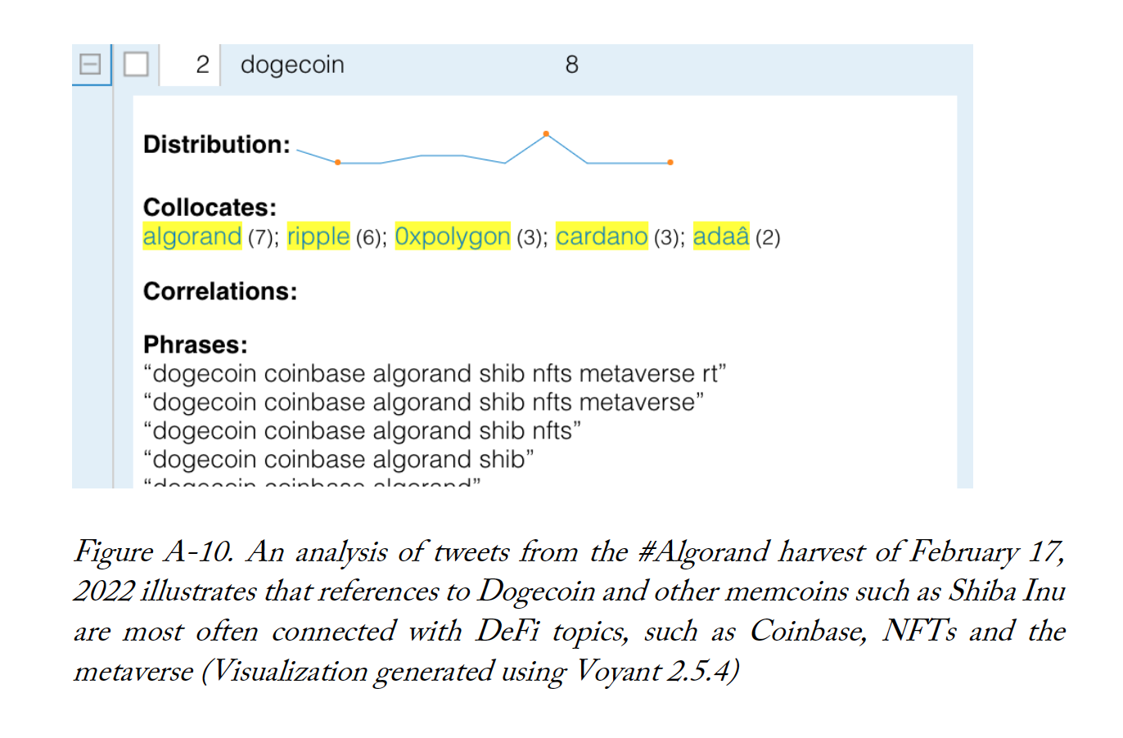
Opportunity #2, Cont’d
‘Distant reading’: A more quantitatively informed way of understanding literature by "aggregating and analyzing massive amounts of data" not only about the work(s) themselves, but also in the contextual information that surround the work(s).
Techniques inspired by digital ethnography (Moretti 2005 & 2013; Jänicke et al. 2017; Bode 2017).

Slide 19
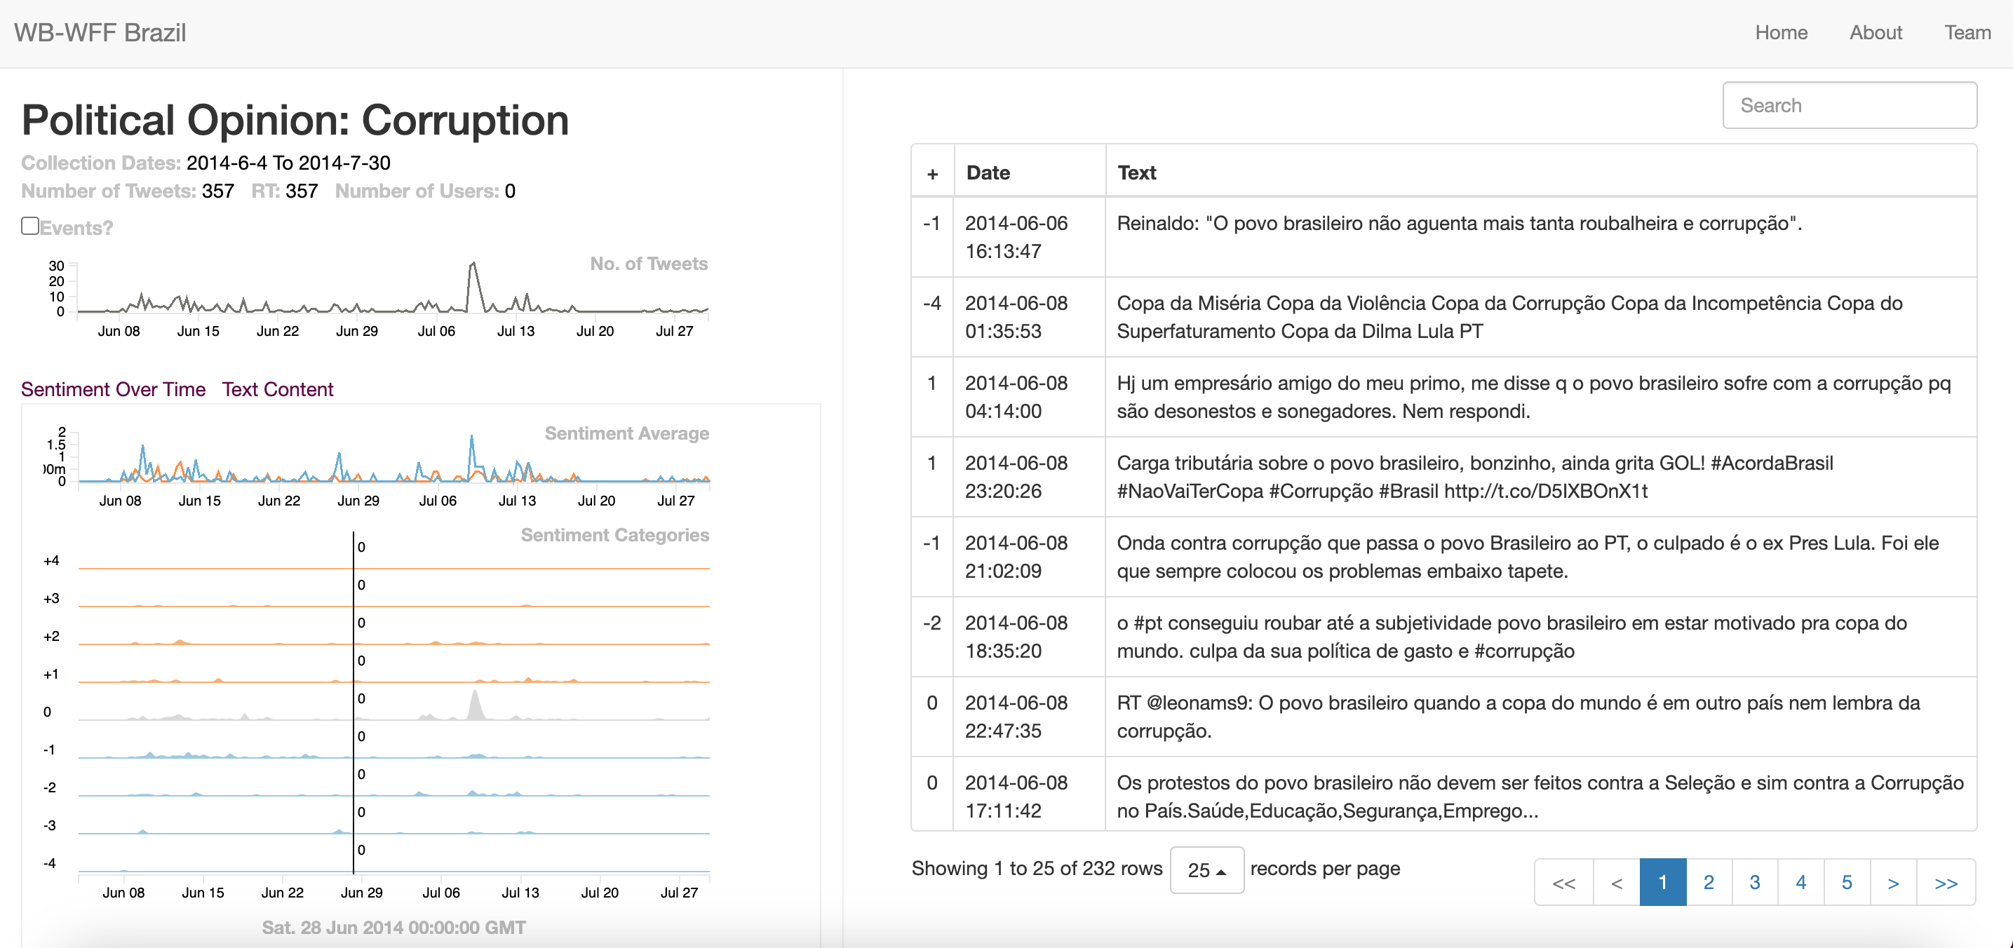
World Bank “We Feel Fine” Project

Slide 20
Key Insight #2
Could we combine PETs and Distant Reading to enable archives to be both accessible and protected?

Slide 21
Key Insight #2
Could we combine PETs and Distant Reading to enable archives to be both accessible and protected?

Slide 22
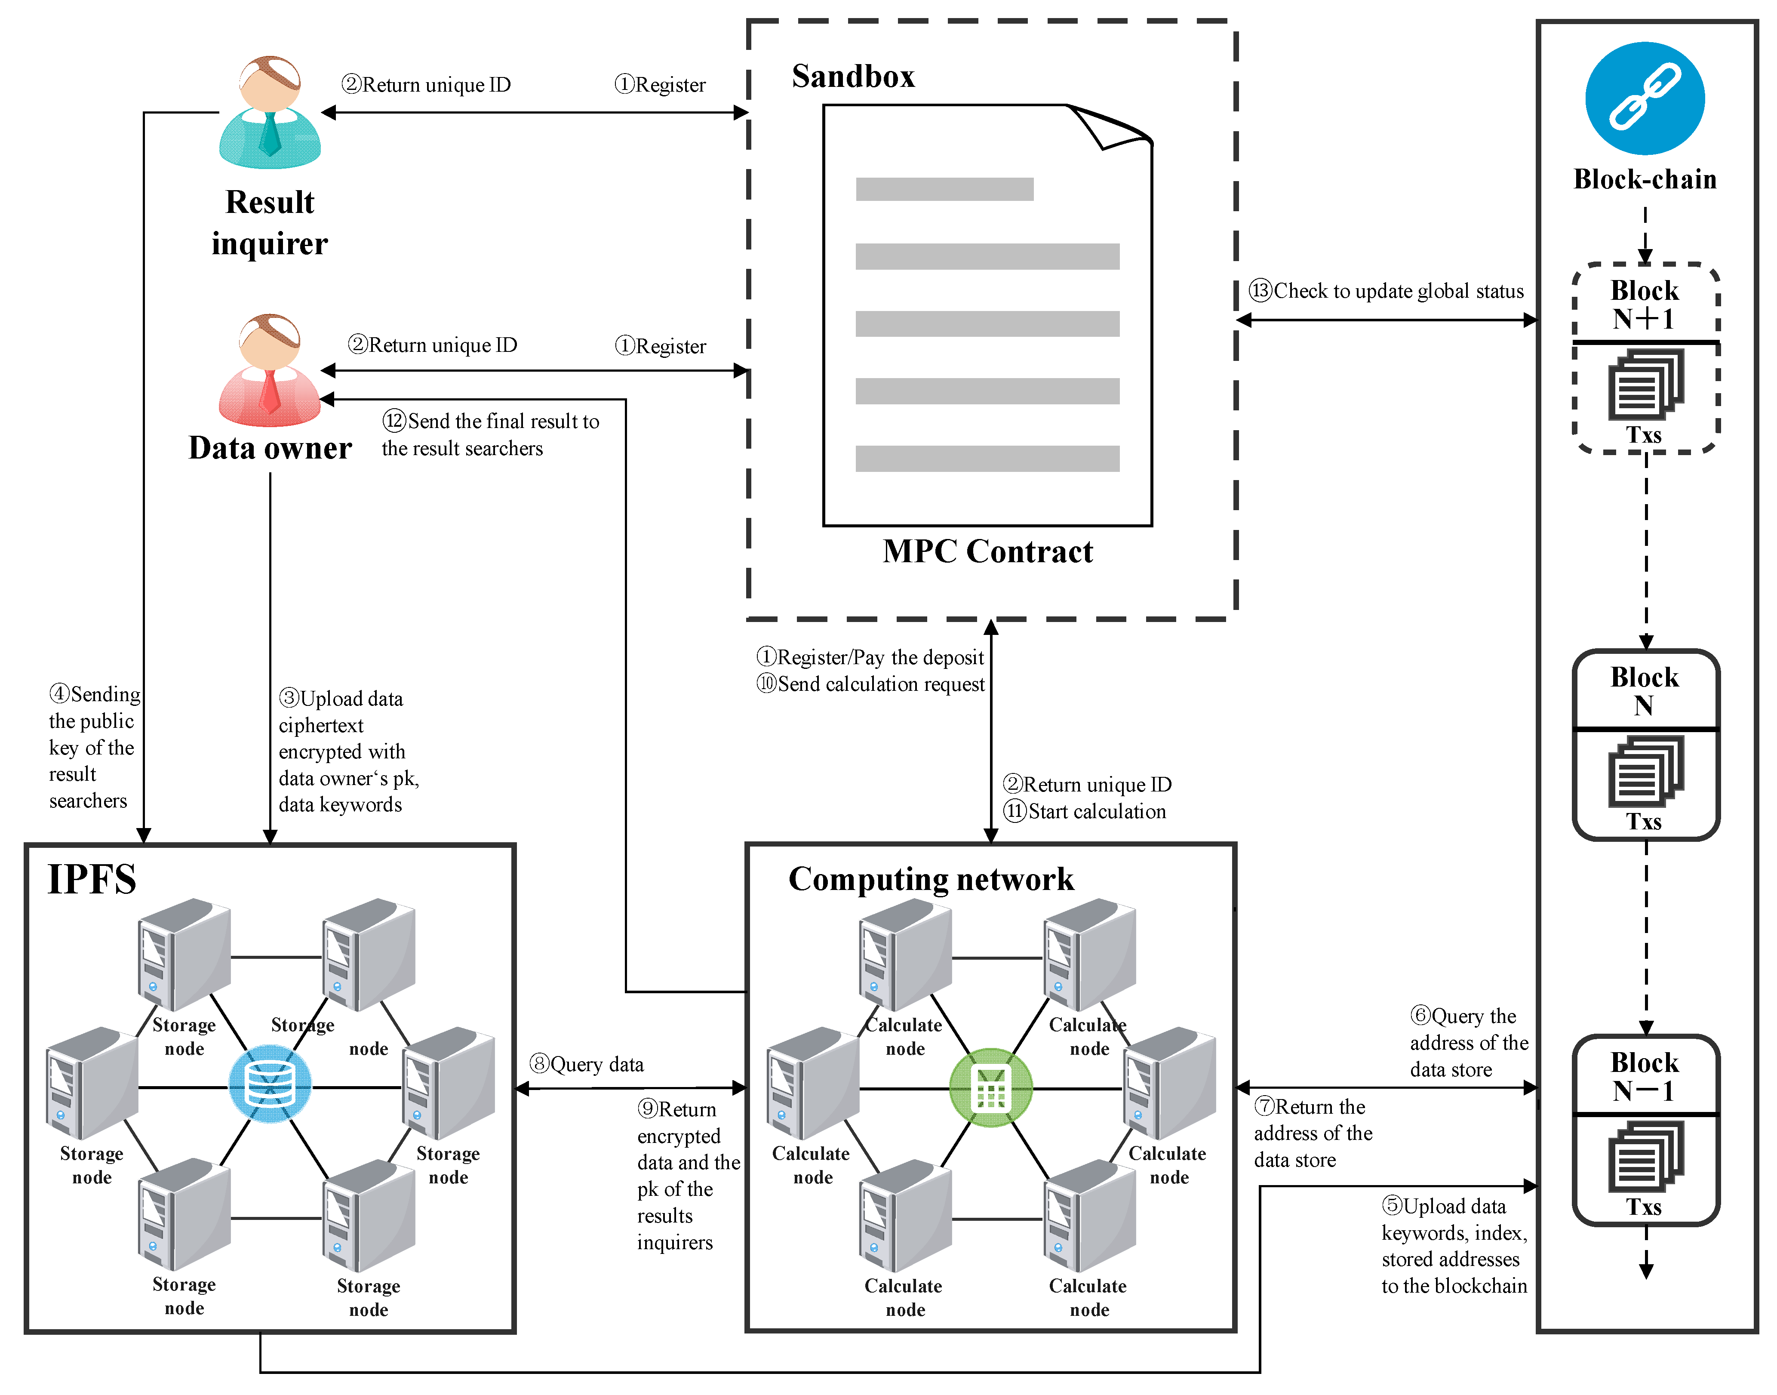
What could this look like?
Adapted from: Jiang, Yongbo, Yuan Zhou, and Tao Feng. 2022. "A Blockchain-Based Secure Multi-Party Computation Scheme with Multi-Key Fully Homomorphic Proxy Re-Encryption" Information 13, no. 10: 481. https://doi.org/10.3390/info13100481

Slide 23
InterPARES ‘We_Can’!
Phase 1 (2024-2025)
-discuss and finalize the solution requirements and architecture & identify initial test data (e.g., newspaper holdings, X (formerly Twitter) holdings).
-refactor the WB project and integrate it & MyCNTRL code to meet initial distant reading requirements (e.g., for sentiment analysis)
-implement with one strategic partner initially, with a view to scaling in Phase 2
Phase 2 (2025-2026)
-scale the solution to additional strategic partners
-identify additional AI functionality to support distant reading
-identify additional PETs & other technical funcitonality
-implement additional functionality into the solution
Beyond
-implement Decentralized Autonomous Organization to govern the shared infrastructure for participating archives & return generated revenue to maintain infrastructure and benefit archives

Slide 24
Questions & Discussion
Generated with DALL-E, using prompt “Picture of a computer with glasses reading a manuscript on Artificial Intelligence in the style of Gaudi”

