Slide 1








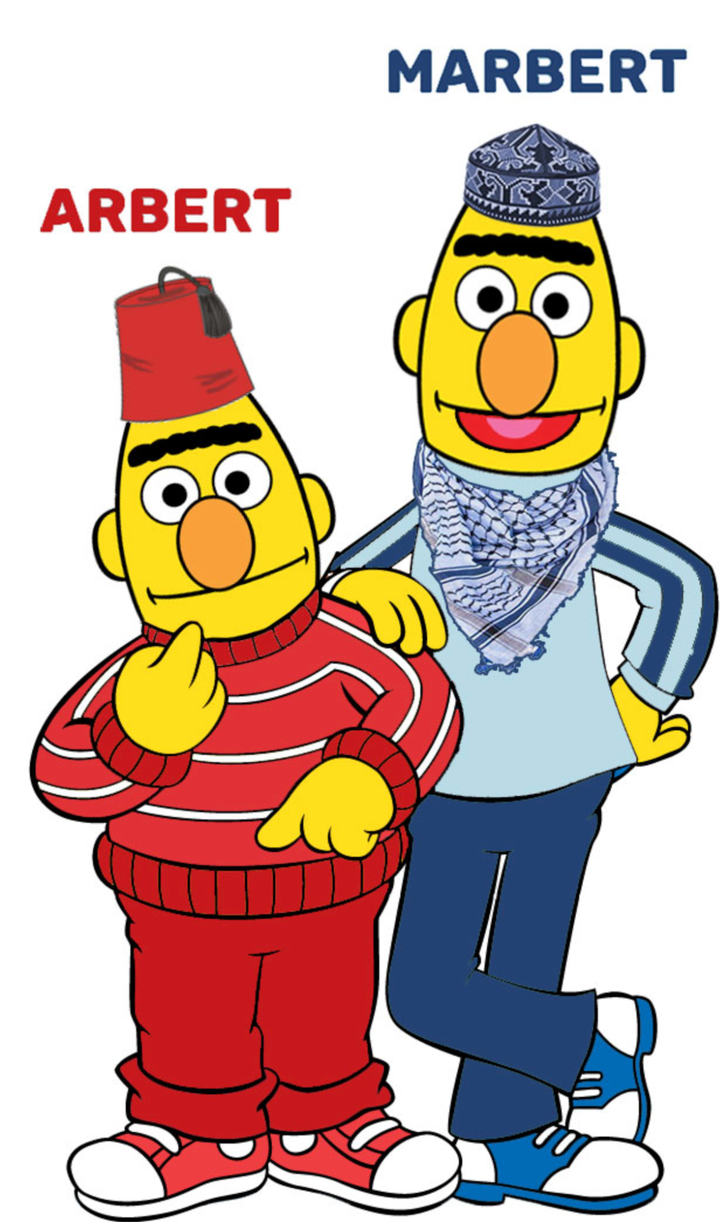


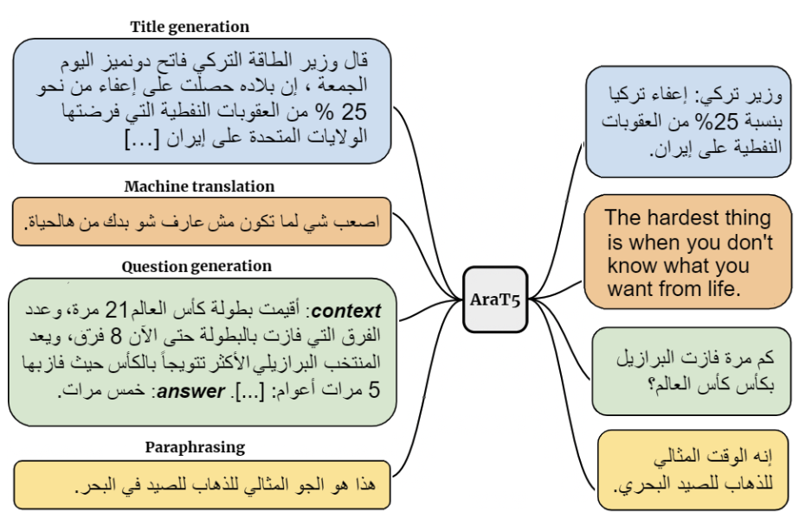




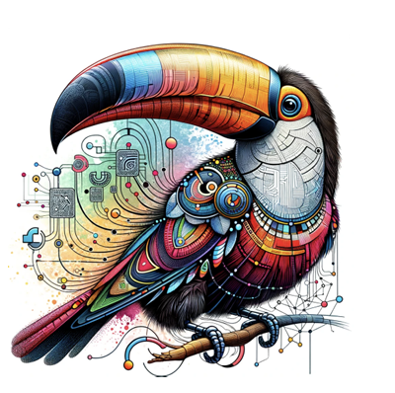
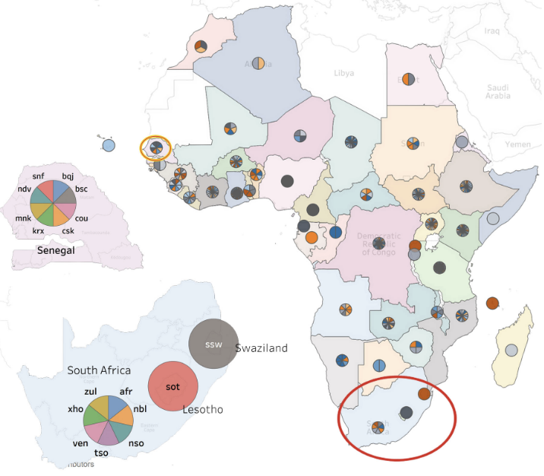

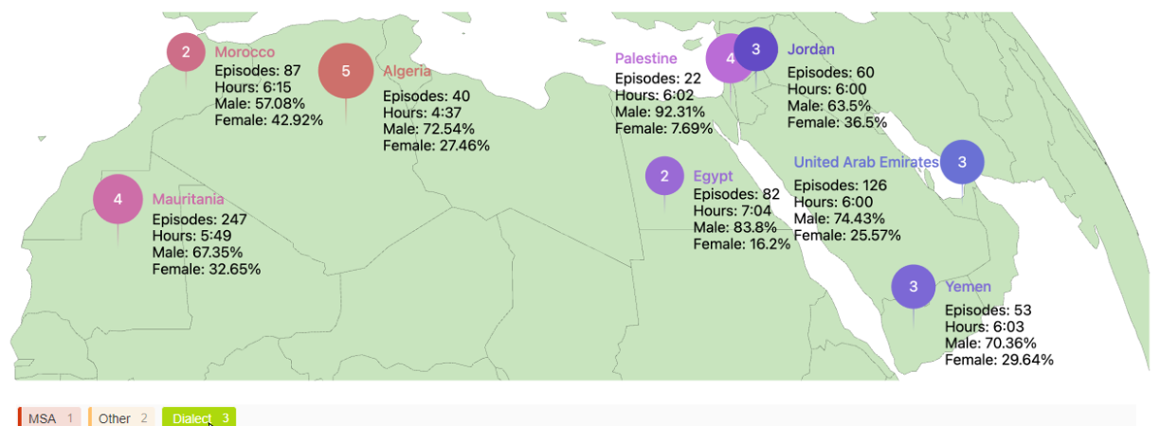


From Records to Reasoning:
The Frontier of AI for Archives
Muhammad Abdul-Mageed
Canada Research Chair in NLP and ML
The University of British Columbia
June 25, 2026

Slide 2
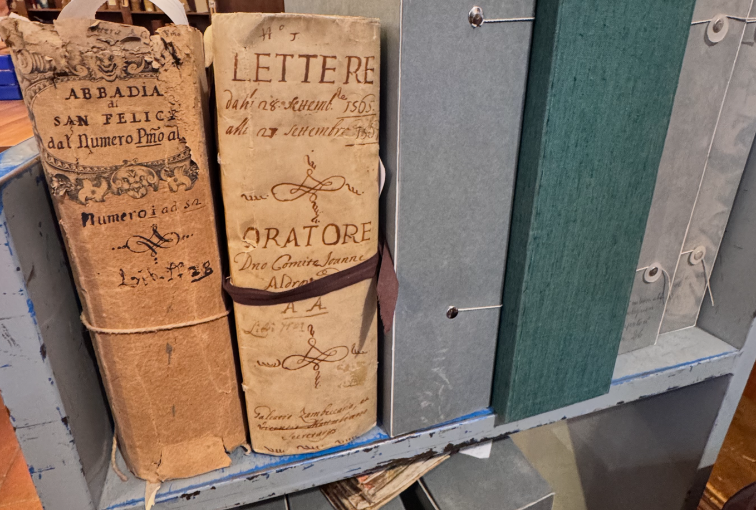
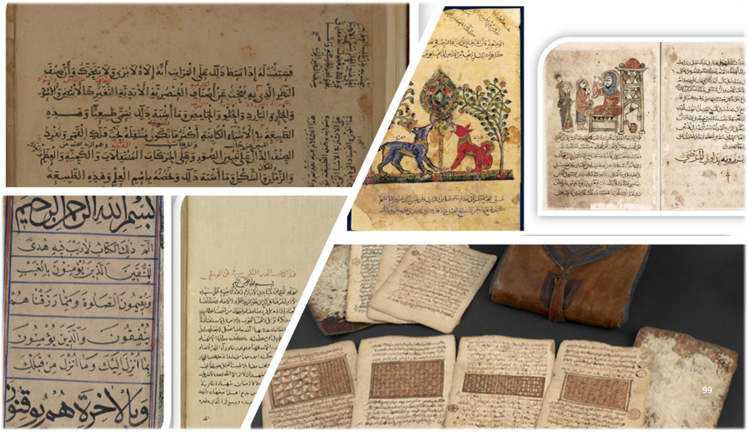

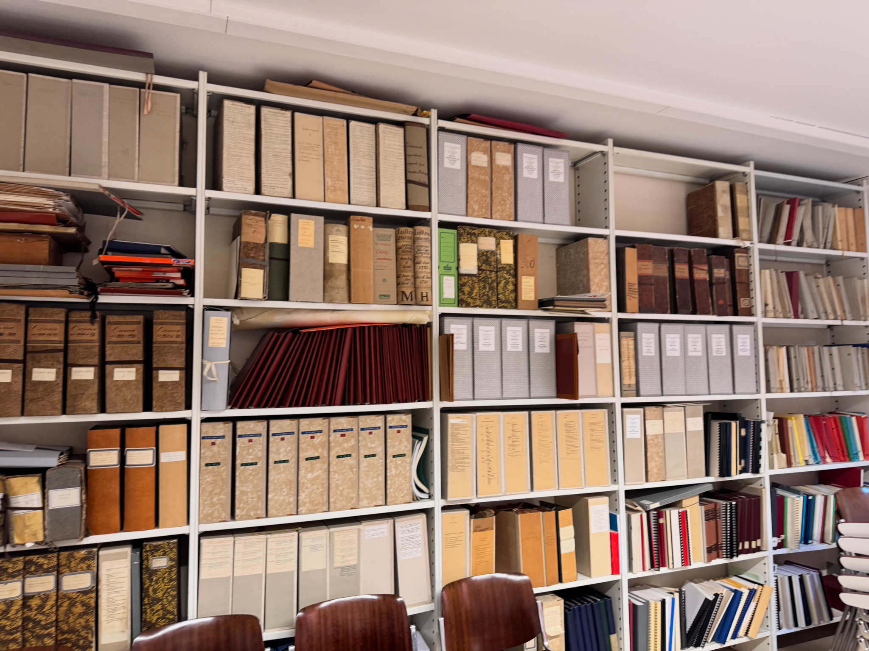



Archives
Archival Content
Audio
Visual
Textual

Slide 3

LLMs

Slide 4
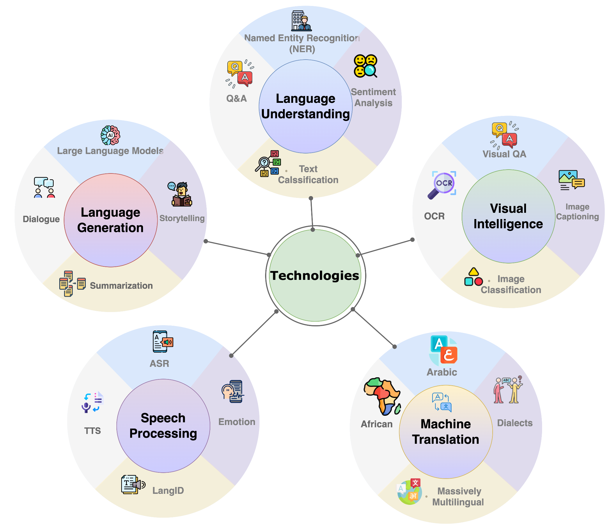
Technologies
Notes:
https://app.diagrams.net/#G1hQPqvliXJBg-oBocILf7dkGNUlL2bCAg#%7B%22pageId%22%3A%22i8ZE51LSi0jTJiv_4nBT%22%7D

Slide 5
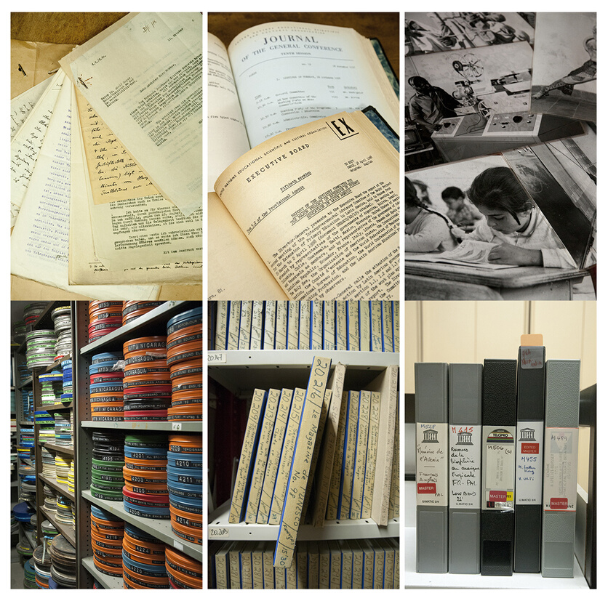
AI-Assisted Metadata Enrichment and Diplomatic Analysis for UNESCO Audio Archives
Slides modified from
Eng Sengsavang, UNESCO &
Peter Sullivan, UBC

Slide 6

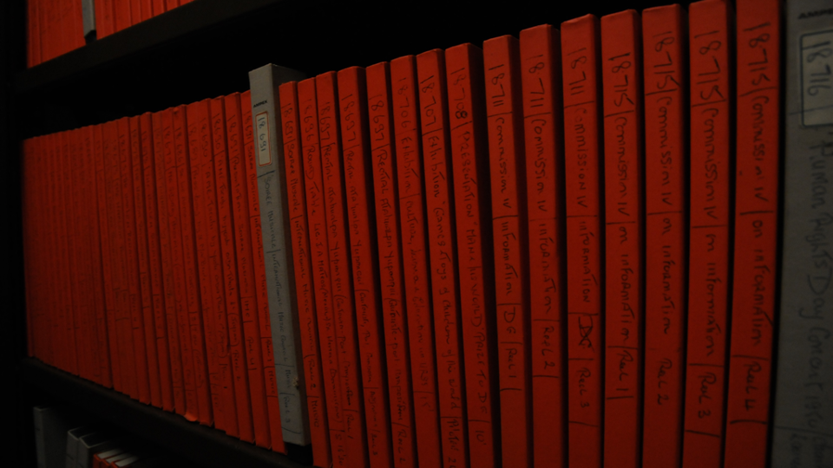
Digitized historical audio archives of the UNESCO Public Information division
Volume: ~17,630 audio recordings
Date: 1940s to 1980s
Original format: Digitized reel-to-reel magnetic tape (2017 - 2022)
Languages: 70+ languages including English, French, Spanish, Arabic, German, Italian, Portuguese, etc.
Topics: Education, culture, sciences, social and human sciences, communications/media
Genres: Radio programmes, interviews, speeches, conferences, meetings, events, musical recordings, etc.

Slide 7
… Radio is an agency which may jump across national barriers in a way impossible to any material medium.
- Julian Huxley, UNESCO Director General, 1946

Slide 8
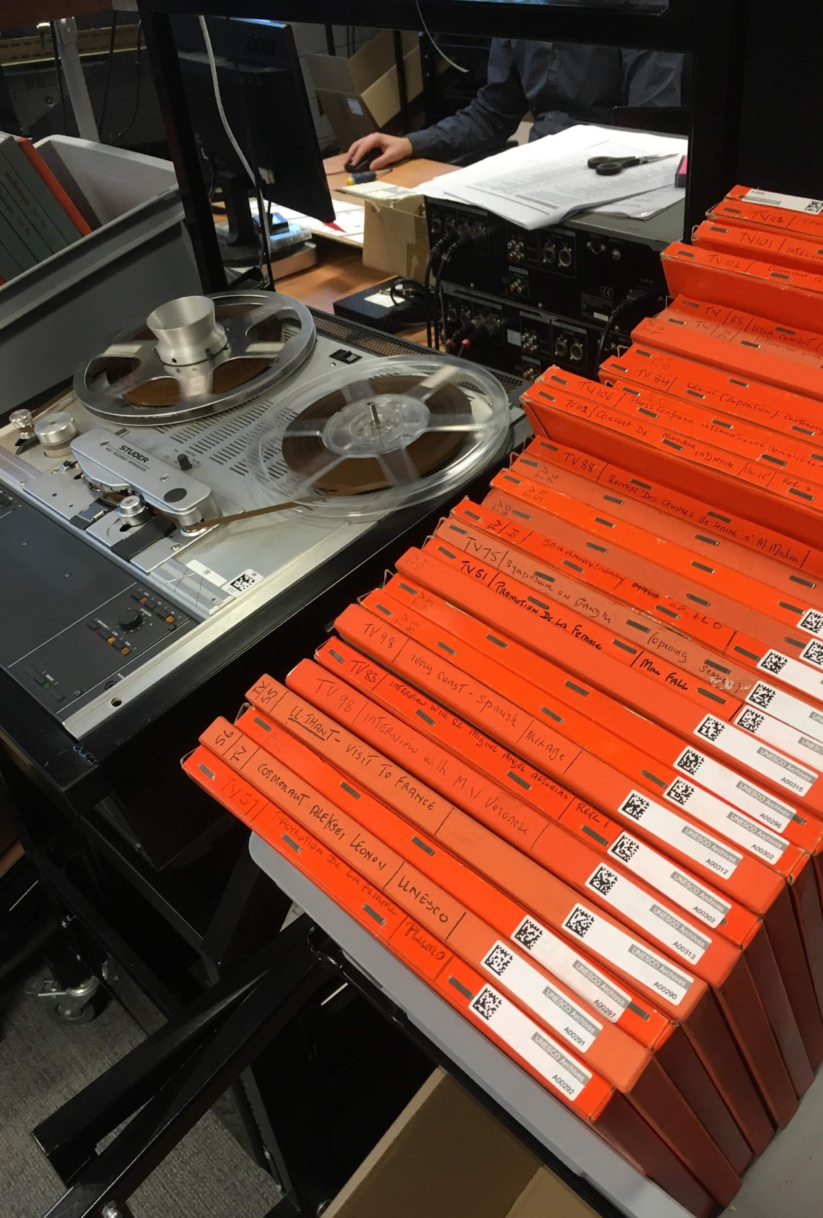
Background
Digitized between 2017 and 2022.
Sometimes minimal existing metadata for audio recordings.
Sometime metadata incorrect or incomplete (e.g., not all major speakers listed; names spelled incorrectly; little or no descriptions of recordings).
Decision made to describe and create metadata post-digitization.
To date, over 1,000 audio recordings published online; the rest still need to be published with metadata.

Slide 9
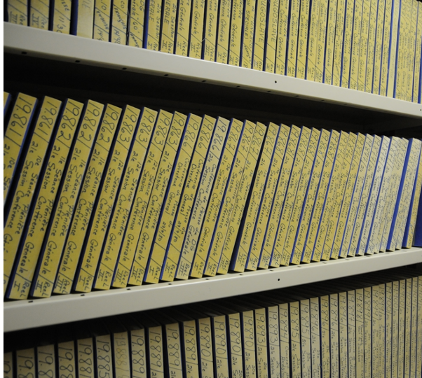
AI Models
Practical Questions
Can AI models and tools support and improve the processes of archival description and metadata creation?
Can AI tools return accurate results and save staff time?
What are the risks and challenges when introducing AI into archival description practices for both publication and preservation?

Slide 10
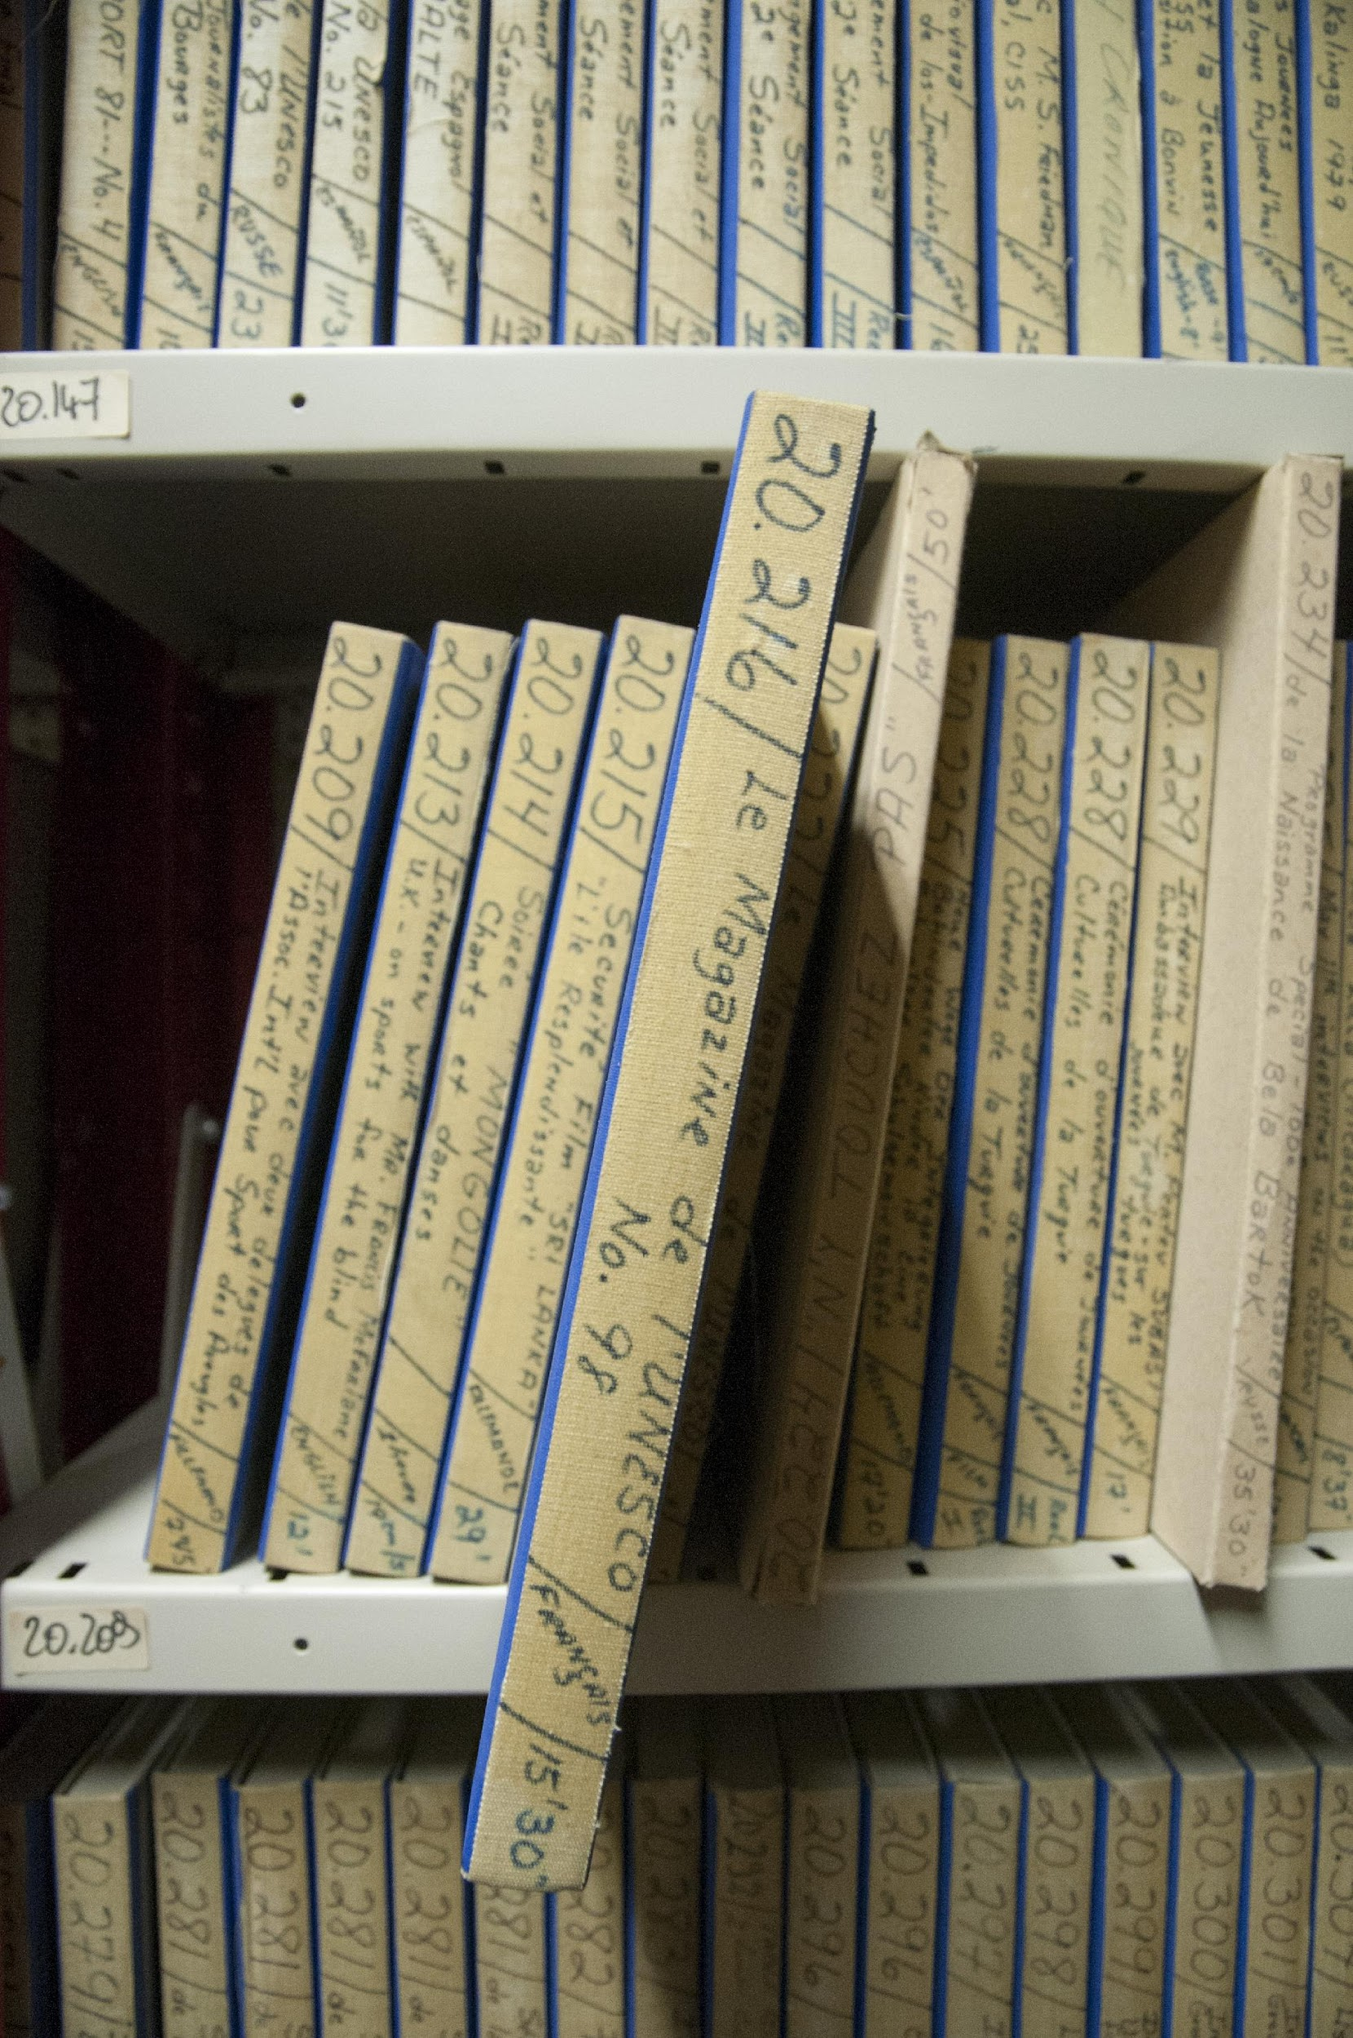
AI Models
AI for Audio Description
Spoken language identification. Recordings in over 70+ different languages. Not humanly possible for staff to identify and describe recordings in all languages.
Transcription. Staff must currently listen to recordings to describe them - labor intensive process.

Slide 11
AI Models
AI for Audio Description cont’d
Speech translation to English. Translations into English can help staff describe recordings in other languages, even when we cannot understand the recordings.
Summarization. Currently UNESCO staff must produce summaries of each recording.

Slide 12
Demo

Slide 13
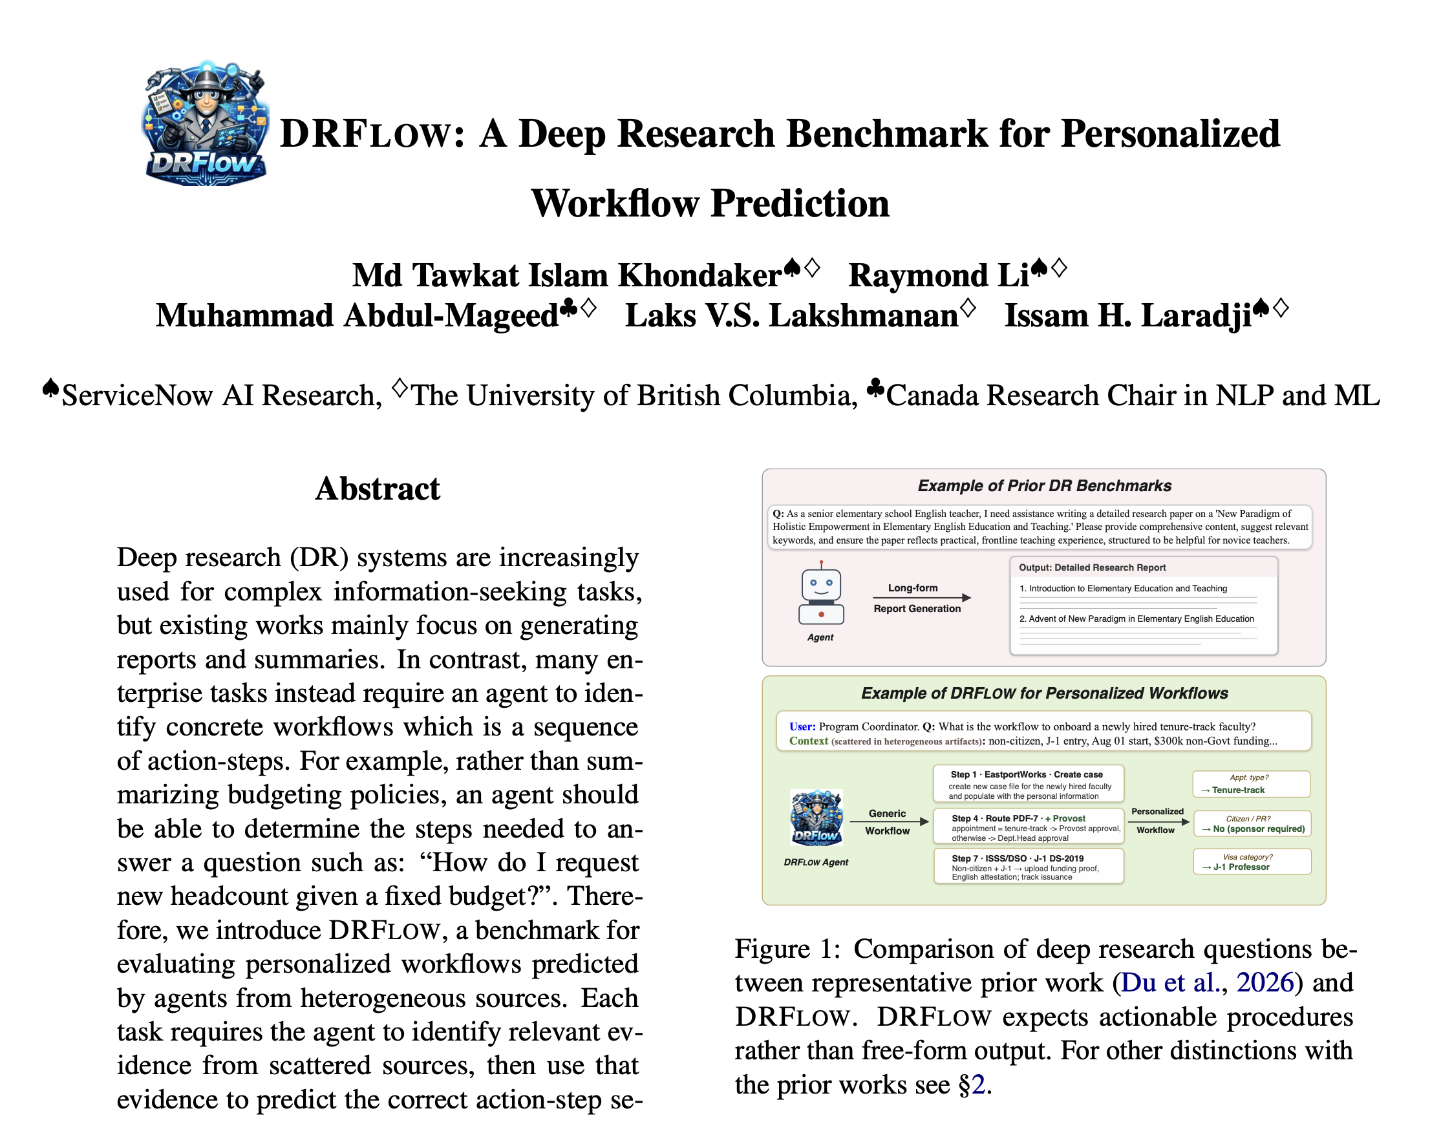
https://arxiv.org/pdf/2606.18191

Slide 14
DRFLOW
DRFLOW: a benchmark for evaluating whether deep-research agents can produce personalized workflows, not just long reports or summaries.
Key distinction: many real professional tasks require knowing what steps to take, in what order, under which conditions, and based on which evidence.
DRFLOW tests this by giving agents scattered evidence from heterogeneous sources such as documents, emails, chats, and local files, then asking them to recover the correct action-step sequence for a user’s specific situation.
The benchmark contains 100 tasks across five domains, with 1,246 reference workflow steps grounded in more than 3,900 sources.
We also introduce DRFLOW-Agent, a workflow-oriented agent that improves over baseline agents.

Slide 15
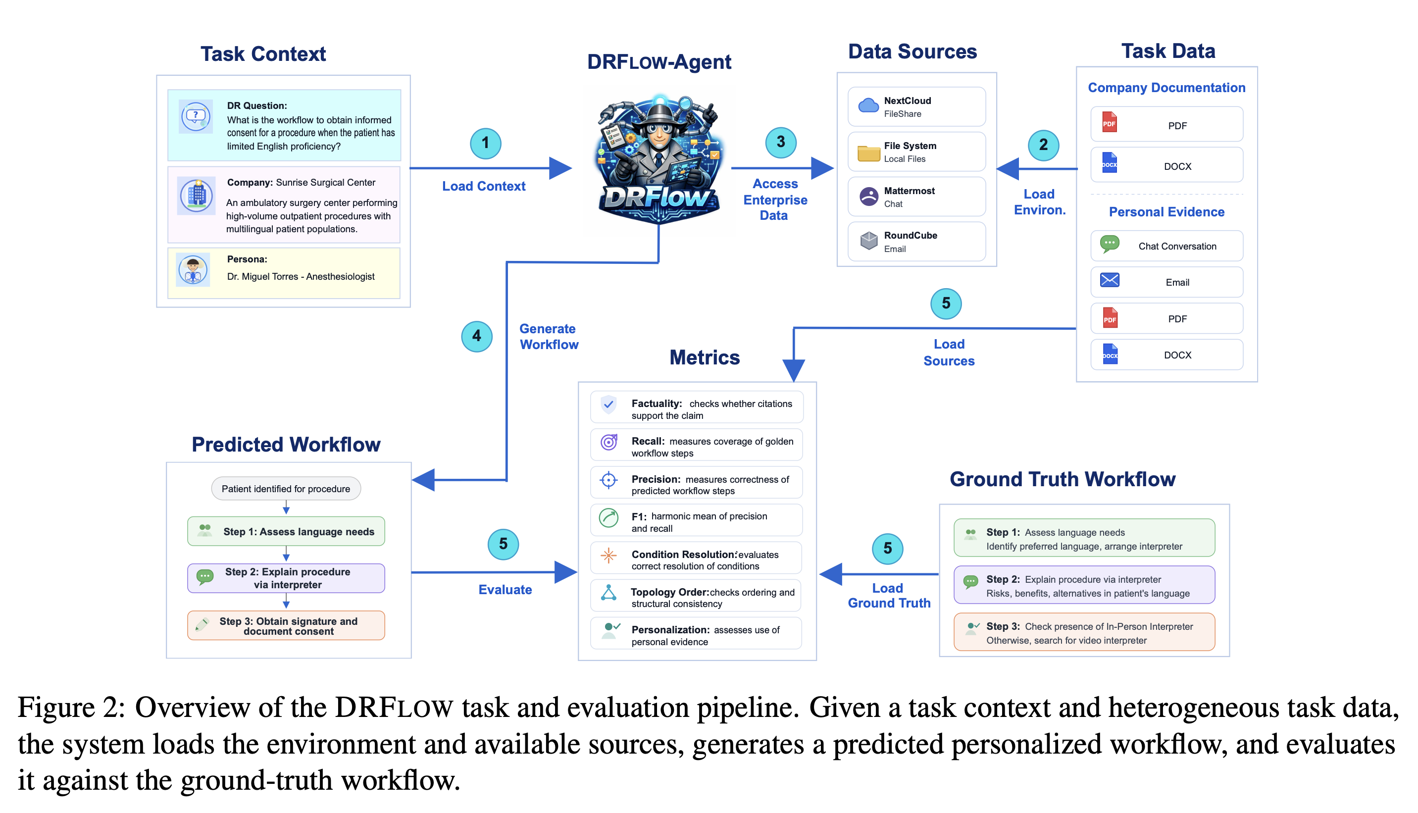
DRFLOW Task and Eval Pipeline

Slide 16
Take-Home for Archivists
This work is about moving from AI as a “report writer” to AI as a system that can reconstruct procedures from records.
That is directly relevant to archives because archival work often involves fragmented evidence across institutional documents, correspondence, forms, logs, policies, and case files.
The future frontier here is AI that can help reconstruct how an institution acted, what procedures governed decisions, which documents support each step, and how general policies were applied to specific cases.

Slide 17
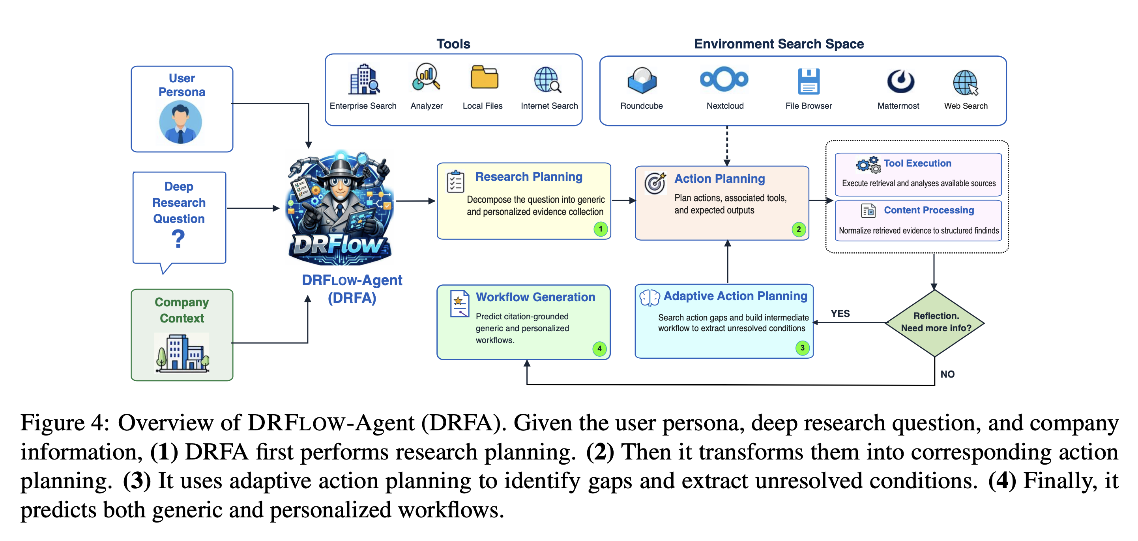
DRFLOW-Agent
A workflow-oriented agent that improves over baseline agents.
Notes:
The agent begins with three inputs: the user persona, the deep research question, and the company or institutional context.
It then uses a set of tools and information sources, including enterprise search, local files, internet search, file browsers, web search, chat systems, and email-like environments.
The first step is research planning. Here, the agent breaks the question down into what evidence needs to be collected, both general evidence and evidence specific to the user’s situation.
The second step is action planning. The agent turns the research plan into concrete actions: which tools to use, which sources to search, and what outputs to expect.
The third step is adaptive action planning. This is important because the agent does not assume that all information is available immediately. It reflects on what it has found, identifies missing information, and searches again when more evidence is needed.
Finally, the agent generates the workflow. The output is not just a general recommendation, but a sequence of steps that combines generic procedural knowledge with personalized evidence from the user’s actual context.
The key point is that DRFA models deep research as an iterative process: plan, search, reflect, fill gaps, and then produce an actionable workflow. For archivists, this is highly relevant because archival interpretation often works the same way: we start with a question, move across scattered records, identify gaps, compare sources, and reconstruct a procedure, event, or decision from the evidence.

Slide 18
Relevance to Archives
The key point is that DRFA models deep research as an iterative process: plan, search, reflect, fill gaps, and then produce an actionable workflow.
For archivists, this is highly relevant because archival interpretation often works the same way: we start with a question, move across scattered records, identify gaps, compare sources, and reconstruct a procedure, event, or decision from the evidence.

Slide 19
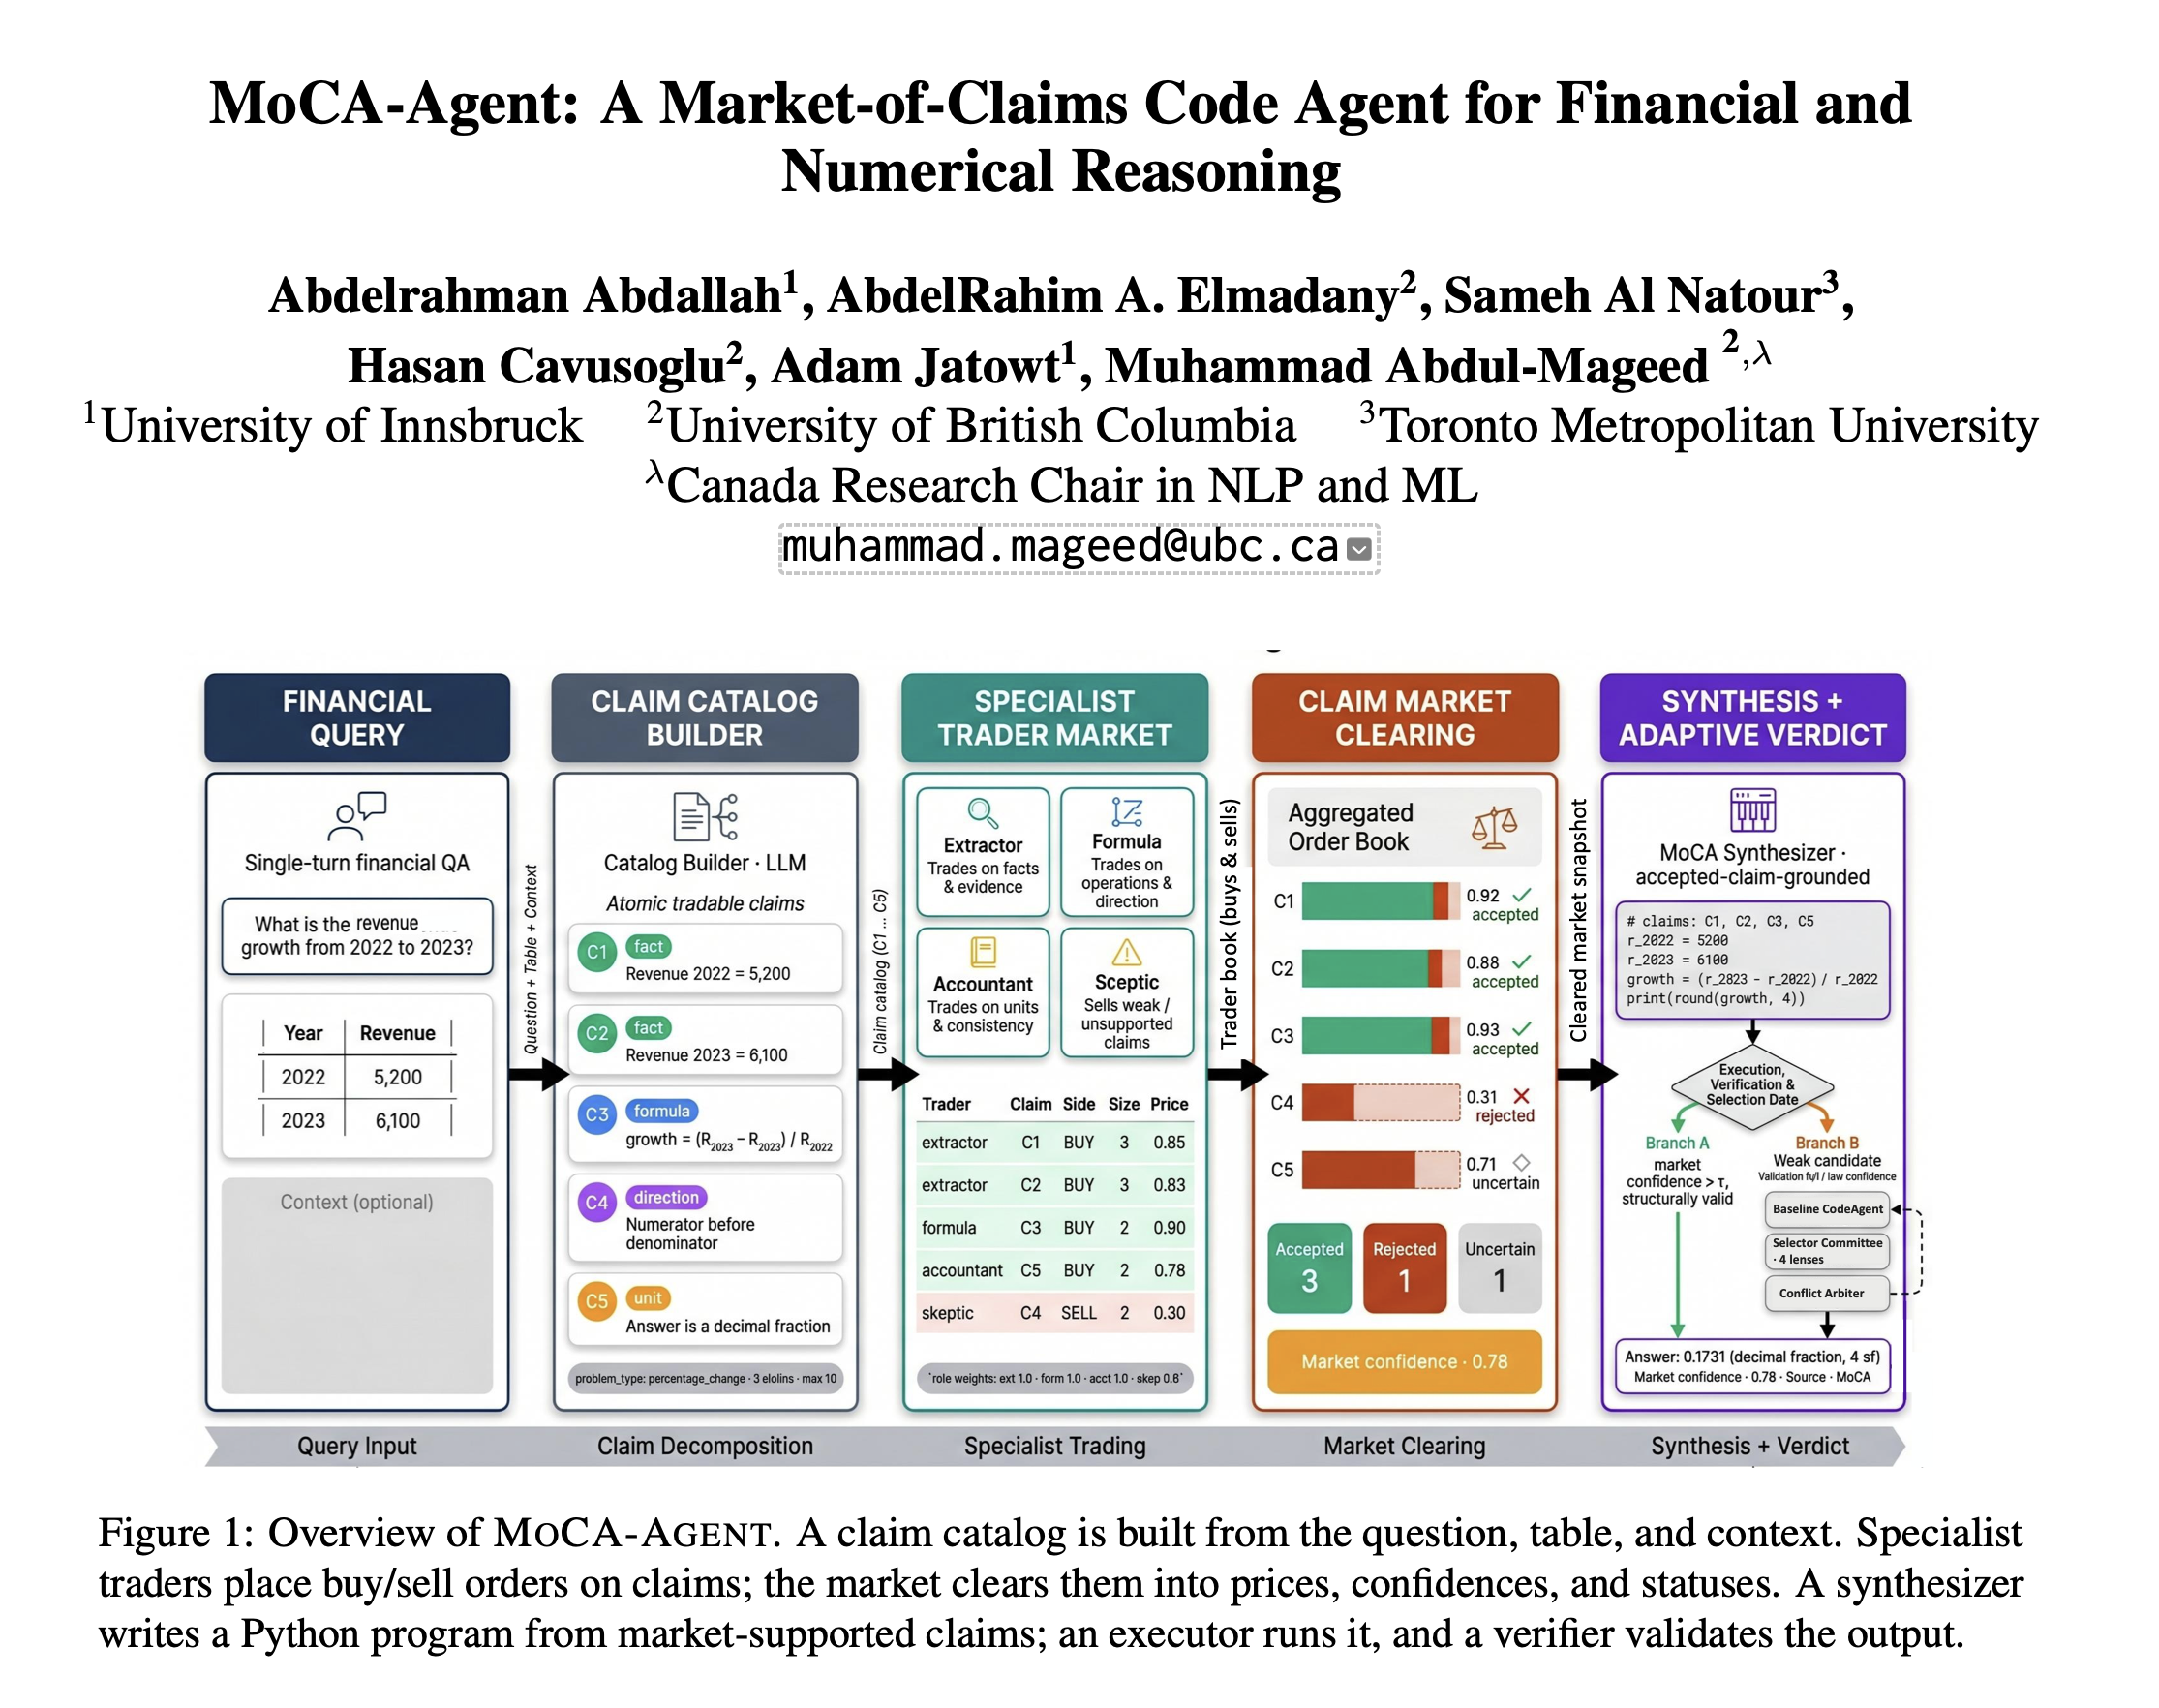
https://arxiv.org/pdf/2606.11537

Slide 20
MoCA-Agent
Illustrates how AI is moving beyond simply answering questions toward building structured reasoning workflows that can examine evidence, compare alternative interpretations, and verify claims.
Introduces MoCA-Agent, a system designed for financial and numerical reasoning, where the central challenge is not only to read text or tables, but to reason carefully over numbers, formulas, and supporting evidence.
This is part of a broader frontier in AI: systems that can help interpret complex records, extract claims from documents, compare competing readings of the same evidence, and produce answers that are more transparent, traceable, and verifiable.

Slide 21
Relevance to Archives
Although the paper focuses on financial tables, its larger significance extends naturally to archival work.
Many archival collections contain structured and semi-structured materials—tables, ledgers, inventories, reports, budgets, administrative files, and institutional records.
Future AI systems will need to reason over these materials with the same care, skepticism, and attention to evidence that archivists and records professionals already bring to their work.

Slide 22
Overview of MoCA-Agent
https://arxiv.org/pdf/2606.11537
Notes:
Rather than asking a single language model to answer a financial question directly, the system breaks the problem into a sequence of smaller, more transparent reasoning steps.
It begins with a financial query, together with any relevant table or contextual information. From there, it builds a catalog of claims, such as which numbers are relevant, which formula should be applied, and what form the final answer should take.
These claims are then passed into a “market” of specialist agents, where different agents act like traders: some support a claim, others challenge it, and their judgments are converted into prices or confidence scores.
The system then clears the market, selecting the claims with the strongest support.
Finally, it synthesizes an answer by writing and executing a program, then verifying the result.
The key message here is that MoCA-Agent is not simply generating fluent text; it is creating an organized process for reasoning, disagreement, validation, and evidence-based final judgment.

Slide 23
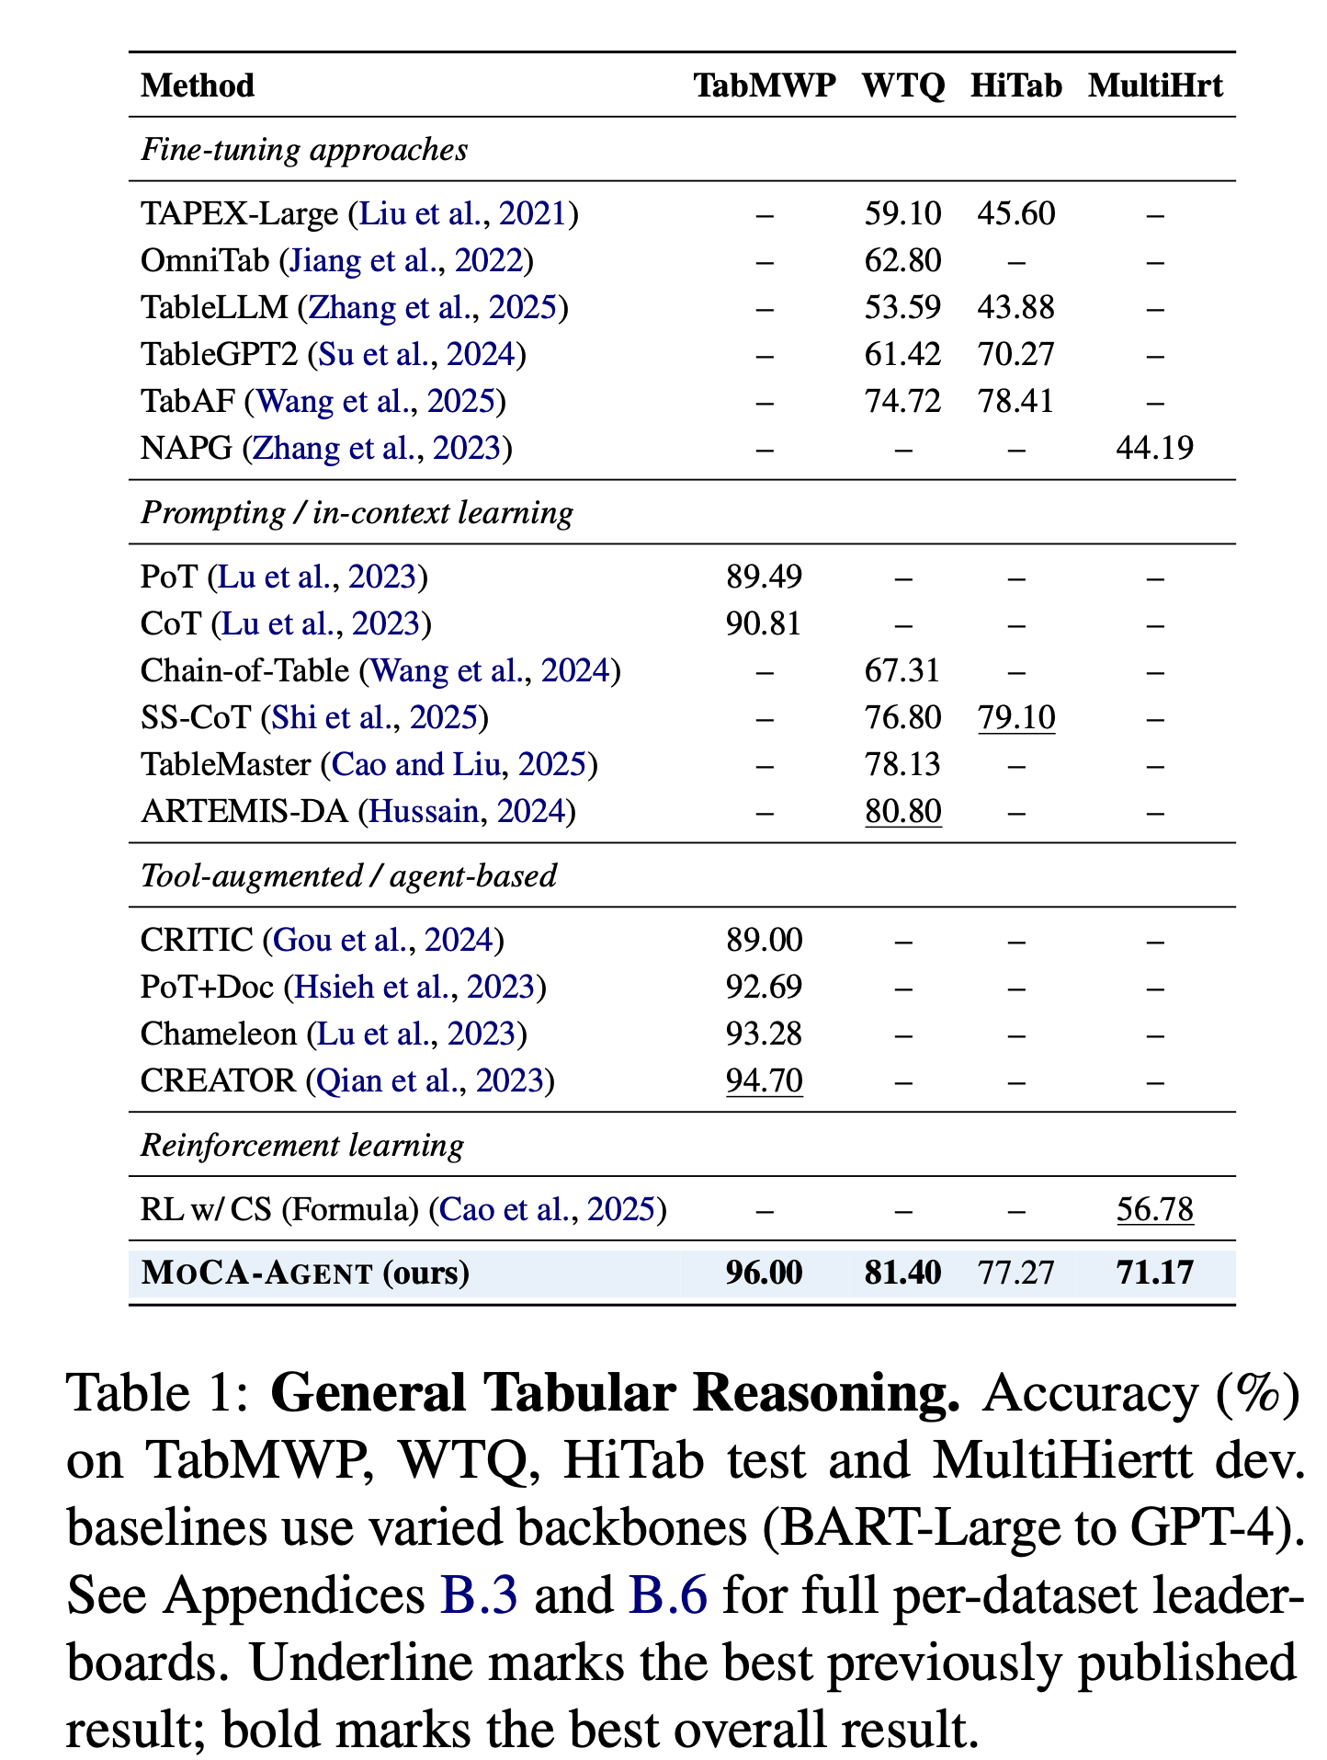
Notes:
This table shows how MoCA-Agent performs on general tabular reasoning tasks. These are tasks where the system has to answer questions based on tables, rather than ordinary text alone.
We compare MoCA-Agent against several types of previous approaches, including fine-tuned models, prompting methods, tool-augmented or agent-based systems, and reinforcement learning approaches.
What we see is that MoCA-Agent achieves very strong performance: it reaches the best overall result on TabMWP, WTQ, and MultiHiertt, and remains competitive on HiTab.
The main takeaway is that this “market of claims” idea is not useful only for financial questions. It also helps more broadly with reasoning over tables by breaking the problem into smaller claims, testing those claims, and using structured computation instead of relying only on the language model’s ability to produce a fluent answer.

Slide 24
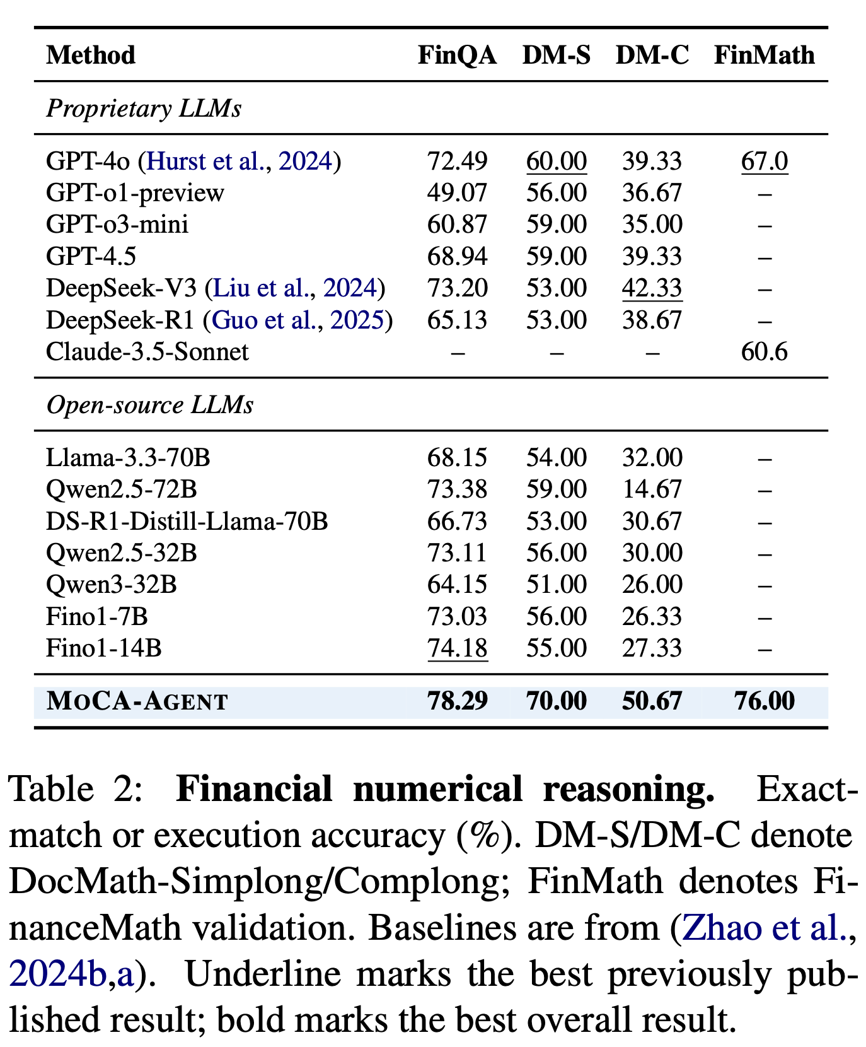
Notes:
This table focuses on financial numerical reasoning. Here, MoCA-Agent is compared against strong proprietary models such as GPT-4o, GPT-4.5, DeepSeek, and Claude, as well as a range of open-source language models.
Across the reported benchmarks, including FinQA, DocMath-Simplong, DocMath-Complong, and FinanceMath, MoCA-Agent achieves the strongest overall performance.
This matters because financial reasoning is not only about understanding language. It often requires exact calculation, careful reading of tables, correct use of formulas, and the ability to avoid answers that sound plausible but are numerically wrong.

Slide 25
Take-Home for Archivists
For archivists, the broader lesson is that AI systems can be designed to work more responsibly with numerical and documentary evidence. They can do more than summarize a record; they can check calculations, connect answers to specific claims, and make the reasoning process more transparent and auditable.

Slide 26


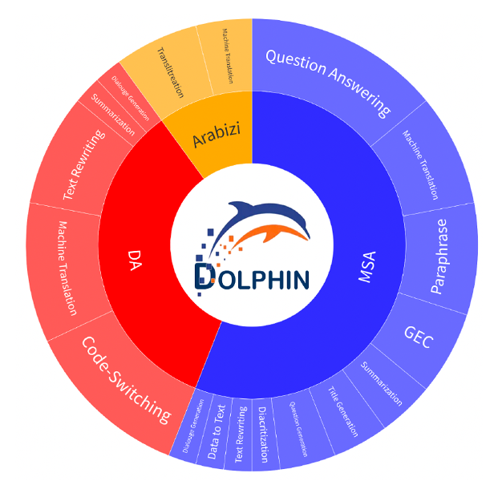


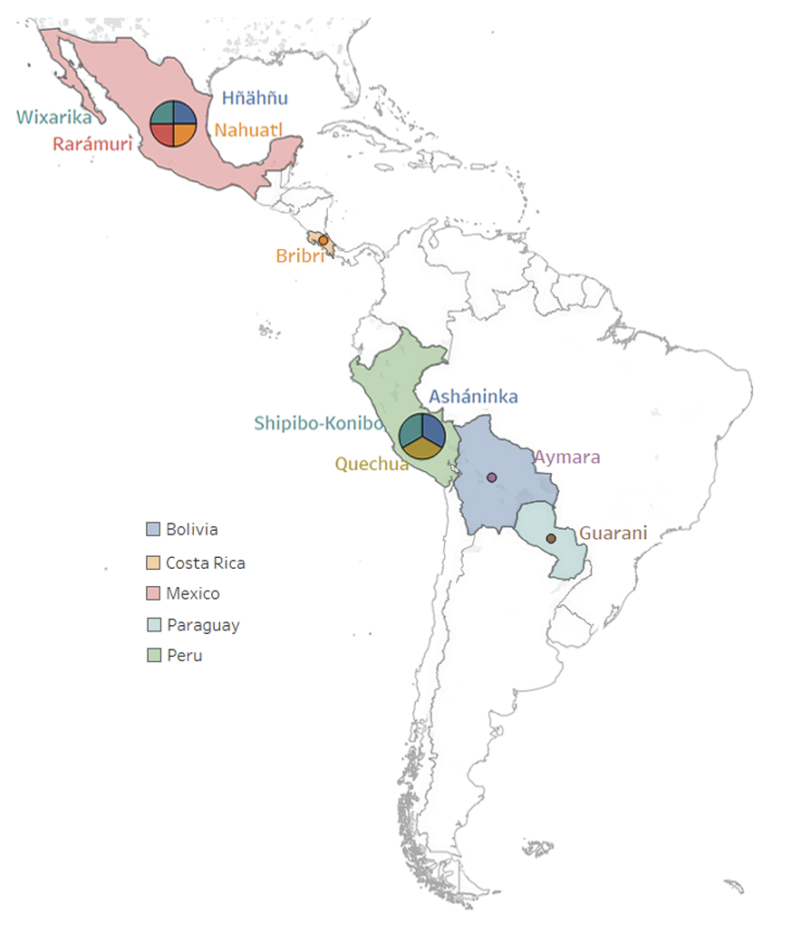

IndT5

Slide 27
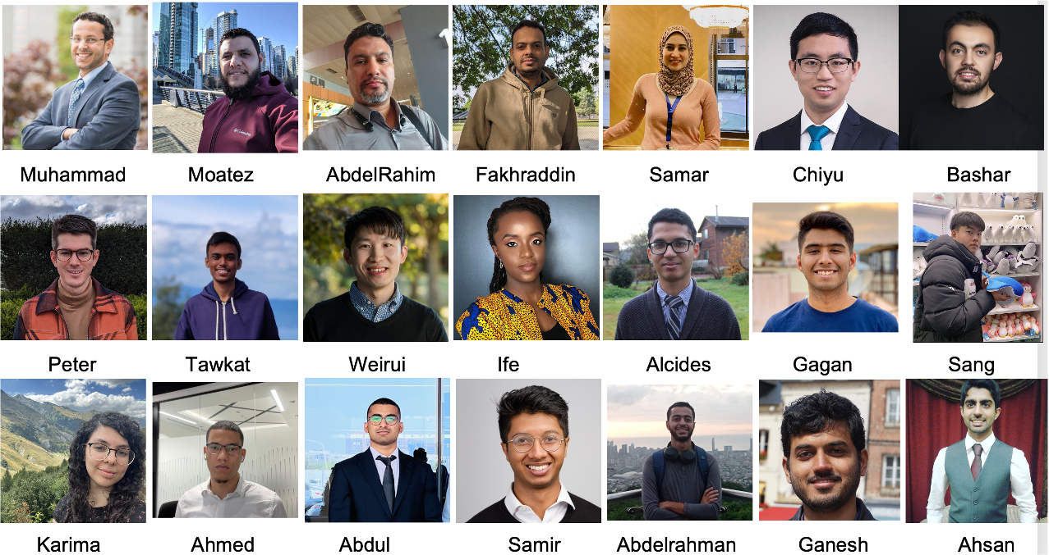

Slide 28
