Slide 1
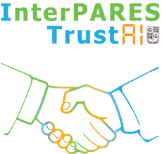
AI Competencies for the Archival Professions Plenary 12
Denver, CO
October 25th, 2024
Richard Arias-Hernandez, PI
Kaila Fewster, GRA

Slide 2
Acknowledgments:
Co-researchers/authors: Kaila Fewster (GRA, MASLIS student) and Sophie Penniman (former GRA, Archival Processing Specialist, Northwestern University).
InterPARES Trust AI: https://interparestrustai.org/ led by Drs. Luciana Duranti and Muhammad Abdul-Mageed, University of British Columbia, and funded by the Social Sciences and Humanities Research Council of Canada (SSHRC).
Research collaborators: Jennifer Douglas (UBC), Victoria Lemieux (UBC), Darra Hofman (SJSU), Moises Rockembach (U.Coimbra), and Peter Sullivan (UBC).
Interviewees & Case Study Reviewers: Bethany Anderson, Stephanie Decker, Glen Humphries, Tim Hutchinson, Devon Mordell, Jessica Moran, Greg Rolan, Jennifer Proctor, David Zeitlyn, Peter Sullivan, Eng Sengsavang, Adam Jansen.
Archival professionals and students: ACA 2024 - Edmonton (24) and Expotecnologia 2024 – Medellin, Colombia (47).

Slide 3
Is more education/training needed?
There is plenty of training on machine learning/artificial intelligence (ML/AI), but not with a focus on archives needs and workflows or considerations of archivist and records managers as learners (Darby et.al., 2022; Cordell, 2020)
Evidence-based evaluations of existing data science, machine learning, and AI training opportunities and identification of training gaps within and outside archives communities are needed to develop further training for archivists and records manager (Darby et.al., 2022; Padilla, 2019)
Notes:
Subportada

Slide 4
Research Question
What are learning outcomes, curriculum structure, activities, and assessment that can be designed for archival students and professionals to be able to “leverage”(and possibly “design”) AI/ML to support the ongoing processing, availability, and accessibility of trustworthy public records?
Notes:
Subportada

Slide 5
Literature Review for case studies
In early 2022 we conducted a literature review on 2012-2022 publications with the following goals:
Identify use cases of archivists and records professionals using (or testing) AI in their workflows.
Identify archival and/or records management practitioners and scholars involved in these cases to involve them in semi-structured interviews.
Identify relevant information and didactic materials that could be incorporated into a curriculum on AI for the processing and management of records.

Slide 6
Case Studies (2017-2021)
#1: using NLP, ENR, and machine learning to enhance description of multiple personal fonds and reveal connections between them. University Archives.
#2: using NLP, NER, and ML techniques such as topic modeling to appraise and process emails and other born-digital records. University Archives and Special Collections.
#3: using Computer vision and NLP to identify relationships between visual records via identification of subjects depicted in them. College Archives.
#4: using ePADD (NER, NLP of PII, Topic Modeling) to process email series in a personal archives to make it available to researchers. National Library.
Notes:
After the lit review, we identified 13 relevant cases & articles and 25 archival professionals and/or scholars that were involved in AI/ML projects that included processing or management of records. We invited these 25 as potential participants for semi-structured interviews, 10 of them agreed to participate in this study, and we used the collected data to document 6 case studies (some of them illustrated in this slide) in which these 10 participants were directly involved.

Slide 7
Case Studies (2017-2021)
#5: using off-the-shelf ML software to classify a corpus of unstructured data against a retention and disposal authority at a State archives
#6: Prototype ML software to open access to email semi-active records from a software company through a ML-enhanced search engine using an attention model (BERT)/deep learning.
Notes:
Case # 5 - application of machine learning to records management by testing the accuracy of an off-the-shelf machine learning software’s ability to classify unstructured data against a previously determined retention and disposition schedule at the New South Wales state archives in Australia (Rolan et al., 2019).
Our 10 participants were archivists, record managers, and digital archives researchers from the UK, Canada, USA, Australia, and New Zealand. All our interviewees had practical experience applying AI and ML to the processing of records in archives or record management offices as illustrated in this and the previous slide.
In our interviews we aimed to identify their key competencies to incorporate AI/ML into their workflows

Slide 8
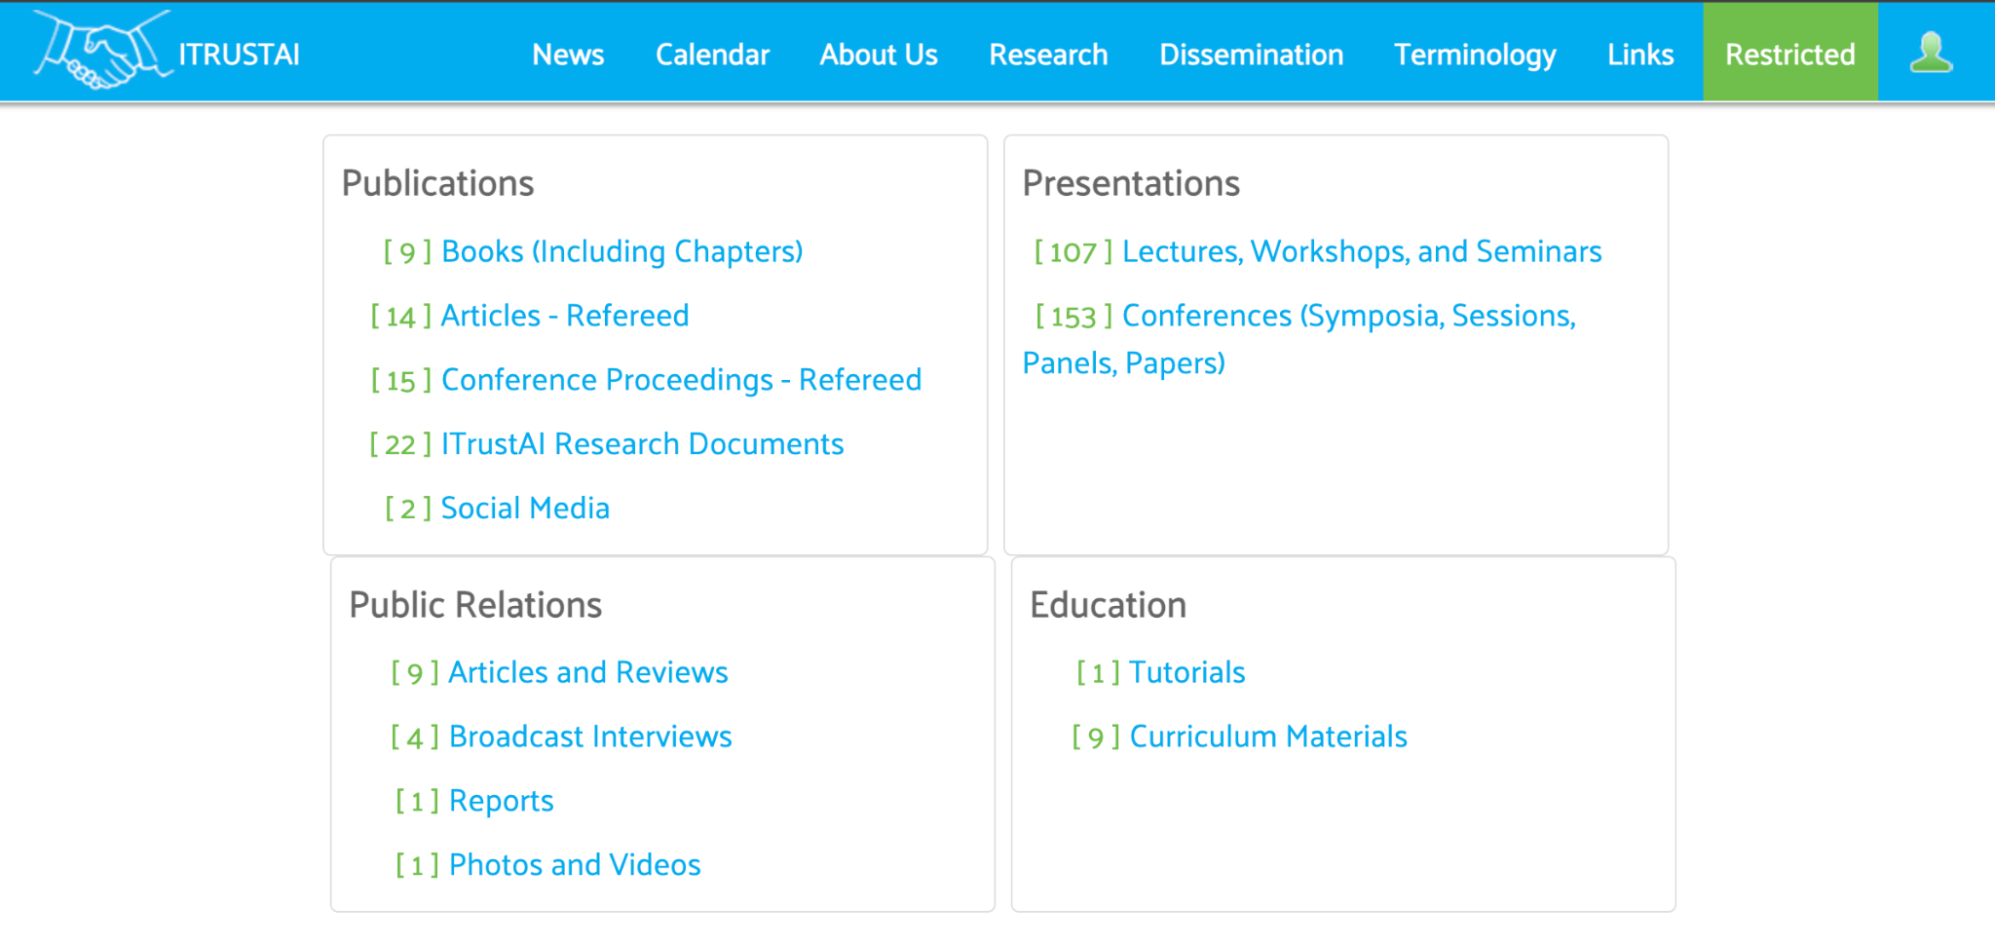
https://interparestrustai.org/trust/research_dissemination
Notes:
Two outcomes of this research: educational case studies and a competency framework for the development of professional education and training for archivists and records managers

Slide 9
Learners should know about:
K1 - Archival principles/practices | e.g., archival theory & functions, legal aspects, etc.
K2 - Basic algorithmic thinking | e.g., computational thinking, using algorithms for problem solving and pattern recognition, etc.
K3 - Basic data analysis | e.g., descriptive statistics, data operations, data exploration, etc.
K4- AI/ML fundamentals & techniques relevant to archives | e.g., AI/ML types of models & pipeline, most commonly applied ML models to archival processing: NER, NLP, Topic Modelling, etc.
K5 - Human-Computer/ Human-Information Interaction | e.g., basic principles of user experience/user interaction with AI/ML apps, tools, data, and interactions with digital records, etc.
K6 - Critical data and critical AI/ML for archives and RM | e.g., Indigenous data sovereignty, data governance, data biases in AI/ML, data provenance/paradata, social implication and ethics, etc.
Notes:
Nouns - Topics - Body of Knowledge - KNOWING (6 categories)

Slide 10
Learners should acquire:
S1 - Basic programming skills | e.g., Scripting, basic coding, tweaking code, using ML libraries, etc.
S2 - Data-related skills | e.g., collecting/selecting data, datafying digitized records, using data transformation tools, creating paradata, etc.
S3 - AI/ML skills | e.g., labelling data, training/refining models, selecting and evaluating ML models, etc.
S4 - Tool testing/adaptation to workflow skills | e.g., experimenting/tweaking will apps and tools, adapting tools (off-the-shelf or not) to archival workflows, etc.
S5 - Management/Collaboration skills | e.g., engaging, teaming-up, and collaborating effectively with SMEs, technical experts, and data stakeholders, project management, etc.
Notes:
Verbs - Actions to master - DOING (5 categories)
Hutchinson (2020) makes references to skill and competencies from archivists using those tools: minimum technical expertise to use these tools (e.g. text conversion, NLP, topic modeling, NER, etc.), ability to integrate results from NLP and ML into archival processes, ability to train and refine models in ML by marking false positives and missed items, ability to supervise ML and refine how NLP and ML are applied (data cleanup options, custom stop word lists, and statistical models used), ability to export results for analysis and visualization. p. 166

Slide 11
Learners should develop attitudes around:
A1- Intellectual curiosity towards AI/ML for archives and RM
A2 - Self-regulated/independent learning of digital tools
A3 - Critical thinker
A4 - Team player
Notes:
4 categories (BEING)

Slide 12
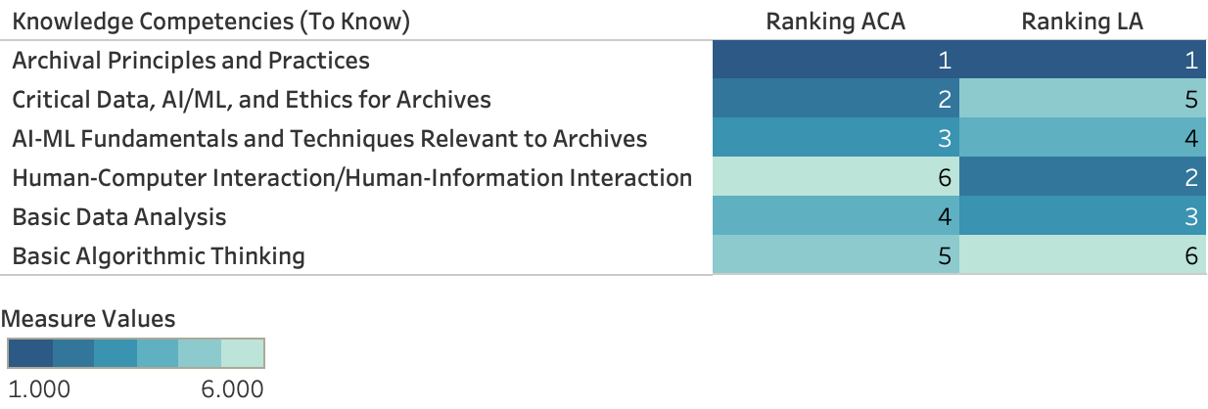
Most
important
Least
important
Notes:
ACA - Canada (24 responses)
LA - Mexico, Costa Rica, Colombia, Venezuela, Ecuador, Peru, Brasil, Chile and Argentina (47 responses)
Bachelor programs provide more generalized competencies and broad foundations in a discipline while Master programs, which build on competencies acquired at the undergraduate level, are more specialized, advanced, and focused on fields of knowledge and practice. At a Master’s level, there is also more room to develop critical thinking for the profession considering that, on average, students bring more years of work-related experiences and reflections to their learning and they are expected to be involved in policy-making and management at the workplace after graduation. *** This hypothesis needs to be tested ***

Slide 13
Least
important
Most
important

Slide 14
Most
important
Least
important
Notes:
A second argument is that changes in AI technologies used at the workplace, and what they require from archival professionals, impact on determining what competencies are more important than others. Today, this is a constant and fast-moving target.
A third argument for the situatedness (and lack of generalization) of the AI/ML competencies for archival professionals come from structural factors that shape archival work and that vary from country to country, and sometimes from institution to institution.

Slide 15
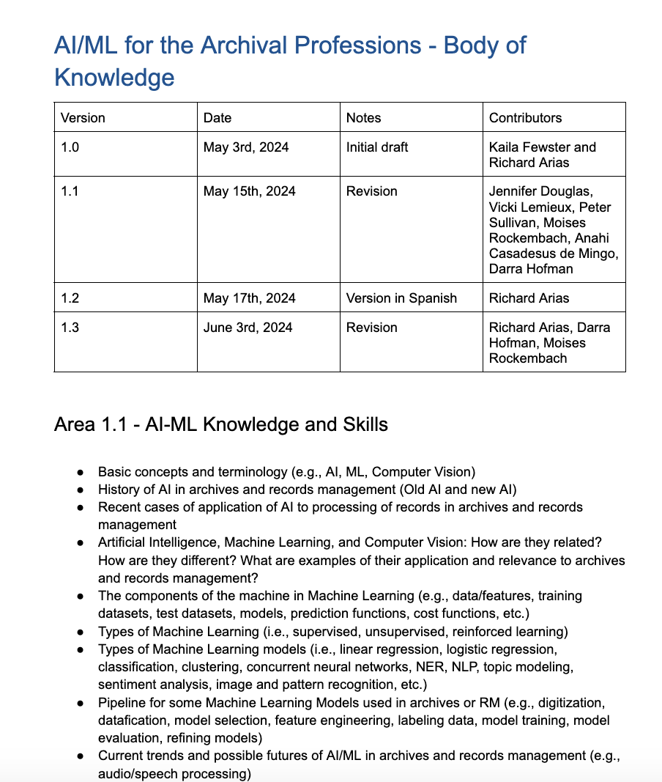
https://docs.google.com/document/d/1UsjkkkGeSJrgCDJGASCAy5q0uo_ZkQpzi_Ch8XUcqYw/edit?usp=sharing

Slide 16
Development of free/open educational modules
Module 1: Introduction to Artificial Intelligence for the archival professions [COMPLETED]
Module 2: Critical AI/ML, Indigenous AI/ML, and AI/ML ethics for archival professionals [IN DEVELOPMENT]
Module 3: AI to enhance access to text- and image-based digital records
Module 4: AI to enhance access to audio- and video-based digital records
Module 5: AI to support sensitivity analysis of digital records
Module 6: AI for appraisal, retention and disposition of digital records
Module 7: LLMs supporting description and reference in digital archives
https://interparestrustai.org/trust/research_dissemination
Notes:
Testing will be done by archival educators in the research team in 2025-2026 either in professional workshops and in formal archival programs in higher education in Canada, USA, Spain, and Portugal.

Slide 17
Scholarly dissemination
Arias-Hernandez, R., Fewster, K., and Penniman, S. (2024). Artificial Intelligence and Machine Learning Competencies for the Archival Professions. Proceedings of the Association for Information Science and Technology, 61(1).
Arias-Hernandez, R. and Rockembach, M. (in review). Building Trustworthy AI Solutions: Integrating Artificial Intelligence Literacy into Records Management and Archival Systems. AI & Society. Springer Nature.
Lemieux, V. and Arias-Hernandez, R. (in preparation). Training in Computational Archival Science: Do CAS Educational Frameworks meet Professional Expectations?. Proceedings of the 9th Computational Archival Science Workshop, IEEE Big Data 2024.

Slide 18
Thank you!
Notes:
Portada 1

Slide 19
References
Anderson, B. G. (2021). On Constructing a Scientific Archives Network Exploring Computational Approaches to the Cybernetics Thought Collective. Archivaria, 91, 104–147.
Cain, J. O. (2016). Using Topic Modeling to Enhance Access to Library Digital Collections. Journal of Web Librarianship, 10(3), 210–225.
Cordell, R. (2020). Machine Learning + Libraries: A Report on the State of the Field. Library of Congress: Washington, DC.
Darby, A. et.al. (2022). AI training resources for GLAM: a snapshot. arXiv:2205.04738. DOI: 10.48550/arXiv.2205.04738
Decker, S., Kirsch, D. A., Kuppili Venkata, S., & Nix, A. (2022). Finding light in dark archives: Using AI to connect context and content in email. AI & SOCIETY, 37(3), 859–872.
Hutchinson, T. (2020), Natural language processing and machine learning as practical toolsets for archival processing. Records Management Journal, 30(2), pp. 155-174
Marciano, R., Underwood, W., Hanaee, M., Mullane, C., Singh, A., & Tethong, Z. (2018). Automating the Detection of Personally Identifiable Information (PII) in Japanese-American WWII Incarceration Camp Records. 2018 IEEE International Conference on Big Data (Big Data), 2725–2732.
Padilla, T. (2019). Responsible Operations: Data Science, Machine Learning, and AI in Libraries. OCLC: Dublin, OH.
Rolan, G., Humphries, G., Jeffrey, L., Samaras, E., Antsoupova, T., & Stuart, K. (2019). More human than human? Artificial intelligence in the archive. Archives and Manuscripts, 47(2), 179–203.
Schneider, J., Adams, C., DeBauche, S., Echols, R., McKean, C., Moran, J., & Waugh, D. (2019). Appraising, processing, and providing access to email in contemporary literary archives. Archives and Manuscripts, 47(3), 305–326.

