Slide 1
Use of AI Tools in Local Governments and its Implications on Public Records Management MA09
Yo Hashimoto
InterPARES Vancouver Plenary
28/10/2023
Notes:
I am Yo Hashimoto. This is my first presentation at the InterPARES Plenary. Today, I’m speaking about my team’s project, “Use of AI Tools in Local Governments and its Implications on Public Records Management.” This project was admitted in March, and it has not advanced much. So, I am talking about the first few steps.

Slide 2
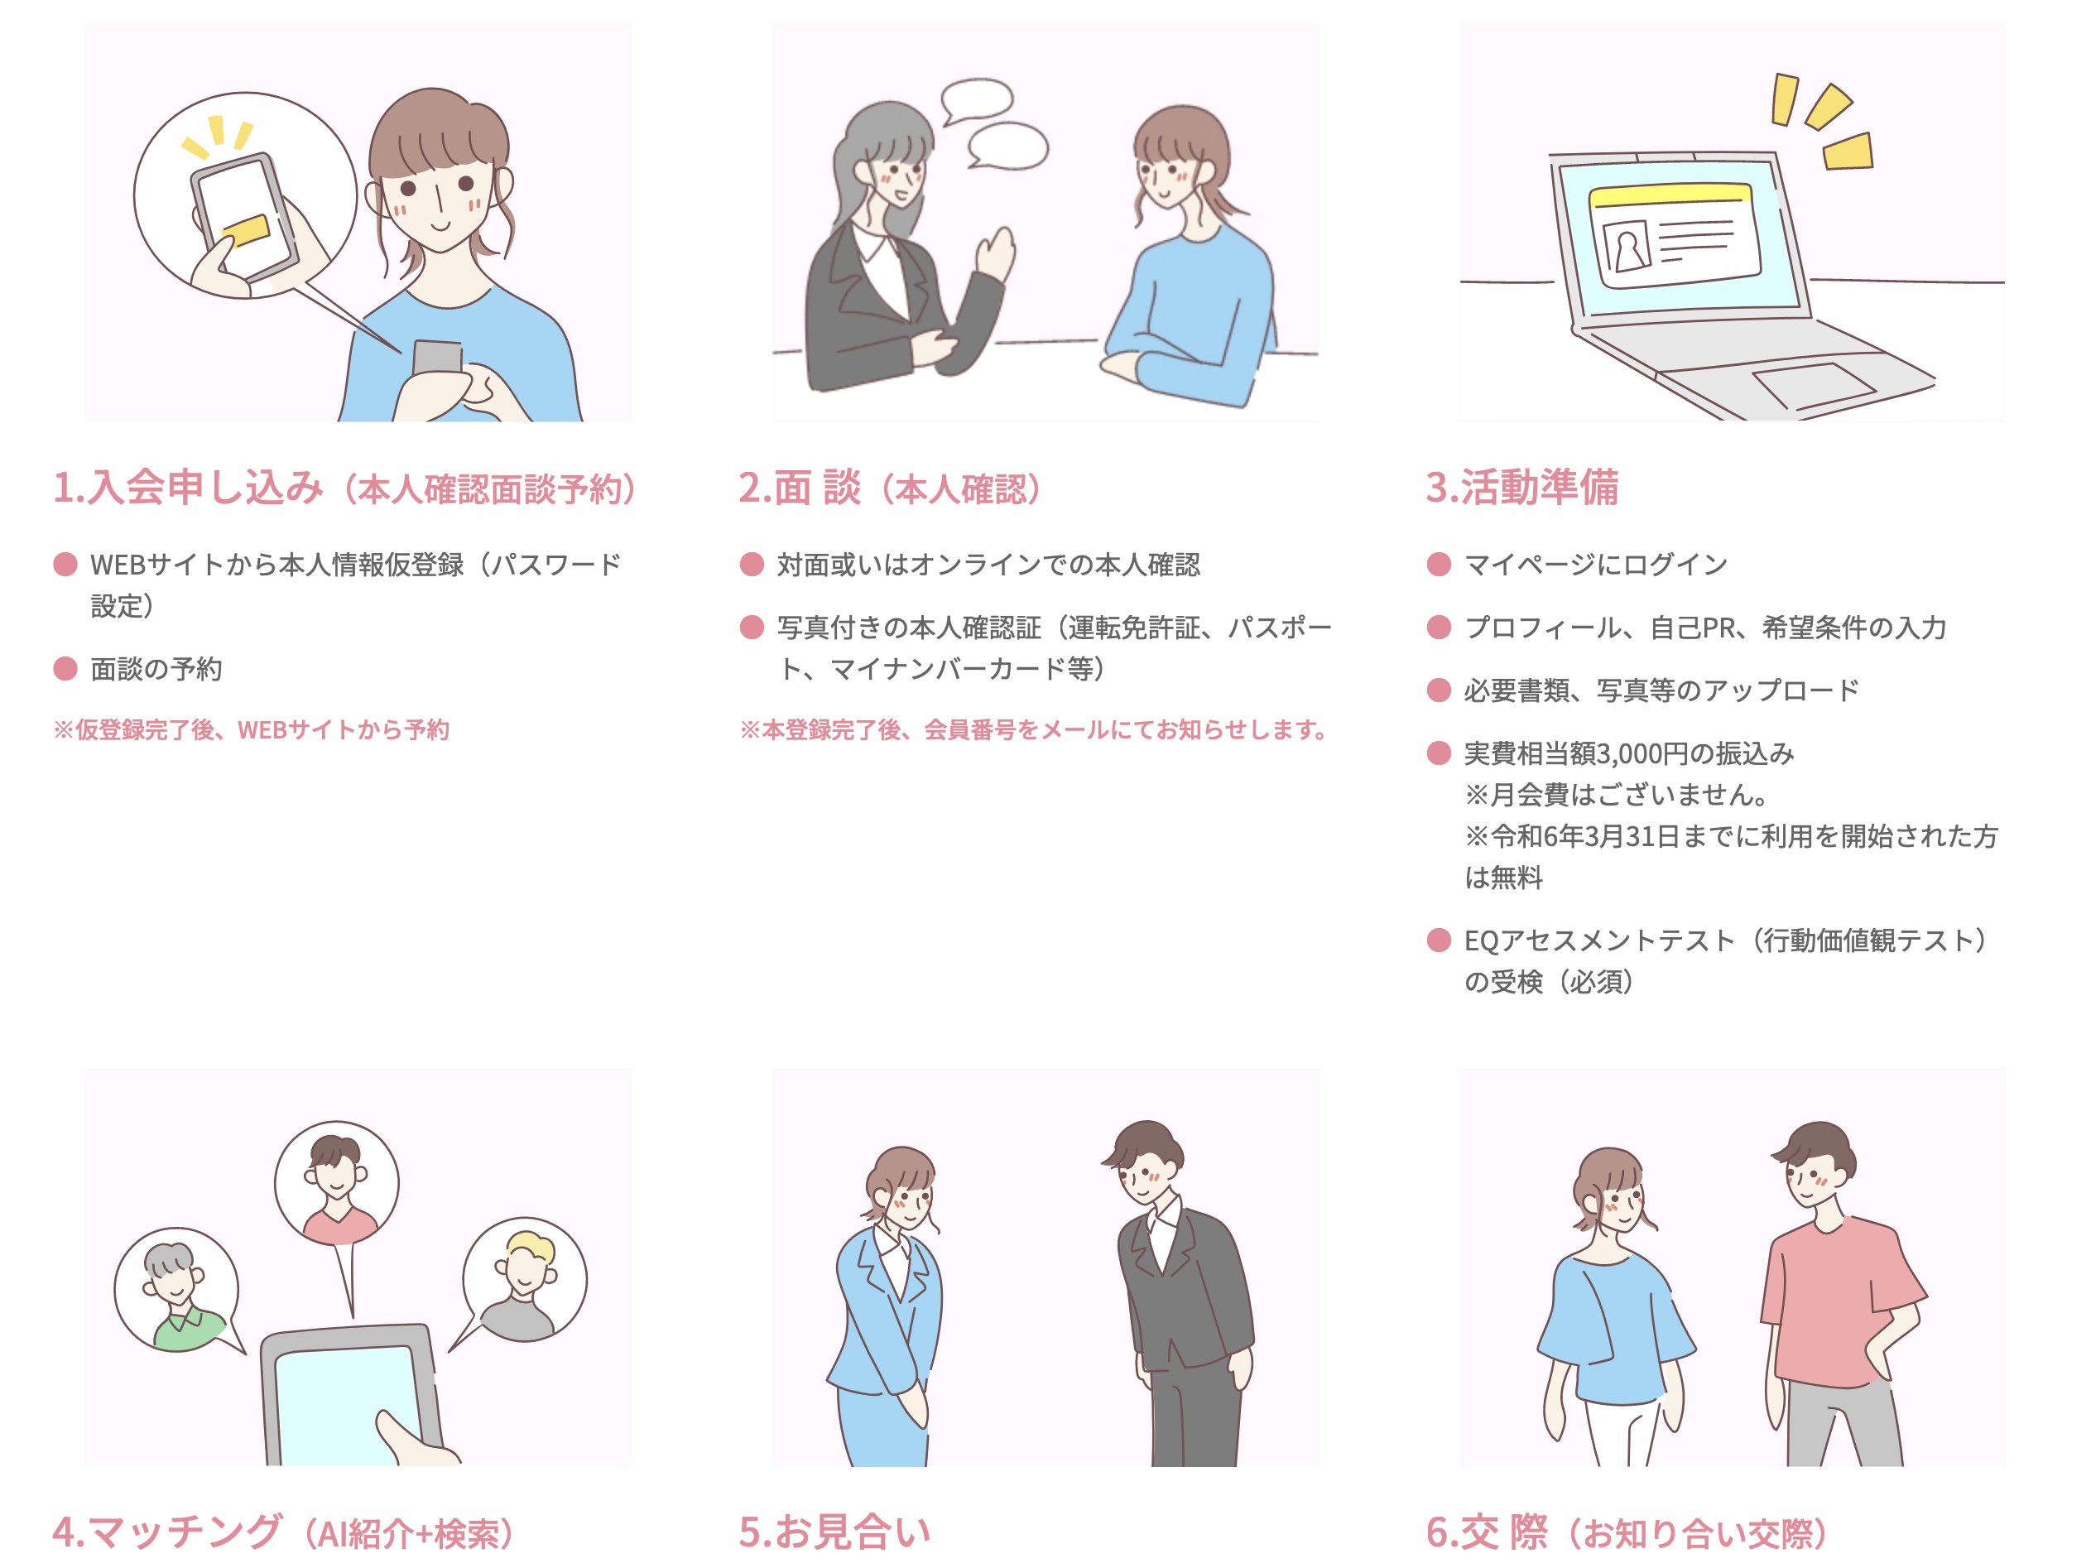
An Example of Using AI in Local Governments in Japan
Automated matchmaking service using AI

Slide 3
Project Abstract
Japanese law uses the word “administrative documents” to designate official records. It is often narrowly construed, leaving records created by new technology out of the official recordkeeping system. In such a recordkeeping context, AI tools are being introduced in local governments for a variety of services to achieve higher operational efficiency, often without considering its implications on the management of public records.

Slide 4
Project Abstract (Cont.)
The aim of this study:
examines what kind of tools using what kind of AI technology are being deployed in local governments and what kind of data and information such tools produce in the conduct of official business;
identifies the records created by AI tools and verifies if they are being managed as “administrative documents.”
explores the implications of the use of AI tools on public records management in the present Japanese legal and administrative framework.

Slide 5
Members
Lead: Yo Hashimoto (Archival Science)
Participating:
Miki Akutsu (Archival Science)
Izumi Hirano (Archival Science)
Nobuyuki Horiuchi (Japanese Modern History)
Boyoung Kim (Cultural and Human Information Studies)
Yukiko Osaka (Cultural and Human Information Studies)
Azusa Ozawa (Archival Science)
Nami Won (Archival Science)

Slide 6
Background toward Recordkeeping Chaos
The Japanese government did not adopt the German registry system in the modern period.
The central government, municipalities, and private companies have never implemented a recordkeeping system following standards such as ISO 15489, DoD 5015.2 and MoReq.
Recently, they have promoted the Digital transformation (DX) movement without any attention to the recordkeeping system.

Slide 7
Research Questions
What AI tools are local governments using in Japan, and what types of data do these tools produce that should be recognized as records?
What knowledge do developers and users respectively have of data or documents the AI tools produce, and what expertise do they have in the recordkeeping?
Which side of developers or users is responsible for managing the data or documents?
How concerned are archivists about the issues related to AI and recordkeeping?

Slide 8
Research Methods
The first question
Systematic literature review
What AI tools are used in which local governments?
Archival diplomatics
What records should be created in the process of AI tools?
What attributes the administrative documents should have?
Historical research
What administrative documents were created in the paper period

Slide 9
Research Methods (Cont.)
The second to fourth one
Qualitative social research
Semi-structured interviews with local government officials and archivists

Slide 10
Examples of AI Introduction to Local Governments by the Ministry of Internal Affairs and Communications [MIC]
Counter services
AI-based automated voice response for garbage disposal
Child welfare
AI automation system of the selection process for matching the needs of children and parents to a suitable nursery
Care for the elderly
AI-based care plan creation system
Informatization
Automatic creation of meeting minutes

Slide 11
Systematic Literature Review
We consulted:
“Investigating the Use of AI Technologies in the Realm of E-Government Development (CU07)”, which followed the review process proposed by (Kitchenham, 2004);
The systematic literature review conducted by (Zuiderwijk, 2021) based on (Kitchenham, 2004), which focused on the use of artificial intelligence in public governance.
Literature written in English following (Zuiderwijk, 2021)
Literature written in Japanese

Slide 12
Literature in English
Database: Scopus; Web of Science
Time range: 2021-2023 after (Zuiderwijk, 2021)
Keywords same as (Zuiderwijk, 2021):
Title=(“Artificial intelligence” OR “AI” OR “machine learning” OR “deep learning” OR “reinforcement learning” OR “supervised learning” OR “unsupervised learning” OR “neural networks” OR “natural language processing” OR “computer vision” or “image recognition” OR “facial recognition” or “face recognition” OR “speech recognition” OR “intelligence systems” OR “virtual assistant” OR “autonomous vehicle” OR “predictive analytics” OR “robotics” OR “self-driving”) AND (“governance” OR “government” OR “public management” OR “public governance” OR “public sector” OR “public administration” OR “public policy”)

Slide 13
Literature in English(Cont.)
For Scopus, four fields: social sciences, decision sciences, multidisciplinary, and business, management and accounting.
For Web of Science, ten research disciplines: public administration, library and information science, political science, management, communication, multidisciplinary sciences, engineering multidisciplinary, international relations, and telecommunications.
264 results in Scopus and 115 results in Web of Science.
For both searches, the first 30 most relevant results are only included.
After removing duplicates, 54 results remained in the end.

Slide 14
Literature in Japanese
Database: Citation Information by NII (CINII)
NII is an abbreviation of National Institute of Informatics
Time range: 2012-2023
Keywords:
based on the ones used by (Zuiderwijk, 2021);
(“Artificial Intelligence” OR “AI” OR “Machine Learning” OR “Deep Learning” OR “Deep Learning” OR “Reinforcement Learning” OR “Supervised Learning” OR “Unsupervised Learning” OR “Neural Network” OR “Natural Language Processing” OR “NLP” OR “Robotic Process Automation” OR “Robotic Process Automation” OR “RPA” OR “Computer Vision” OR “Image Recognition” OR “Face Recognition” OR “Speech Recognition” OR “Intelligent Systems” OR “Virtual Assistant” OR “Autonomous Vehicle” OR “Predictive Analytics” OR “Robotics” OR “Self-Driving”) AND (“Governance” OR “Government” OR “Municipalities” OR “Local Government” OR “Public Management” OR “Public Governance” OR “Public Sector” OR “Public Administration” OR “Public Policy” OR “Business”)

Slide 15
Literature in Japanese (Cont.)
886 results of database search
Most of the results were non-academic
246 results after reviewing the titles of searched literature from the viewpoint of the relevance to the use of AI in the public sphere.
The selected literature, even if non-academic, can provide an overall picture of AI use by local governments.

Slide 16
Next Steps
Ongoing literature review
almost finished the process of collecting literature
Starting to read the selected literature
Determine the local governments in which the interview will be conducted.

Slide 17
Qustions
I hope you to speak to us slowly!

