Slide 1
AI and Access to Public Records
Darra Hofman, PhD, JD, MSLS, CIPP/US
InterPARES Summer Symposium 2026
25 June 2026

Slide 2
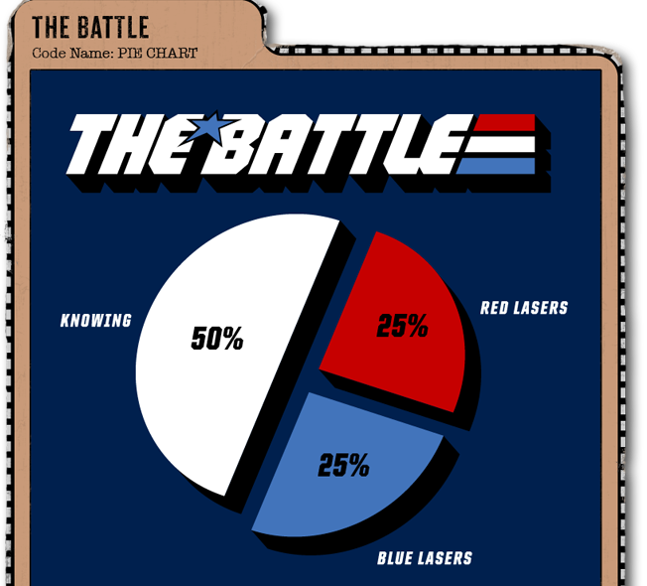
This Photo by Unknown Author is licensed under CC BY-NC-ND

Slide 3

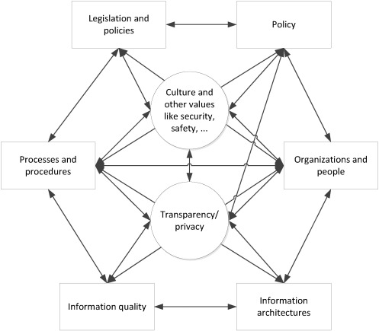
“Elements and dependencies comprising transparency and privacy landscape,” Janssen and van den Hoven (2015, 367)

Slide 4
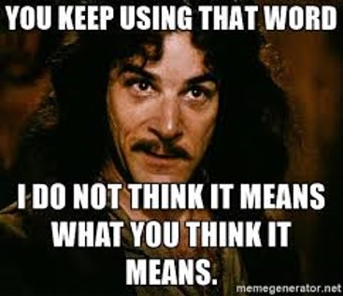
“Transparency” and the Inigo Montoya Problem
Technical transparency
System transparency
Democratic transparency

Slide 5
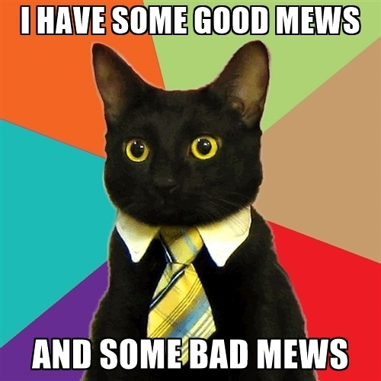
Democratic Transparency and the Public/Private Boundary

Slide 6
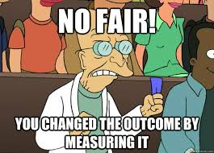
“Raw data” is both an oxymoron and a bad idea.
Geoffrey C. Bowker, Memory Practices in the Sciences

Slide 7
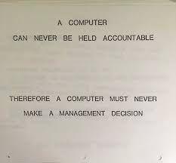
Kranzberg’s First Law of Technology
“Technology is neither good nor bad, nor is it neutral.”
- Melvin Kranzberg

Slide 8

A is for AI: Problems
“AI” actually encompasses a number of technologies, but we’ll focus on generative AI (like large language models)
AI-specific risks:
  Data leakage
  Model inference
  Differential privacy v *large* models
  Accountability
  Stochastic parrots’ privacy cousin, screaming toddlers
A prompt for “toddler happy yell” yielded…Lucille Bluth. In case you thought AI was going to take all of our jobs.
This Photo by Unknown Author is licensed under CC BY-ND
8

Slide 9
Datafication and opaque bias
[…] large datasets based on texts from the Internet overrepresent hegemonic viewpoints and encode biases potentially damaging to marginalized populations. In collecting ever larger datasets we risk incurring documentation debt.
-Bender et al., 2021, p. 610

Slide 10
"The future is already here — it's just not evenly distributed."
- William Gibson

Slide 11
“Any sufficiently advanced technology is indistinguishable from magic”
- Arthur C. Clark, Profiles of the Future: An Inquiry Into the Limits of the Possible

Slide 12
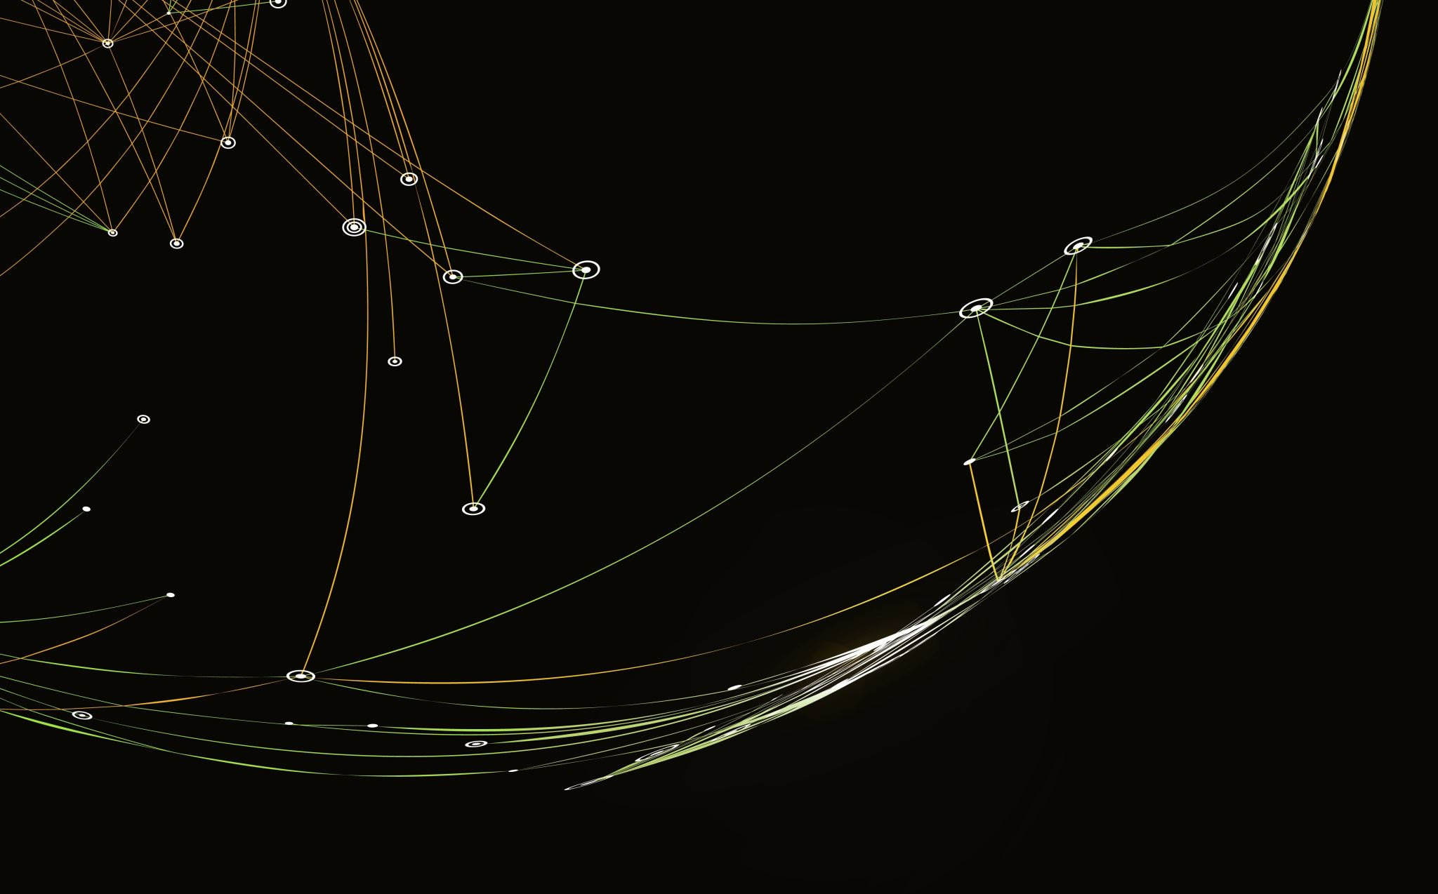
I got 99 problems, and provenance is definitely one
Data problems, RECORDS solutions

Slide 13
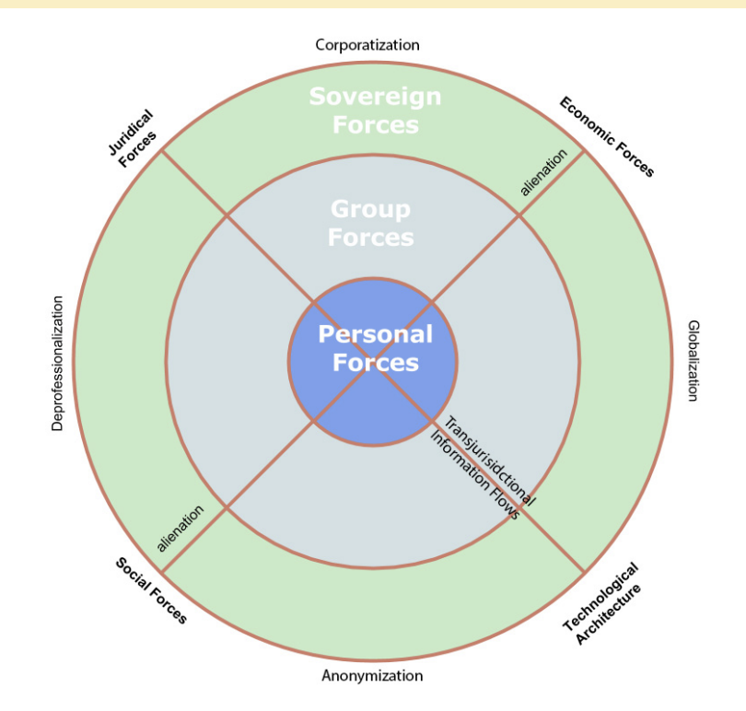
Model by Hofman and Novin

Slide 14
Refusing to Accept Terrible
“When we are no longer able to change a situation, we are challenged to change ourselves.”
- Viktor E. Frankl, Man’s Search for Meaning

Slide 15
Citations
Ford, Richard Thompson. "Law's Territory: A History of Jurisdiction." Michigan Law Review, vol. 97, no. 4, 1999, pp. 843–930
Garner, B. A. (Ed.). (2024). Control. In Black's law dictionary (12th ed.). Thomson Reuters.
Hildebrandt, Mireille.Smart technologies and the end(s) of law: Novel entanglements of law and technology. Edward Elgar Publishing.
---"Extraterritorial Jurisdiction to Enforce in Cyberspace? Bodin, Schmitt, Grotius in Cyberspace." University of Toronto Law Journal, vol. 63, no. 2, 2013, pp. 196–224
Hofman, D., & Katuu, S. (2022). Law and recordkeeping: A tale of four African countries. In M. Ngoepe (Ed.), Managing Digital Records in Africa (pp. 7–48). Routledge. https://doi.org/10.4324/9781003203155-2
Hofman, D. L. (2020). Extraterritoriality and international organizations. In J. Boel & E. Sengsavang (Eds.), Recordkeeping in International Organizations: Archives in Transition in Digital, Networked Environments (pp. 67–83). Routledge.
Kymlicka, Will. Multicultural Citizenship: A Liberal Theory of Minority Rights. Clarendon Press, 1995.
Lessig, Lawrence. (1999). Code and Other Laws of Cyberspace. Basic Books.
Nissenbaum, Helen. "A Contextual Approach to Privacy Online." Daedalus 140, no. 4 (2011): 32–48.
Reidenberg, Joel. Lex Informatica: The Formulation of Information Policy Rules Through Technology, 76 Tex. L. Rev. 553 (1997).

