Slide 1
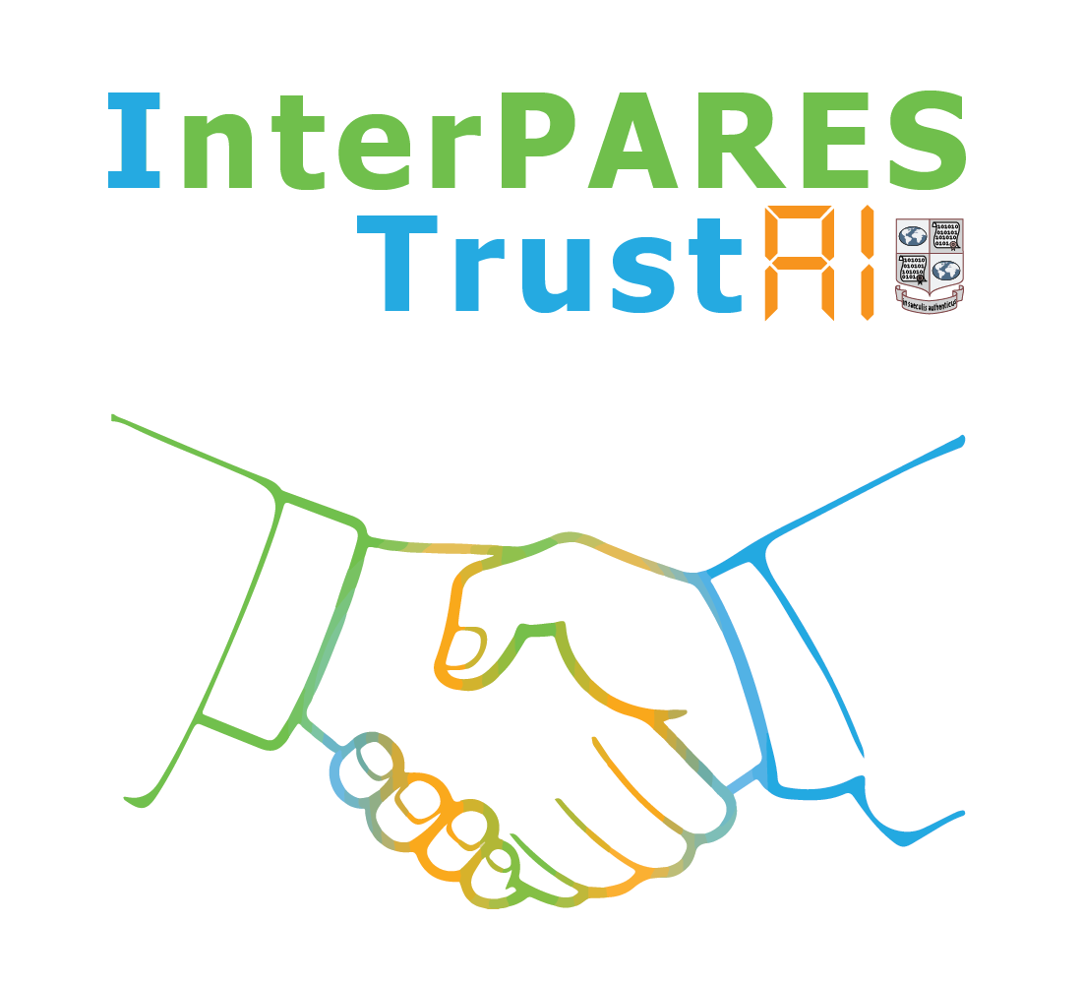
Where’s the Balance?:
AI, Archives, and Privacy
Presented to the InterPARES Trust AI Symposium
Bringing AI to the Archives
Iori Khuhro
Regis University
October 25, 2024

Slide 2
Land Acknowledgement
Regis University recognizes that Indigenous Peoples are the original stewards of the land we stand on today. We respectfully acknowledge that this land is the traditional homeland and buffalo hunting grounds of the Arapaho, Cheyenne and Ute Nations. We also recognize the 48 tribal nations that are historically tied to the lands that make up the state of Colorado.
2024-10-25
Where’s the Balance?
2

Slide 3
History
Contemporary
Government Records
Social Memory
Archivists
2024-10-25
Where’s the Balance?
3

Slide 4
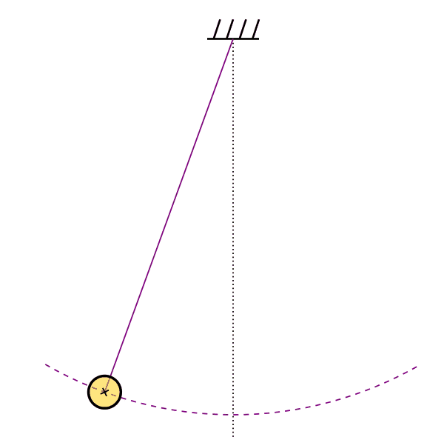
Access
Privacy
2024-10-25
Where’s the Balance?
4

Slide 5
Methodology
Criterion | Initial Requirements | Expanded?
Date | 2017 and subsequent; initially chosen due to the breakthroughs in AI | Yes – critical earlier publications included
Type of publication and peer review | Peer-reviewed journal articles and conference proceedings | Yes – relevant grey literature included, including white papers and reports
Research setting | Inclusive | No
Research design | Inclusive | No
2024-10-25
Where’s the Balance?
5

Slide 6
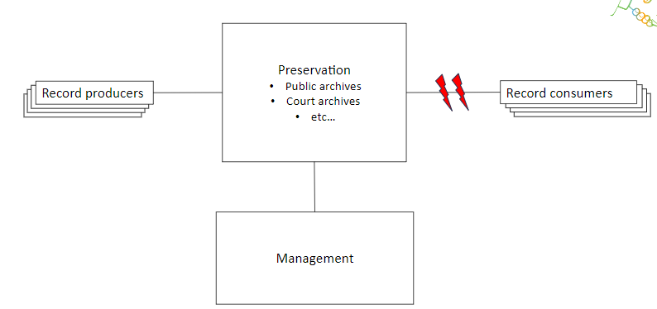
Access Hindered
Strategy to protect privacy?
Strategy to adopt / support AI?
Adapted from the OAIS Reference Model
2024-10-25
Where’s the Balance?
6

Slide 7
Equilibrium
Access
Harm Reduction
Privacy
2024-10-25
Where’s the Balance?
7

Slide 8
Thank You!
by Iori Khuhro, Erin Gilmore, Darra Hofman & Jim Suderman
InterPARES Trust AI
2024-10-25
Where’s the Balance?
8

