Slide 1
THE LOGIC OF THE RECORDS-IN-CONTEXT ONTOLOGY
Hugolin Bergier
InterPARES Symposium
Denver, CO– October 2024

Slide 2
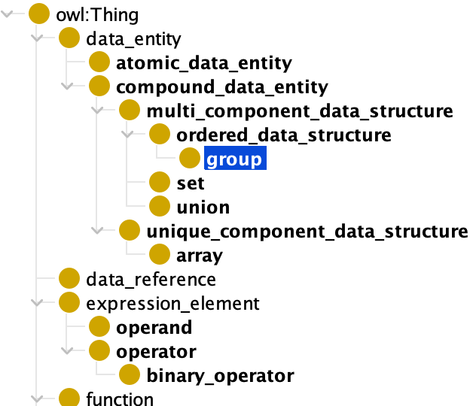
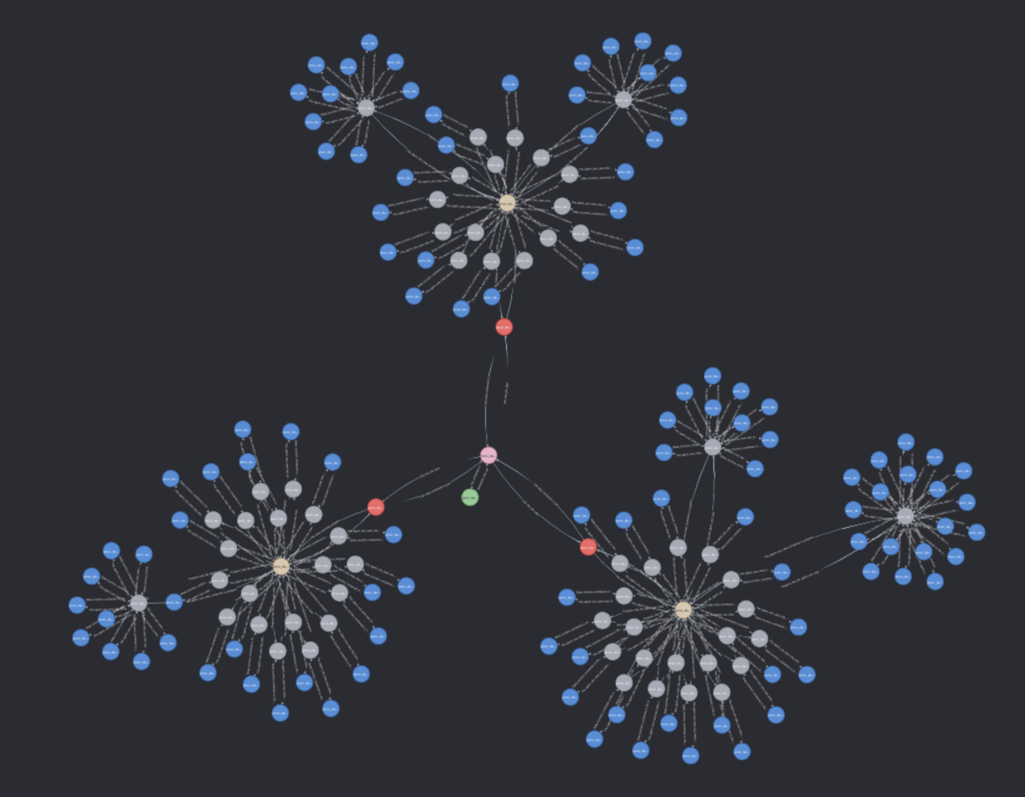
THE RIC-O AMBITION
From the presentation page of the International Council on Archives Records in Contexts Ontology (ICA RiC-O) version 1.0.2 (https://www.ica.org/standards/RiC/ontology)
“RiC-O provides a generic vocabulary and formal rules for creating datasets that describe in a consistent way any kind of archival record resource. It supports publishing RDF datasets as Linked Data and making inferences using the logic of the ontology.”
“RiC-O is a technical implementation of RiC-CM that includes formal logic.”
“RiC-O is a generic, domain ontology: it is a high-level framework”
RiC-O is an ambitious project: it completely and formally defines (like mathematics) the domain of archival description
It is much more than a useful tool for archival description, search, and reasoning (AI)
It is a formal and normative definition of what archives and records are.
Important question: what is the truth criteria behind such an ontology?

Slide 3
ONTOLOGY AS FORMAL THEORY
A theory is a class of true statements (called theorems)
Statements are true or false with respect to a theory.
A theory provides a context to determine the truth of statements
A theory is
Deductive if it is an inductive class
Decidable if it is a definite class
Consistent if it doesn’t exhaust all the statements (PNC)
Complete if it is incapable of a consistent (proper) axiomatic extension
An interpretation of the theory is a relationship between statements of a theory and contensive statements of a subject matter (e.g. archival science)
We have an interpretation of the theory in the subject matter
Interpretation
Statements
Theory
Subject matter
Theorems
Consistent
Decidable
Deductive
Given from
experience
Curry (1951). Outline of a Formalist Philosophy of Mathematics

Slide 4
ONTOLOGY AS FORMAL THEORY
An interpretation of the theory is a relationship between statements of a theory and contensive statements of a subject matter (e.g. archival science)
We have an interpretation of the theory in the subject matter
The interpretation is full (as opposed to partial) if there is a contensive statement for each statement in the theory
The correspondent contensive statements are called intepretants
Ex: an interpretant of a physical theory may have an interpretant which can be experimentally tested.
An interpretation is valid when the interpretant of every theorem is true
An interpretation is adequate when every statement whose interpretant is true is a theorem
A theory is acceptable when the interpretation is is built for is both valid and adequate for the purpose of the theory
Interpretation
full
Statements
Theory
Subject matter
Theorems
Interpretants
Acceptable
Valid
Adequate
Consistent
Decidable
Deductive
Given from
experience
Curry (1951). Outline of a Formalist Philosophy of Mathematics

Slide 5
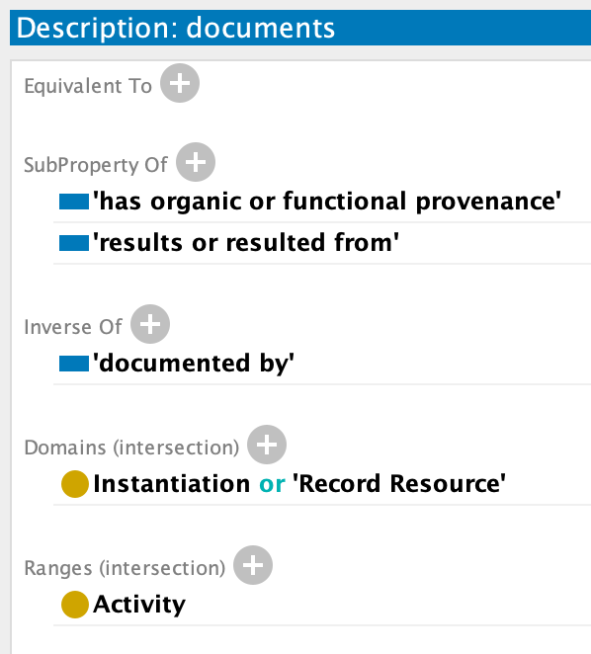
ONTOLOGY AS FORMAL THEORY
Examples from the RiC ontology
RiC is a formal theory (RDF)
Subject Matter: archival description
Statements and theorems:
[Activity] <documents> [Record Resource]
[Record Resource] <documents> [Activity]
[Instantiation] <documents> [Activity]
Theory: RiC-O
Consistent (OWL Reasoner)
Decidable (OWL)
Deductive (OWL Reasoner)
Interpretation is full
Validity
All theorems have a true contensive statement (interpretant)
Adequacy
All contensive true statements of archival science correspond to a statement that is a theorem
Interpretation
full
Statements
Theory
Subject matter
Theorems
Interpretants
Valid
Theorem
Adequate
Theorem
Consistent
Decidable
Deductive
Given from
experience
One is more difficult to achieve / verify
RiC-O_1-0-2.rdf

Slide 6
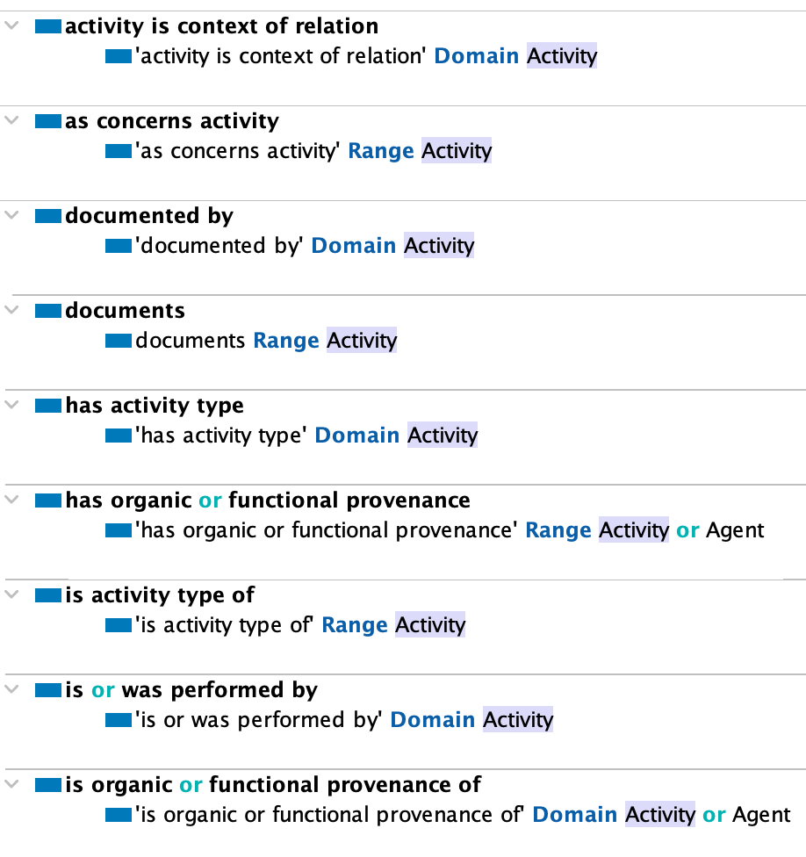
RIC-O: VALID BUT NOT ADEQUATE
Interpretation
A record can document an activity.
What about an activity having a record as its object?
A physical location has coordinates
Isn’t a physical location a place?
Many other examples
full
Statements
Theory
Subject matter
Theorems
Interpretants
Valid
Adequate
Consistent
Decidable
Deductive
True statements
Given from
experience

Slide 7
IN GENERAL, ADEQUACY IS DIFFICULT TO ACHIEVE
An acceptable theory is built through a back-and-forth between the subject matter and the formal system.
This is usually done by working on a partial set of true statements within the subject matter.
This is related to a fundamental problem: how does a formal system relate to intuition?
Is it possible to achieve adequacy?
Absolutely!
Assumes a general agreement of the community
Example: the Church-Turing thesis
So what is the problem with the RiC ontology?
Interpretation
full
Statements
Theory
Subject matter
Theorems
Interpretants
Valid
Adequate
Consistent
Decidable
Deductive
Given from
experience
Curry (1951). Outline of a Formalist Philosophy of Mathematics

Slide 8
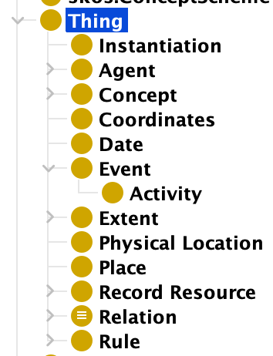
THE DOMAIN IS TOO LARGE
The archival science domain is…
Everything.
It is too large to be tackled as one domain.
If we try to do so:
We risk ending up with a laundry list
And thus missing adequacy
Divide and conquer
Subject matter
True statements

Slide 9
DIVIDE AND CONQUER
Two ways of dividing the theory:
We can build distinct independent theories corresponding to distinct domains
We can build axiomatique extensions of theories: C extends A ; B extends A
Domains themselves should thus be treated in a rigorous order, starting with the most fundamental and primitive notions
In this example, theory A should be the first one built.
Theory B
Theory A
Theory C

Slide 10
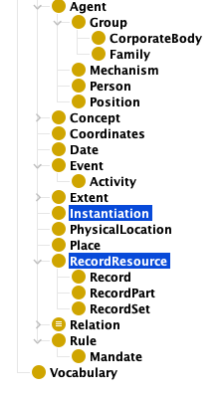
IDENTIFYING THE PRIMITIVE NOTIONS
Primitive notions are the “axioms” of the ontology. They are the building blocks that are necessary to derive other notions.
Primitive-to-derived relations:
Is-a:
Group is an Agent => ‘Agent’ is more primitive
Has-a:
An event has a date => ‘Event’ is more primitive
A PhysicalLocation has coordinates => ‘PhysicalLocation’ is more primitive
A Place has a PhysicalLocation => ‘Place’ is more primitive
I can conceive X without Y, but not the other way around:
I can conceive of an agent without a record, but not the other way around => ‘agent’ is more primitive than ‘record’
I can conceive of a record resource without the notion of ‘instantiation’, but not the other way around => ‘’record resource’ is more primitive
I can conceive of an agent without an activity, but not the other way around => ’agent’ is more primitive
I can conceive of activity without records, but not the other way around =>’activity’ is more primitive.
Thus we can isolate a first range of primitive notions that is going to constitute our most abstract schema
Then we can build from there a second range of notions that are directly derived but still abstract.
And so forth…
From RiC-O 1.02

Slide 11
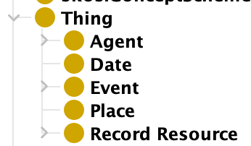
BUILDING BLOCKS OF SCHEMAS
General Schema
Each schema is ‘standalone’ and consistent.
Each schema is a formal system with its own domain of interpretation.
Each schema has limited dependencies (arrows).
Each schema is complete.
Agent
Event
Process
Common Sense
Schema
Archival Science
Schema
Activity
Person
Corporation
Record
Creation
Search
Archival Domain Schema
Informative Schema/Attributes
Notary
Notary Act
5th arrondissment
Date
Coordinates
Measures

Slide 12
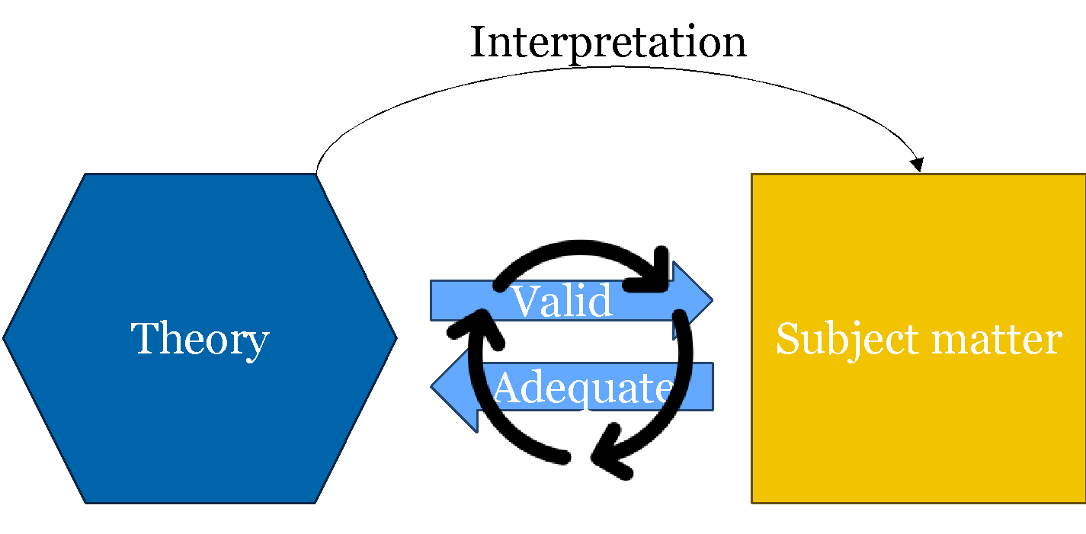
ON THE INTEGRATION OF FORMAL SYSTEMS WITH LLM
There is a strong trend today to leverage the power of LLMs by sending ontologies as RAGs.
It is easy to do and provides immediate “WOW” results (like most LLM queries)
On the other hand, purely formal queries are difficult to design and they require a rich ontology, also difficult to design.
But this is like giving pearls to swines because the nature of the reasoning capability is radically different from one to the other
In the case of the ontology, the reasoning is entirely formal, traceable, and explainable.
In the case of ML, the reasoning is fundamentally probabilistic and not explainable.
An ontology gives you what ML can never give you: 100% certainty.
By sending it as part of a prompt or a RAG, one completely loses this level of formality, explainability, and certainty.
RAG = Retrieval Augmented Generation

