Slide 1
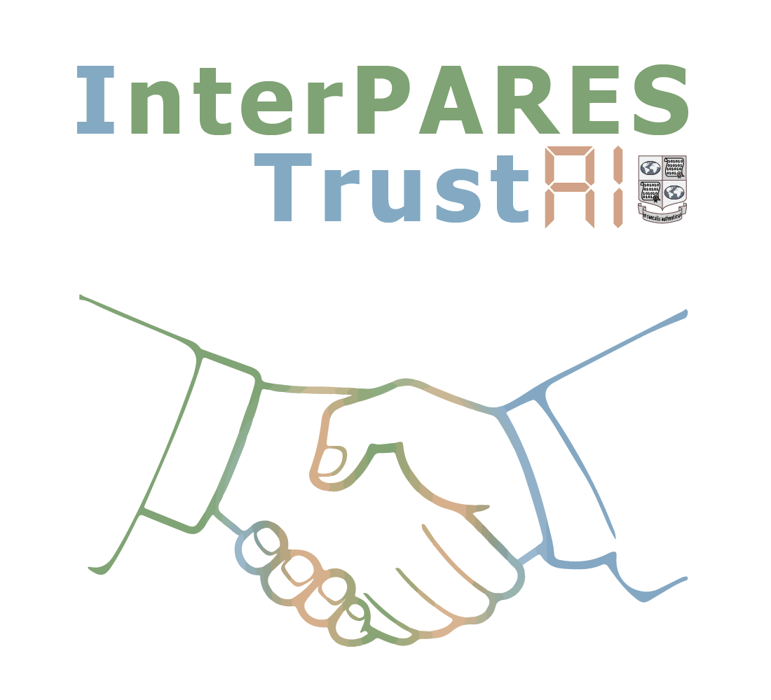
Points of Departmentalization
Joseph T. Tennis
University of Washington iSchool
Articulating AI Techniques to the InterPARES Chain of Preservation Model. Step One: Rationale and What Are We Currently Doing?

Slide 2
Points of Departmentalization
Definitions
Chain of Preservation
Motivation
Context: InterPARES Trust AI Studies
Next Steps

Slide 3
Definitions

Slide 4
Definitions
record
n., A document made or received in the course of a practical activity as an instrument or a by-product of such activity and set aside for action or reference. Syn.: archival document.
InterPARES Glossary

Slide 5
Definitions
record
n., A document made or received in the course of a practical activity as an instrument or a by-product of such activity and set aside for action or reference. Syn.: archival document.
InterPARES Glossary

Slide 6
Definitions
archives
n., [records] The whole of the documents made and received by a juridical or physical person or organization in the conduct of affairs and preserved. Syn.: fonds.
n., [place] A place where records selected for permanent preservation are kept.
n., [institution] An agency or institution responsible for the preservation and communication of records selected for permanent preservation.
InterPARES Glossary

Slide 7
Definitions
records lifecycle
n., A model of records management and archival science that characterizes the life span of a record as comprising eight sequential stages: creation or receipt; classification; maintenance and use; disposition through destruction or transfer to an archival institution or agency; description in archival finding aids; preservation; reference and use.
InterPARES Glossary

Slide 8
Definitions
identity
n., The whole of the characteristics of a document or a record that uniquely identify it and distinguish it from any other document or record. With integrity, a component of authenticity.
integrity
n., The quality of being complete and unaltered in all essential respects. With identity, a component of authenticity.
InterPARES Glossary

Slide 9
Definitions
authenticity
n., The trustworthiness of a record as a record; i.e., the quality of a record that is what it purports to be and that is free from tampering or corruption.
InterPARES Glossary

Slide 10
Definitions
chain of preservation
n., A system of controls that extends over the entire lifecycle of records in order to ensure their identity and integrity over time.
InterPARES Glossary

Slide 11
Chain of Preservation

Slide 12
Four Major Activities in the COP Model
Record-Making
Recordkeeping
Permanent Preservation
Chain of Preservation
A2
A3
A4
Records Lifecycle

Slide 13
Four Major Activities in the COP Model
Manage Records in a Record-Making System
Manage Records in a Recordkeeping System
Manage Records in a Permanent Preservation System
Chain of Preservation
A2
A3
A4

Slide 14
Manage Chain of Preservation
Four Major Activities in the COP Model
Manage Framework for Chain of Preservation
Manage Records in a Record-Making System
Manage Records in a Recordkeeping System
Manage Records in a Permanent Preservation System
Chain of Preservation
A1
A2
A3
A4
A-0

Slide 15
Motivation

Slide 16
Motivation
The InterPARES Trust AI goals are to:
Identify specific AI technologies that can address critical records and archives challenges;
Determine the benefits and risks of using AI technologies on records and archives;
Ensure that archival concepts and principles inform the development of responsible AI; and
Validate outcomes from Objective 3 through case studies and demonstrations.

Slide 17
Motivation
This aids all four goals of the project.
This study:
Whereas the computational lift of large language models are costly, can we seek out more lightweight solutions that align with archival theory?
Through the lens of the chain of preservation and the records lifecycle we want to examine how “traditional” AI can be exploited for the creation, management, and permanent preservation of records.
Can we departmentalize points in the chain or preservation with particular “traditional” techniques of AI?

Slide 18
Motivation
What is meant by “traditional” AI
Reasoning and problem solving with lightweight techniques
Knowledge representation for basic activities or proposing actions that could be fed to reasoning techniques
Learning to characterize the materials and contexts
Perception techniques that do not require much power

Slide 19
Context: InterPARES Trust AI Studies

Slide 20
Manage Chain of Preservation
Four Major Activities in the COP Model
Manage Framework for Chain of Preservation
Manage Records in a Record-Making System
Manage Records in a Recordkeeping System
Manage Records in a Permanent Preservation System
Chain of Preservation
A1
A2
A3
A4
A-0

Slide 21
Manage Chain of Preservation
Four Major Activities in the COP Model
Manage Framework for Chain of Preservation
Manage Records in a Record-Making System
Manage Records in a Recordkeeping System
Manage Records in a Permanent Preservation System
Chain of Preservation
A1
A2
A3
A4
CU07
CU01 | CU02 | CU04
CU05 | AA02 | AA03
AA01 | AA02 | AA03 |
AD02
AA02 | AD02 | AD03
AD04 | AD05 | MA05
RA01 | RA02 | RA03 | RA04
RA07, RA08, RA09
A-0
RP01 | RP04 for paradata | RP05 | MA07 | MA08 | RA03 | RA06
Not linked to the COP: CU03 | CU06 | AD01 | MA01 | MA02 | MA03 | MA04 | MA06 | MA09 | MA10 | RA03 | RA05

Slide 22
Manage Chain of Preservation
A-0
Retention and Preservation 01: Identification of critical archival challenges which are the best
candidates for improvement by AI technologies in the context of retention
and preservation of digital records (survey and image recognition techniques being developed)
Retention and Preservation 04 for paradata: Preserving AI Techniques as Paradata (how do we describe the AI techniques applied to all aspects of the chain of preservation?)
Retention and Preservation 05: Feasibility study of creating a web archive in the top universities in the Iran and South Africa (pattern of classification, regression and deep learning on collections of web pages)
Management and Administration 07: Metadata and Metadata Models in the AI Context (conceptual)
Management and Administration 08: Representing Archival Record Sets for Machine Learning Experts (lit review)
Reference and Access 03: Model for an AI-Assisted Digitization Project (prototyping)
Reference and Access 06: Privacy in Digital Records Containing Personally Identifiable Information (PII): An Exploration of Current Status and the potential of AI Tools and Techniques (literature, survey, case studies)

Slide 23
Manage Chain of Preservation
Four Major Activities in the COP Model
Manage Framework for Chain of Preservation
Manage Records in a Record-Making System
Manage Records in a Recordkeeping System
Manage Records in a Permanent Preservation System
Chain of Preservation
A1
A2
A3
A4
CU07
CU01 | CU02 | CU04
CU05 | AA02 | AA03
AA01 | AA02 | AA03 |
AD02 |
AA02 | AD02 | AD03
AD04 | AD05 | MA05
RA01 | RA02 | RA03 | RA04
RA07, RA08, RA09
A-0
RP01 | RP04 for paradata | RP05 | MA07 | MA08 | RA03 | RA06
Not linked to the COP: CU03 | CU06 | AD01 | MA01 | MA02 | MA03 | MA04 | MA06 | MA09 | MA10 | RA03 | RA05

Slide 24
Four Major Activities in the COP Model
Manage Framework for Chain of Preservation
Chain of Preservation
A1
Creation and Use 07: Investigating the Use of AI technologies in the Realm of E-Government Development
(literature review and survey)

Slide 25
Manage Chain of Preservation
Four Major Activities in the COP Model
Manage Framework for Chain of Preservation
Manage Records in a Record-Making System
Manage Records in a Recordkeeping System
Manage Records in a Permanent Preservation System
Chain of Preservation
A1
A2
A3
A4
CU07
CU01 | CU02 | CU04
CU05 | AA02 | AA03
AA01 | AA02 | AA03 |
AD02 |
AA02 | AD02 | AD03
AD04 | AD05 | MA05
RA01 | RA02 | RA03 | RA04
RA07, RA08, RA09
A-0
RP01 | RP04 for paradata | RP05 | MA07 | MA08 | RA03 | RA06
Not linked to the COP: CU03 | CU06 | AD01 | MA01 | MA02 | MA03 | MA04 | MA06 | MA09 | MA10 | RA03 | RA05

Slide 26
Manage Records in a Record-Making System
A2
Four Major Activities in the COP Model
Creation and Use 01: Context and provenance for disaster data (corpus analysis and repository design)
Creation and Use 02: Records Classification using Natural Language Processing Techniques to Support
Trustworthy Public Digital Records (automatic records classification)
Creation and Use 04: Building & Creating a Digital Twin for Preservation (literature review and case study)
Creation and Use 05: The role of AI in identifying or reconstituting archival aggregations of digital
records and enriching metadata schemas (survey)
Appraisal and Acquisition 02: Maturity assessment for appraisal practices readiness in AI age
(literature review and case studies)
Appraisal and Acquisition 03: Appraisal and disposition: AI tools being
used to support records creation and recordkeeping in Brazil and Mexico (surveys)
Chain of Preservation

Slide 27
Manage Chain of Preservation
Four Major Activities in the COP Model
Manage Framework for Chain of Preservation
Manage Records in a Record-Making System
Manage Records in a Recordkeeping System
Manage Records in a Permanent Preservation System
Chain of Preservation
A1
A2
A3
A4
CU07
CU01 | CU02 | CU04
CU05 | AA02 | AA03
AA01 | AA02 | AA03 |
AD02 |
AA02 | AD02 | AD03
AD04 | AD05 | MA05
RA01 | RA02 | RA03 | RA04
RA07, RA08, RA09
A-0
RP01 | RP04 for paradata | RP05 | MA07 | MA08 | RA03 | RA06
Not linked to the COP: CU03 | CU06 | AD01 | MA01 | MA02 | MA03 | MA04 | MA06 | MA09 | MA10 | RA03 | RA05

Slide 28
Manage Records in a Recordkeeping System
A3
Appraisal and Acquisition 01: Employing AI for Retention & Disposition in Trusted
Digital Recordkeeping Repositories (TDRRs) (literature review, case studies,
survey, pilot TDRR)
Appraisal and Acquisition 02 (again): Maturity assessment for appraisal practices
readiness in AI age (literature review and case studies)
Appraisal and Acquisition 03 (again): Appraisal and disposition: AI tools being used to support records
creation and recordkeeping in Brazil and Mexico (surveys)
Arrangement and Description 02: Analyzing, Defining and
Evaluating Archival Datasets in Governmental Organizations
(corpora analysis and case studies)
Chain of Preservation

Slide 29
Manage Chain of Preservation
Four Major Activities in the COP Model
Manage Framework for Chain of Preservation
Manage Records in a Record-Making System
Manage Records in a Recordkeeping System
Manage Records in a Permanent Preservation System
Chain of Preservation
A1
A2
A3
A4
CU07
CU01 | CU02 | CU04
CU05 | AA02 | AA03
AA01 | AA02 | AA03 |
AD02 |
AA02 | AD02 | AD03
AD04 | AD05 | MA05
RA01 | RA02 | RA03 | RA04
RA07, RA08, RA09
A-0
RP01 | RP04 for paradata | RP05 | MA07 | MA08 | RA03 | RA06
Not linked to the COP: CU03 | CU06 | AD01 | MA01 | MA02 | MA03 | MA04 | MA06 | MA09 | MA10 | RA03 | RA05

Slide 30
Manage Records in a Permanent Preservation System
A4
Reference and Access 01 Increasing Access to Photos, Videos and Social Media records through
AI-generated Descriptive Metadata (annotated bibliography, literature review, ai testing, pilot, case study)
Reference and Access 02 Case Study on Extraction and Identification of Records containing Personal
Data and Sensitive Personal Data for Long Term Preservation (algorithm development)
Reference and Access 03 (again) Model for an AI-Assisted Digitization Project (prototyping)
Reference and Access 04 Gamification of archival experience for users (lit review, survey, modeling, pilot)
Reference and Access 07 Research on the process of declassify personal information towards the use of
AI tools - Israel State Archives (ISA) as a case study (lit review and survey)
Reference and Access 08 Trusted access/use of archives and AI: a conceptual model (modeling)
Reference and Access 09 Exploring Possible Uses of AI to Support Research in Archives
(lit review, survey, coding)
Chain of Preservation

Slide 31
Chain of Preservation
Manage Records in a Permanent Preservation System
A4
Four Major Activities in the COP Model
Appraisal and Acquisition 02
Arrangement and Description 02 Analyzing, Defining and Evaluating Archival
Datasets in Governmental Organizations (li review, survey, modeling)
Arrangement and Description 03 AI in the Middle age. Arrangement of the documents via appearance- based recognition (scanning documents,
computer vision, networked repository development)
Arrangement and Description 04 Intensional logic-based AI for the Records in Contexts Conceptual Model(RiC-CM) and Ontology (RiC-O) (ontology design)
Arrangement and Description 05 Tatuoca Magnetic Observatory: from paper to intelligent bytes (scanning documents, applying AI to scanned documents for retrieval)
Management and Administration 05 Personal Information Content Assessment (literature review, pilot)

Slide 32
Next Steps

Slide 33
Next Steps
With the transfer of a sub-award from UBC to UW, I can hire a research assistant to help me look at extant AI techniques and propose places in the chain of preservation model where we can departmentalize them – rendering a prescribed relationship between records lifecycle activity and a particular AI technique delegated to carry out that activity for the records professionals.

Slide 34
Thank you!
Joseph T. Tennis
University of Washington iSchool
Google scholar = “jt tennis”

