Slide 1
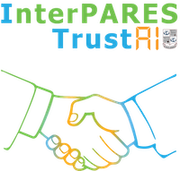
Paradata in the field: on the ground reports from the InterPARES paradata study
Capturing and preserving the AI process for archivists
Scott Cameron
InterPARES, paradata research group
scottm.cameron@alumni.utoronto.ca
June 26, 2026
(views are my own)
This document licensed under Creative Commons Attribution 4.0 (CC BY 4.0) – please reuse freely with attribution
Notes:
- earlier presentation introduced concept, vocabulary, and key implementation and design considerations
- this presentation will summarize findings from final report and other publication outputs

Slide 2
What is paradata?
“information about the procedure(s) and tools used to create and process information resources, along with information about the persons carrying out those procedures.”
  (InterPARES definition, qtd in Davet et al., “Archivist in the Machine”, 2023)
Paradata is identified, preserved and communicated to maintain the accountability of archivists and records managers while using AI tools
Notes:
Recall: interpares definition of paradata
Renewed interest in documentation, transparency of archival practices necessary for AI
Archivists have already been doing paradata! But ai introduces new challenges

Slide 3
Metadata
is about
information resources
is about
Paradata
Processual insight
Transparency
Accountability
enables

Slide 4
Paradata: evolutions in perspective
At the beginning of RP04, I perhaps thought that the whole thing was about documenting a technology or tool and its use. But now – even if I am critical of anthropomorphizing AI – I am probably more inclined to think that the AI process has probably much more in common with sociotechnical non-AI processes than I first thought. The AI itself might not be as important in the end as how it was trained on data and how its outputs were assessed and acted upon, much as we have traditionally provided records of people as data processors and decision-makers.
    Huvila, Isto. InterPARES Paradata final report - researcher interviews (2026).
Notes:
Jenny Bunn asked the question in this way a few years ago - often quoted in the paradata conversations
How will AI systems produce records? what are these records going to look like? What will make AI produced records trustworthy - how does this differ from traditional records?
Will still need records - so what does an AI record look like? This is a big question - how to tackle this or begin to approach it?
Paradata is a small part of addressing this question within the context of AI used in archives

Slide 5
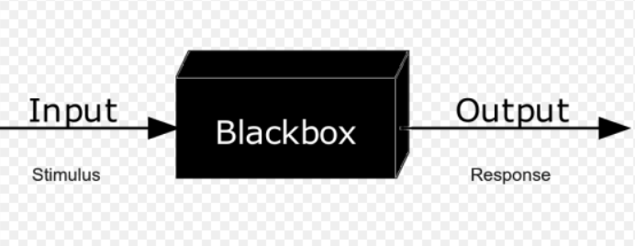
Barriers to transparency: AI and hybrid agency
Organizational processes
Computational processes
Human processes
Notes:
Ai workflows add a new, opaque technological device into archival processes – this is not merely a technological challenge but one which is associated with the decisions that archivists are making
These are human and organizational processes which are being introduced vis a vis AI – so in addition to understanding the technological processes & workflows, it is crucial to think of the human decisions made in AI implementations too
Paradata is more than just technical info – there is technical and organizational paradata.

Slide 6
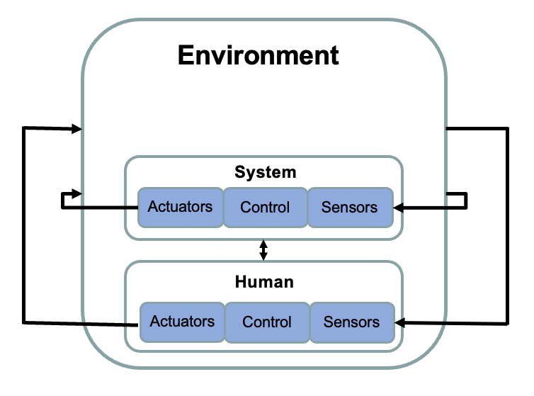
Automated and semi-automated systems
See: Scott Cameron & Babak Hamidzadeh, Preserving paradata for accountability of semi-autonomous AI agents in dynamic environments: An archival perspective,Telematics and Informatics Reports, Volume 14, 2024, https://doi.org/10.1016/j.teler.2024.100135.
Notes:
Another way to think of this, developed in the paper cited below on this slide: our operating framework is becoming more complex; autonomous or semi autonomous systems are being introduced into previously human spheres of activity
Within a given environment, a human operates, takes in stimuli (via sensors), makes decisions (control), and enacts changes (via actuators – using our hands and our communicative facilities)
Machines are now doing this too – these could be digital twins or autonomous vehicles as discussed in Tracy’s presentation (or Claude co-work), or it could be as an archival information processing system, which is functioning within a bounded computing environment but with real world consequences – and sharing these responsibilities with humans

Slide 7
Contents
Calls for paradata in the wild: AI regulation requirements for paradata
Paradata study use cases: findings
Thesis: Archivists should be conversant with AI systems, limitations to transparency, and records/documentation/paradata strategies to mitigate & understand these limitations – since they will be applying AI themselves & working with records of AI-augmented processes
Link to final study: Scott Cameron, Patricia C Franks (lead), Kaila Fewster, Isto Huvila and Norm Mooradian. InterPARES Paradata RP-04 working group final report (2026). https://interparestrustai.org/assets/public/dissemination/RP04-PARADATA-FINALREPORT-2026(3-30-26).pdf
Notes:
Paradata in AI regulation documents + paradata – what are key processes
Paradata use case studies – ouputs and findings
Archivsits need to understand AI systems – technical paradata is means to do so – and need to make decisions about using AI – which will largely be documented in organizational paradata. If you are not keeping paradata, then you ‘d better have absolute faith in the AI – and if you do that’s not on me

Slide 8
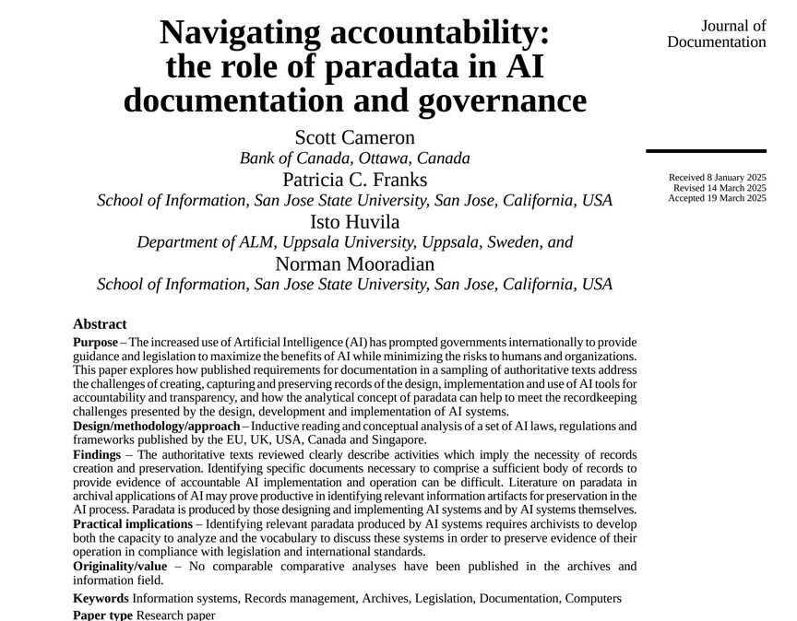
Cameron S, Franks PC, Huvila I, Mooradian N (2025), "Navigating accountability: the role of paradata in AI documentation and governance". Journal of Documentation, Vol. 81 No. 4 pp. 906–926, doi: https://doi.org/10.1108/JD-01-2025-0009
Notes:
Paper : Examining AI governance frameworks to understand the question: WHAT is the law interested in us documenting thruout the AI lifecycle.

Slide 9
AI regulation: Is paradata required by law for AI users?
Question: What specific information artefacts must be preserved, according to authoritative documents (law or regulation)?
Can examining authoritative regulations/laws give us insight into common paradata elements?
Notes:
Can the regulations help us understand necessary paradata elements?

Slide 10
AI regulation: Is paradata required by law for AI users?
Documents reviewed: EU AI Act, CA AI Act, CA Directive on Automated Decision Making, Singapore Model AI governance, US NIST AI Risk Management Framework, UK approach to AI regulation
Published as "Navigating accountability: the role of paradata in AI documentation and governance". Journal of Documentation - Link to version of record (for personal use); Link to summary tables reviewing governance frameworks (open data)
Notes:
Scope – EU, Canada (existing government + proposed legislation that probably won’t pass), Singapore, USA – Natl Institute of Science and Tech – feds don’t regulate this in uSA - aiming for a reasonable sample

Slide 11
Common elements identified in multiple authoritative documents
RECORD PROVISIONS: How did you do what you did using AI?
Risk and impact assessments
Training datasets
Model: Is the preservation of computational tool itself achievable? Can outputs and processes be recreated?
Validation and testing
Ongoing quality assurance measures
Response to harms caused
DOCUMENTATION PROVISIONS: How did you communicate what you did?
Instruction manuals, guides, and public-facing system descriptions required
Targeted notifications required (Overlap with Response to Harms and Ongoing QA)
Two questions per facet: What information should be public? What information should be preserved but not public?
Notes:
There are thruout the AI lifecycle some common elements listed here identified for preservation or for some kind of accountability
For archivists, each of these will have afollowing question of course: does this information need to be made public or is it sensitive, and need retention, but not broad access

Slide 12
Terminology used: Paradata, records, documentation
Paradata: information about the procedures and tools used to create and process information resources
Record: a document with fixed form and stable content, put aside for later reference or action
Documentation: typically describes explanatory materials created with communicative intent. Sometimes a record; often paradata.
Records
Documentation
Paradata
Notes:
Overlap of the terms paradata, record, documentation – this is what much of the terminology used in these conversations for making ai understandable is couched in
these terms are overlapping and all aim for the same goal of accountability

Slide 13
Divergences
Different types of information required: intentional, communicative OR incidental + organic generation from traditional business processes
Explicit vs implicit approach to records requirement: regulation and law will sometimes explicitly require specific information artefacts be produced and preserved; however, specific processes identified for regulation will implicitly require records preservation
Recordkeeping processes are both direct compliance responses to governance documents and necessary for enabling other aspects of compliance
Notes:
There are different types of information required according to documents:
Some will prioritize intentionally generated documentation ; others will prioritize documentation
Records are not always explicitly called for, although typically processes which involve records are identified
-

Slide 14
Table: Paradata in the AI Lifecycle
From: Scott Cameron, Patricia C Franks (lead), Kaila Fewster, Isto Huvila, &Norman Mooradian. Paradata study final report (2026): https://interparestrustai.org/assets/public/dissemination/RP04-PARADATA-FINALREPORT-2026(3-30-26).pdf

Slide 15
Stage | Paradata Examples | Interpretation | Generation | Purpose
Business Understanding | Project Documents (Project charter, stakeholder registry, project plan | Implicit | Human Made | Incidental
 | Ethics Impact Assessments (Algorithmic Impact Assessment (AIA), Data Privacy Impact Assessment (DPIA) | Explicit | Human Made | Incidental, Intentional
Data Understanding | Data provenance record | Explicit | Human Made | Incidental, Intentional
Data Preparation | Documentation (data quality assessment, record of cleansing, corrective steps | Explicit | Human Made | Incidental, Intentional
Modeling | Documentation (algorithm/model type selection) | Explicit | Human Made | Incidental, Intentional
 | Documentation (training process, history) | Explicit | Human Made | Incidental, Intentional
Evaluation | Testing outcomes Model scoring | Implicit | Human Made, Automated | Incidental, Intentional
Deployment | Stakeholder communications | Implicit | Human Made | Incidental, Intentional
 | User testing | Implicit | Human Made | Incidental
 | Incident reporting | Implicit | Human Made | Incidental
 | Audit trails | Implicit, Explicit | Automated | Incidental, Intentional
 | Audits | Implicit, Explicit | Human Made | Incidental, Intentional
Notes:
This table comes from the final report of InterPARES on Paradata, is drafted by Norm Mooradian (coauthor of the paper)
Includes a list of the relevant items that tend to be identified in regulations, characterizes these as human made or machine made, and notes whether these are made intentionally as communicative documents or organically and incidentally throughout a process.
Most of these are human generated or accounting for a business process – even if it is written by Claude or chat gpt they are involved in human business processes

Slide 16
Findings from evaluating regulations & laws
Many (most) identified paradata elements which are necessary for accountable AI are generated by humans (or at least, outside of an automated and integrated system)
AI regulation scales with risk level of application context – so will paradata requirements
AI system implementation processes can be high risk organizational processes and decision workflows; they require active documentation and record keeping
Paradata includes materials described as communicative documentation AND records designed to facilitate AI implementation processes

Slide 17
Problems: Implementing paradata in practice
Case Studies: St Louis Zoo - digitization
Bank of Canada - documenting LLMs for economic analysis
Clinical frameworks for AI recordkeeping framework analysis
CU-05: The role of AI for records management: findings from case studies
Notes:
With this in mind: does this finding track to the paradata case studies?
Short answer is yes but we need more case studies

Slide 18
St Louis Zoo
Goal: to assess reliability of digitizatrion + tagging automation, reducing reliance on short-term staff
Microfilm comprising diverse records
OCR
Scanned & digitized
Content analysis
Metadata assignment for long term preservation and access
Research lead: Rae Lynn Haliday
Notes:
Beginning with a discussion of what the archival process looks like, and then what
will likely look familiar, even if abstracted - this is a traditional overview of the archival process
records are sent to the archives, where they await the attention of the archivist
archivist appraises and selects the records for preservation
Archivist arranges and describes the records - creates suitable metadata to manage the holdings
Records are completely processed and now accessible to researchers

Slide 19
Outcomes
AI tools already embedded in existing electronic records management system – HOWEVER:
AI tools could not identify records aggregations out of the box, since microform holdings were not consistently formatted
AI tools could not parse handwritten documents or annotations, which often contained highly relevant information

Slide 20
Bank of Canada
Goal: understanding how to describe, document & reproduce this process for public accountability
News sources about oil commodity markets, Business Outlook Survey
Generated predictions re: oil commodity prices, business investment
LLM analysis
Improved knowledge of factors contributing to inflation and economic developments
Research leads: Alex Richmond, Mario Beauchamp
(S Cameron not involved in this project)

Slide 21
Outcomes
Paradata preservation standard proposed for AI tools based on this project, but not formally approved [technical vs organizational implementation]
  Training paradata
  Model architecture paradata
  Model evaluation paradata
  User paradata
day to day operational and technical Paradata must be collected under automated framework for ongoing use
Prompts used with LLMs should be tightly controlled with version tracking

Slide 22
CU-05: The role of AI for records management: findings from case studies
Final report: Stefano Allegrezza, Gabriele Bezzi, Maria Mata Caravaca, Massimiliano Grandi, Mariella Guercio, Bruna La Sorda, Francesca Magnoni, Marianna Tascone
Final report: https://interparestrustai.org/assets/public/dissemination/CU05_TheroleofAIforrecordsmanagement_Findingsfromcasestudies_FINAL_v2.pdf

Slide 23
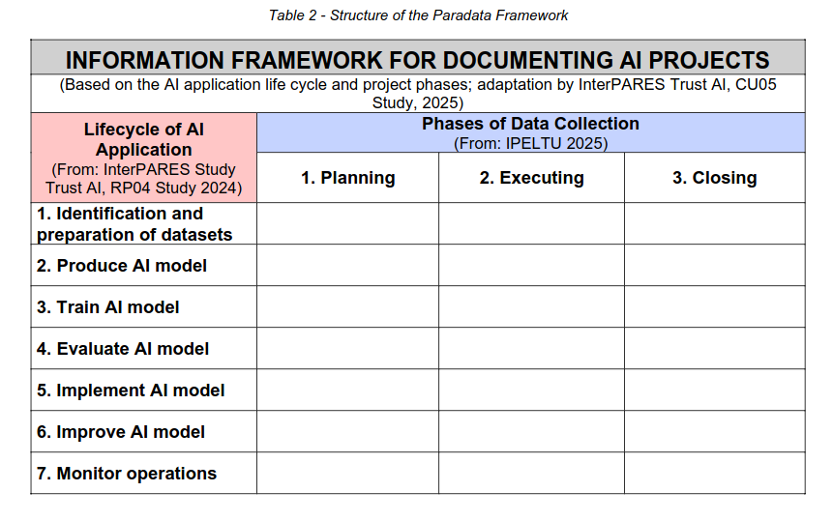
Inputs: Paradata study work, Info. Pres. to Enable Long Term Use (CCSDS), Model Requirements + expertise of study participants

Slide 24
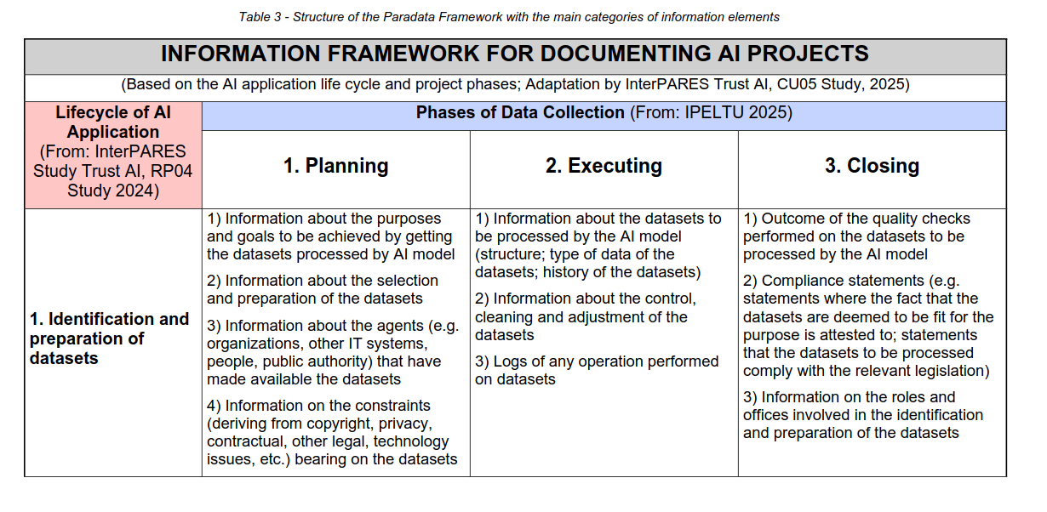
Example table for ONE stage in ML lifecycle
Notes:
This level of detail is completed for the whole AI lifecycle in CU 05 final report

Slide 25
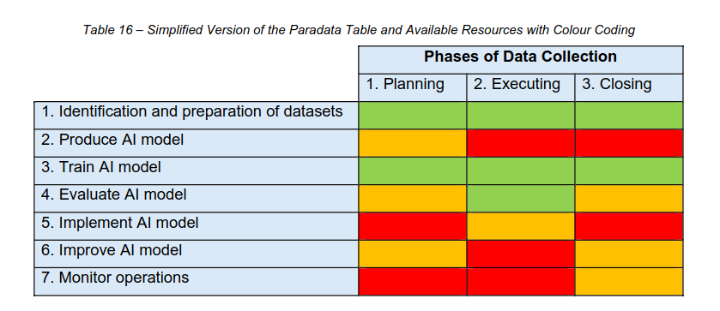
Study evaluates RecordPoint integrated software used for record classification + metadata creation for paradata availability
Datasets used for training are the archives’ own records, which may be trained using the software; elements of the AI model are less transparent.
Notes:
Technical limitations to documenting the technical processes; the transparent parts are those conducted by the end user, but the technical processes are concealed from the user. with this in mind, the reduced levels of technical paradata available are a key organizational consideration before implementing a solution like this.

Slide 26
Forthcoming paper: “Governing Clinical AI as Information Infrastructure: A Lifecycle Documentation Architecture of Metadata, Provenance, and Paradata,” by Nancy Powell, Pat Franks and Souvick Ghosh
The problem: Artificial intelligence (AI) systems are increasingly embedded in routine clinical practice, yet lifecycle governance remains difficult to operationalize because the documentation required to support accountability, oversight, and post-deployment monitoring is fragmented and unevenly specified, particularly beyond pre-deployment evaluation…
Seven clinical AI standards reviewed: CONSORT-AI, SPIRIT-AI, TRIPOD-
AI, STARD-AI, DECIDE-AI, MI-CLAIM, MINIMAR
Output: Study consolidates 113 documentation elements accounting for metadata, paradata, provenance across seven different standards resulting architecture comprises 113 distinct documentation elements organized across five lifecycle domains and structured as a three-tier architecture spanning governance requirements (59 items), scientific and technical reporting (80 items), and contextual and operational paradata documentation.
Provides common language for understanding these standards
Notes:
Very detailed case study of medical recordkeeping frameworks for working with AI – also forthcoming.
Will present a detailed approach to understanding and comparing the unique paradata elements in a specific application case, right at the MOMENT of records creation - rather than understnading their role in archives & records processing alone

Slide 27
Conclusions
Open questions:
Can we further test paradata frameworks in practice – eg this study’s question-based approach, OR CU-05 lifecycle approach?
Multimodal AI Agents can be saved, exported shared; how can they best be designed for transparency in archival contexts? What comprises relevant paradata for agentic AI use?
Archivists can address paradata for our own AI processes – how can we influence other accountable AI implementations outside of archives?
Off-the-shelf commercial AI tools present significant barriers to transparency and understandability, albeit with impressive capabilities – these gaps must be acknowledged & understood within acceptable risk framework
AI implementation presents complex workflows and business decisions; these decisions themselves comprise highly relevant paradata!
Standards, laws, regulations with AI documentation and records requirements exist - but these are not necessarily developed with the input of archivists; much room for contribution here!
Operational and technical paradata is DOWNSTREAM of governance decisions and context

