Slide 1
UNESCO Audio Archives: AI for Metadata Enrichment
Peter Sullivan, UBC
Eng Sengsavang, UNESCO Archives
Interpares Trust AI Symposium
October 25, 2024
Denver, CO

Slide 2
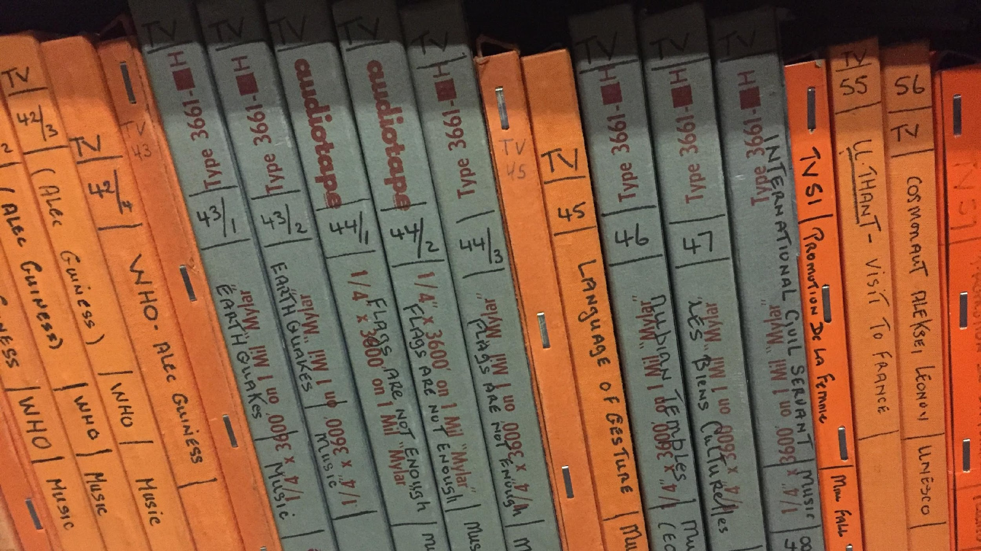
Roadmap
Introduction to the UNESCO Radio Archives
Goals
“The story so far”
Large language models for diplomatics analysis of transcripts
Unsupervised speaker clustering for speaker attribution

Slide 3
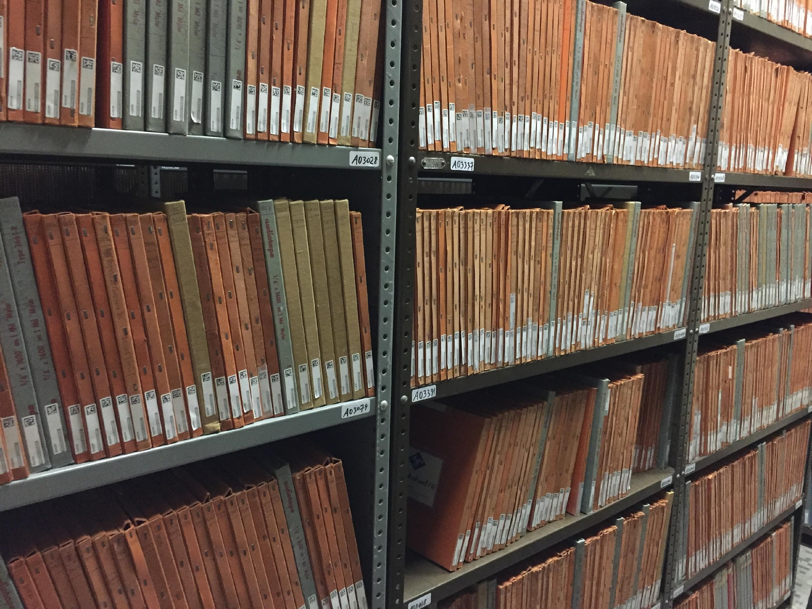
Archives At A Glance
Size: ~16,000 Recordings (~1000 described)
‹#›

Slide 4
Archives At A Glance
Size: ~16,000 Recordings (~1000 described)
Time: 1950s – 1980s
‹#›

Slide 5
Archives At A Glance
Size: ~16,000 Recordings (~1000 described)
Time: 1950s – 1980s
Languages: 70+ (Including multilingual)
‹#›

Slide 6
Archives At A Glance
Size: ~16,000 Recordings (~1000 described)
Time: 1950s – 1980s
Languages: 70+ (Including multilingual)
Topic Coverage:
Education, Culture, Natural Sciences, Communication and Information
Social and Human Sciences, UNESCO History
‹#›

Slide 7
Archives At A Glance
Size: ~16,000 Recordings (~1000 described)
Time: 1950s – 1980s
Languages: 70+ (Including multilingual)
Topic Coverage:
Education, Culture, Natural Sciences, Communication and Information
Social and Human Sciences, UNESCO History
Genre: Interviews Speeches Educational Program
‹#›

Slide 8
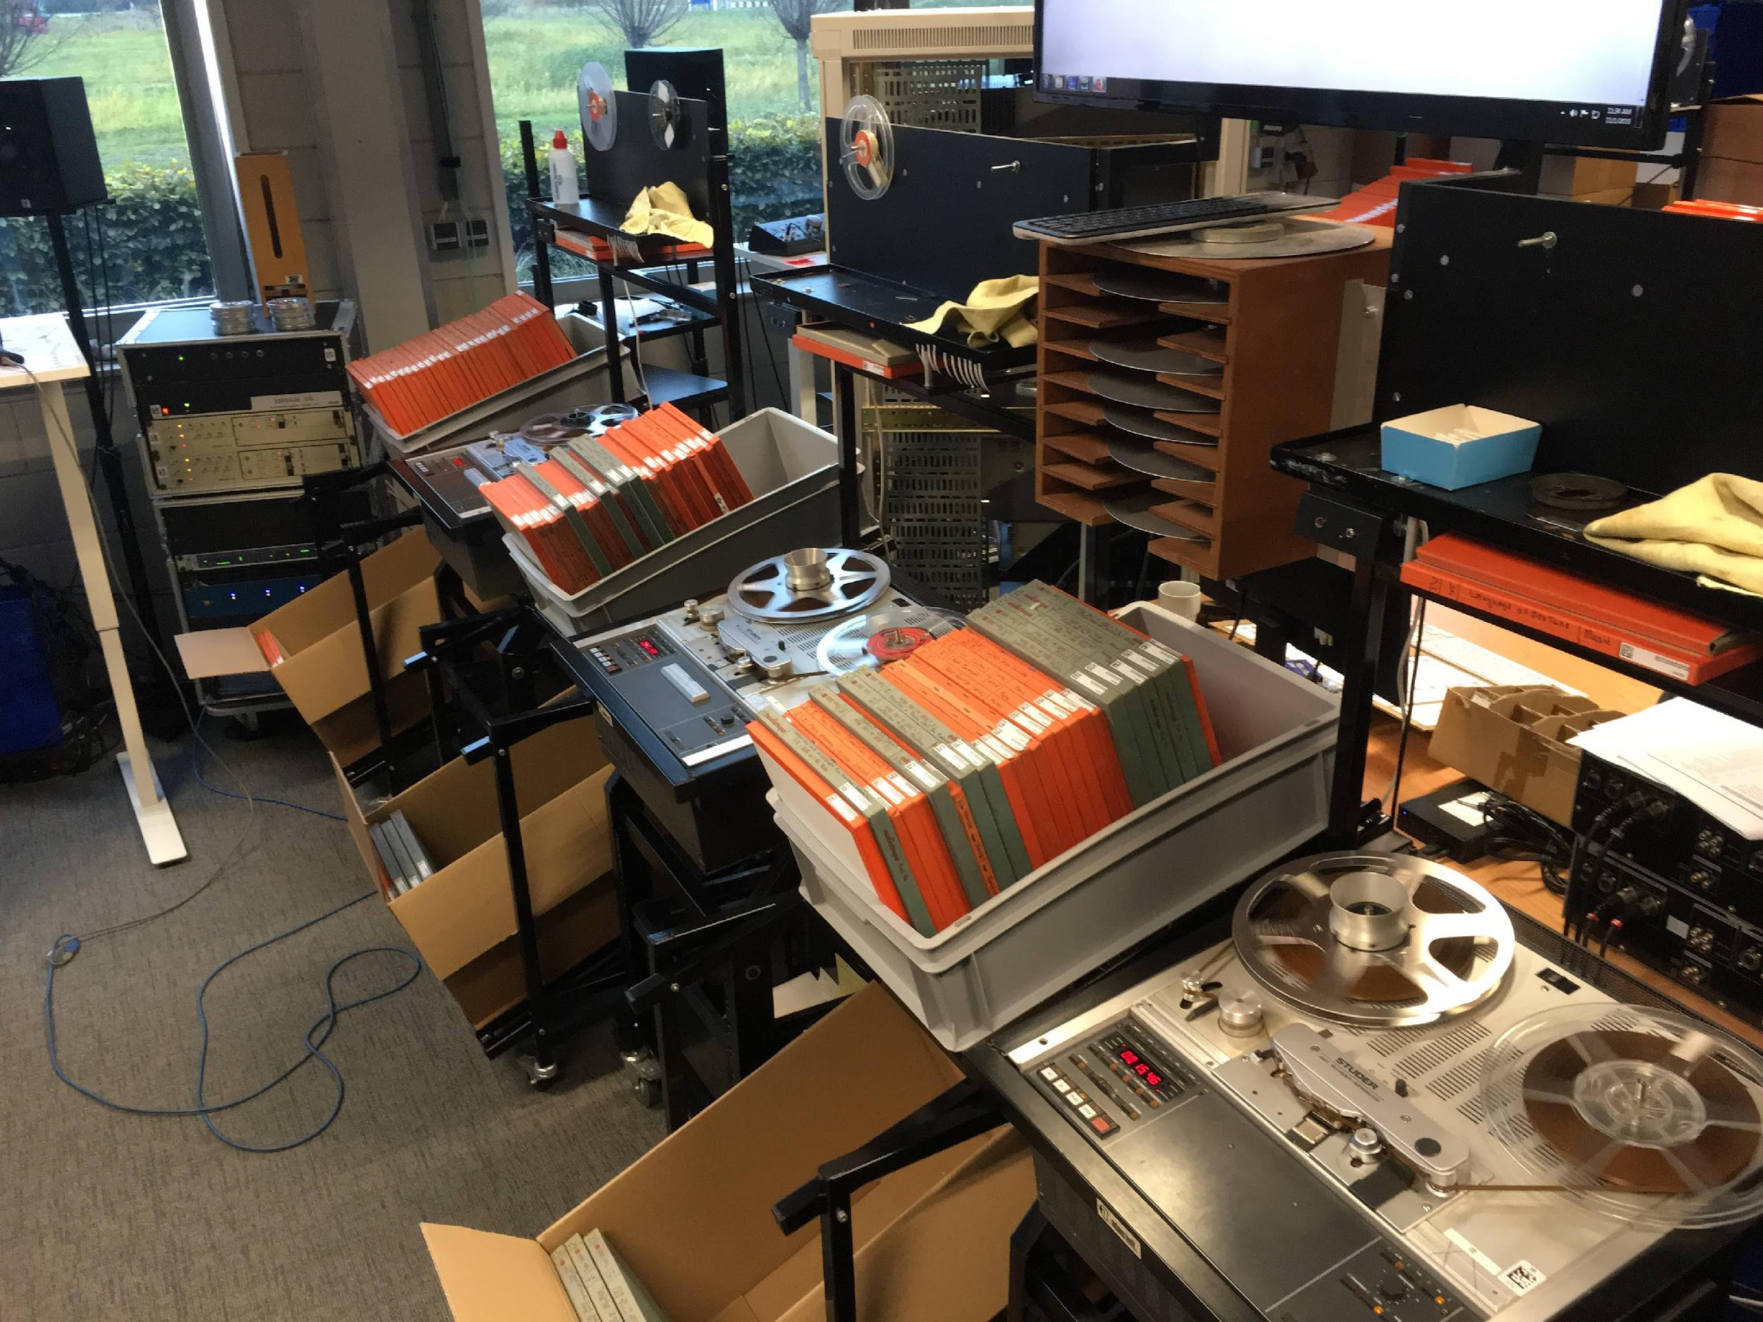
Overarching Goal
Problem: Missing / incomplete metadata for audio records hinder discoverability
AI tools show potential for language ID, speaker recognition, and generating descriptions.
How can AI enable better description of archival audio?

Slide 9
The story so far…
Diplomatics Analysis for Audio Description
Initial focus group analysis of transcripts
Language ID and Speaker Embedding exploration
(Sullivan & Abdul-Mageed, 2024)
Speaker Attribution and Retrieval

Slide 10
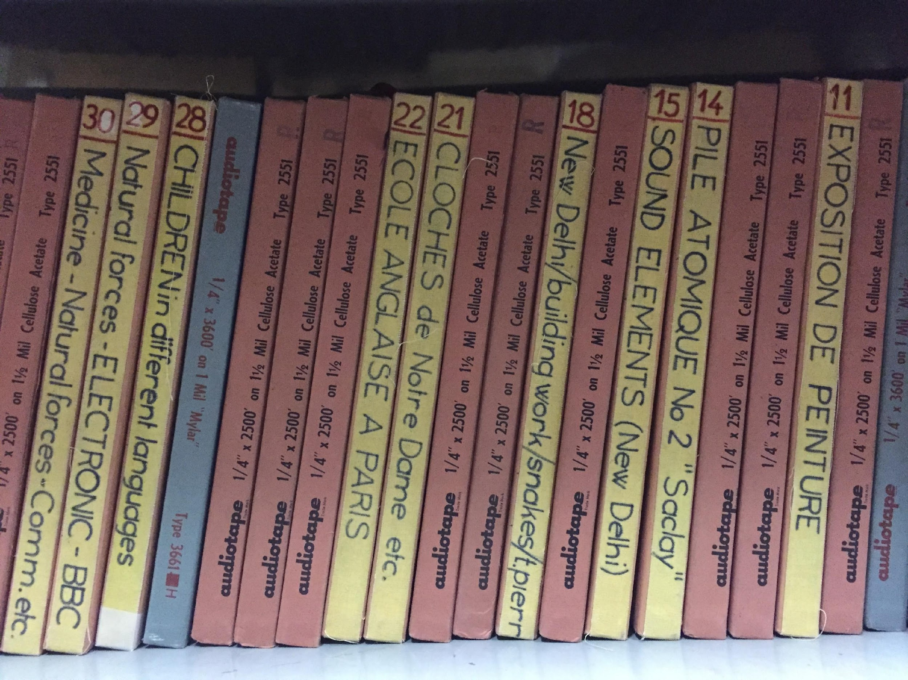
On Barriers to Archival Audio Processing (Sullivan & Abdul-Mageed, 2024)
Goal to understand the challenges of applying Speaker and Language ID tools to archival audio:
Our main findings include the importance of addressing:
Cross-age Speaker Recognition
Cross-lingual Speaker Recognition
For language ID we find that for second language (accented) English speech, as well as the mixed language dataset, modern tools, such as Whisper (Radford et al., 2023), perform reasonably well.

Slide 11
Ongoing Work: Diplomatics Analysis for Audio Description

Slide 12
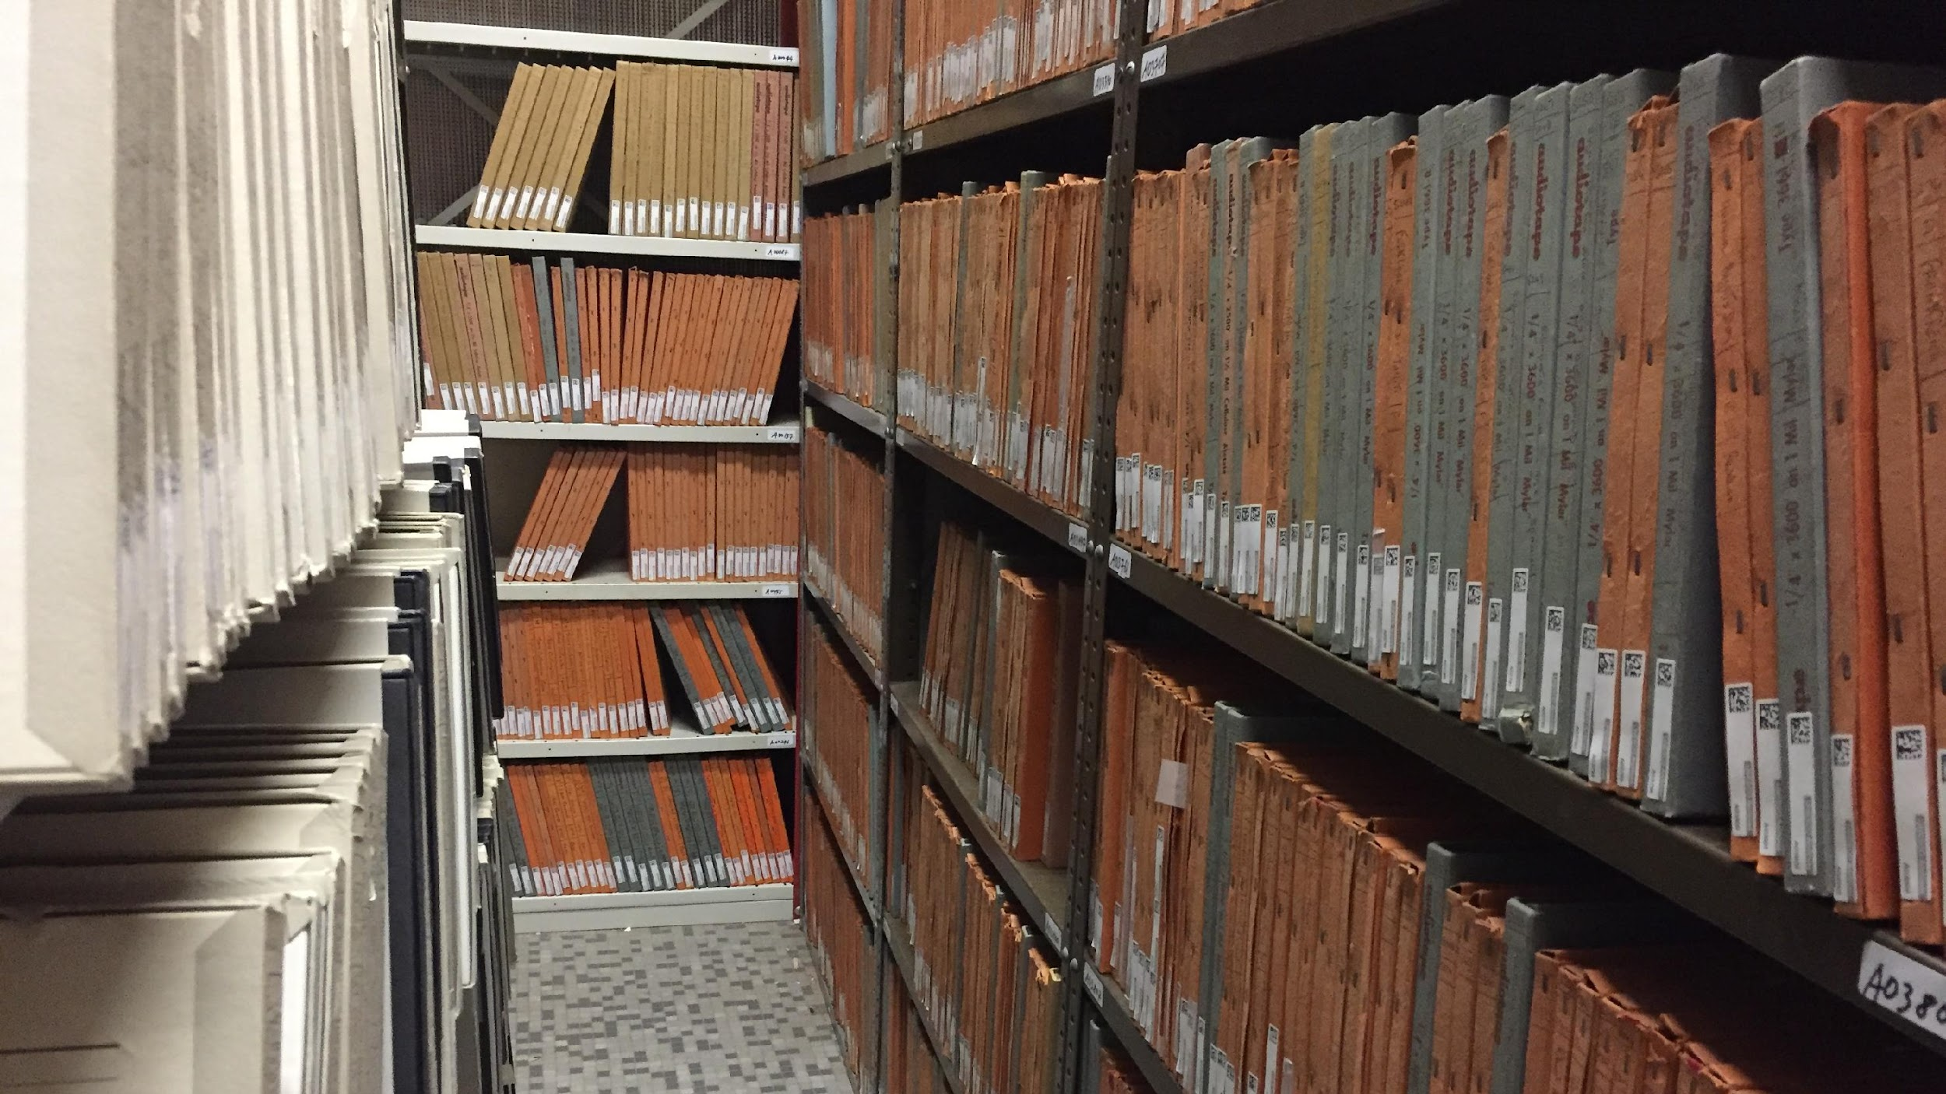
Diplomatics Analysis for Audio Description
Diplomatics Analysis provides a model for understanding the structure of documents…
“These rules, which we call form, reflect political, legal, administrative, and economic structures, culture, habits, myths, and constitute an integral part of the written document, because they formulate or condition the ideas or facts which we take to be the content of the documents.” (Duranti, 1989, p. 15)
Meetings, radio programs, and interviews often have regular form, which we aim to leverage for extracting the most relevant information to write descriptions.

Slide 13
Diplomatics Analysis for Audio Description
Intuition: Use understanding of form to extract descriptive sentences
Large language models (LLMs) have been trained on countless documents, and may internalize rules governing form.
Diplomatics
Analysis
LLMS

Slide 14
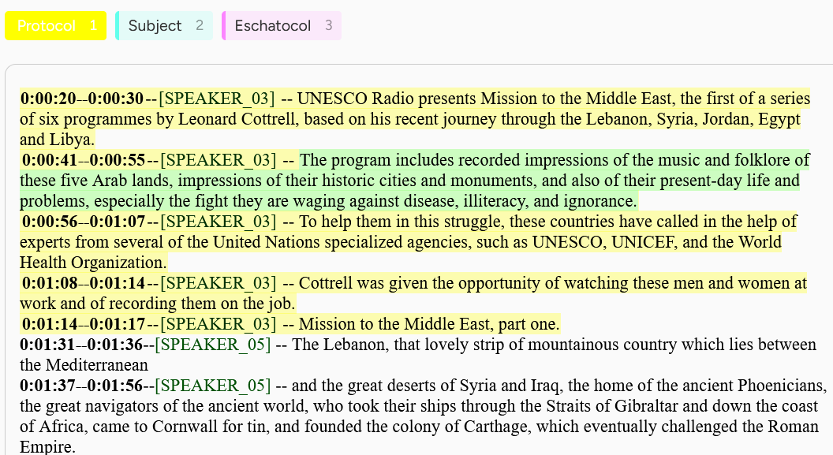
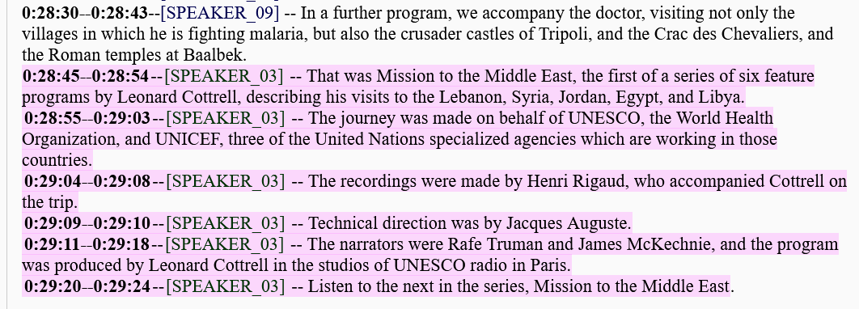
Example
Human Description
UNESCO Radio presents, Mission to the Middle East, the first of a series of six programmes by Leonard Cottrell based on his journey through Syria, Lebanon, Jordan, Egypt, and Libya. This recording includes recorded impressions of the music and folklore of these five lands.
These countries had called for aide from several of the United Nations specialized agencies, such as UNESCO, UNICEF, and the World Health Organization (WHO).
The recordings were made by André Rigaux and the technical direction was by Jacques Ogus. The narrators were Ralph Truman and James McKechnie. The programme was produced by Leonard Cottrell in the studios of UNESCO in Paris.

Slide 15
Example
Human Description
UNESCO Radio presents, Mission to the Middle East, the first of a series of six programmes by Leonard Cottrell based on his journey through Syria, Lebanon, Jordan, Egypt, and Libya. This recording includes recorded impressions of the music and folklore of these five lands.
These countries had called for aide from several of the United Nations specialized agencies, such as UNESCO, UNICEF, and the World Health Organization (WHO).
The recordings were made by André Rigaux and the technical direction was by Jacques Ogus. The narrators were Ralph Truman and James McKechnie. The programme was produced by Leonard Cottrell in the studios of UNESCO in Paris.

Slide 16
Diplomatics Analysis for Audio Description
Progress: Currently in data labeling process
Aim to investigate along two axes:
Zero-shot, few-shot, and instruction finetuned LLMs (LLAMA 3).
Abstractive vs. Extractive summarization.

Slide 17
Ongoing Work:
Speaker Attribution/ Indexing

Slide 18
Background: Speaker Recognition
Speaker Verification (1-to-1): Telebanking, Voice Assistants
1 unknown sample, does it belong to a known speaker?

Slide 19
Background: Speaker Recognition
Speaker Verification (1-to-1): Telebanking, Voice Assistants
1 unknown sample, does it belong to a known speaker?
Speaker Identification (1-to-many): Prefiltering for Speaker Verification
1 unknown sample, it belongs to which of n known speakers?

Slide 20
Background: Speaker Recognition
Speaker Verification (1-to-1): Telebanking, Voice Assistants
1 unknown sample, does it belong to a known speaker?
Speaker Identification (1-to-many): Prefiltering for Speaker Verification
1 unknown sample, it belongs to which of n known speakers?
Speaker Retrieval (1-to-many) Fast retrieval of a given speaker
1 known sample, rank top-k most similar unknown samples.

Slide 21
Background: Speaker Recognition
Speaker Verification (1-to-1): Telebanking, Voice Assistants
1 unknown sample, does it belong to a known speaker?
Speaker Identification (1-to-many): Prefiltering for Speaker Verification
1 unknown sample, it belongs to which of n known speakers?
Speaker Retrieval (1-to-many) Fast retrieval of a given speaker
1 known sample, rank top-k most similar unknown samples.
Speaker Attribution (many-to-many) Cross-recording speaker diarization
m unknown samples, which samples belong to the same person?

Slide 22
Unsupervised Indexing Exploratory Work
Speakers In The Wild set (1 speaker, 2 or more speakers)
Unique Target Speakers DEV 119, EVAL 180
5 second sliding window speaker embeddings (VoxCeleb Pretrained Resnet)
Workflow:
Extract embeddings
Cluster file embeddings
Average each cluster
Cluster across files

Slide 23
Unsupervised Speaker Attribution
Speakers In The Wild dataset (McLaren et al., 2016)
Unique Target Speakers DEV 119, EVAL 180
Embeddings: WeSpeaker ResNet32 with Large Margin (Wang et al., 2023)
Clustering: DBSCAN (Ester et al. 1996)
Diarize
Extract embeddings
Cluster file embeddings
Average each cluster
Cluster across files

Slide 24
Unsupervised Speaker Attribution
Metrics:
Adjusted Mutual Information (AMI):
How well do the cluster labels match the file-level speaker labels?
Per-file speaker count
Does the clustering generate the same number of clusters as there are people in each file?

Slide 25
Unsupervised Speaker Attribution
No timestamp labeled segments (Can’t do Attribution Error Rate)
Unsupervised metrics:
Adjusted Mutual Information (AMI):
How well do the cluster labels match the file-level speaker labels?
AMI for single-speaker files
For files with only one known speaker how well do they match?
Per-file speaker count
Does the clustering generate the same number of clusters as there are people in each file?

Slide 26
Unsupervised Indexing Exploratory Work
Clustering: (Evaluated algorithms that don’t need to know number of clusters)
Mean Shift
iteratively move points to centers of clusters
Density based spatial clustering (DBSCAN)
form clusters around densest regions
Hierarchical DBSCAN (HDBSCAN)
automaticaly search DBSCAN hyperparameter

Slide 27
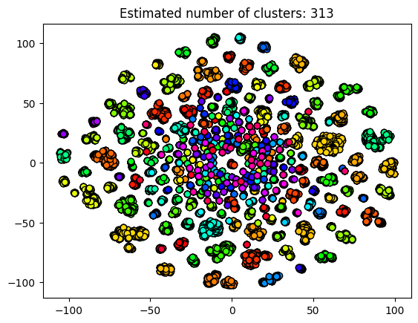
Unsupervised Speaker Attribution
DBSCAN w/ loose initial clusters
Speaker count acc 0.41
AMI 0.83

Slide 28
Unsupervised Speaker Attribution
DBSCAN w/ loose initial clusters
Speaker count acc 0.41
AMI 0.83

Slide 29
Next steps
To diarize or not?
Diarization seems well justified, but loose clustering has an advantage of ensuring enough samples for each speaker.
Need for Uniform metrics:
Speaker Attribution Error rate: Requires timestamped speaker labels
Single Speaker Adjusted Mutual Information: Least effort but doesn’t verify mixed speaker recordings.
Adjusted Mutual Information: Appears to be a useful proxy in the face of noisy labels.

Slide 30
Next steps
Prepping UNESCO dataset for speaker indexing:
Need to consider: gender, time span, languages
Threshold number of recordings
UNESCO core recordings vs. supplementary recordings

Slide 31
Citations
Duranti, L. (1989). Diplomatics: New uses for an old science, Part I. Archivaria, 7-27.
Ester, M., Kriegel, H. P., Sander, J., & Xu, X. (1996, August). A density-based algorithm for discovering clusters in large spatial databases with noise. In KDD (Vol. 96, No. 34, pp. 226-231).
McLaren, M., Ferrer, L., Castan, D., & Lawson, A. (2016, September). The Speakers in the Wild (SITW) speaker recognition database. In Interspeech (pp. 818-822).
Radford, A., Kim, J. W., Xu, T., Brockman, G., McLeavey, C., & Sutskever, I. (2023, July). Robust speech recognition via large-scale weak supervision. In International conference on machine learning (pp. 28492-28518). PMLR.
Sullivan, P. & Abdul-Mageed, M. (2024). On Barriers to Archival Audio Processing. International Conference on Natural Language and Speech Processing 2024.
Wang, H., Liang, C., Wang, S., Chen, Z., Zhang, B., Xiang, X., ... & Qian, Y. (2023, June). Wespeaker: A research and production oriented speaker embedding learning toolkit. In ICASSP 2023-2023 IEEE International Conference on Acoustics, Speech and Signal Processing (ICASSP) (pp. 1-5). IEEE.

