Slide 1

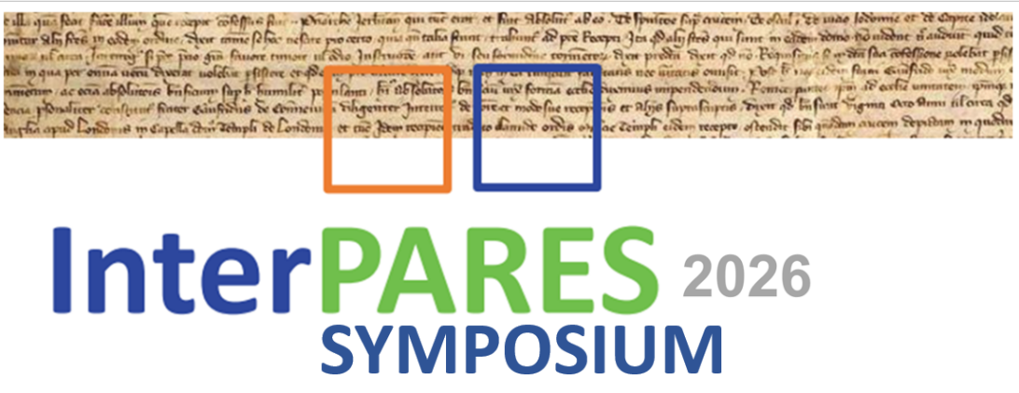

Blockchain and AI: A Perfect Match
Dr. Hrvoje Stančić, professor
University of Zagreb, Faculty of Humanities and Social Sciences
Zagreb, Croatia
hstancic@ffzg.unizg.hr
InterPARES Symposium 2026
Ascoli Piceno, Italy, 26 June 2026

Slide 2
Contents
Introduction
TrustChain concept
Management of digital originals
Project I.Trust.Original
Research activities
Technological trust and its benefits for archival science
Conclusion
Acknowledgements
Resources

Slide 3
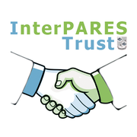

1. Introduction
Previous research
  InterPARES Trust (ITrust), 2013-1019:
  Model for Preservation of Trustworthiness of the Digitally Signed, Timestamped and/or Sealed Digital Records (EU31), https://interparestrust.org
    TrustChain model v1 proposed
  Application of blockchain technology in heritage environment (2022-2025), https://nft.ffzg.unizg.hr/en/
    focus on digital originals – NFTs

Slide 4
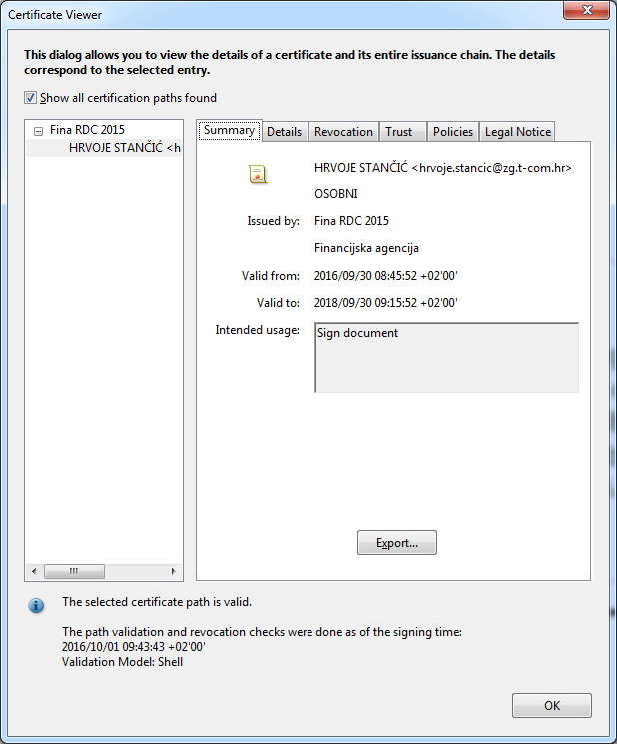

1. Introduction ...
Digital transformation of society
Reliance on digital documents
Digital signatures and seals
  authenticity
  trustworthiness
  issue with the validity period

Slide 5
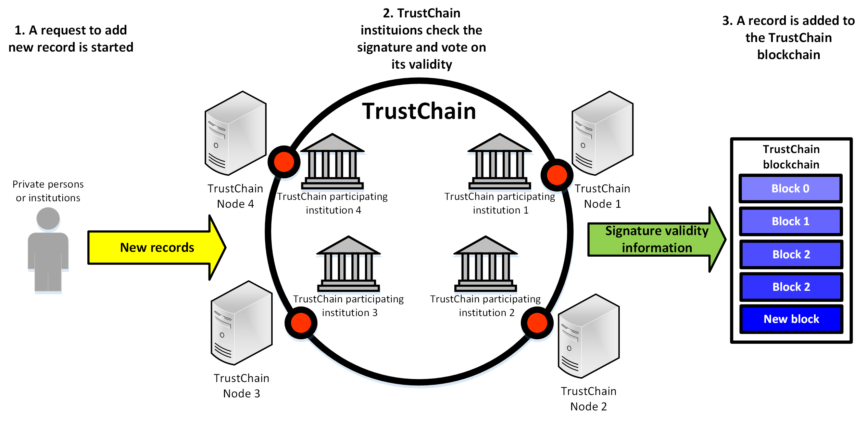
2. TrustChain concept
High-level overview of the TrustChain concept

Slide 6
2. TrustChain concept ...
Archival bond
  "The network of relationships that each record has with the records belonging in the same records aggregation."
  Duranti, Luciana, Terry Eastwood, and Heather MacNeil. Preservation of the Integrity of Electronic Records. Dordrecht, Netherlands: Kluwer Academic Publishers, 2002.
    cited from the Multilingual Archival Terminology (MAT), https://www.ciscra.org/mat/mat/term/49
For keeping archival bond up to date and faster search, TrustChain needs an auxiliary database, e.g. MongoDB (noSQL) ⇨ this is where AI will come in

Slide 7
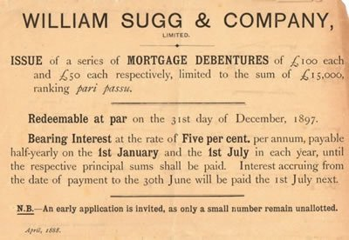
3. Management of digital originals
Analogue (paper) originals
  issued in a single copy
    e.g. negotiable instruments,
    like promissory notes, or
    bills of landing – bearer rights
    documents of title
    certificates
    accreditations
    diplomas
  COVID-19 uncovered
  challenges in delivering
  paper originals
    e.g. bills of lading
Source: What is Debenture? Definition, Types, Features, Advantage & Disadvantage,
https://www.toppers4u.com/2021/02/what-is-debenture-types-advantage.html

Slide 8

3. Management of digital originals …
Can we digitally replicate analogue originals issued in one copy, i.e. can we
  have only one digital original?
  know who has it?
  allow infinite copies?
  distinguish original from the copies?
  allow free transfer, buying, selling?
  enable rights coming out from
  the digital original in possession?
Yes, we can!

Slide 9
3. Management of digital originals ...
Digital originals
  Smart contracts
    many enabled actions and events usable for contracts
    computer scientists – state machine
    no semantics
  Ricardian Contracts
    David Ricardo (1772-1823) – British political economist – theory of international trade
    a structured, human-readable contract that describes the content and rules of the contract and corresponds to legal regulations
    semantically rich

Slide 10
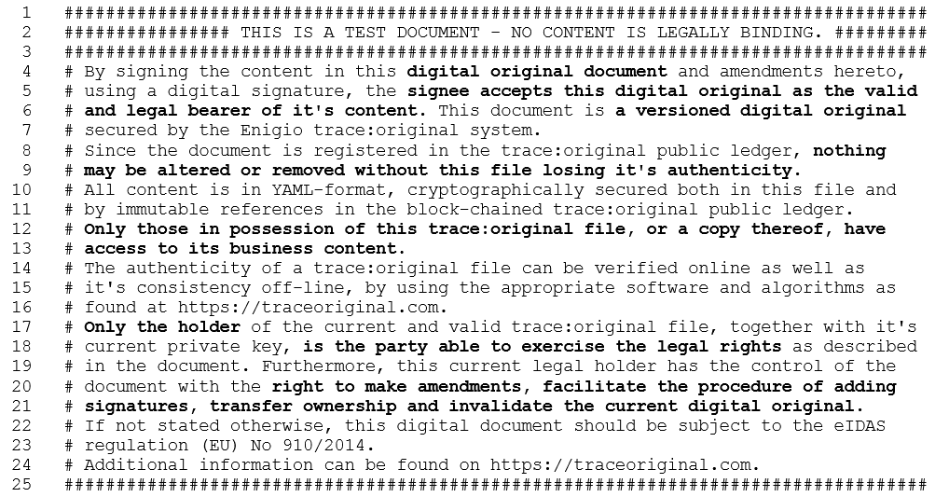
3. Management of digital originals ...
Example – promissory note as a Ricardian contract

Slide 11
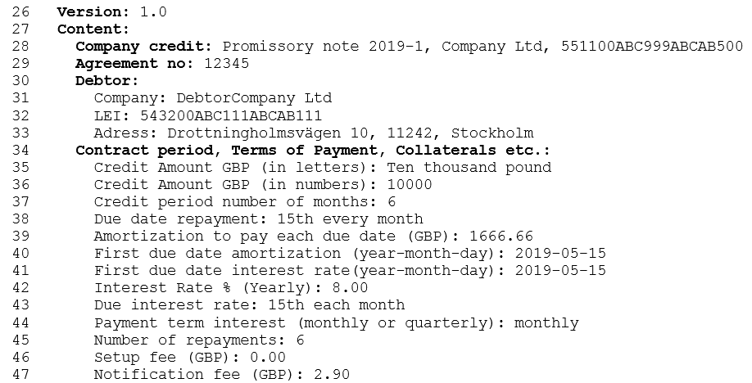
3. Management of digital originals ...
Example – promissory note as a Ricardian contract

Slide 12
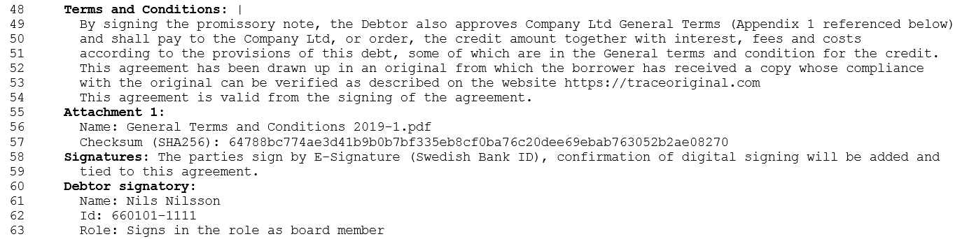
3. Management of digital originals ...
Example – promissory note as a Ricardian contract

Slide 13
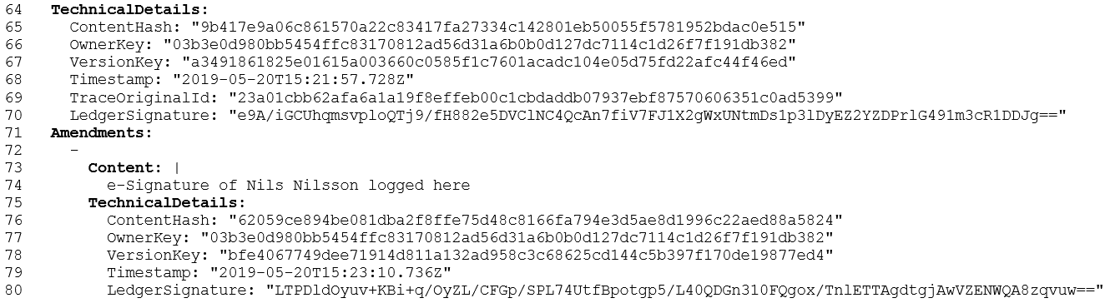
3. Management of digital originals ...
Example – promissory note as a Ricardian contract

Slide 14
3. Management of digital originals ...
Every transaction is registered in a distributed ledger
sequence id | time stamp | document id | content hash | ... | operation type | document version | public key | ledger seal
1 | 2019-06-07 10:01:24 | FD3F1 | FD3F1 | ... | CRE | 1 | AC21F | 14A2B
2 | 2019-06-07 10:01:26 | DF231 | AD121 | ... | CRE | 1 | EDF12 | AE234
3 | 2019-06-08 13:23:12 | FD3F1 | DFF23 | ... | AME | 2 | AC21F | F4BC1
4 | 2019-06-09 15:09:45 | FD3F1 | A3E4E | ... | TRA | 3 | FD3ED | 5E4C1
5 | 2019-06-10 08:35:11 | FD3F1 | BA4DA | ... | INV | 4 | 00000 | A2C4D

Slide 15
4. Project I.Trust.Original
Long-term preservation of authenticity of digital originals using blockchain technology and artificial intelligence (2025-2029) – I.Trust.Original
  funded by the European Union – NextGenerationEU fund
  continues ITrust and ITrust AI research
Harmonises technological concepts and archival principles
  uses blockchain for preservation of validity of digitally signed, timestamped and/or sealed digital records
  uses AI to (semi-)automate establishment of archival bond

Slide 16
4. Project I.Trust.Original ...
Project will investigate the following fundamental
research questions:
How can blockchain technology be applied to the long-term preservation of the trustworthiness of digital originals without the need for their periodic (re)signing?
How can machine learning and artificial intelligence methods be used to classify and (semi-)automatically establish an archival bond between related documents?

Slide 17
4. Project I.Trust.Original ...
What is the optimal model for creation, description, and long-term preservation of (unique) digital originals?
What are the security, legal, ethical and technical advantages and limitations of the proposed innovative solutions compared to traditional digital archiving methods?
Project positions itself at the intersection of
archival theory and technological innovation

Slide 18
5. Research activities
1. Research on the impact of technological development on trustworthiness of digital originals
  collection and analysis of relevant sources
  key topics include laws, bylaws, and regulations governing archival materials, as well as specifications and literature
  based on initial findings, a digitization and preservation process for digitally born documents will be developed, integrating new principles and technologies to produce trustworthy digital originals eligible for acceptance as evidence

Slide 19
5. Research activities ...
2. Modelling, digitization, testing and proof of concept (PoC)
  Advanced technologies research and innovation laboratory (NEXTGEN-LAB)
    blockchain and AI research environment
    development and testing environment for software components
    PKI environment
    environment for simulation of fast ageing of digital signatures, seals and certificates
    AI training environment (partly will use University Computing Centre's supercomputer infrastructure)
  blockchain and AI components to be integrated in a functional TrustChain prototype to be tested in the laboratory environment

Slide 20
5. Research activities ...
3. Preparing project proposals for future funding and planning long-term collaboration
4. Verification and protection of intellectual property
(patents, if relevant)
5. Education and training
6. Dissemination
7. Project management

Slide 21
6. Technological trust and its benefits for archival science
Digital preservation systems
  typically aligned with the OAIS reference model
  ensure bit-level integrity through fixity checks and redundancy, thus supporting one dimension of authenticity
Metadata frameworks
  support preservation of authenticity by documenting context, provenance, and relationships between records
  linked data and knowledge graph approaches enable reconstruction of archival bond across distributed environments

Slide 22
6. Technological trust and its benefits for archival science ...
Artificial intelligence and machine learning
  enhance archival processes through automation, particularly in description, classification, preservation, and access
  improve efficiency and scalability
Blockchain and distributed ledger technologies
  provide robust mechanisms for ensuring data integrity and tamper-evidence through cryptographic hashing and distributed consensus

Slide 23
6. Technological trust and its benefits for archival science ...
Digital signatures and trust services
  establish legally recognized mechanisms for asserting authenticity at the time of record creation and validation
Other technological domains
  include cloud computing and digital forensics
  contribute to the preservation of digital records by enhancing storage scalability and enabling capture of technical metadata and the original context

Slide 24
7. Conclusion
Blockchain and
distributed ledger technologies
Promising solution for on-chain preservation
of validity of digitally signed, timestamped
and/or sealed digital records.

Slide 25
7. Conclusion ...
Artificial intelligence
Promising approach for (semi-)automating establishment of archival bond between documents already registered on the blockchain and the new ones being registered.

Slide 26
7. Conclusion ...
Concept of digital original documents created simultaneously as human-readable and machine-computable documents
Promising solution for both digitisation of processes based on paper documents created as single originals and the creation of digital art, music, video, and other copyrighted works in digital form.
On-chain archival records to be preserved!

Slide 27


8. Acknowledgements
Projects InterPARES Trust and InterPARES Trust AI, UBC, Vancouver, Canada were funded by SSHRC
Project "Long-term preservation of authenticity of digital originals using blockchain technology and artificial intelligence (I.Trust.Original)", Faculty of Humanities and Social Sciences, University of Zagreb, Croatia is funded by the European Union – NextGenerationEU.

Slide 28
9. Resources
Andersson, L., Huvila, I., & Sköld, O. (2024). An Introduction to Paradata. In I. Huvila, L. Andersson, & O. Sköld (Eds), Perspectives on Paradata (Vol. 13, pp. 1–14). Springer International Publishing. https://doi.org/10.1007/978-3-031-53946-6_1
Barad, K. M. (2007). Meeting the Universe Halfway: Quantum Physics and the Entanglement of Matter and Meaning. Duke University Press.
Bearman, D. A. (1994). Managing Electronic Mail. Archives & Manuscripts, 22(1), 28–50.
Bearman, D. A., & Lytle, R. H. (1985). The Power of the Principle of Provenance. Archivaria, 21. https://archivaria.ca/index.php/archivaria/article/view/11231
Bilogrivić, M., & Stublić, H. (2023). Application of Blockchain Technology and NFTs in a Museum Environment. 2023 46th MIPRO ICT and Electronics Convention (MIPRO), 1353–1358. https://doi.org/10.23919/MIPRO57284.2023.10159780
Brocke, J. vom, Simons, A., Niehaves, B., Riemer, K., Plattfaut, R., & Cleven, A. (2009). Reconstructing the Giant: On the Importance of Rigour in Documenting the Literature Search Process. ECIS 2009 Proceedings. 161. https://aisel.aisnet.org/ecis2009/161
Cameron, S., Franks, P., & Hamidzadeh, B. (2023). Positioning Paradata: A Conceptual Frame for AI Processual Documentation in Archives and Recordkeeping Contexts. https://doi.org/10.14288/1.0438178
Cencetti, G. (1939). II fondamento teorico della dottrina archivistica [The Basic Theory of Archival Science]. Archivi, 6(1), 7–13.
Colavizza, G., Blanke, T., Jeurgens, C., & Noordegraaf, J. (2022). Archives and AI: An Overview of Current Debates and Future Perspectives. Journal on Computing and Cultural Heritage, 15(1), 1–15. https://doi.org/10.1145/3479010
Consultative Committee for Space Data Systems. (2014). Producer–Archive Interface Specification (CCSDS 651.1-B-1). CCSDS. https://ccsds.org/publications/bluebooks/entry/3044/
Consultative Committee for Space Data Systems. (2004). Producer–Archive Interface Methodology Abstract Standard (PAIMAS) (CCSDS 651.0-M-1). CCSDS. https://ccsds.org/publications/magentabooks/entry/3040/
Croatian State Archives. (2022). Specifikacija metapodaraka za opis dokumentarnog i arhivskog gradiva. (Guidelines for the Digitisation of Documentary and Archival Materials) https://www.arhiv.hr/Portals/0/Specifikacija.pdf
De Sordi, N. A. D., & Vasco, J. A. C. (2026). Trustchain e a preservação digital de longo prazo: Análise de aderência aos modelos de requisitos
Duchein, M. (1983). Theoretical Principles and Practical Problems of Respect des fonds in Archival Science. Archivaria, 16, 64–82.
Duranti, L. (1997). The Archival Bond. Archives and Museum Informatics, 11(3–4), 213–218. https://doi.org/10.1023/A:1009025127463
Duranti, L. (2010). Concepts and Principles for the Management of Electronic Records, or Records Management Theory is Archival Diplomatics. Records Management Journal, 20(1), 78–95. https://doi.org/10.1108/09565691011039852

Slide 29
9. Resources ...
European Parliament & Council of the European Union. (2024). Regulation (EU) 2024/1183 of 11 April 2024 Amending Regulation (EU) No 910/2014 as Regards Establishing the European Digital Identity Framework. EUR-Lex. https://eur-lex.europa.eu/eli/reg/2024/1183/oj/eng
Government of the Republic of Croatia. (2024, October 22). Tehnička specifikacija informacijskog sustava elektroničkog uredskog poslovanja (Electronic Record Management Systems Technical Specification) [Specifikacija]. MPUDT. https://mpudt.gov.hr/o-ministarstvu/ustrojstvo-6300/uprava-za-politicki-sustav-i-opcu-upravu/uredsko-poslovanje-26231/26231
Hurley, C. (2005). Parallel provenance. Archives & Manuscripts, 33(2), 52–91.
Hutchinson, T. (2020). Natural Language Processing and Machine Learning as Practical Toolsets for Archival Processing. Records Management Journal, 30(2), 155–174. https://doi.org/10.1108/RMJ-09-2019-0055
International Council of Archives. (2023). Records in Contexts – Conceptual model (Version 1.0.). https://www.ica.org/app/uploads/2023/12/RiC-CM-1.0.pdf
International Organization for Standardization. (2010). Space Data and Information Transfer Systems – XML Formatted Data Unit (XFDU) Structure and Construction Rules (ISO 13527:2010). https://www.iso.org/standard/53985.html
International Organization for Standardization. (2025). Space Data System Practices – Reference model for an open archival information system (OAIS) (ISO 14721:2025). https://www.iso.org/standard/87471.html
Kirschenbaum, M. G., Ovenden, R., Redwine, G., & Donahue, R. (2010). Digital Forensics and Born-digital Content in Cultural Heritage Collections. Council on Library and Information Resources.
Lavoie, B. (2014). The Open Archival Information System (OAIS) Reference Model: Introductory Guide (2nd Edition). DPC Technology Watch Report 14-02. York, UK: Digital Preservation Coalition. https://dx.doi.org/10.7207/twr14-02
Lemieux, V. L. (2016). Trusting Tecords: Is Blockchain Technology the Answer? Records Management Journal, 26(2), 110–139. https://doi.org/10.1108/RMJ-12-2015-0042
Lemieux, V. L. (2017). A Typology of Blockchain Recordkeeping Solutions and Some Reflections on Their Implications for the Future of Archival Preservation. 2017 IEEE International Conference on Big Data (Big Data), 2271–2278. https://doi.org/10.1109/BigData.2017.8258180
Lemieux, V. L. (2024). Blockchain: The Theory and Practice of Trustworthy Archival Documents. In Archival Science in Interdisciplinary Theory and Practice. Rowman & Littlefield.

Slide 30
9. Resources ...
Massari, A., Peroni, S., Tomasi, F., & Heibi, I. (2026). Representing Provenance and Track Changes of Cultural Heritage Metadata in RDF: A survey
McKenna, L., Debruyne, C., & O’Sullivan, D. (2022). Using Linked Data to Create Provenance-Rich Metadata Interlinks: The Design and Evaluation of the NAISC-L Interlinking Framework for Libraries, Archives and Museums. AI & SOCIETY, 37(3), 921–947. https://doi.org/10.1007/s00146-021-01373-z
Millar, L. (2017). Archives: Principles and Practices (Second edition). Facet Publishing.
Rolan, G., Humphries, G., Jeffrey, L., Samaras, E., Antsoupova, T., & Stuart, K. (2019). More human than human? Artificial Intelligence in the Archive. Archives and Manuscripts, 47(2), 179–203. https://doi.org/10.1080/01576895.2018.1502088
Schellenberg, T. R. (1956). Modern Archives: Principles and Techniques. SAA. https://babel.hathitrust.org/cgi/pt?id=mdp.39015071452539&seq=10&q1=manager
Schlarb, S., Schmidt, R., Karl, R., Bartha, M., Rorden, J., Delve, J., & Aas, K. (2016). An OAIS-oriented System for Fast Package Creation, Search, and Access. iPRES 2016 - Proceedings of the 13th International Conference on Digital Preservation, 85–95. https://phaidra.univie.ac.at/o:502851.
Snyder, H. (2019). Literature Review as a Research Methodology: An Overview and Guidelines. Journal of Business Research, 104, 333–339. https://doi.org/10.1016/j.jbusres.2019.07.039
Stančić, H. (2023): Digitalizacija i upravljanje digitalnim izvornicima. Zbornik 54. savjetovanja hrvatskih arhivista: Utjecaj digitalizacije na arhivsku praksu, 7-30. https://urn.nsk.hr/urn:nbn:hr:131:583191
Stančić, H., Trbušić, Ž., & Rajh, A. (2025). Model of Application of Blockchain Technology FTand Nfts in Heritage Environment. 2025 IEEE International conference on cyber humanities (IEEE-CH), 1–6. https://doi.org/10.1109/IEEE-CH65308.2025.11279589
Stublić, H., Bilogrivić, M., & Zlodi, G. (2023). Blockchain and NFTs in the Cultural Heritage Domain: A Review of Current Research Topics. Heritage, 6(4), 3801–3819. https://doi.org/10.3390/heritage6040202
Thibodeau, Kenneth, et al. (2018). Preservation as a Service for Trust (PaaST): Functional and Data Requirements for Digital Preservation – version 1.0. https://interparestrust.org/assets/public/dissemination/PreservationasaServiceforTrust1_0-FINAL.pdf
Thibodeau, K., Richmond, A., & Beauchamp, M. (2025). Archival Research Theory: Putting Smart Technology to Work for Researchers. 2025 IEEE International Conference on Big Data (BigData), 6044–6051. https://doi.org/10.1109/BigData66926.2025.11401002
Van Hijfte, S. (2026). Blockchain Platforms: A Look at the Underbelly of Distributed Platforms. Springer Nature Switzerland. https://doi.org/10.1007/978-3-032-00979-1
Xie, S. (2024). Digital Archival Bond: A Universal Bond for Digital Trustworthiness. In Archival Science in Interdisciplinary Theory and Practice. Rowman & Littlefield.
Zhang, J. (2012). Original Order in Digital Archives. Archivaria, 74 (Special issue on arrangement and description of archives), 167–193.
Zheng, X., Mukkamala, R. R., Vatrapu, R., & Ordieres-Mere, J. (2018). Blockchain-based Personal Health Data Sharing System Using Cloud Storage. 2018 IEEE 20th International Conference on E-Health Networking, Applications and Services (Healthcom), 1–6. https://doi.org/10.1109/HealthCom.2018.8531125

Slide 31
Blockchain and AI: A Perfect Match
THANK YOU!
Dr. Hrvoje Stančić, professor
University of Zagreb, Faculty of Humanities and Social Sciences
Zagreb, Croatia
hstancic@ffzg.unizg.hr
InterPARES Symposium 2026
Ascoli Piceno, Italy, 26 June 2026

