Slide 1
AI-as-a-Service for Archives
Dr. Hrvoje Stančić, full. prof.
Faculty of Humanities and Social Sciences
University of Zagreb, Croatia
hstancic@ffzg.unizg.hr
InterPARES Trust AI public symposium
"Bringing AI to the Archives"
Denver, Colorado, USA
October 25 2024

Slide 2
Contents
Introduction
The survey
AI model training methodology
Conclusion

Slide 3
1. Introduction
The aim of the study – identify critical archival challenges for improvement by AI technologies in the context of digital records.
Create an AI model to address them

Slide 4
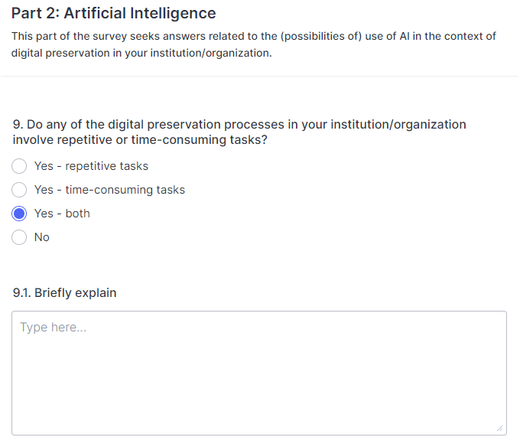
2. The survey
Online and the follow up in-person (March 2022 – January 2023)
English, Spanish, Portuguese
106 responses from 27 countries
Identified 30 repetitive and/or time-consuming tasks
The highest ranked response was: “adding, gathering, and extracting metadata”

Slide 6
3. AI model training methodology
We are following “typical life cycle of an ML system”
Data collection
Data preparation
Model development
Model evaluation
Model postprocessing
Model deployment
Model development process description
Suresh, H., Guttag, J. A framework for understanding sources of harm throughout the machine learning life cycle. In: EAAMO 2021: Equity and Access in Algorithms, Mechanisms, and Optimization, 5-9 October 2021, New York, SAD: Association for Computing Machinery, pp. 1-9, https://doi.org/10.48550/arXiv.1901.10002

Slide 7
3.1. Data collection
Cooperation with the State Archives in Osijek, Croatia
provided an AI training set
collection of digitized (set – studio and outdoor) portraits
total: 1,417 images
recto: 908 images
from 1870s to the beginning of the 20th century
9 categories
male, female, children, group – studio + outdoors
school groups + groups of members of associations
description of the set

Slide 8
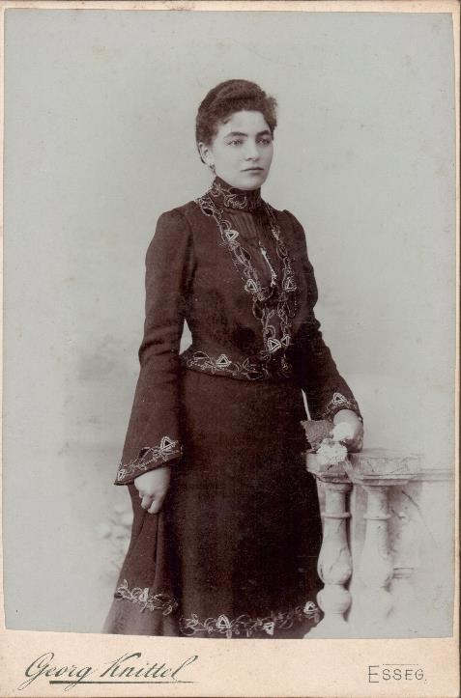
3.1. Data collection
Description of the set – example
Name: Marija Sudić, married Tadijanović
Description: young female person shot in studio (dress, jewelry, flower, pillars)
Photographer: Georg Knittel
Atelier: Georg Knittel, Osijek
Date: 1865. – 1907.
Place: Osijek
Format: 14.50 x 10.50 cm
Medium: paper
Technique: black and white
Polarity: positive

Slide 9
3.2. Data preparation
Implicit data extraction
male / female
age: child, young, adult, old
place: studio, outdoor
Explicit data extraction
extract all labels
create a set of unique labels
Male portraits: "suit", "military uniform", "hunting uniform", "priest dress", "mustache", "coat", "fur", "beard", "glasses", "hat", "cap", "tie" , "butterfly bow", "bow", "scarf", "decoration", "decorations", "sword", "staff", "jewelry", "pipe", "watch", "gloves", "chair", "table", “small table", "fence", "cabinet", "mirror", "stand", "haircut and shaving accessories", "pen", "cigarette", "flower", "flowers", "vase ", "umbrella", "books", "box", "bag", “chair back", "armchair", "deer statue", "cross", "number"

Slide 10
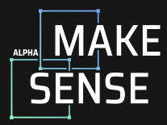
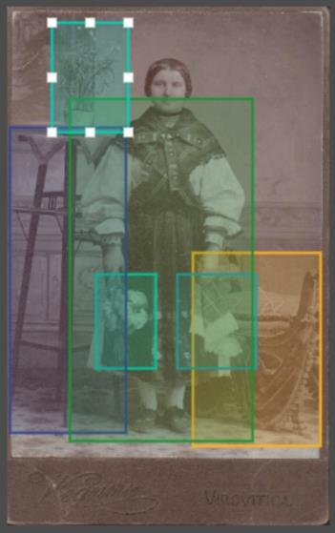
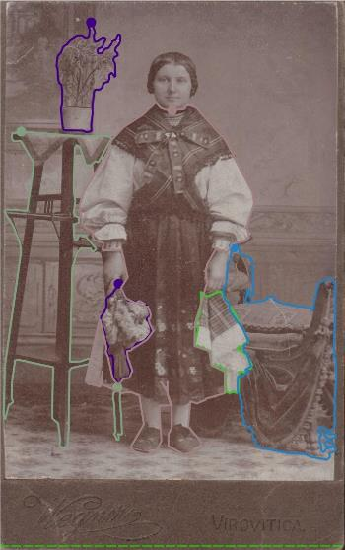
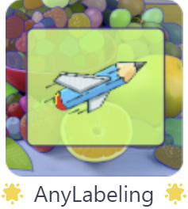
3.2. Data preparation
Comparative analysis of two image annotation solutions (precision, speed)

Slide 11
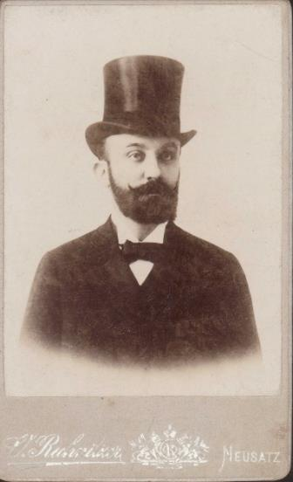
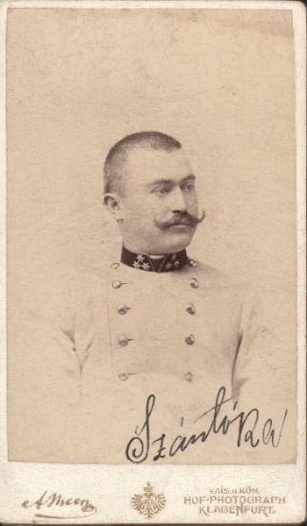
3.2. Data preparation
Annotation challenges
Easy to detect object borders
Object borders blurred with the background

Slide 12
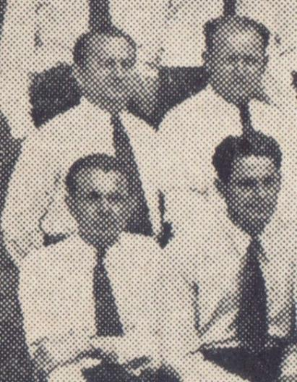
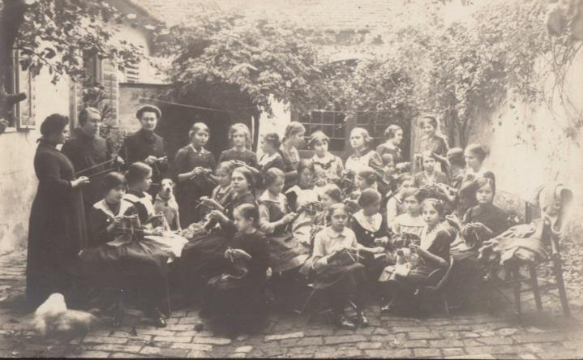
3.2. Data preparation
Annotation challenges
Not easy to detect object borders
Low resolution images

Slide 13
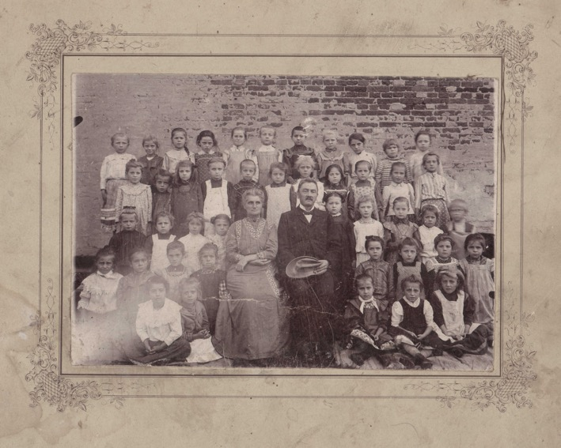
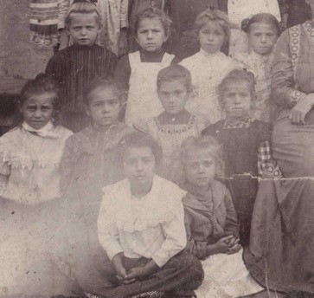
3.2. Data preparation
Annotation challenges
Faded/damaged
images

Slide 14
3.3. Model development
Initial AI model training environment
PyTorch and YOLOv5 utilities
PyTorch is an open-source machine learning (ML) framework
YOLOv5 is a model in the You Only Look Once (YOLO) family of computer vision models
https://pytorch.org/hub/ultralytics_yolov5/
DOI: 10.5281/zenodo.3908559
Google Colab + local environment
positive and negative sides

Slide 15
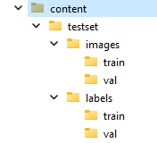
3.3. Model development
Creation of folder structure for training
images and labels folders
train and val(idation) subfolders (75:25 ratio)
train = images (e.g. 001.jpg, 002.jpg etc.)
val = .txt files (e.g. 001.txt, 002.txt etc.)
Contents of a .txt file:
2 0.483673 0.592011 0.428583 0.638241
4 0.727217 0.644075 0.096601 0.067325
2 and 4 correspond to the label set + coordinates
2 = dress, 4 = flowers

Slide 16
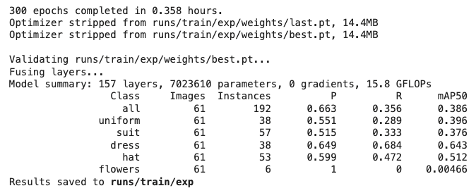
3.3. Model development
Model training
Duration depending on the complexity of the data
21.48 min

Slide 17
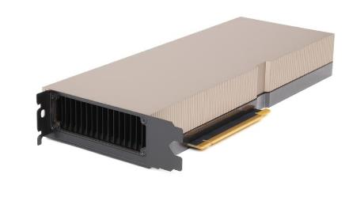
3.3. Model development
Scaling up
Obtained access to a server at the University Computing Centre in Zagreb
Ubuntu virtual machine
CPU processing with access to GPUs on demand
AMD EPYC 7713 64-Core Processor
128 Gb RAM
NVIDIA A100 Tensor Core GPU

Slide 18
3.4. Model evaluation
Testing on untrained data
images from the same collection NOT used for training
images from other available collections
images from the web
our photos of historic images
Model is performing well in recognition of the trained objects on unlabeled images (not 100% correct, of course)

Slide 19
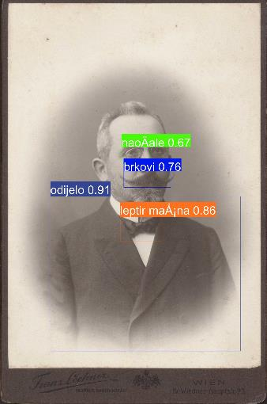
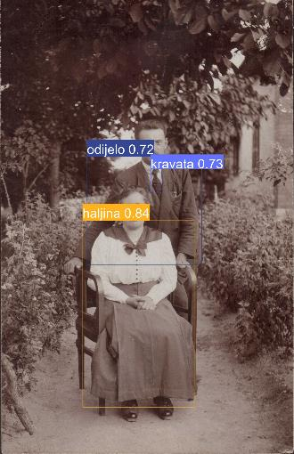
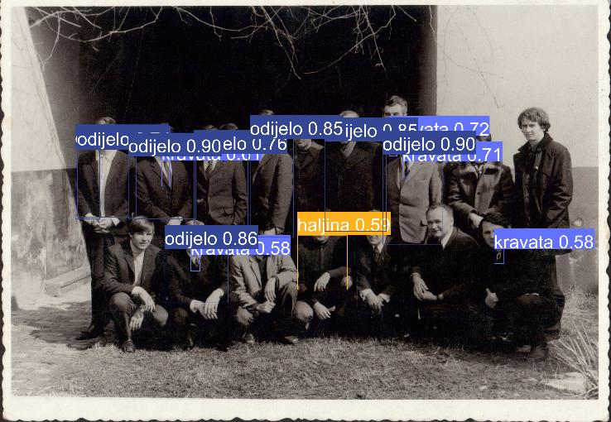
3.4. Model evaluation
Source: State Archives in Osijek, Croatia

Slide 20
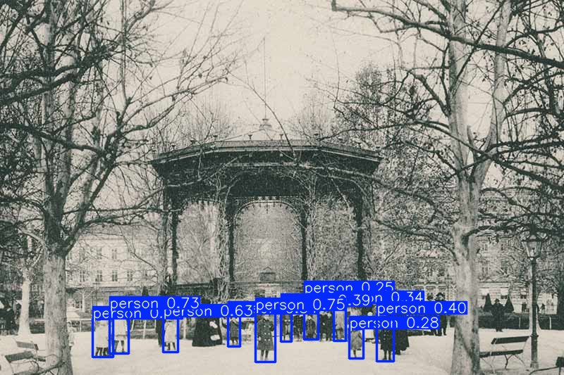
3.4. Model evaluation
Source: State Archives in Zagreb, Croatia

Slide 21
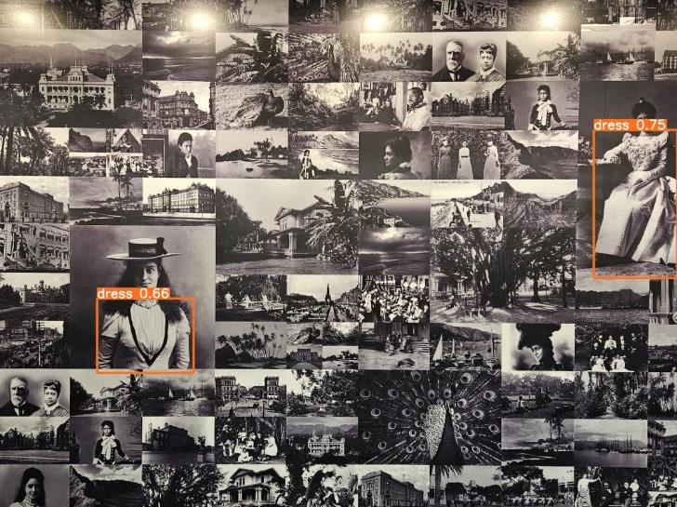
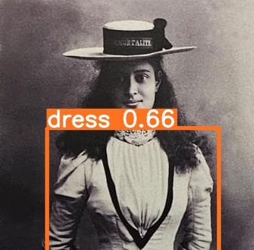
3.4. Model evaluation
Sheraton Princess Kaiulani, Honolulu – reception wallpaper

Slide 22
3.5. Model postprocessing
AI model improvement based on the evaluation results
adding more annotated photos
finite number of images in the collection – create a synthetic set
slightly rotated images
resolution variations (e.g. 320 / 640 / 1280 dpi)
using image upscaling solutions to increase quality of low-resolution images (?)
⇒requires new AI model training process!

Slide 23
3.6. Model deployment
Future work – "AI model-as-a-service"
Model deployment – setting up a server environment with the trained model
Allowing anyone to
describe their collections by pointing the model trained on archival images to their set of (archival) images
effectively reduce the time needed for repetitive and time-consuming task of “addition, gathering, and extracting metadata”

Slide 24
3.7. Model development process description – paradata
Data, just as metadata, used to describe the development process of an AI model creation
Important for understanding
how AI model works
what it can be used for
what it cannot be used for

Slide 25
3.7. Model development process description – paradata
describe each step in the model development (1-6), e.g.
information on who initially described the collection
is a model developed using a final number of images?
who defined labels?, who did the labelling?
technical aspects of the model development environment ⇒ important for future emulation (digital preservation)

Slide 26
4. Conclusion
Getting as close to the concept of "AI (model)-as-a-Service" as possible
Aiming at creating a product (trained AI model) to be easily used by an average archivist
Develop a guidance how to replicate the training process on other collections

Slide 27
AI-as-a-Service for Archives
THANK YOU!
Dr. Hrvoje Stančić, full prof.
Vice dean for business /
Chair of archival and documentation sciences
Department of Information and Communication Sciences
Faculty of Humanities and Social Sciences
University of Zagreb, Croatia
hstancic@ffzg.unizg.hr
LinkedIn

