Slide 1
Records in the cloud Lessons from InterPARES Trust and others
Prof. Erik Borglund
23 May 2025

Slide 2
Bio
Erik Borglund, Professor, Archives and Information Science Mid Sweden University
Researcher within InterPares since 2012/13

Slide 3
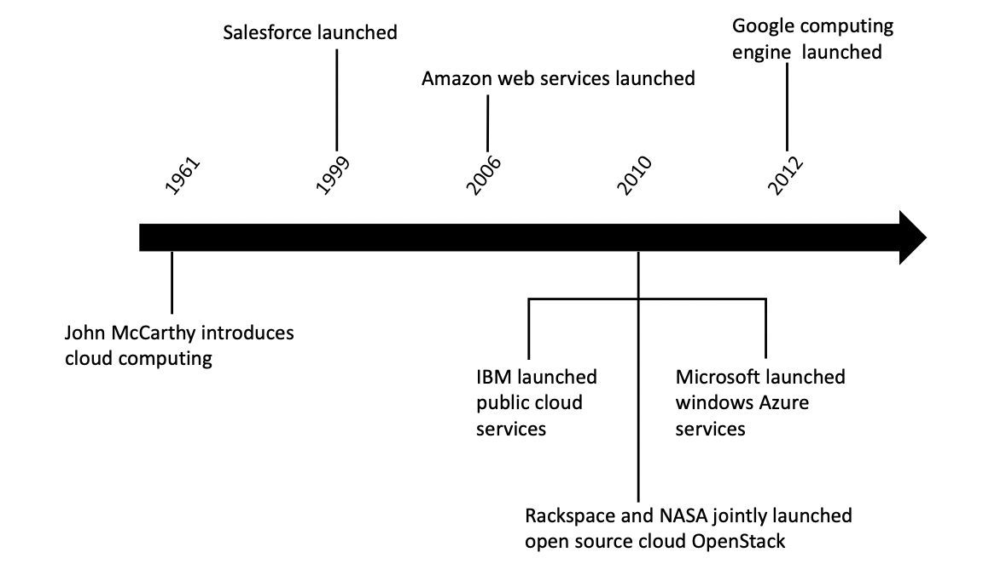
Cloud computing history
J. Surbiryala and C. Rong, "Cloud Computing: History and Overview," 2019 IEEE Cloud Summit, Washington, DC, USA, 2019, pp. 1-7, doi: 10.1109/CloudSummit47114.2019.00007.

Slide 4
Cloud computing
Cloud computing is a model for enabling convenient, on demand network access to a shared pool of configurable computing resources (e.g., networks, servers, storage, applications, and services) that can be rapidly provisioned and released with minimal management effort or service provider interaction
(P. Mell and T. Grance, "Draft nist working definition of cloud computing - v15," 21. Aug 2009, 2009).

Slide 5
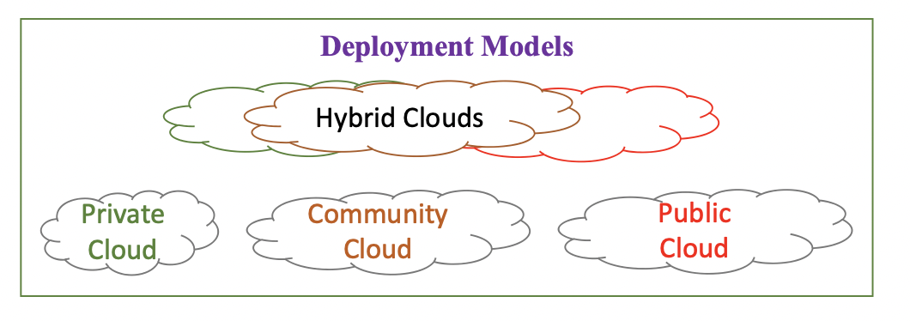
Deployment models
J. Surbiryala and C. Rong, "Cloud Computing: History and Overview," 2019 IEEE Cloud Summit, Washington, DC, USA, 2019, pp. 1-7, doi: 10.1109/CloudSummit47114.2019.00007.

Slide 6
Community cloud InterPARES def
A cloud infrastructure deployment model in which a specified group of organizations with common privacy, security, or legal concerns, collaborate to share resources that may be managed by the organizations or a third party, on or off premises.

Slide 7
Private cloud InterPARES def.
A deployment model in which a provider manages and supports infrastructure, platform, or software as a service for the exclusive use of a consumer.

Slide 8
Public cloud InterPARES def.
A deployment model in which services (infrastructure, platform, or software) are managed by a third-party provider and made available to the general public.

Slide 9
Hybrid cloud InterPARES def.
A deployment model in which two or more clouds (private, community, or public) remain unique entities, but are connected by standardized or proprietary technology that enables data and application portability.

Slide 10
five essential elements of cloud computing
On-demand self-service
Broad network access
Resource pooling
Rapid elasticity
Measured Service
(Dillon, T., Wu, C., & Chang, E. (2010, April). Cloud computing: issues and challenges.
In 2010 24th IEEE international conference on advanced information networking and applications (pp. 27-33).)

Slide 11
Three different services
Infrastructure as a Service (IaaS): This is the most basic cloud service model, where users can rent virtualized computing resources like virtual machines, storage, and networks. Users have more control over the infrastructure but are responsible for managing the operating system and applications.
Platform as a Service (PaaS): PaaS provides a higher level of abstraction, allowing users to develop, deploy, and manage applications without having to worry about the underlying infrastructure. The cloud provider manages the infrastructure, and users focus on coding and application development.
Software as a Service (SaaS): SaaS delivers software applications over the internet on a subscription basis. Users can access and use the software through a web browser without having to install or maintain it locally.

Slide 12
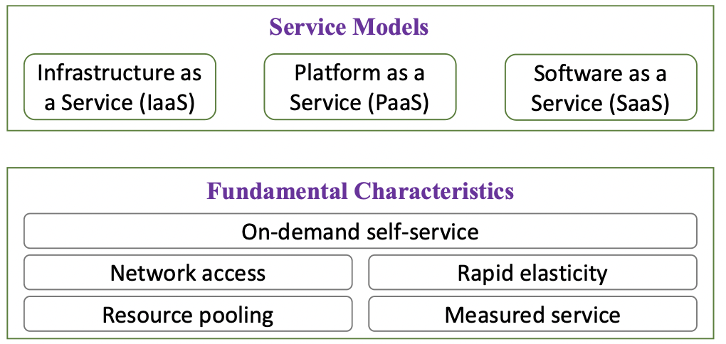
A picture
J. Surbiryala and C. Rong, "Cloud Computing: History and Overview," 2019 IEEE Cloud Summit, Washington, DC, USA, 2019, pp. 1-7, doi: 10.1109/CloudSummit47114.2019.00007.

Slide 13
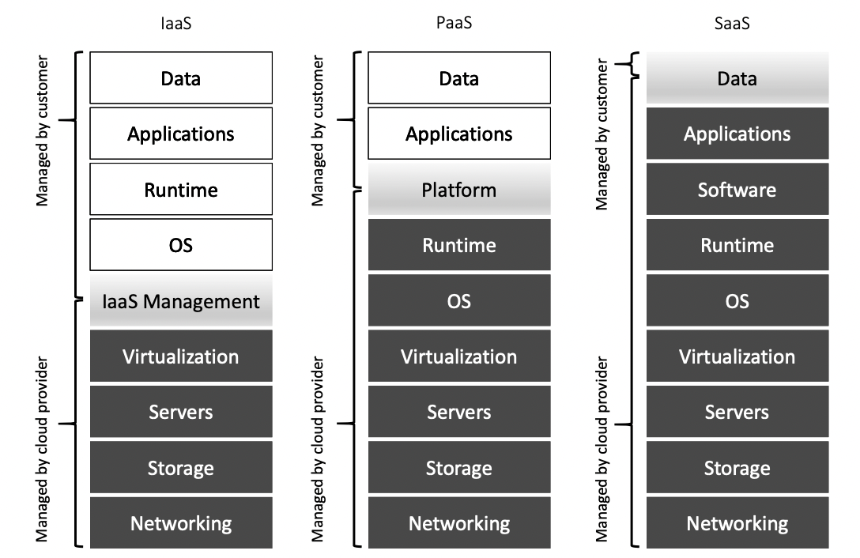
The various service models
J. Surbiryala and C. Rong, "Cloud Computing: History and Overview," 2019 IEEE Cloud Summit, Washington, DC, USA, 2019, pp. 1-7, doi: 10.1109/CloudSummit47114.2019.00007

Slide 14
Some perspective from 2014-15
The cloud was still new and yet not well studied
A Swedish study
12 archivists
Interviews
Transcribed and analyzed

Slide 15
Challenges I
Long-term perspective. How long can cloud service providers guarantee the service? How can we guarantee that the information stored in a cloud service today can also be accessible and useful in the future?
Knowledge. Archivists do not have enough competence and knowledge about cloud services and IT to be able to define the requirements for a cloud service. There is a risk that due to this low level of knowledge the organization’s IT department will assume responsibility for the written contract between the cloud service provider and the organization.

Slide 16
Challenges II
Black box syndrome. Even if the cloud service provider gives several customer business references, they still resemble a black box service. For a potential customer, it is very difficult to verify and check that the cloud service provider really can do what they claim. It is also very difficult to check that the cloud service provider has the relevant technical systems for long-term preservation.
Information security. Managing information security is a challenge when information is managed in a cloud service and the ‘‘information owner’’ does not have physical access to the information.

Slide 17
Trust in the cloud provider
Relationship with the cloud provider—a relationship that exists between the user and the provider of the cloud service.
Trust is also expected to be easier to achieve if the cloud service provider is close to the client organization. In other words, the perception of trust can be related to physical distance between the customer (the organization) and the cloud service provider.
‘‘Can we trust the cloud service provider not to give away the stored information to someone else?’
”Can we really trust that the cloud service provider knows what they are doing, that they have the relevant competence about Swedish archival regulations?’’

Slide 18
Trustworthiness and records
Similar challenge as in other digital environments
It is challenging to guarantee that the record fulfils the quality criteria of authenticity, integrity, completeness, and usability.
Some of the archivists also said that the trustworthiness of records stored in the cloud might even be higher than with records stored and managed in-house by an IT department with doubtful competence.

Slide 19
Competence needed
IT knowledge.
Requirement engineering.
Agreement/contract design.

Slide 20
Some final thoughts
Archivist role have changed partly with the cloud from reactive to proactive
SaaS, PaaS, or IaaS
Interwined services no clear border
Organizations and CIO are risk takers
Some archivist on the other hand meant the risk is lower with the cloud than with in-house IT
Stuart and Bromage (2010) identified three problem areas with the cloud (1) trust in records, (2) general problems with the management of records, (3) the unknown location of the stored records.
This research only fully verified the third problem, and partly the first and second.

Slide 21
The InterPARES Trust 5 domains
Infrastructure: This domain considers issues relating to system architecture and related infrastructure as they affect records held in online environments. Examples of areas to be investigated include such topics as: types of cloud and their reliability; types of contractual agreements (service level agreements or SLAs) and their negotiation, coverage, flexibility, etc.; costs, up front and hidden.
Security: The security domain considers records issues relating to online data security, including: security methods (encryption, sharing, obfuscation, geographic location); data breaches; cybercrime; risks associated with shared servers; information assurance; governance; audits and auditability; forensic readiness; risk assessment; and backup.

Slide 22
Control: The control domain differs from the security domain in its focus on the management of digital material in online environments. It addresses such issues as: authenticity, reliability, and accuracy of data; integrity metadata; chain of custody; retention and disposition; transfer and acquisition; intellectual control, and access controls.
Access: The access domain researches open access/open data; the right to know/duty to remember/right to be forgotten; privacy; accountability; and transparency.
Legal: The legal domain considers issues such as: the application of legal privilege (including the issue of extra-territoriality); legal hold; chain of evidence; authentication of evidence offered at trial; certification; and soft laws (in particular UN standard-setting instruments) - mapping, scope, potential impact, and constraints;

Slide 23
One hands on contribution

Slide 24
How to choose the best service?
Trusted Cloud Service Provider (CSP)
From the archival, long-term preservation perspective, the service being offered should be thoroughly investigated against ten different categories: (1) general information about the service; (2) governance; (3) compliance; (4) trust; (5) architecture; (6) identity and access management; (7) software isolation; (8) data protection; (9) availability; and (10) incident response
Stančić, H., Bursic, E. and Al-Hariri, A. (2015) Ensuring Trust in Storage in
Infrastructure-as-a-Service. EU08, Final Report. InterPARES Trust.

Slide 25
1. General information about the service
General information relates to the basic questions about the CSP and to three specific areas: storage, service, and networks (Rackspace, 2017). Users should investigate what technologies are being used and how the implemented storage, servers, networks and technology affect the security and privacy of the system.
Cunningham chapter 9 in Duranti, L., & Rogers, C. (Eds.). (2019). Trusting records in the cloud : The creation, management,
and preservation of trustworthy digital content. Facet Publishing.

Slide 26
2. Governance
Governance is the key factor in assuring security over data produced by a company. In this category, users should examine how they can verify the integrity of the data stored by a CSP and how they can monitor the security of their data. Potential users should examine how the CSP ensures that the data from different users are kept separate in a multi-tenant system on the one hand, and on the other, that the client’s data is not shared with unauthorised employees, i.e. those not responsible for a certain task. Finally, the usage of audit mechanisms and enforcement of policies should be assessed.
Cunningham chapter 9 in Duranti, L., & Rogers, C. (Eds.). (2019). Trusting records in the cloud : The creation, management,
and preservation of trustworthy digital content. Facet Publishing.

Slide 27
3. Compliance
For a company considering IaaS it is important to be aware of which jurisdiction the CSP is governed by, where, geographically, the data is stored, and whether any part of the service is subcontracted. Along with those critical issues, it is also important to verify whether the service being considered is compliant with relevant standards, such as ANSI/TIA-942 Quality standard for data centres (TIA-942.org, n.d.), ISO 27001:2013 Information security management systems (International Organization for Standardization (ISO), 2013), and ISO 9001:2015 – Quality Management (International Organization for Standardization (ISO), 2015).
Cunningham chapter 9 in Duranti, L., & Rogers, C. (Eds.). (2019). Trusting records in the cloud : The creation, management,
and preservation of trustworthy digital content. Facet Publishing.

Slide 28
4. Trust
This category addresses the fundamental grounds for judging the trust- worthiness of a CSP. It is important to find out whether the CSP implements risk management systems – the technical and physical measures of protection that secure service from unauthorized access, usage, discovery, interruption, alteration and destruction of data. For example, one should ask what kind of physical and logical security is set up for virtual servers and applications against attacks like DoS (Denial of Service) or DDoS (Distributed DoS).
Another important issue in the context of trust deals with the ownership of the data given to the custody of the CSP as well as that of the metadata generated by the CSP about preservation actions (e.g. who owns the technical metadata about the conversion or migration process that are needed for judging the authenticity of a record).
Cunningham chapter 9 in Duranti, L., & Rogers, C. (Eds.). (2019). Trusting records in the cloud : The creation, management,
and preservation of trustworthy digital content. Facet Publishing.

Slide 29
5. Architecture
Since the hardware and software architecture used to deliver cloud services can vary significantly, the actual set-up can have repercussions for security. Therefore, it must be investigated what type of architectural solutions the CSP has implemented, e.g. measures of protection against attack on hypervisor, virtual machine monitor, images, proprietary code, client (on user’s computer) and server. It is also important to learn whether the process of virtual machine images management is used or not. By knowing this, the users can understand whether the processes of creation, storage and use of virtual machines are governed, i.e. procedures exist and are documented.
Cunningham chapter 9 in Duranti, L., & Rogers, C. (Eds.). (2019). Trusting records in the cloud : The creation, management,
and preservation of trustworthy digital content. Facet Publishing.

Slide 30
6. Identity and access management
Data sensitivity and privacy of information have always been areas of concern for organizations. The identity proofing and authentication aspects of identity management entail the use, maintenance and protection of personally identifiable information (PII) collected from users. The data collected by the provider of the purchased service include details about the accounts of consumers, customer-related activities, meter and charge for consumption of resources, logs and audit trails, and other metadata that are generated and accumulated within the cloud environment, data of an organization’s initiatives (e.g. the activity level or projected growth of the company), as well as metadata generated by the CSP. In the wrong hands, the loss of these data can be damaging to the client’s business. All of the above-mentioned data – ancillary data – should be protected and potential users given assurance of this protection.
Cunningham chapter 9 in Duranti, L., & Rogers, C. (Eds.). (2019). Trusting records in the cloud : The creation, management,
and preservation of trustworthy digital content. Facet Publishing.

Slide 31
7. Software isolation
In order to achieve the flexibility of on-demand services, cloud service providers have to use high degrees of multi-tenancy over a large number of platforms. The multi-tenancy in an IaaS cloud computing environment is typically done by multiplexing the execution of virtual machines from potentially different consumers on the same physical server. Multi-tenancy in virtual machine-based cloud infrastructure, together with the way physical resources are shared among the guest virtual machines, give rise to new sources of threat, for example the man-in-the-middle attack. Therefore, it is important to assess how the service prevents these kinds of threats.
Cunningham chapter 9 in Duranti, L., & Rogers, C. (Eds.). (2019). Trusting records in the cloud : The creation, management,
and preservation of trustworthy digital content. Facet Publishing.

Slide 32
8. Data protection
Data protection should be applied to data-at-rest, data-in-transit and data-in- use. The data-at-rest may be protected by an encryption mechanism, while the data-in-transit may be much harder to encrypt. A fully homomorphic encryption scheme allows data to be processed without being decrypted.
Cunningham chapter 9 in Duranti, L., & Rogers, C. (Eds.). (2019). Trusting records in the cloud : The creation, management,
and preservation of trustworthy digital content. Facet Publishing.

Slide 33
9. Availability
Users should investigate whether the CSP guarantees service availability in case a court orders a seizure of equipment, because, in multi-tenant systems, the data, documents and records from more than one customer will be stored in the same physical equipment. Also, the provider can encounter facility damage or loss due to natural disasters or human-influenced incidents, or it can go out of business or bankrupt, or have other kinds of financial difficulties. Continuity of customer access to data in such circumstances is vital and must be legally guaranteed.
Regardless, every organization considering a cloud service should have a contingency plan. If the organization relies on IaaS for data storage and processing, such a plan should have a business continuity solution for prolonged or permanent service disruptions, especially with mission critical operations, until restoration of the service.
Cunningham chapter 9 in Duranti, L., & Rogers, C. (Eds.). (2019). Trusting records in the cloud : The creation, management,
and preservation of trustworthy digital content. Facet Publishing.

Slide 34
10. Incident response
Incident response involves an organized method for dealing with the consequences of an attack against the security of a computer system, equipment failure or other kinds of service provision disruption. The CSP’s role is vital in performing incident response activities, including incident verification, determination of the scope of the incident and assets affected, attack or failure analysis, containment, data collection and preservation, problem remediation, and service restoration. Each layer in a cloud application stack generates event logs. These data are accessible and under the control of the CSP. One should investigate the existence of an incident response plan as well as whether the CSP keeps a forensic copy of incident data for legal proceedings or in case it is needed by the client. Aiming for business transparency, the incident response plan should also include the reporting phase in the course of which the custom- ers will be informed about the incident and the way the CSP resolved it.
Cunningham chapter 9 in Duranti, L., & Rogers, C. (Eds.). (2019). Trusting records in the cloud : The creation, management,
and preservation of trustworthy digital content. Facet Publishing.

Slide 35
Challenges today
Bring back the cloud to the organization
Or within national borders
"The cloud” is no longer ”a big issue”
Problems are more about robustness
IT-attacks Ransomware

Slide 36
Challenges today cont.
Privacy and security concerns in public clouds
failure recovery in disastrous situations
poor performance when the demand on the resources peaks
Interoperability problems
e.g. Vendor-lock in
Providers 🡪proprietary services

Slide 37
The end
erik.borglund@miun.se

