Slide 1
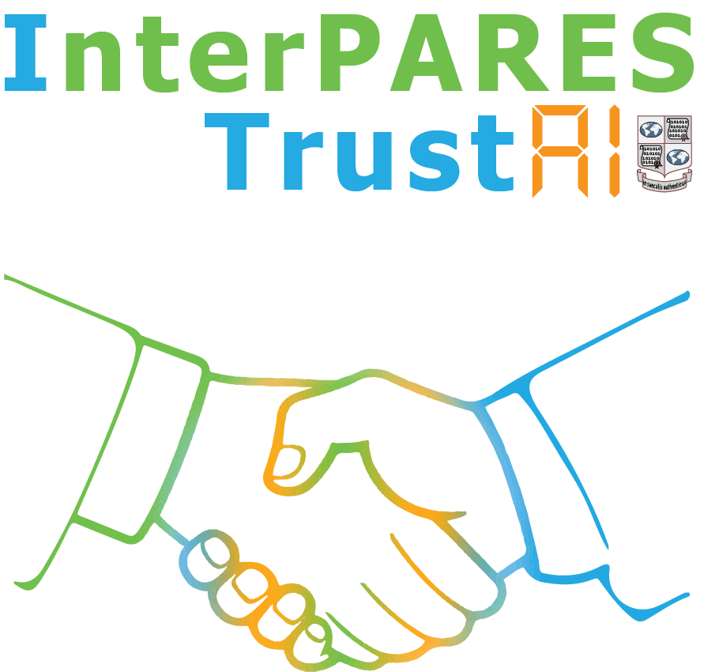
Personal Information Content Assessment: a case study
Study Participants and Affiliation
Paige Hohmann
Kisun Kim
Jason R. Baron
Souvick Ghosh
Darra Hofman
Carlos Quevedo-Comacho
Ivan Despot
Mia Steinberg
Presented to the webinar:
What does AI look like when archival concepts and principles inform its development?
by Jim Suderman
15 February 2022
Glenn Dingwall
Isabel Taylor
Shadrack Katuu
Jim Suderman

Slide 2
Study purpose
Assess the utility of Machine Learning to assist record custodians / preservers with privacy protection.
How to gain knowledge about transferred records needed to assign appropriate resources to administer responsibly (risk).
Study context: British Columbia, Canada
Increasing specificity – in development:
Binary: is PI present?
Type: what type(s) of PI are present?
Location: where is the PI?
100%
Responsibility for information
Knowledge of records
0%
Creator
Custodian(s) / Preserver(s)

Slide 3
Literature Review
Types of ML approaches sidebar
Exclude PI at document creation
Significant risk resides with document creator.
See, for example, Tesfay, Serna, and Rannenberg, “PrivacyBot: Detecting Privacy Sensitive Information in Unstructured Texts” (2019)
Detect PI and anonymize or redact
Primary risk resides with custodian / preserver.
See, for example, “Wu, Xie, Lian, and Pan, “A privacy protection approach for XML-based archives management in a cloud environment” (2019)
Queries of the literature
Findings
What privacy protection risk models are identified and assessed?
What machine learning models exist for parsing/labeling text for statute-based types of PI?
What success measures are referenced?
No comprehensive risk models found to date
Nevertheless, predictive Machine Learning (ML) approaches are risk-based.
ML models moving from character strings, e.g., credit card numbers, to judgement- based predictions.
“Human-in-the-loop” continues necessary
Success measures are specific to the specific approach studied, i.e., not general PI protection.

Slide 4
Definitions of PI are inclusive. [But…]
British Columbia Freedom of Information and Protection of Privacy Act (1996):
personal identity information means any personal information of a type that is commonly used, alone or in combination with other information, to identify or purport to identify an individual;
personal information means recorded information about an identifiable individual other than contact information;
NIST (2010) defines ‘personally identifiable information’ as:
any information about an individual maintained by an agency, including (1) any information that can be used to distinguish or trace an individual‘s identity, such as name, social security number, date and place of birth, mother‘s maiden name, or biometric records; and (2) any other information that is linked or linkable to an individual, such as medical, educational, financial, and employment information.
GDPR (2016) defines ‘personal data’ as:
any information relating to an identified or identifiable natural person (‘data subject’); an identifiable natural person is one who can be identified, directly or indirectly, in particular by reference to an identifier such as a name, an identification number, location data, an online identifier or to one or more factors specific to the physical, physiological, genetic, mental, economic, cultural or social identity of that natural person – Art. 4(1)
But each jurisdiction recognizes that some types of PI are more sensitive than others

Slide 5
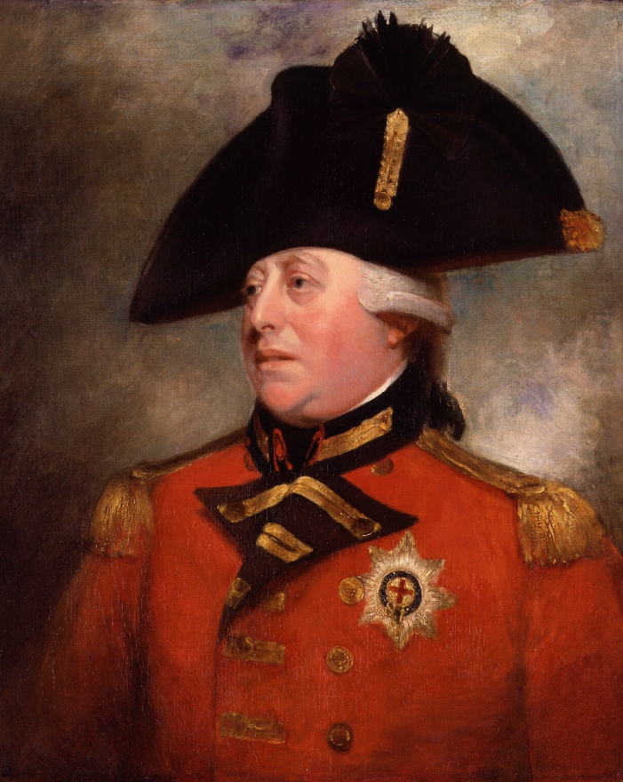
PI Labels
King George III
Portrait
ca. 1800
British Columbia lists at least 32 types of PI
Some types are specific, e.g., age, others are general, e.g., medical information
PI of EU citizens is unknown, but probable
“Sensitive” PI includes biometric and health information
Published label sets (see below)
Include 25-50% of types listed by British Columbia
May be multiple labels for a particular type, e.g., unique identifier
Movie
1994
Musical
2015
Types of PI | Published PI label sets
Types of PI | gretel | Presidio (MS) | Amazon Web | PII Tools
32 | 8 | 9 | 8 | 16

Slide 6
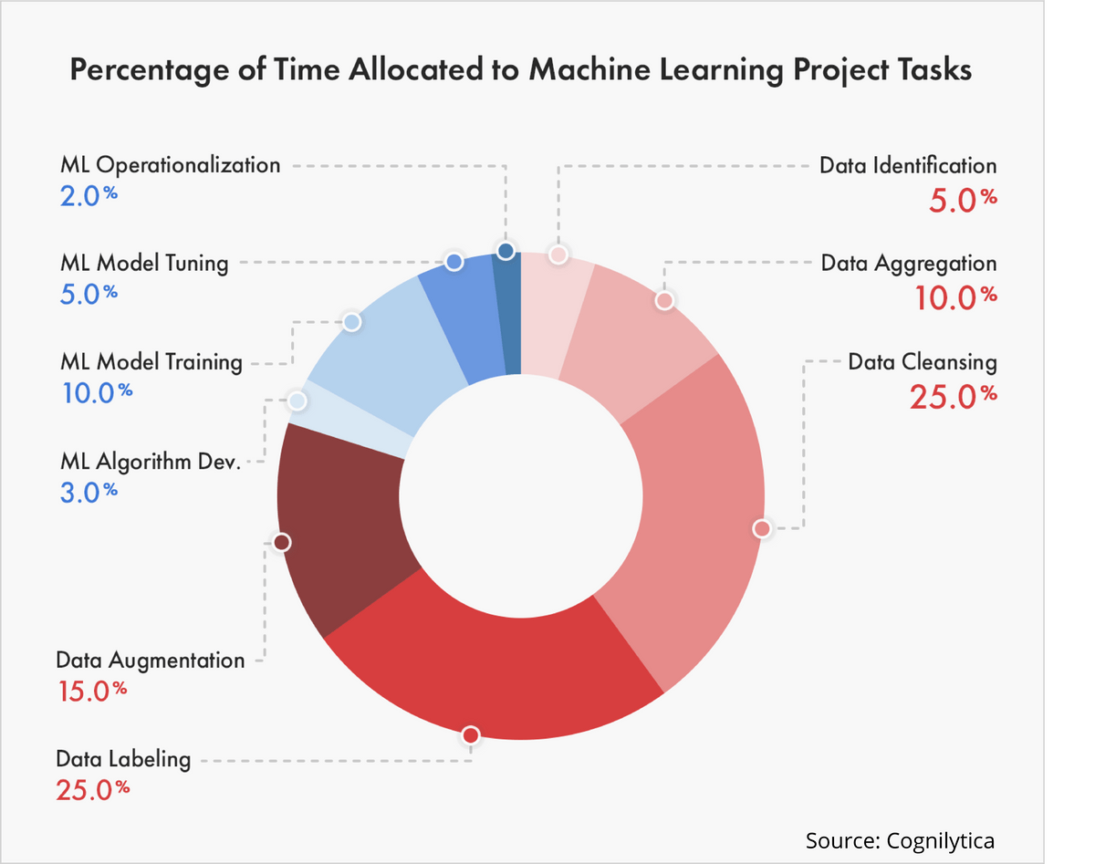
Labeling PI
Consistent classification and assessments a key challenge
Ratio of digital records to available experts is increasing
A record set labeled with PI is only as good for Machine Learning as:
The amount and types of PI present
The scope of the PI labels

Slide 7
Algorithm Review (draft): PI detection
Regular expressions, used by string-searching algorithms
For example, Fugkeaw, et al, “AP21: Adaptive PII Scanning and Consent Discovery System“ (2021)
Named Entity Recognition (NER)
For example, Silva, et al, “Using NLP [Natural Language Processing] and machine learning to detect data privacy violations” (2020)
Logistic Regression, Naïve Bayes, Decision Tree, Support Vector Machine, and Random Forest
For example, Tesfay, et al, “PrivacyBot: detecting privacy sensitive information in unstructured texts” (2019)
Recommends research “to address the problem of PII detection in a cohesive and sequential way.”

Slide 8
Identifying a training record set
Target record set is a body of administrative records held by the University of British Columbia Archives
Offices of the Provost and Deputy Vice Chancellor
About 15 GB, dated 2000-2021
Approval to use for study purpose is pending
Where to find appropriate training and testing record sets?
Fishrot files (Wikileaks)?
Clinton emails (Wikileaks)? Enron emails?
U.S. Federal Court records?
Other…?

Slide 9
Preliminary Study Findings
Available PI detectors are not comprehensive
Variations in juridical contexts, including defining PI
Absence of a ‘gold standard’ for classifying PI, assessing sensitivity
Lack of comprehensive record sets to train machines
Risk acceptance in the public sector varies by type, sensitivity of PI
Risk appetite for custodians/preservers due to limited knowledge of PI content
Capability of machines to identify and assess complex PI are experimental but also promising
Opportunities for Archives and Archivists
Identify large-scale record sets with many types of PI
A new form of appraisal? For a new type of client?
Develop research agreements/partnerships with machine learning initiatives that are respectful of the subjects of the records
Continue work with regulatory authorities on risk mitigation steps for using machines to help balance privacy protection with access to information
Regulatory revisions, privacy impact (harm) assessments, data management plans

Slide 10
Thank you
Jim Suderman
interparestrustai.org
jgsuderman@gmail.com

